Slide 1
Achieving Success in Food Retail
with Engineered Water Solutions

Slide 2
agenda what we’ll cover
01
02
overview
Engineered water solutions for success
One Zurn working for you
Zurn contributes to the delivery
of quality food/beverages
Delivers clean water
Maintains sanitary water temperatures
Enhances kitchen cleanliness
03
04
Zurn enhances the customer experience
Provides beautiful aesthetics
Ensures optimal cleanliness
Maximizes ease of use
Zurn helps meet compliance
Maintains water quality
Preserves water control
Enhances safety
Achieves ADA regulations
Ensures wastewater compliance
05
Zurn provides cost savings
Conserves water and other resources
Optimizes productivity of kitchen staff
Saves time in installation and maintenance
06
resources

Slide 3
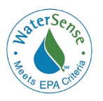
overview engineered water solutions for food retail success
More retailers are turning to food and beverage to add a little something extra to their operation
Whether it’s a sit-down restaurant or a quick-service counter, retailers and grocers are finding success with these partnerships, cross promotions and collaborations. The trend is driven, in part, by today’s ever-changing retail landscape and the need for retailers to adapt and change their brick-and-mortar spaces in order to keep up with the desires of today’s consumers. Anything you can do to create an experience for the consumer makes for better business.
“How retailers are using food and beverage to enhance the shopping experience” – SmartBrief
Fresh prepared foods are the sweet spot for time-starved, quality-seeking consumers
- between choices of costlier restaurant meals and less-catchy, more laborious packaged goods. The opportunity is so ripe that A.T. Kearney forecasts dollar sales of the $26 billion fresh prepared foods segment will grow at a 6%-7% compound annual growth rate (CAGR) through 2017, up from its 5%-6% CAGR in the 2007 to 2012 period. This will outpace the anticipated 2%-3% CAGR of retail grocery food and beverage, and the 3%-4% CAGR of foodservice between now and 2017, the consultancy predicts. Already, more than one in four shoppers (27%) go to the supermarket with the sole intent to pick up a prepared meal – and this trend is growing, says AlixPartners.
“Prepared meals will outpace foodservice, packaged foods growth” – Phil Lempert, SupermarketGuru
Bathrooms affect retail experience
Were you aware that bathrooms affect the retail experience? A clean bathroom encourages shoppers to linger and return whereas a lousy one repels them.
“Bathrooms affect retail experience say studies” – Simple Marketing Now
Operating costs and environmental impacts are influenced by water use
Industry estimates suggest that implementing water-efficient practices in commercial facilities can decrease operating costs by approximately 11 percent and energy and water use by 10 and 15 percent, respectively.² Because food service facilities use hot water for many tasks, reducing water use can provide real benefits by decreasing energy bills. If it is necessary to replace existing food service equipment, upgrading this equipment with water-efficient models can save money, with a relatively short payback period. Install WaterSense labeled toilets, bathroom faucets, and urinals where applicable. These products have been independently certified to be at least 20 percent more water-efficient and perform as well or better than standard models.
watersense@epa.gov

Slide 4
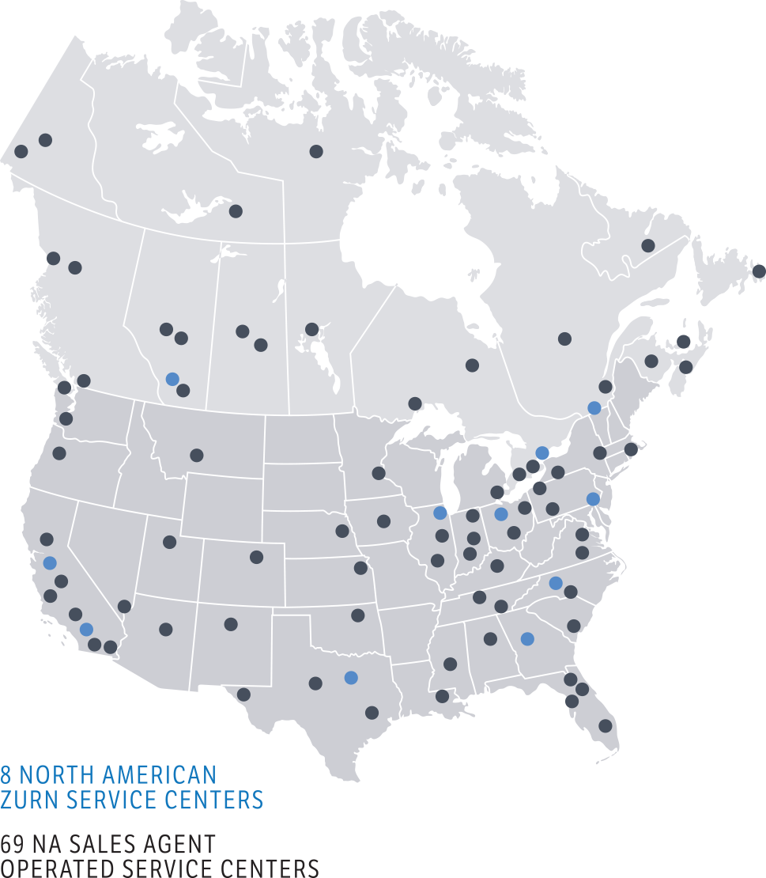
One Zurn
working for you
Multi-Tiered Strategic Accounts Team
Multi-disciplinary Engineer Teams
Partnerships with Channel Distributors and
National Consolidators Across North America
1-855-ONE-ZURN
Global representation spanning 6 continents
Founded in 1900
Largest Breadth of Commercial Plumbing Products
Notes:
Zurn was founded in 1900 in Erie, PA; now with manufacturing facilities in Pennsylvania, North Carolina, Texas, California and Canada.
Zurn’s unique offering makes them one of the largest manufacturers of plumbing products in North America.
Zurn’s annual sales are approximately $800 million serving primarily in the commercial plumbing market with strategic emphasis also in the, residential plumbing, irrigation, waterworks, fire protection, transportation, and food service markets
Zurn’s products focus on water conservation, reduced overall operating costs, and labor savings; positively impacting the total cost of ownership.
Zurn places the customer first, building value and trust through superior knowledge of the global markets we serve

Slide 5
Zurn contributes to the delivery of quality food/beverages
Delivers clean water
Maintains sanitary water temperatures
Enhances kitchen cleanliness

Slide 6
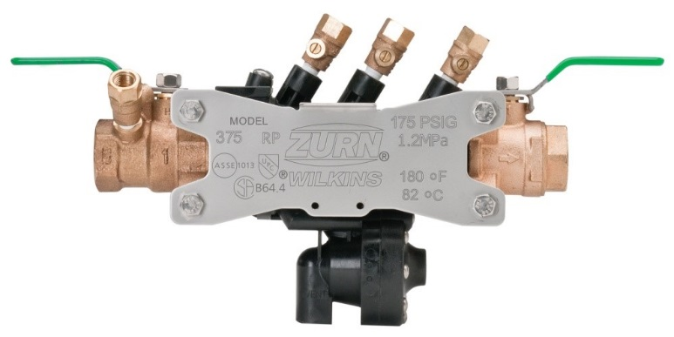
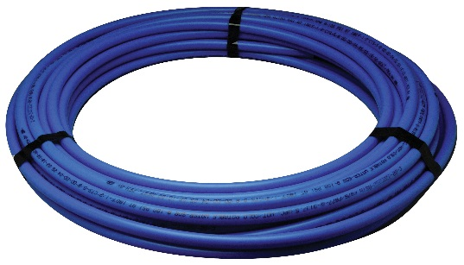
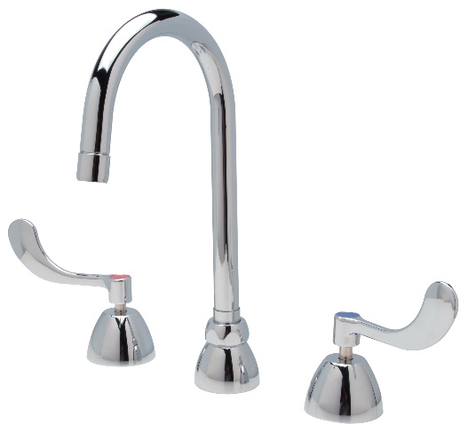
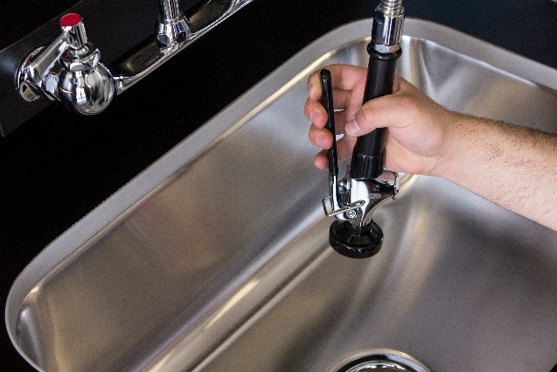
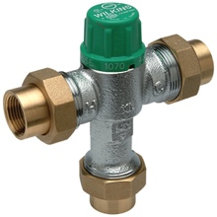
Zurn contributes to the delivery of quality food/beverages delivers clean water | maintains sanitation and cleanliness
reduced pressure backflow preventers
Protects potable water lines against both backsiphonage and backpressure of polluted water
Maximum working water temperature = 180°F
Easy line flushing
Simple maintenance and repair
Low lead, durable bronze body
carbonated beverage backflow preventers
Prevents backflow of carbon dioxide or carbonated water into the potable supply
For vending machine supply lines
PEX plumbing
Reliable, corrosion, and mineral resistant, and safe potable distribution system
Easy to install
Highest burst pressure ratings and tensile strength
Lead-free
thermostatic mixing valves
Accurately mixes and delivers hot and cold water from the distribution system
Reduces bacteria
Delivers safe temperatures for users
Inlet checks and strainers
Certified to ASSE standard 1017
NSF/ANSI 61
AquaSpec gooseneck faucets
High quality brass that complies with state laws and local codes that mandate lead content levels
Interconnecting copper tubes
Lifetime warranty ceramic disc cartridges
¼ turn paddle handles
3-year warranty
AquaSpec wall-mount pre-rinse faucet
Provides rinsing to contribute to optimal cleanliness in commercial and industrial kitchen environments
Long swivel inlets with integral stops
Cast-brass bodies
Angled aerated outlet and self-closing valve option
Stainless steel hose option

Slide 7
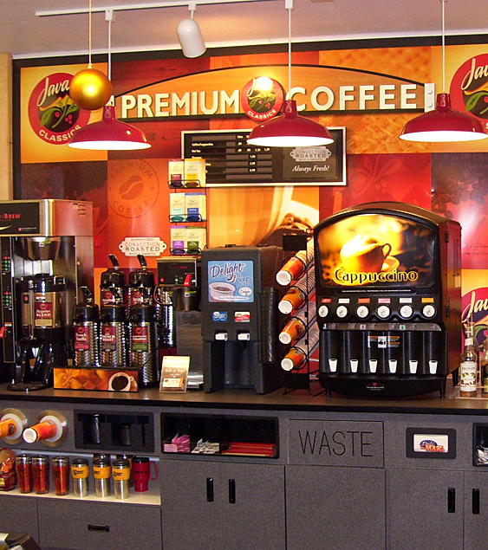
Zurn enhances
the customer experience
Provides beautiful aesthetics
Ensures optimal cleanliness
Maximizes ease of use

Slide 8
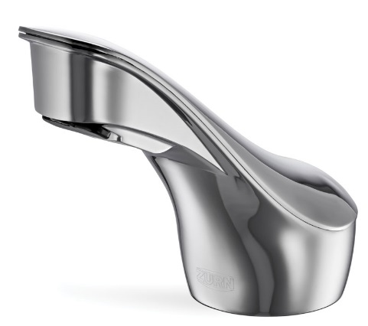
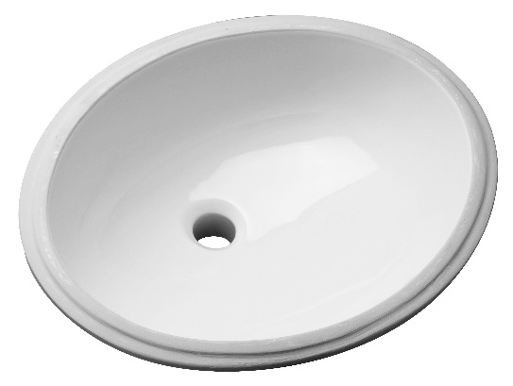
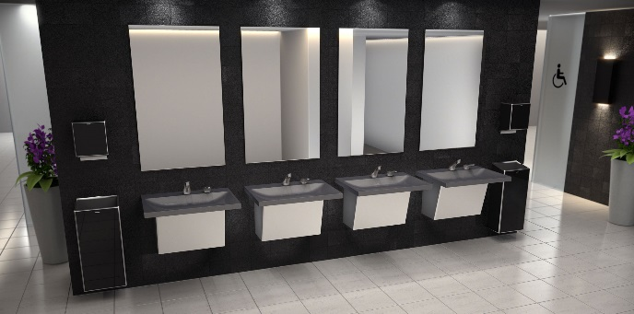
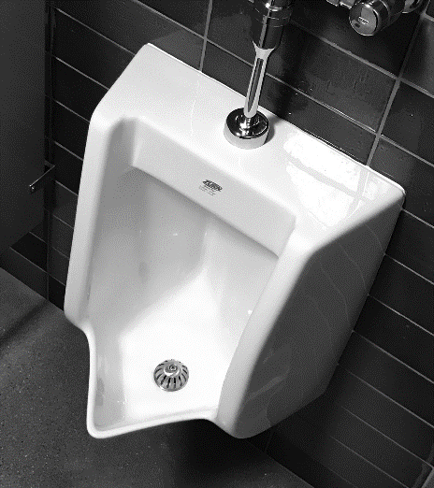
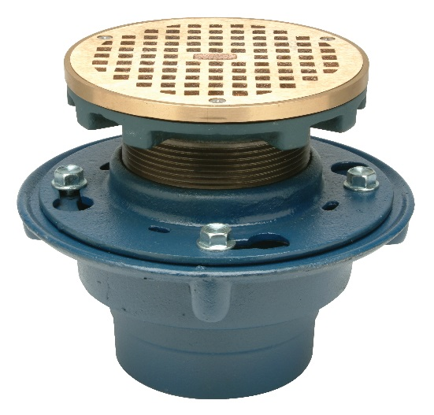
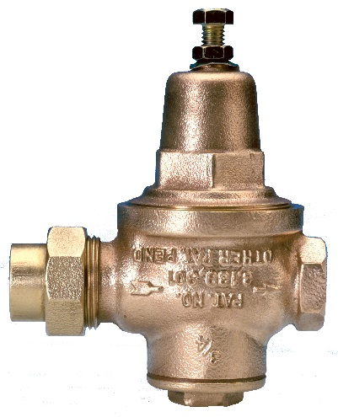
Zurn enhances the customer experience provides beautiful aesthetics
Sundara Handwashing Systems
Integrated solid surface sinks/countertops in designer styles and color
Single, double, or triple connected sink configurations with individual user space
Modern faucets and soap dispenser designs
vitreous china lavatories
White shiny finish
Countertop and undermount styles
Durable and impermeable
lavatory faucets
Brushed nickel, polished nickel, polished brass
Onsite customization options
Some with matching soap dispensers
toilets, urinals & flush valves
Sleek, modern designs
White, shiny vitreous china finish
Durable and impermeable
floor drains
Decorative grates in various shapes and sizes
Stainless and nickel bronze finishes
pressure reducing valves for irrigation
One component of a total irrigation system
Precise pressure control for drip or other irrigation

Slide 9
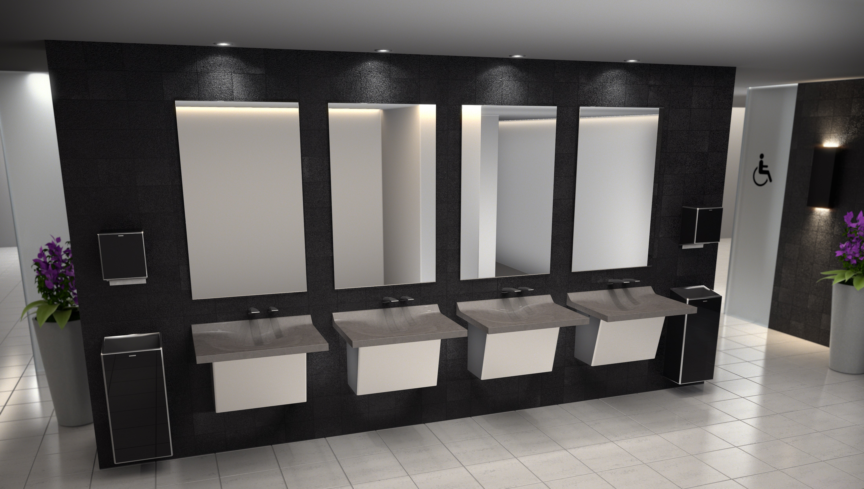
Sundara single basins with wall-mount sensor faucets and soap dispensers
Notes:
The restroom is a key part of the overall dining experience

Slide 10
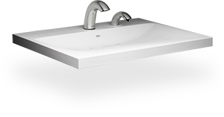
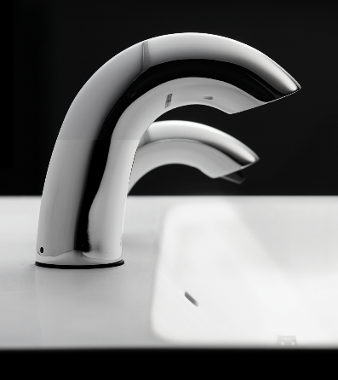
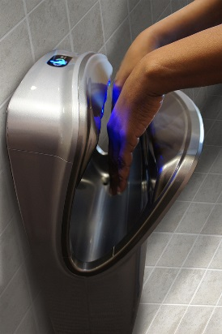
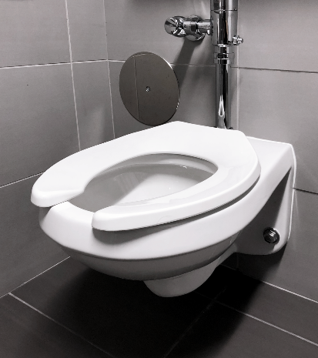
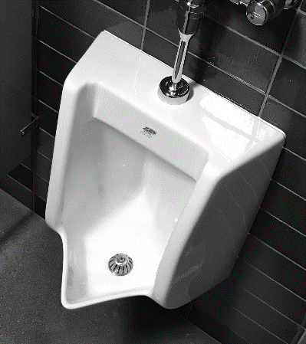
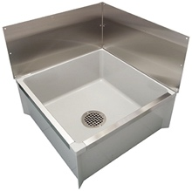
Zurn enhances the customer experience ensures optimal cleanliness
splash-free basins
No-splash solid surface to maintain cleanliness
Stain and scratch-resistant
no-touch sensor faucets and soap dispensers
No-touch faucet eliminates splashing around faucets/soap dispensers
Chemical-resistant chrome finishes
hand dryers
Reduces paper towel costs and mess
HEPA filters to maintain air quality
wall mount toilets
Ease of cleaning under and around the toilet
Paired performance with Zurn flush valves for consistent and reliable flushing action
Splash-free urinals
Innovative asymmetric back wall designed to minimize splash back
Paired performance with Zurn flush valves for consistent and reliable flushing action
mop sinks
Corner custodial floor sink with high front curb
Stainless steel wall surrounds
Fast drainage

Slide 11
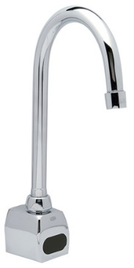
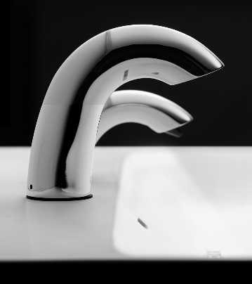
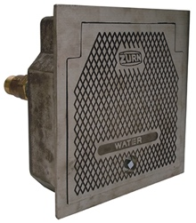
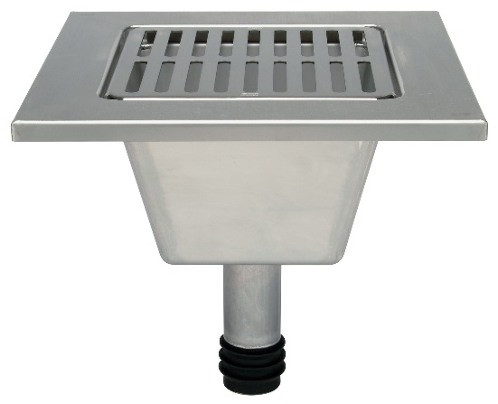
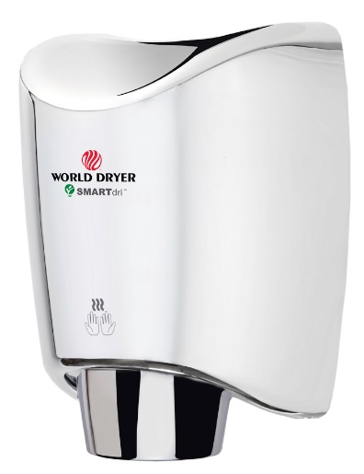
Zurn enhances the customer (and staff) experience maximizes ease of use
gooseneck sensor faucets
For quick, high-use applications where durability and hands-free operation are necessary
Multiple flow rates
sensor faucets, flush valves, and soap dispensers
Reliable and hygienic hands-free operation
LEED pre-set flow rates of 0.5 gpm / 0.35 gpm
hot/cold hydrants
For quick, easy flushing of loading areas
Anti-siphon, non-freeze, automatic draining
Encased to minimize vandalism
“WATER” stamped on the cover
Sundara Handwashing System
Hands-free sensor faucets and soap dispensers in close proximity
ADA accessible, with everything within reach and optimized floor space underneath
floor sinks & drains
Easy, sanitary surface drainage for sending indirect waste and sending it to the waste system, in compliance with code
Stainless steel options for minimal maintenance
Diverse grating options meet various applications
no-touch sensor dryers
Automatic high-speed, hands-free dryers
Green Restaurant Association approved

Slide 12
Zurn helps meet compliance
Maintains water quality
Preserves water control
Enhances safety
Achieves ADA regulations
Ensures wastewater compliance

Slide 13
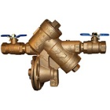
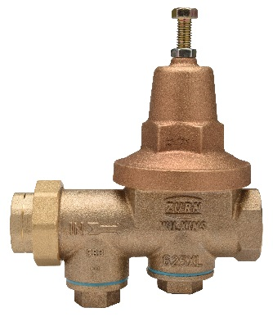
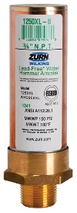
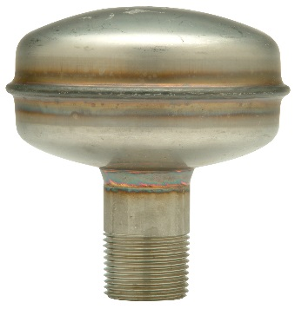
Zurn helps meet compliance maintains water quality | preserves water control
reduced pressure backflow preventers
Protects potable water lines against both backsiphonage and backpressure of polluted water
Maximum working water temperature = 180°F
Easy line flushing
Simple maintenance and repair
Low lead, durable bronze body
Wye pattern backflow preventer
Protects against both backsiphonage and backpressure of non potable applications in low hazard conditions
Lead-free
PEX plumbing
Reliable, corrosion, and mineral resistant, and safe potable distribution system
Easy to install
Highest burst pressure ratings and tensile strength
Lead-free
pressure reducing valves
Lowers the municipal water supply pressure feeding commercial businesses
Adjusts pressure from 100 psi to 50 psi, reducing water consumption by 33%
Extends the life of pipes, faucets, and appliances by reducing wear caused by excessive pressure
Lead free
water hammer arrestors
Protects water lines against over-pressure during surges following quick valve closure
Low-lead Law compliant
thermostatic mixing valves
Accurately mixes and delivers hot and cold water from the distribution system
Reduces bacteria
Delivers safe temperatures for users
Inlet checks and strainers
Certified to ASSE standard 1017
NSF/ANSI 61

Slide 14
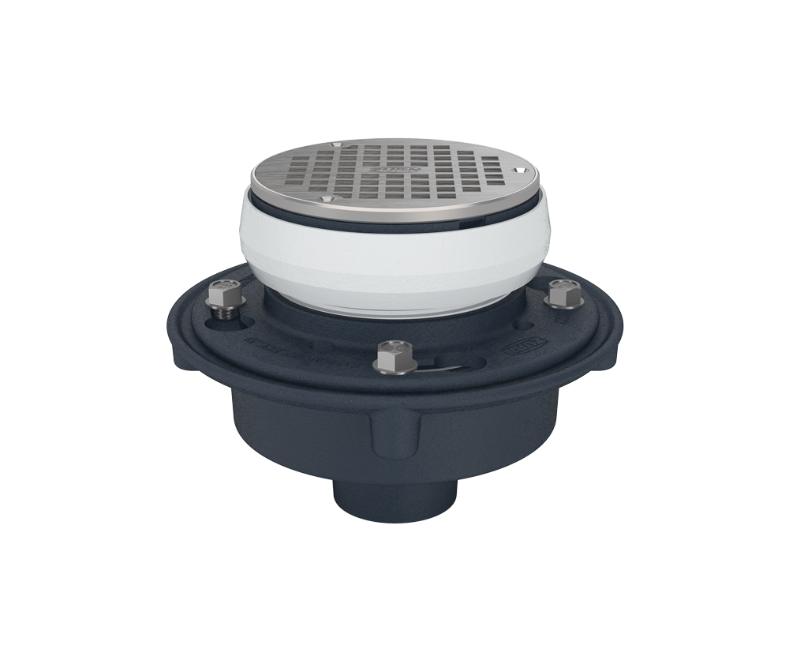
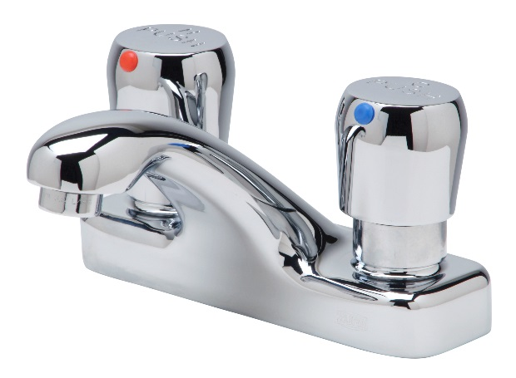
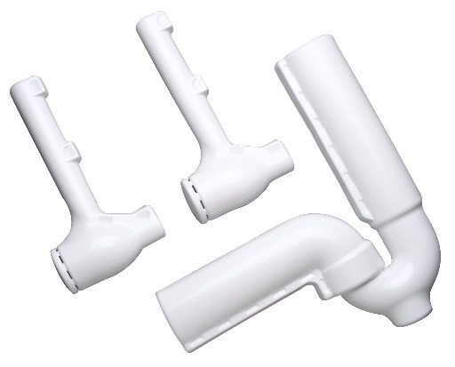
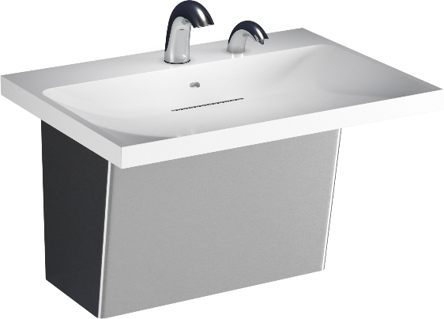
Zurn helps meet compliance enhances safety | achieves ADA regulations
reduced pressure backflow preventers
Protects potable water lines against both backsiphonage and backpressure of polluted water
Maximum working water temperature = 180°F
Easy line flushing
Simple maintenance and repair
Low lead, durable bronze body
PEX plumbing
Reliable, corrosion, and mineral resistant, and safe potable distribution system
Easy to install
Highest burst pressure ratings and tensile strength
Lead-free
carriers
To secure lavatories, toilets, and urinals for enhanced user safety and ADA compliance
Adjustable uprights and header plates to achieve proper ADA height requirements
faucets
Default timing = ADA’s minimum 10 seconds to meet ADA compliance
Timing can be adjusted to run longer
¼ turn paddle handles are also ADA compliant and available on some faucets
tubular brass protectors / shrouds
Trap protectors, supply stop protectors and offset drain protectors for ADA compliance
Resists thermal transfer
3/8” white PVC resin with vandal resistant clips
Sundara Handwashing System shrouds protect users from thermal transfer
floor and trench drains
ADA-designed
Adjustment shims and leveling for final floor finish
Stable, load-bearing grate
Heel-proof grate openings

Slide 15
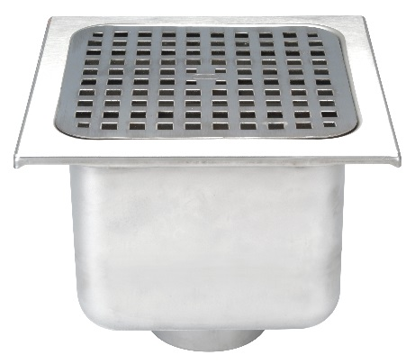
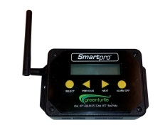
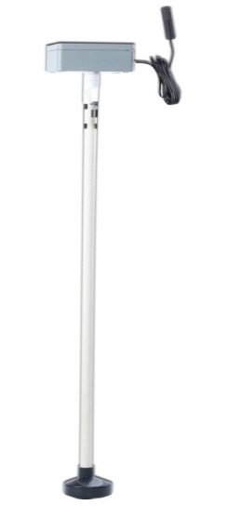
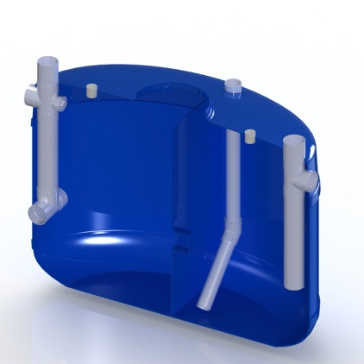
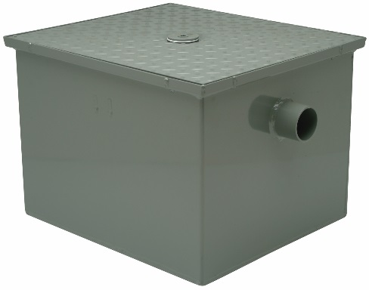
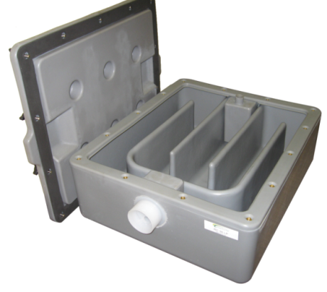
Zurn helps meet compliance ensures wastewater compliance
floor drains
ADA-designed
Stable, load-bearing grate
Heel-proof grate openings
floor sinks
Easy, sanitary surface drainage for sending indirect waste and sending it to the waste system, in compliance with code
Stainless steel options for heat resistance
coffee grounds Microceptor®
90% of coffee grounds removed from the waste water
Flow-through filtration system can be services and emptied by restaurant staff
Easily installed – connected under the sink and tied into the effluent piping
interceptors
Designed to meet compliance for the separation of oil and sediment from the waste water
Zurn interceptors may meet IPC, PDI, or UPC code/certification
grease interceptors Proceptor®
Extensive certification approvals for North American acceptance
Patented laminar flow delivers superior performance
Highly configurable to accommodate engineering design requirements
Fiberglass robust construction for sustainable life cycle – 30 year warranty
interceptor monitoring and alarm system
Minimizes risk and ensures compliance for waste water
Total peace of mind regulatory compliance
Wireless monitoring of interior content grease level, solids, level, total liquid, and temperature
Alarm signals when it is time to pump
Retrofits most interceptor systems

Slide 16
Zurn provides cost savings
Conserves water and other resources
Optimizes productivity of kitchen staff
Saves time in installation and maintenance

Slide 17
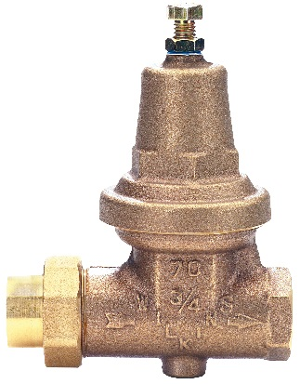
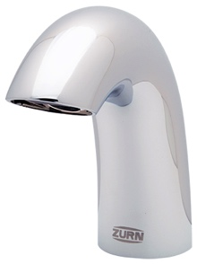
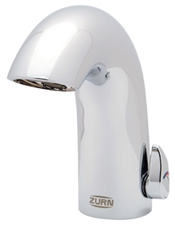
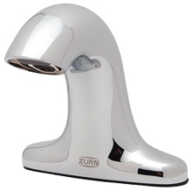
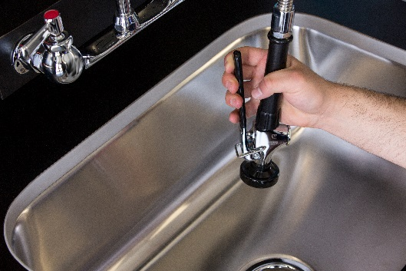
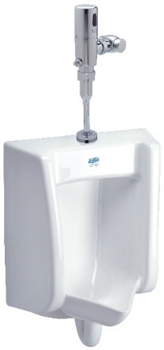
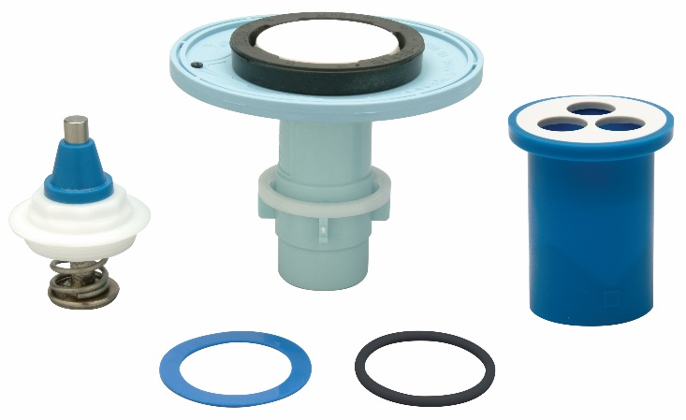
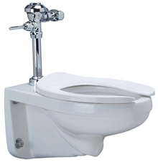
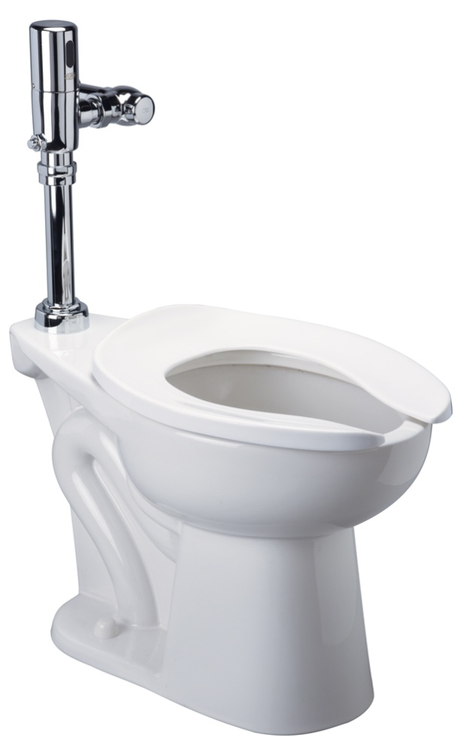
Zurn provides cost savings conserves water and other resources
pressure reducing valves
Reduces high inlet pressure to lower outlet pressure
Adjusting the pressure from 100 psi to 50 psi reduces water consumption by 33%, reduced resource and sewage treatment, lower water and sewer bills. Less water is pumped through the distribution system, resulting in lower energy and heating costs
sensor faucets
Aqua-FIT LEED flow rates of 0.35gpm and 0.5gpm options
Automatic shut-off / field adjustable time-outs + adaptable line purge settings
Energy saving electronics and sensors for a 10-year lithium ion battery (4AA)
Concealed aerator and sensor lens reduces vandalism
pre-rinse units
AquaSpec® low flow kitchen pre-rinse units can save 62.000 gallons of water/year = $682 savings vs. standard units
Aerated spray valve
high efficiency toilets (HETs), paired with flush valves
1.1 gpf wall and floor bowls
Can save 20,000-80,000 gallons of water per yr
With average water & sewer costs = $11 per thousand gallons = $220-$880 savings vs.1.6 gpf
Sensor and manual
high efficiency urinals (HEUs), paired with flush valves
Zurn’s Pint Urinal System can save from 35,000 to 120,000 gallons of water/year
$385-$1,320 savings over 1.0 gpf urinals
Go Blue flush valve repair kits
Long lasting superior chemical resistant parts = 8-10 times longer life than tradition black rubber components
Used in all Zurn flush valves and parts
Long lasting quality and dependability

Slide 18
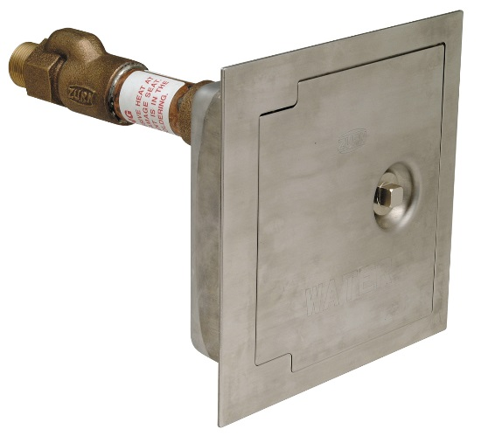
Zurn provides cost savings optimizes productivity of kitchen staff
sensor faucets
For quick, high-use applications where durability and hands-free operation are necessary
Multiple flow rates and power configurations
AquaSpec pre-rinse faucet
Provides rinsing to contribute to optimal cleanliness in commercial and industrial kitchen environments
Long swivel inlets with integral stops
Cast-brass bodies
Angled aerated outlet and self-closing valve option
Stainless steel hose option
hydrants
For quick, easy flushing of docking areas
Anti-siphon, non-freeze, automatic draining
“WATER” stamped on the cover
Encased to minimize vandalism
floor sinks
Easy, sanitary surface drainage for sending indirect waste and sending it to the waste system, in compliance with code
Diverse grating options for various applications
floor drains
Quick, easy removal of wastewater
Dura-Coated cast iron, stainless steel, or polymer body material for easy maintenance
Medium Duty – Extra Heavy Duty load ratings
mop sink
Easy floor cleanup with corner custodial floor sink with high front curb
Stainless steel wall surround minimizes wall splashing/cleanup
Fast drainage

Slide 19
Zurn provides cost savings saves time in installation and maintenance
reduced pressure backflow assemblies
Zurn Wilkins = lower annual cost and less downtime = lower total cost of ownership
Most jurisdictions require annual testing
Simple maintenance and repair
Easy line flushing and winterizing
PEX plumbing
Easy to install, with less connections needed
Reliable, corrosion, and mineral resistant, and safe potable distribution system
Highest burst pressure ratings, tensile strength
Go Blue for flush
Less maintenance with superior chemical resistant parts = 8-10 times longer life than the ‘Old Fashioned’ black rubber components
Used in all Zurn flush valves and parts
Long lasting quality and dependability
stainless replacement floor sinks
Save up to 50% time and costs with simple drop-in vs. traditional retrofit construction
No caulking, with push-fit gasket
Design fits most floor sinks and piping
Create a sanitary environment with a stainless steel replacement
EZ1 floor drains + ZShield trap seal
Save 14 minutes in installation time vs. the competition
Cover removed via upside down pliers + rotation
Strainer and shim kits are attached w/ cover
Protective grate sticker
ZShield is easily installed in almost any floor drain
Proceptors
Patented fiberglass design is simple to clean and maintain, and is backed by a no-nonsense 30 year warranty against corrosion or cracking
Lightweight fiberglass construction can be easily installed free-standing above ground, in kitchen, or buried in landscaped or traffic load areas

Slide 20
about Zurn One Systems®
The customer has the ability to design and build their complete restroom using Zurn products to meet any and all their needs. Individual component product numbers needed for a Zurn One System are rolled up into one single model number for easy ordering.
Z5344
Z6915
Z8743-PC
=
Z8700-PC
Z8800LR-8860-12-PC
Z8946-1-NT
Z5344.291.1.07.01.5

Slide 21
summary Zurn overview
For more than a century, Zurn Engineered Water Solutions® has established itself as an innovator and leading manufacturer of highly engineered water product solutions.
Markets We Serve
Zurn Engineered Water Solutions is a recognized leader in retail, commercial, municipal, and industrial markets, delivering sustainable building solutions for new construction and retrofit applications.
Industry Leading Product Lines
The Zurn product offering includes items such as specification drainage products, manual and sensor operated flush valves, radiant heating systems, snow melt systems, trench drain systems, backflow and fire protection systems, and much, much more.
Solutions We Provide
At Zurn we are committed to providing smart solutions that save time and money. Our goal is serving the customer through innovation, continuous improvement, and assurance behind every installation.
One Choice. One Zurn.
Choose Zurn for a reliable, recognized manufacturer to supply your entire installation, from behind the wall rough-in, to finished trim product and fixture systems.

Slide 22
our contacts
address
phone
online
511 Freshwater Way
Milwaukee, WI 53204
toll-free 1-855-ONE-ZURN
zurn.com
linkedin/Zurn Industries, LLC
facebook/Zurn Industries, LLC
youtube/OneZurn
twitter/ZurnInd
Notes:
Access Zurn information on your mobile devices!

