Slide 1
Zurn Connected Products - Overview
April 2019

Slide 2
agenda what you’ll learn
01
about connected and
the Internet of Things (IoT)
02
Zurn connected products and technology
03
Zurn Wilkins
Connected Flood Control System
04
Zurn
Connected Flush Valves
05
Zurn
Connected Faucets
06
installation and setup of Zurn Connected Network and plumbSMART portal

Slide 3
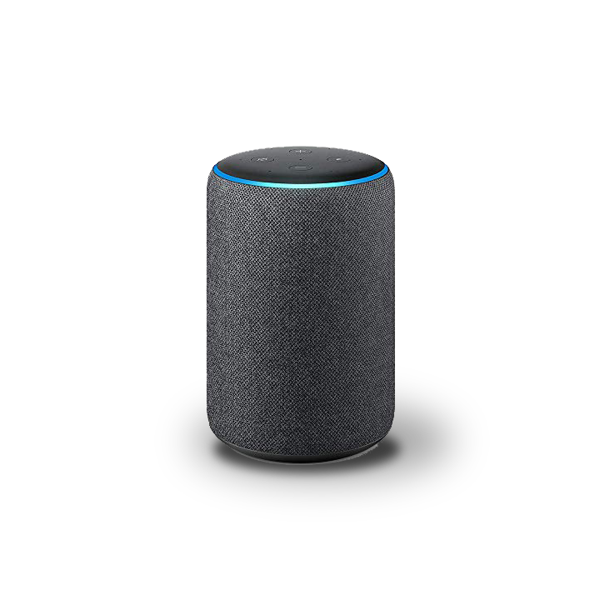
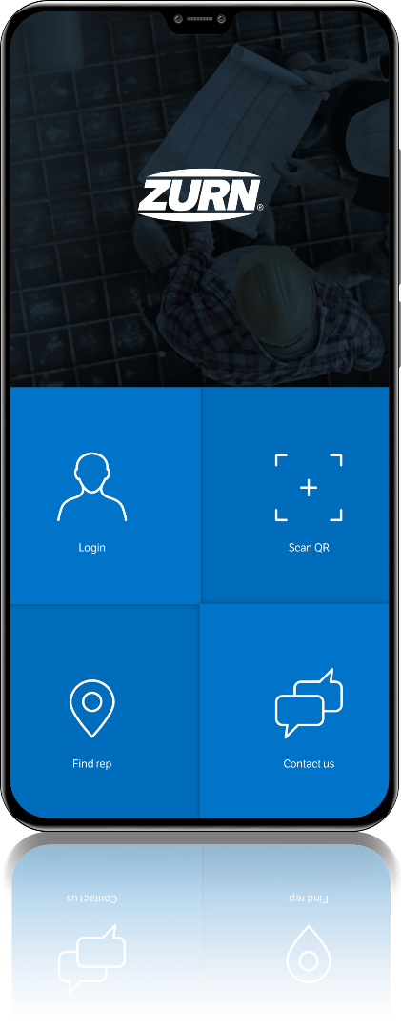
4 BILLION
Adults have smartphones
Launched in 2004
100 MILLION
Alexa devices sold
Launched in 2014
Industrial Internet of Things
Notes:
How many of you have an Smart Phone?
4B out of 5.5B adults in the world have a smart phone
Launched in 2004, that is incredibly fast growth and adoption
How many of you have an Alexa device or Nest or a connected video doorbell in your home?
Launched in November 2014, More than 100 million Alexa devices have been sold
Connected devices are growing like crazy!
Today, buildings have connected elevators, connected heating and cooling systems, connected lighting…
Forbes Magazine recently reported that Smart Buildings and Smart Cities comprise the top two IoT project types
(source: https://www.forbes.com/sites/louiscolumbus/2018/06/06/10-charts-that-will-challenge-your-perspective-of-iots-growth/#7d7721bf3ecc)
The head of plumbing at our largest retail national account said he knows everything will be connected sooner, not later
Industrial Internet of Things is is booming and plumbing is just now getting on board

Slide 4
industrial Internet of Things “IoT” growth projections
$475
BILLION
by 2020
31
BILLION DEVICES
by 2020
75
BILLION DEVICES
by 2025
28%
Growth
Notes:
https://www.forbes.com/sites/louiscolumbus/2018/06/06/10-charts-that-will-challenge-your-perspective-of-iots-growth/#7d7721bf3ecc
Consulting firm McKinsey predicts the IoT market will be worth $581B by 2020
The IoT market will continue to grow at a Compound Annual Growth Rate (CAGR) between 7 and 15% thereafter
That is 2-4X the growth of the overall economy. Why wouldn’t you want to be a part of that?
Over 7 billion Industrial (non-consumer) devices will be connected by 2020
That is equal to almost 25% CAGR in three years (stat not shown)
McKinsey also forecasts the Industrial Internet of Things – where we play – will reach $123B by 2021

Slide 5
smart buildings complete with plumbing
Complete your smart
HVAC
Lighting/Electrical
Security
Conveyance
building with Zurn
Connected Products

Slide 6
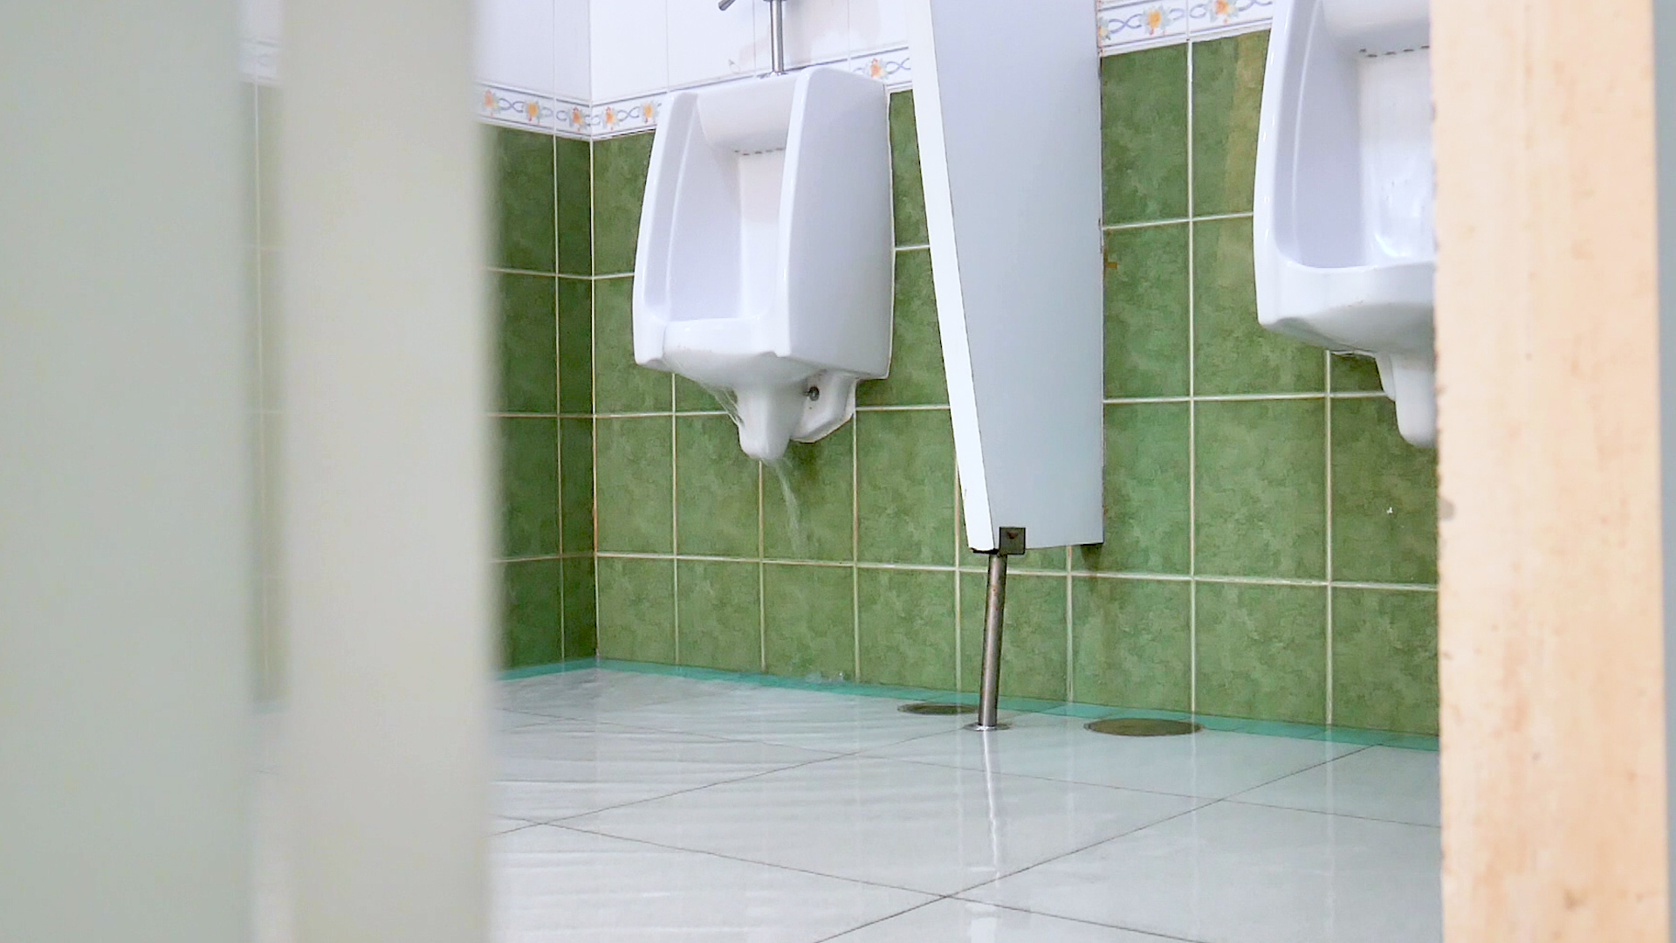
CATASTROPHIC FLOODING OR MESSY CLOGS

Slide 7
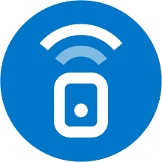
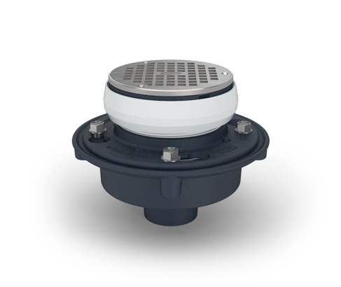
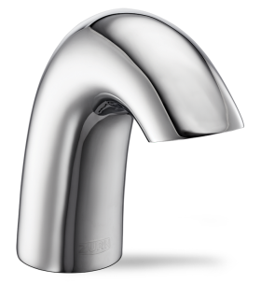
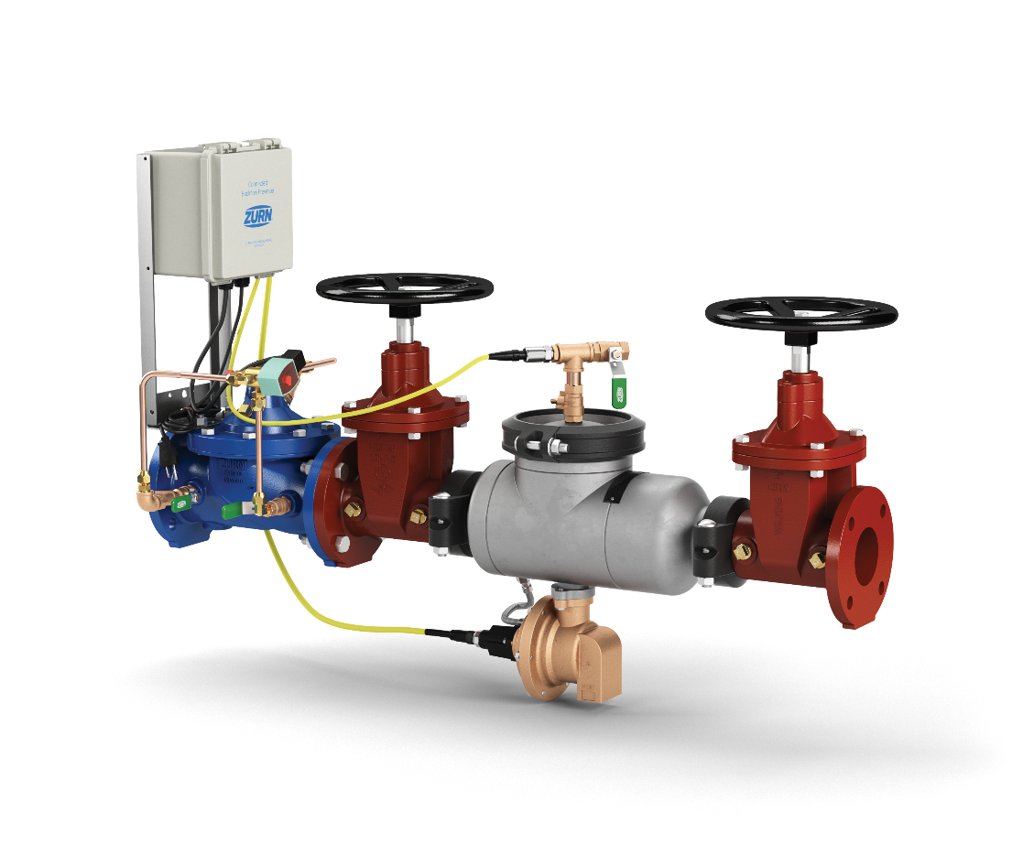
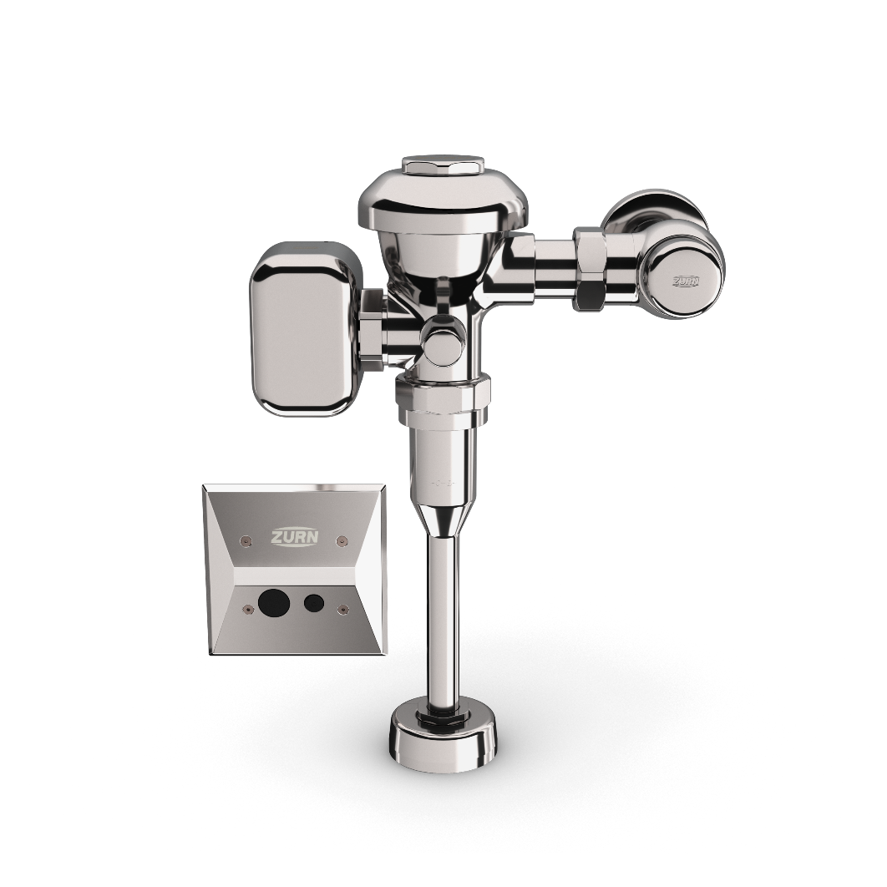
What if your plumbing system could talk to your maintenance crew?
PORTAL | ANALYTICS | ALERTS

Slide 8
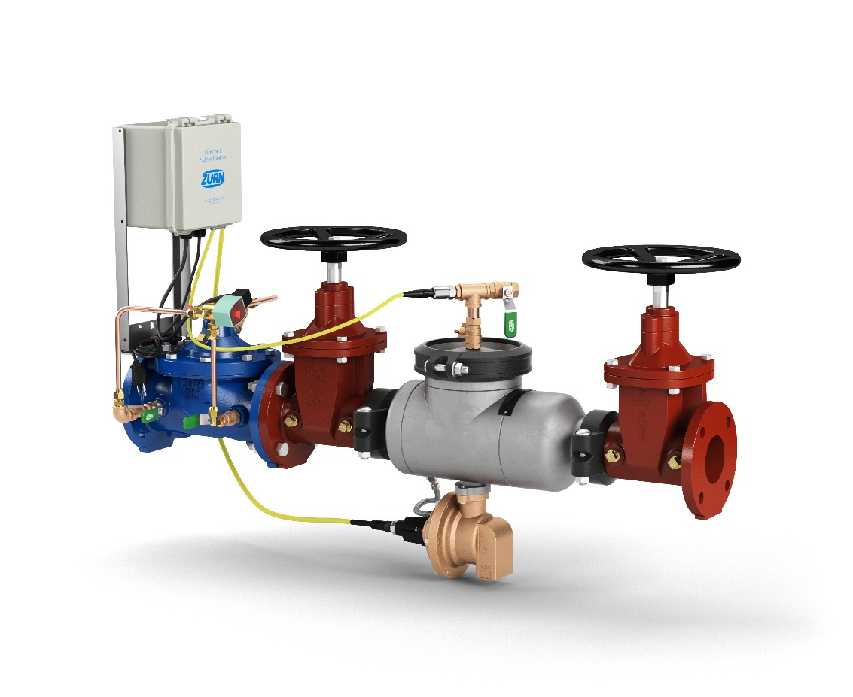
real-time, customizable data 24/7 text | email | plumbSMART™ secure portal
Relief valve discharge alerts
Automatic ACV shut-off
Optional output to building alarm system
Zone pressure alerts
Relief valve discharge volume
Frequency of discharge events
Fixture usage metrics
Water usage volume
Solenoid replacement alerts
Preventative maintenance alerts
Fixture usage metrics
Water usage volume
Diaphragm replacement alerts
Preventative maintenance alerts

Slide 9
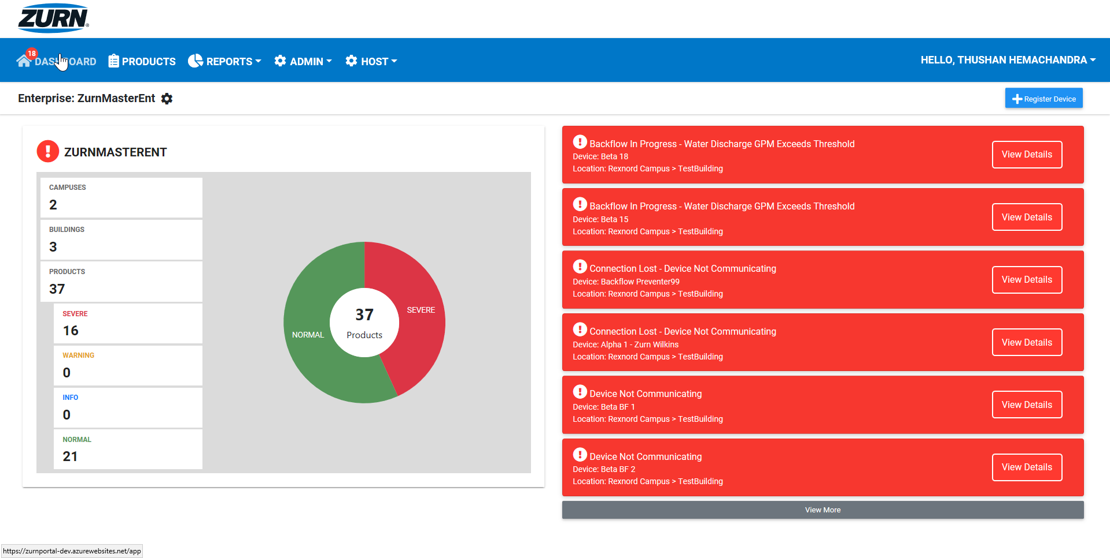
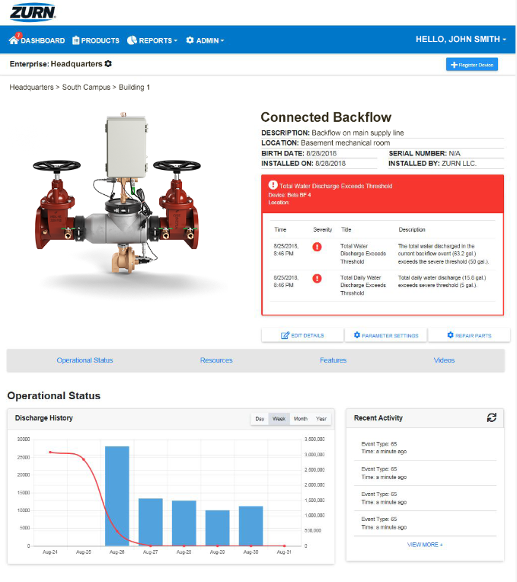
benefits Zurn Connected Products
1. preventative maintenance
2. reduced downtime
3. safety and compliance
https://zurnportal.azurewebsites.net/app/
Zurn Connected Products – Headquarters – Backflow 3
4. lowered risks and costs
5. best-in-class guest experience
Notes:
Backflow without remote ACV is like lighting insurance
PM is huge for retailers, stadiums, airports, etc.
Knowing when to replace parts based on usage, not time, could save a lot of money and man hours
Measurement and Verification – Sustainability (we have not looked into LEED credits yet); Rebate programs for water saving replacements

Slide 10
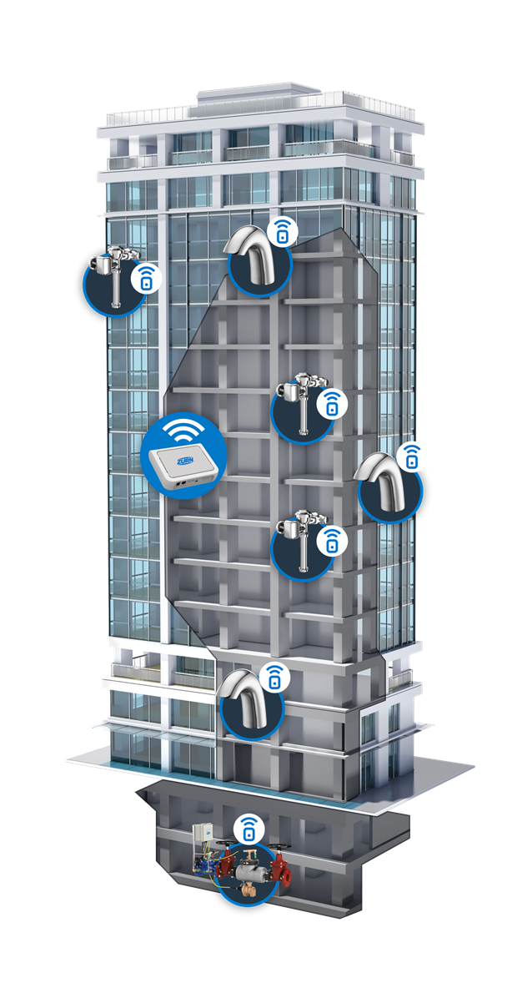
Zurn connected products how it works
1
Sensors capture and send data to Zurn cloud via Zurn gateway
2
Data analyzed in Zurn cloud for alerts and insights
3
Information delivered to plumbSMART™ in real-time and available 24/7
4
Alerts sent via email or text when parameter thresholds are exceeded
ALL DATA IS FULLY ENCRYPTED & SECURED USING THE EXISTING NETWORK CONNECTION OR
A SEPARATE CELLULAR CONNECTION

Slide 11
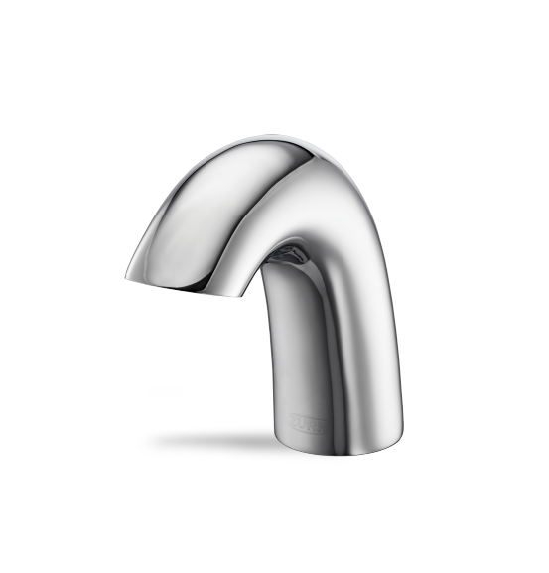
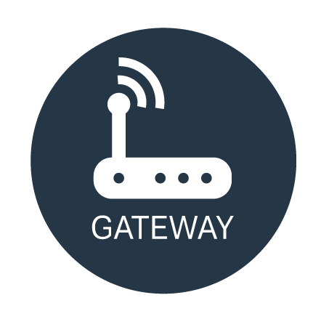
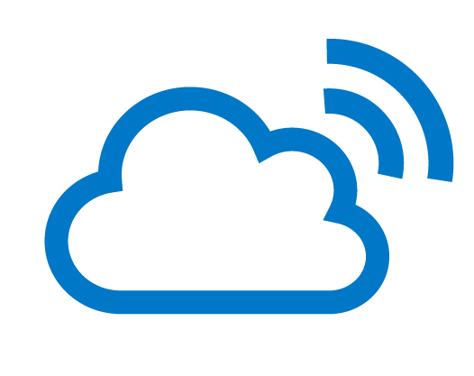
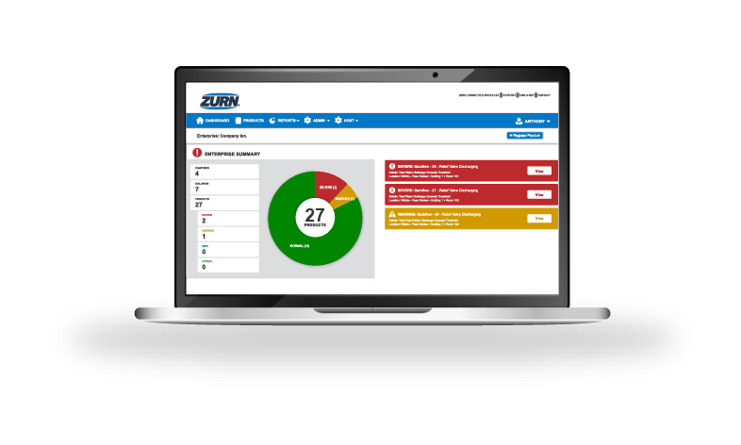
ALL DATA IS FULLY ENCRYPTED ACROSS ALL NODES OF TRANSMISSION
SMART END TO END
GATEWAY SYNCS YOUR PLUMBING PRODUCTS TO THE INTERNET VIA ETHERNET OR LTE CELLULAR, ACTS JUST LIKE AN INTERNET MODEM OR ROUTER IN YOUR HOME/OFFICE OR WIRELESS MOBILE HOTSPOT
ONE GATEWAY CAN HANDLE SEVERAL HUNDRED ZURN CONNECTED PRODUCTS WITHIN A 1,000-FOOT RADIUS

Slide 12
real-time alerts
preventative maintenance insights
historic data/trends
dashboard-style view of enterprise
organized by building and campus
customizable alert parameters
opt-in/out of email and mobile alerts
add/assign sub-users
Step-by-step plumSMART™ instructions in less than 15 minutes!
https://zurnportal.azurewebsites.net/app/
Zurn Connected Products – Headquarters – Backflow 3
PLUMBSMART™ ACCESS IS BY INVITATION ONLY; USERS MUST BE AUTHORIZED AND VALIDATED
AUTHENTICATION IS SECURED BY MICROSOFT AZURE ENCYPTION PROTOCOLS
USER PRIVILEGES CAN BE LIMITED TO SPECIFIC ROLES, LOCATIONS & PRODUCTS
Notes:
Complimentary access to the plumbSMART™ and alerts for 1 year from the time of the first purchase of a Zurn Connected Product. Thereafter, subscription renewal rates are in a tiered format, based on the total number of Zurn Connected Products installed across your enterprise.

Slide 13
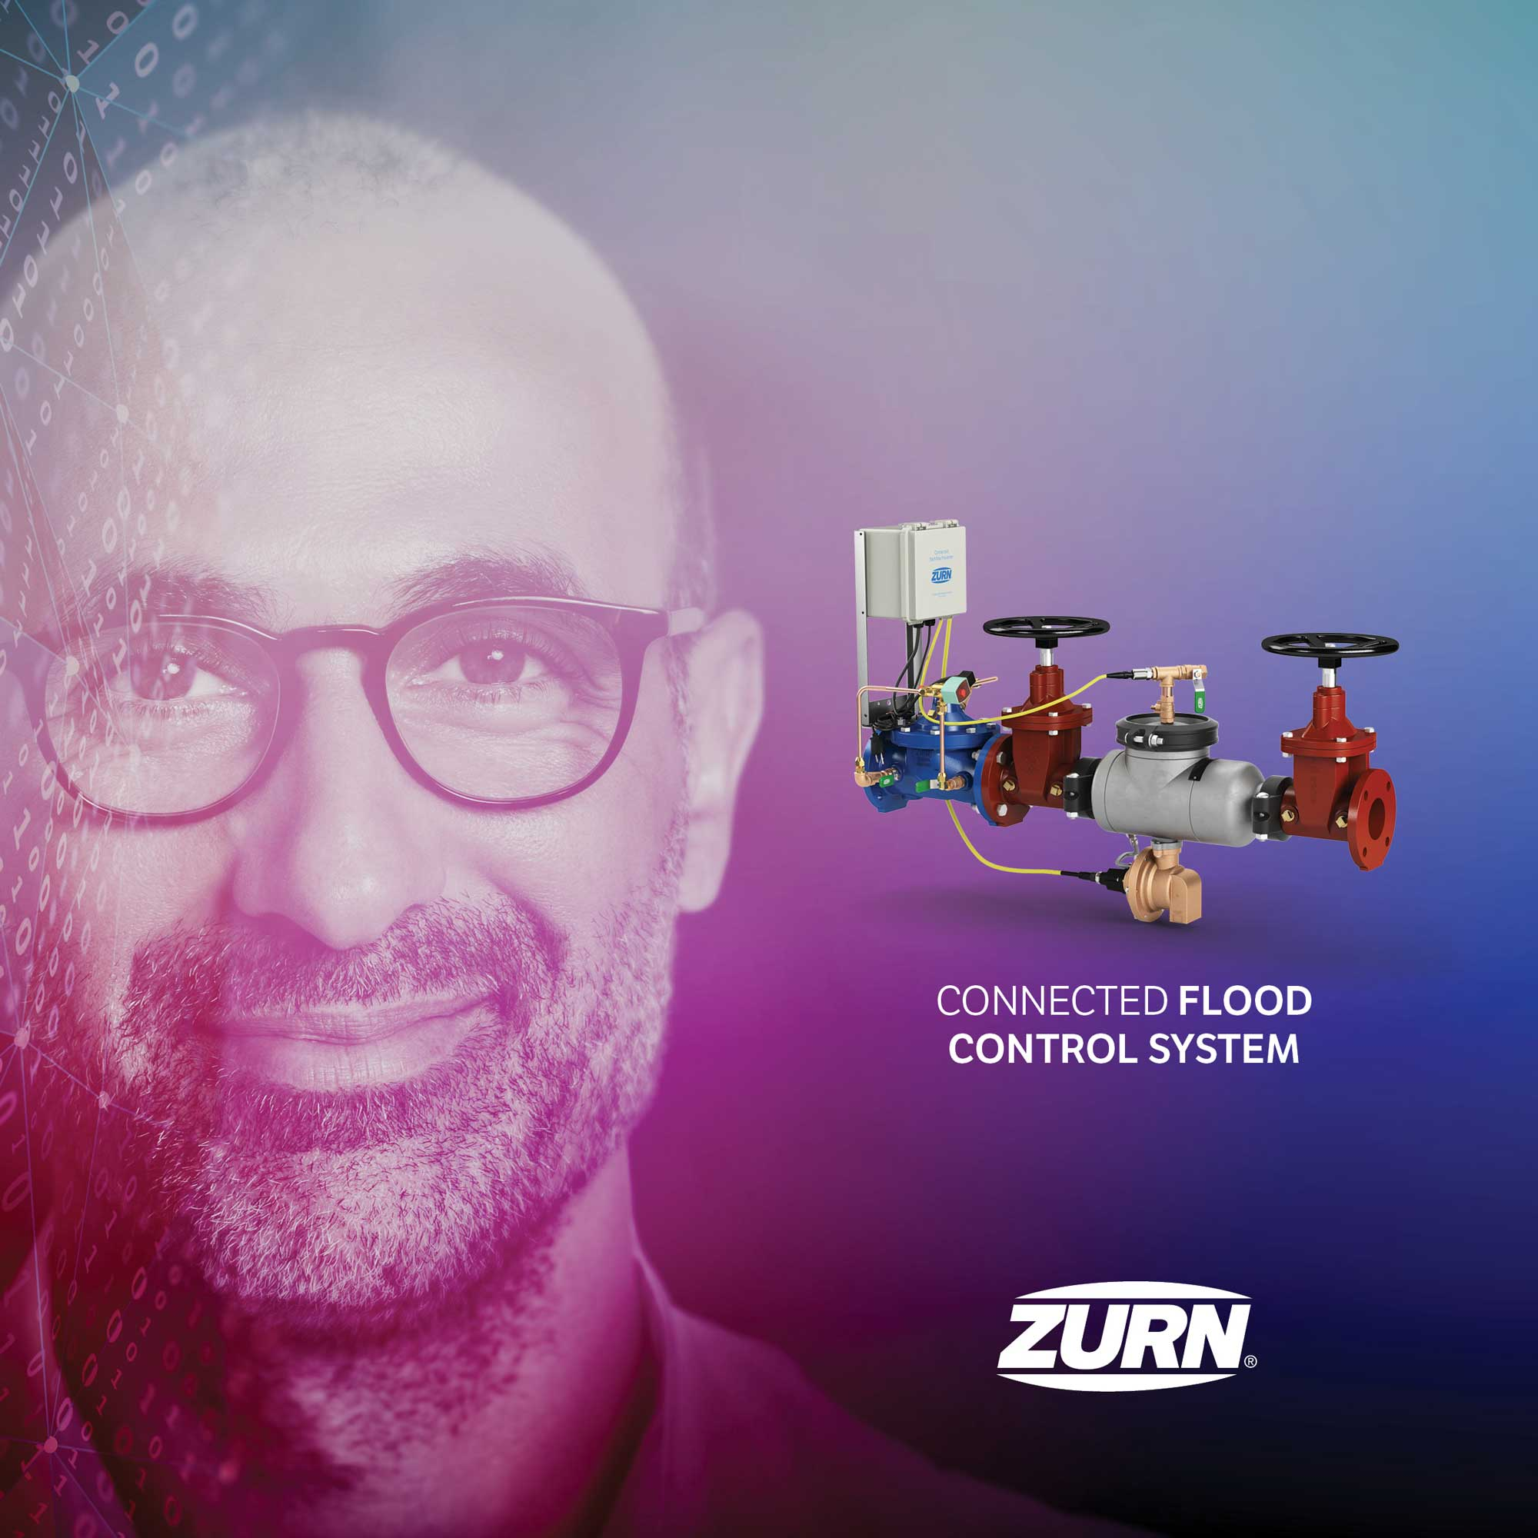
voice of customer industries

Slide 14
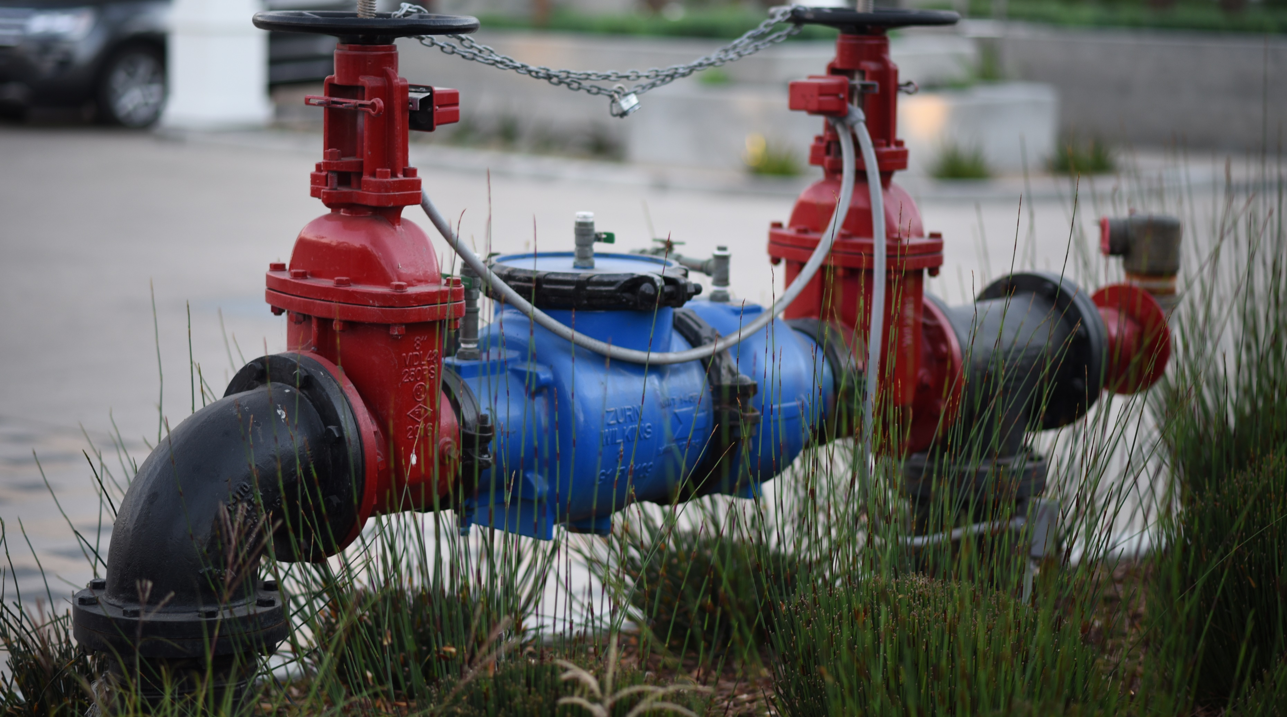
product 101 backflow preventers
Protects against backsiphonage and backpressure of contaminated water into the water supply.
Reduce Pressure Principle Backflow Preventers provide the ultimate level of protection against cross-contamination and are ideal for high or low hazard protection for water applications.

Slide 15
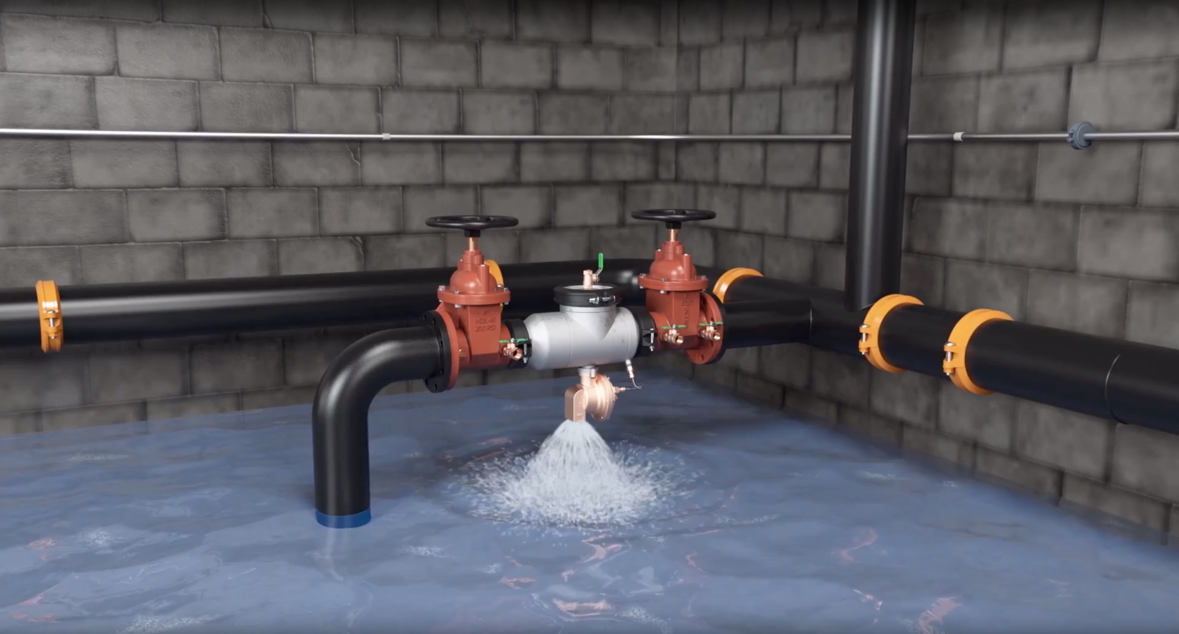
WHAT IF THIS HAPPENS OVER THE WEEKEND?

Slide 16
connected products why flood control?
relief valve discharge can be catastrophic
An 8” backflow preventer at 110psi can discharge more than 550gpm; enough water to fill a 20’ x 20’ x 10’ room in one hour (33,000 gallons)
value to the customer
building owners and property managers value the ability to prevent flooding due to relief valve discharge and desire smarter solutions that integrate with their operational needs for real-time data
market-leader in backflow prevention
Zurn Wilkins brand highly recognized and respected and has significant market share
experience in flood control technology
FCIS system already deployed across the United States
Competitor models considered unreliable and difficult to install/operate
Millions of dollars in cleanup, equipment replacement, and other liability costs
Notes:
In 1994, a Syracuse NY hospital’s mechanical room was inundated by 100,000 gallons of water from a backflow discharge
The water filled the room to a height of eight feet and caused extensive equipment failures
Patients were evacuated where one died in transport
The domestic water supply was contaminated as a result
Cleanup and patient transfer costs were put at more than $2,000,000
Today, concerns over mold only add to the liability risk

Slide 17
ZURN WILKINS CONNECTED FLOOD CONTROL SYSTEM WITH AUTOMATIC SHUT OFF
Wireless monitoring and simple setup that provides the highest level of flood prevention, avoiding the potential for millions of dollars in damage and liability, caused by the discharge from a catastrophically fouled Reduced Pressure Principal backflow preventer.
Drop in pressure at the city mains?
Debris lodged in one of the checks?
IDEAL FOR CUSTOMERS WHO:
Are required by code to install large, RP-style backflow preventers indoors
Worry about protecting their property from flood damage and mitigating liability
Need a solution that does not require manual monitoring or extensive setup
Take a data-driven approach to asset management and facilities maintenance
Relief valve discharge alerts (single and daily)
Solenoid control valve shutoff alerts
Flow rate of discharge
Volume of discharge
Notes:
The FCIS option of our Connected Flood Control System gives you the ability to set an automatic shut-off of the Solenoid Control Valve (SCV) and send you a notification immediately based on the severe alert threshold for relief valve discharge. A warning will be sent before reaching the severe alert threshold, and both settings can be adjusted to suit your specific needs at any point within PlumbSMART™ by your system administrator.
And of course, we do offer the Connected Flood Control System as a monitor only package for critical applications like fire protection where you would never want to shut down the water automatically.
We do not currently offer the ability to shut-off the water through a remote signal sent by the portal.
Q: When testing the backflow does it trip and send alerts or is there a bypass mode for testing?
A: There is no bypass mode. Normally when testing a valve, you only let a few drips out, so that would not trigger any alerts. If you drain the valve for maintenance, then it may trip unless you power it down first.
Q: Do your backflow preventers measure total water flow into the building? If no, then when will that be available? Total water flow is a key part of M&V.
A: Zurn Wilkins backflow preventers do not measure flow at this time. Would that be a valuable feature to you as a customer?
Q: When will self-testing backflow preventers be available?
A: There are currently no self-testing backflow preventers on the market by any manufacturer. Would this be of value to you as a customer?
Q: Will we get an alert if the relief valve is stuck (in any position)?
A: If the relief valve is open and discharging when stuck, then yes. But if the relief valve is closed, there will be no notice. We are looking into developing this functionality for the future.
Q: Why not retrofit vs. replace the backflow?
A: We plan to offer kits for in-field retrofit to Zurn Wilkins backflow preventers in the very near future.
Q: How low is the flow through the relief valve when an alarm is sent?
A: The parameter settings that drive alerts and alarms are adjustable in PlumbSMART™ on your desired level for notice.
Q: Is there an alert for when the relief valve has failed?
A: The backflow will send an alert for relief valve discharge. This is often when the relief valve is doing its job. We plan to investigate predictive maintenance in the future.

Slide 18
features & benefits Connected Flood Control System (FCIS)
best-in-class flood prevention
Real-time notifications when there’s relief valve water discharge
Prevent potential damage with warning and critical alerts sent to you via email or text
Check your system with the click of a button 24/7 from anywhere through access to PlumbSMART™
Records relief valve discharge frequency and volume data in the cloud for diagnostic analysis and maintenance planning
“Plug-and play” ease of installation and setup
Can connect to a building alarm system; actively developing integrations with leading BMS/BAS systems providers
Ideal in mechanical rooms, basements, and enclosures where undetected relief valve discharge could potentially cause catastrophic flooding and water damage
2.5” | 3” | 4” | 6” | 8” | 10” systems
Estimated average annual value to customer: $250 - $3,000 Helps avoid upwards of $1 million in catastrophic damage

Slide 19
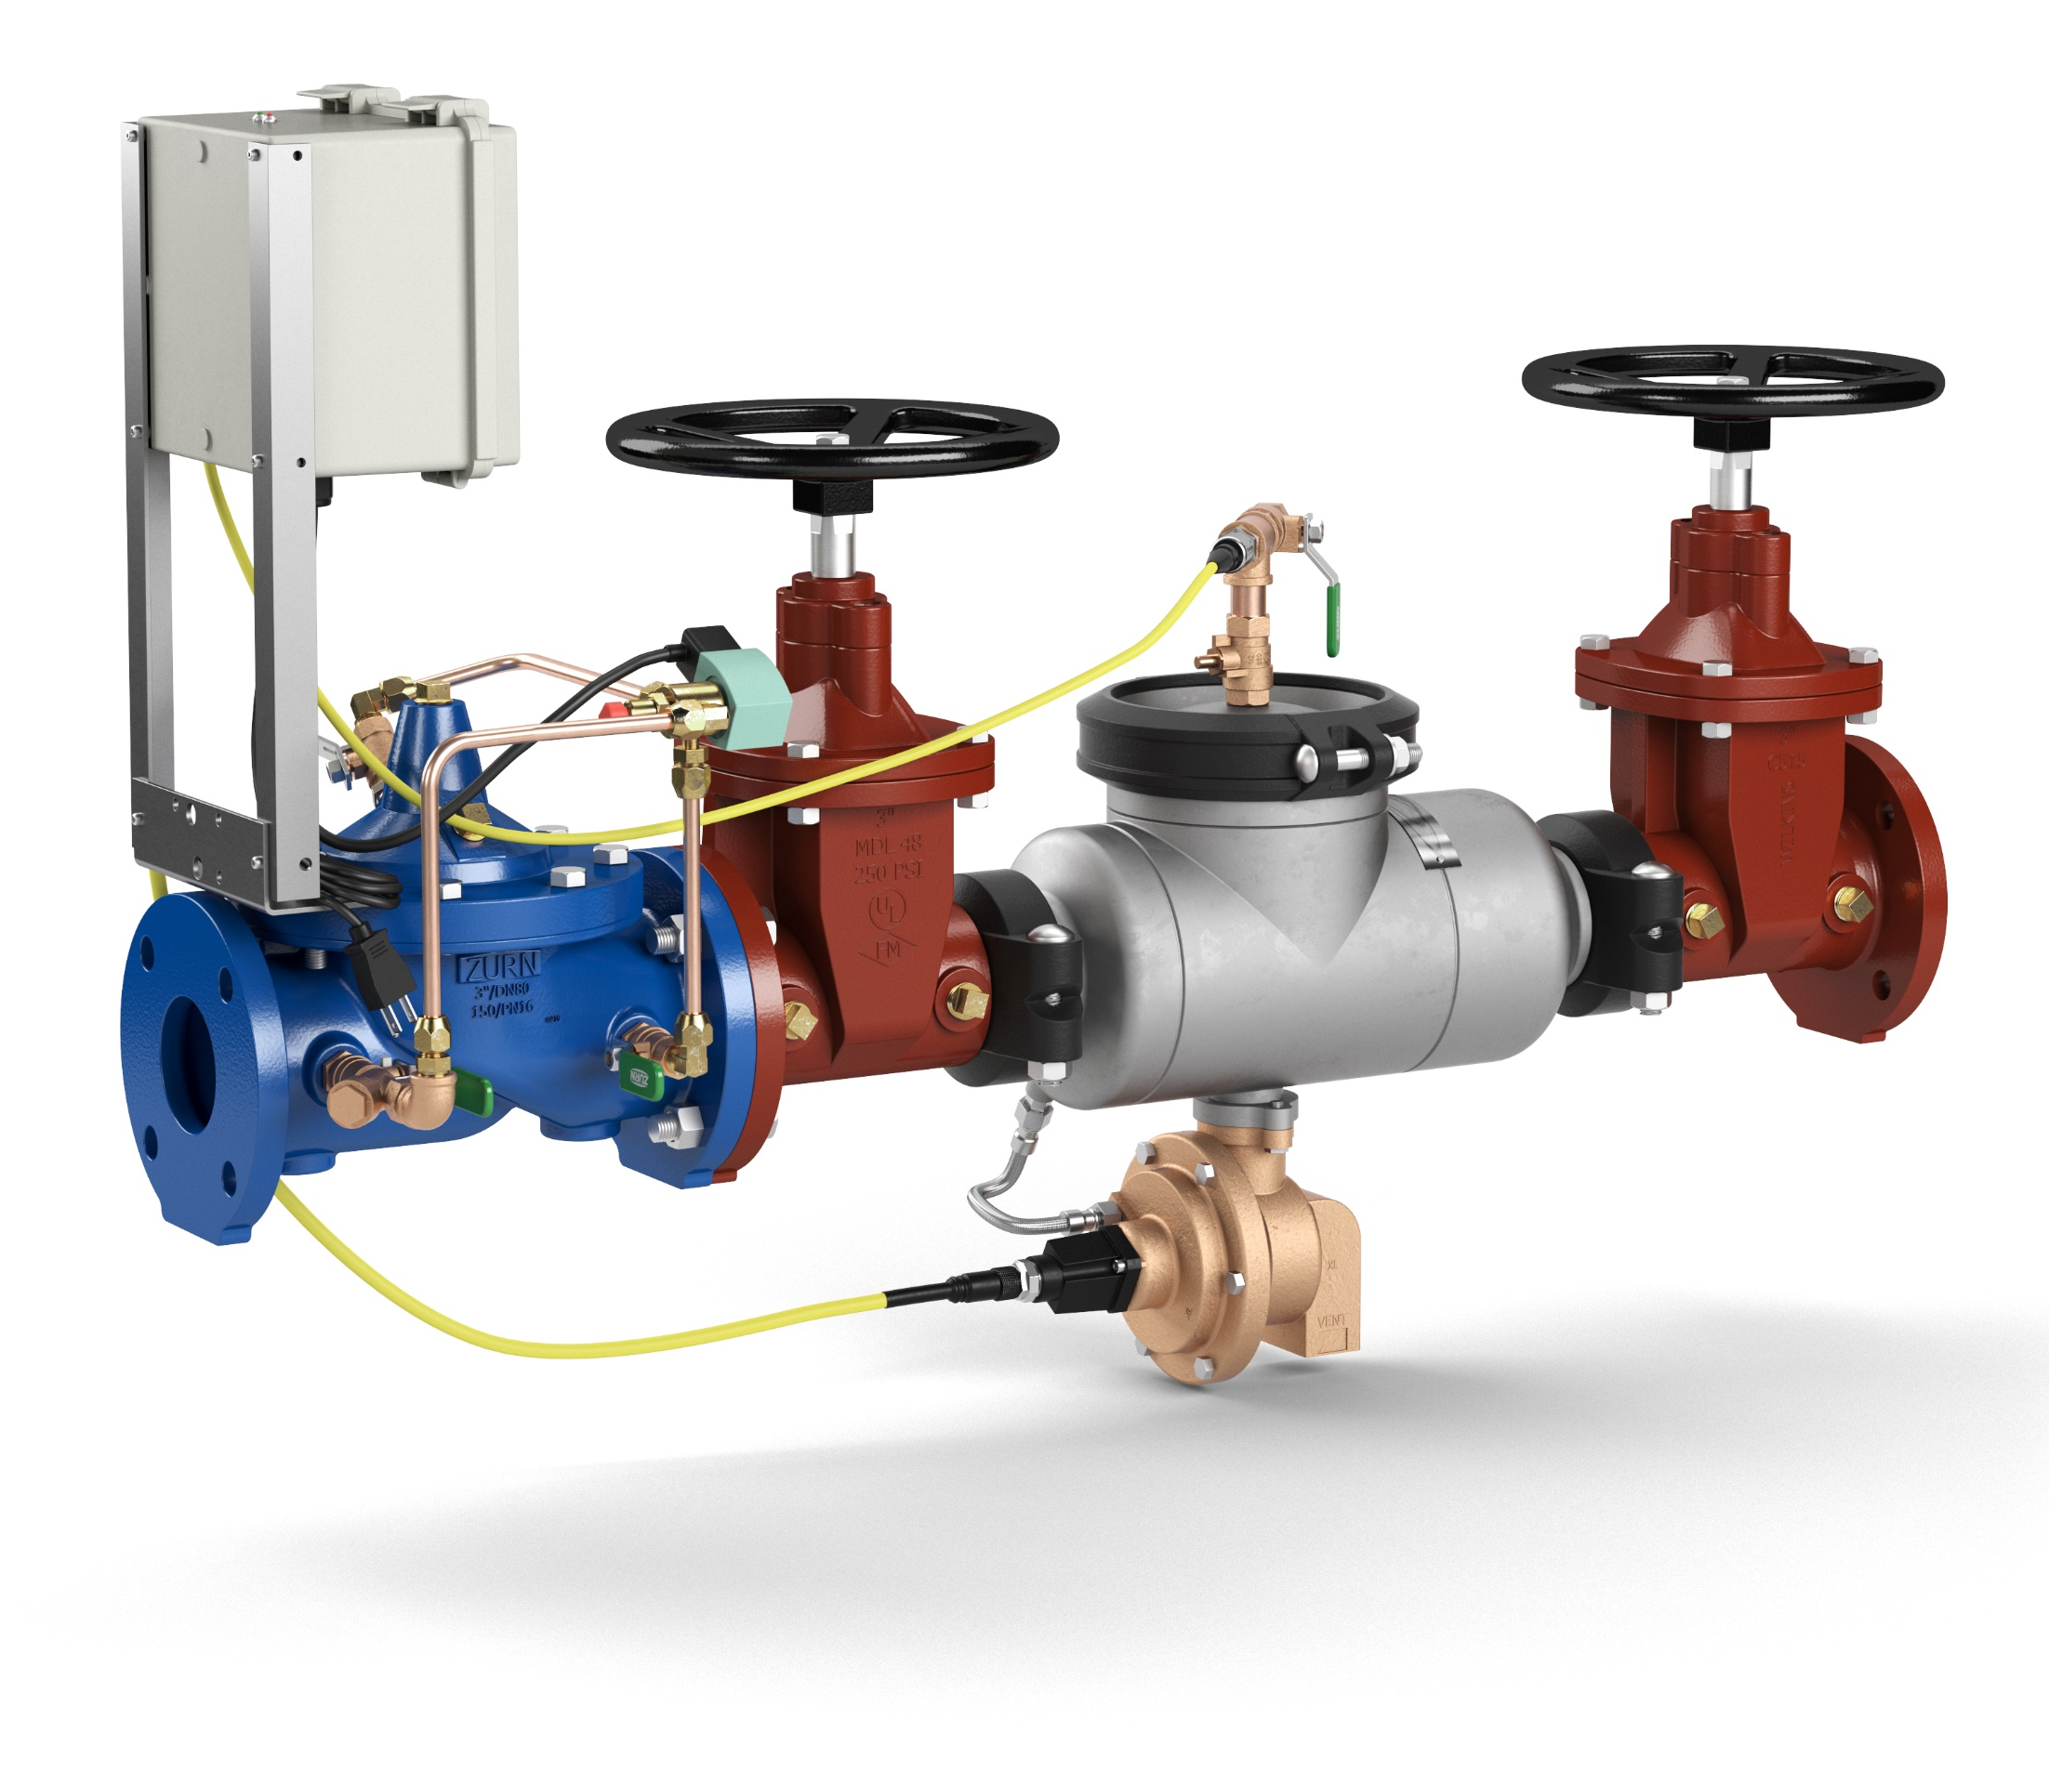
design & specify components Connected Flood Control System
FICSAST (Stainless Steel), pictured
FICSA (Ductile Iron Grooved Ends)
FCIS (Ductile Iron Flanged Ends)
Relief-Valve Monitor detects minute openings
and transmits data on size of opening multiple times per second to the end-point
ZW206 Solenoid Control Valve (SCV)
customizable shut-off
375 Reduced Pressure Principle Assembly
backflow detection and relief valve discharge
SINGLE for fouled first check, pictured
DOUBLE for fouled first or second check
TRIPLE/CRITICAL for fouled first or
second check + in bypass
containing a backup backflow preventer
375ASTW1 stainless steel body
375AW1
375W1
+ Floor Drain An adequately sized drain MUST be installed to handle water discharge from the backflow relief valve
Notes:
You can order a Connected Flood Control System through any distributor that sells Zurn Wilkins backflow.
Since we sell to distributors and they sell to contractors, you will need to get an exact quote from your supply house.

Slide 20
features & benefits Connected Flood Control System
“Plug-and-play” ease of installation for both electronics box and Zurn hub with instant connectivity test via laptop or mobile device
LONG-RANGE (LoRa) ANTENNA
CIRCUIT BOARD
Compact, enclosed and valve-mounted electronics controller that’s NEMA 4 (IEC 60529 IP66) rated
POWER SUPPLY

Slide 21
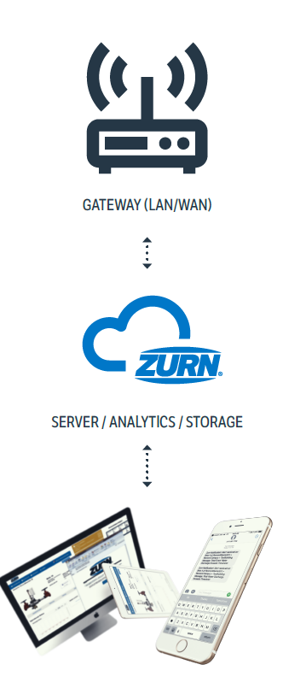
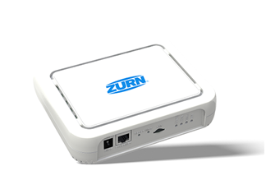
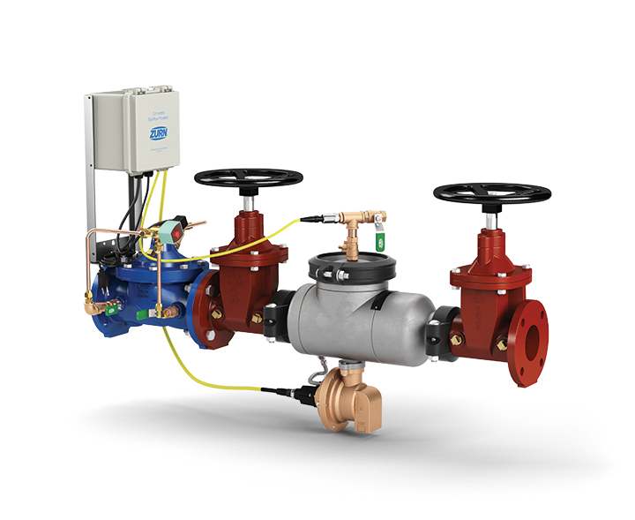
how it works Connected Flood Control System
1
sensors capture and send data to cloud
relief valve position sensor detects for opening of the relief valve and size of that opening, and then transmit these readings multiple times per second wirelessly to the Zurn cloud via Zurn gateway
ZURN GATEWAY
2
data analyzed for alerts and insights
relief valve opening size data is then computed in real-time to determine:
current flow rate (gallons per minute)
total volume of water discharged during an event (gallons)
total volume discharged by product in a 24-hr period (gallons)
ZURN CLOUD
3
alerts sent via web/email/text
if any of these computed results surpasses a threshold for warnings and then severe alerts, they are displayed immediately on plumbSMART™ and notifications are sent to the building owner/facility manager via email/text based on severity with link back to plumbSMART™
4
24/7 access to product info and trends
plumbSMART™ allows customers to view current product status, adjust their alert settings and view historic data trends from any location with an internet connection
IMPORTANT NOTE: Connected technology/electronics DOES NOT CHANGE OR AFFECT the regular functions of the backflow preventer in any way. Only senses for changes.

Slide 22
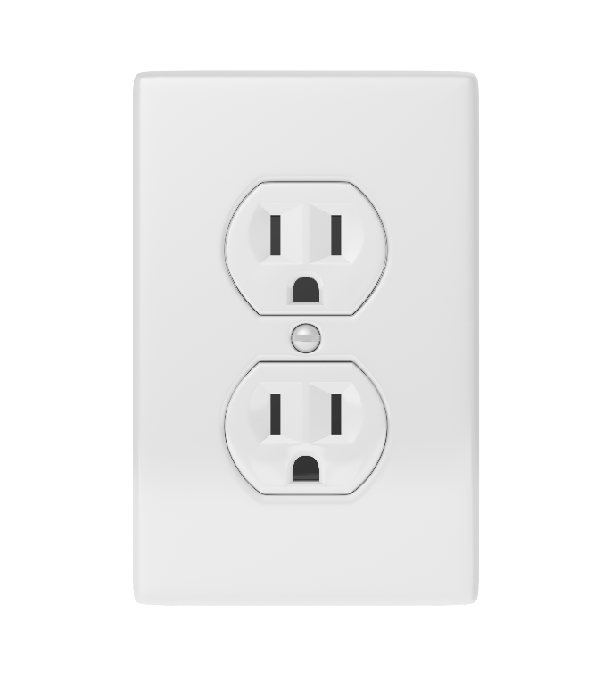
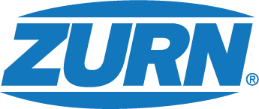
connectivity and power supply Flood Control System (Backflow Preventer)
Each backflow preventer sends its own wireless signal to a single gateway
120V
Wall Outlet

Slide 23
voice of customer industries

Slide 24
CATASTROPHIC FLOODING OR MESSY CLOGS

Slide 25
ZURN CONNECTED FLUSH VALVES
IDEAL FOR CUSTOMERS WHO:
Want to know about water consumption trends, peak hours, and when it’s time for a part replacement or simple upkeep
Require warnings and severe alerts about diaphragm end-of-life
Need to schedule cleaning and service work when it’s needed and avoid major repairs
Eliminate ghost activations that waste water or take patrons by surprise
Reduce downtime from unforeseen replacements
Take a data-driven approach to asset management and facilities maintenance
Flush count
Water usage volume
Diaphragm replacement alerts for preventative maintenance

Slide 26
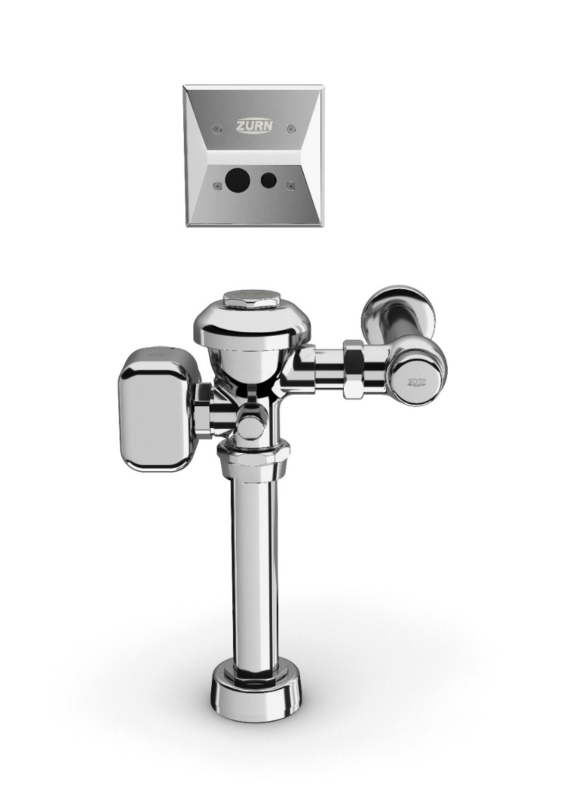
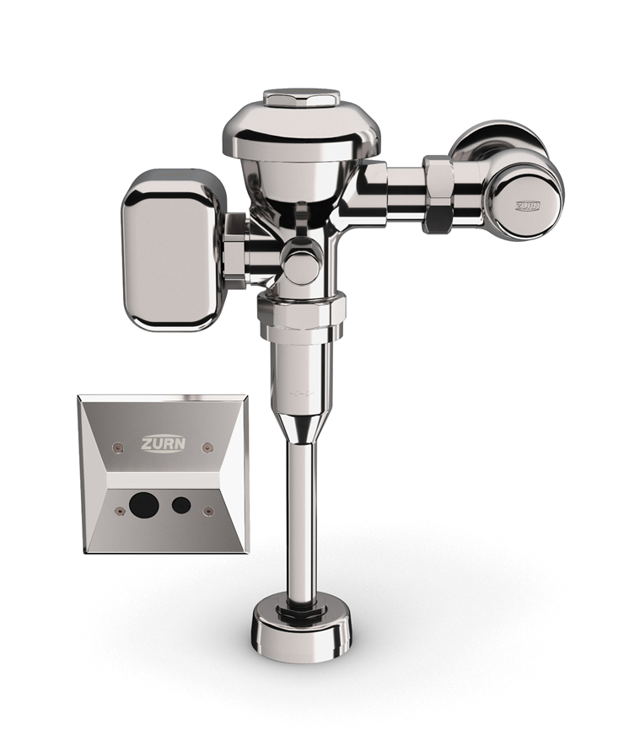
present launches connected products
Connected Flush Valves
PRECISION
Sensor flush valve accurately delivers hands-free operation to reduce germ transfer and enhance the user experience
Connected
ZEMS Hardwired Sensor Flush Valve
for 3.5 gpf – 1.1 gpf Water Closets
ZEMS6000AV-MOB-W1
DEPENDABLE
Clog-resistant triple filter diaphragm, chemical-resistant gaskets, and seals extend service life and reduce maintenance costs
INSTANT ANALYTICS
Wireless monitoring technology tracks data around set parameters for usage, water consumption, and preventative maintenance
additional features
Connected
ZEMS Hardwired Sensor Flush Valve
for 0.125 gpf -1.5 gpf Urinals
ZEMS6003AV-MOB-W1
Water conserving options with LEED flow rates
Heavy-duty cast brass body with chrome finish
ADA compliant
Notes:
Thushan Hemachandra

Slide 27
how it works connected flush valves
1
sensors capture and send data to cloud
flush valve transmits readings multiple times per second wirelessly to the Zurn cloud via Zurn gateway
ZURN GATEWAY
2
data analyzed for alerts and insights
flush valve data is then computed in real-time to determine:
flush count
water usage volume
diaphragm replacement alerts for preventative maintenance
ZURN CLOUD
3
alerts sent via web/email/text
if any of these computed results surpasses a threshold for warnings and then severe alerts, they are displayed immediately on plumbSMART™ and notifications are sent to the building owner/facility manager via email/text based on severity with link back to plumbSMART™
4
24/7 access to product info and trends
plumbSMART™ allows customers to view current product status, adjust their alert settings and view historic data trends from any location with an internet connection
IMPORTANT NOTE: Connected technology/electronics DOES NOT CHANGE OR AFFECT the regular functions of the flush valve in any way. Only senses for changes.

Slide 28
Each individual flush valve and faucet sends its own wireless signal to a single gateway
HW6
Power Supply
Powers 6 devices
Input = 120V
Output = 7.6V

Slide 29
voice of customer industries

Slide 30
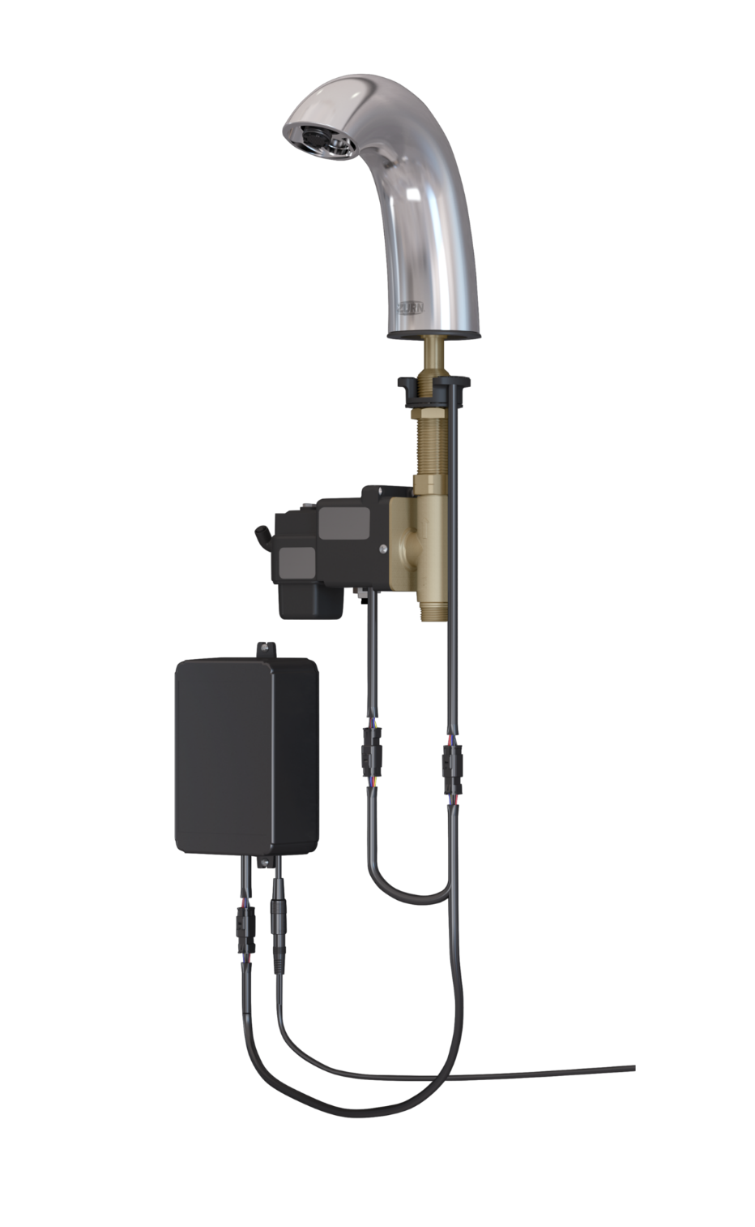
ZURN CONNECTED FAUCETS
IDEAL FOR CUSTOMERS WHO:
Want to conserve water
Eliminate ghost activations and save money
Require warnings and severe alerts about solenoid end-of-life
Want to determine peak/low traffic times to set effective cleaning and maintenance schedules
Need to avoid unexpected repair downtime altogether
Need a solution that does not require manual monitoring or extensive setup
Take a data-driven approach to asset management and facilities maintenance
Usage count and duration
Water usage volume
Solenoid end-of-life alerts
Preventative maintenance
alerts

Slide 31
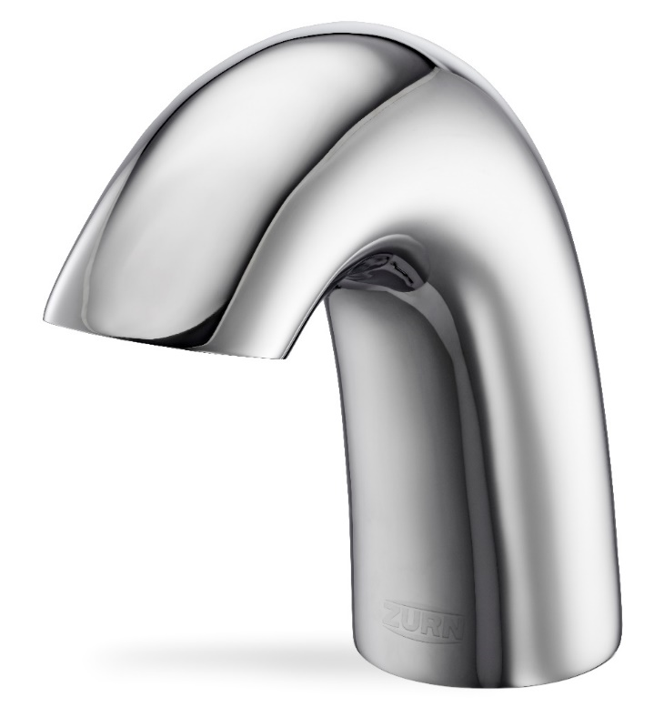
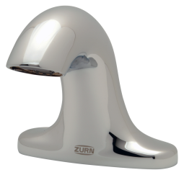
features & benefits connected faucets
Connected Faucets
PRECISION
Concealed sensor lens accurately delivers hands-free operation to reduce germ transfer and enhance the user experience
Connected
Aqua-FIT® Serio Series™
Hardwired Sensor Faucet
Z6950-XL-S-W1
FEATURE FLEXIBILITY
Timeouts, line purge, sensor range and metering mode offer custom control to meet the varying demands of restroom environments
INSTANT ANALYTICS
Wireless monitoring technology tracks data around set parameters for usage, water consumption, and preventative maintenance
Connected
Aqua-FIT® Serio Series™
Hardwired Sensor Faucet
Z6955-XL-S-W1
additional features
Water conserving options with LEED flow rates of 0.5/0.35 gpm
Heavy-duty cast brass body with chrome finish
ADA compliant
Notes:
Thushan Hemachandra

Slide 32
how it works connected faucets
1
sensors capture and send data to cloud
faucet transmits readings multiple times per second wirelessly to the Zurn cloud via Zurn gateway
ZURN GATEWAY
2
data analyzed for alerts and insights
faucet data is then computed in real-time to determine:
usage count and duration
total volume (gallons) of water discharged in a 24-hr period
preventative maintenance alerts
ZURN CLOUD
3
alerts sent via web/email/text
if any of these computed results surpasses a threshold for warnings and then severe alerts, they are displayed immediately on plumbSMART™ and notifications are sent to the building owner/facility manager via email/text based on severity with link back to plumbSMART™
4
24/7 access to product info and trends
plumbSMART™ allows customers to view current product status, adjust their alert settings and view historic data trends from any location with an internet connection
IMPORTANT NOTE: Connected technology/electronics DOES NOT CHANGE OR AFFECT the regular functions of the faucet in any way. Only senses for changes.

Slide 33
Each individual flush valve and faucet sends its own wireless signal to a single gateway
HW6
Power Supply
Powers 6 devices
Input = 120V
Output = 7.6V

Slide 34
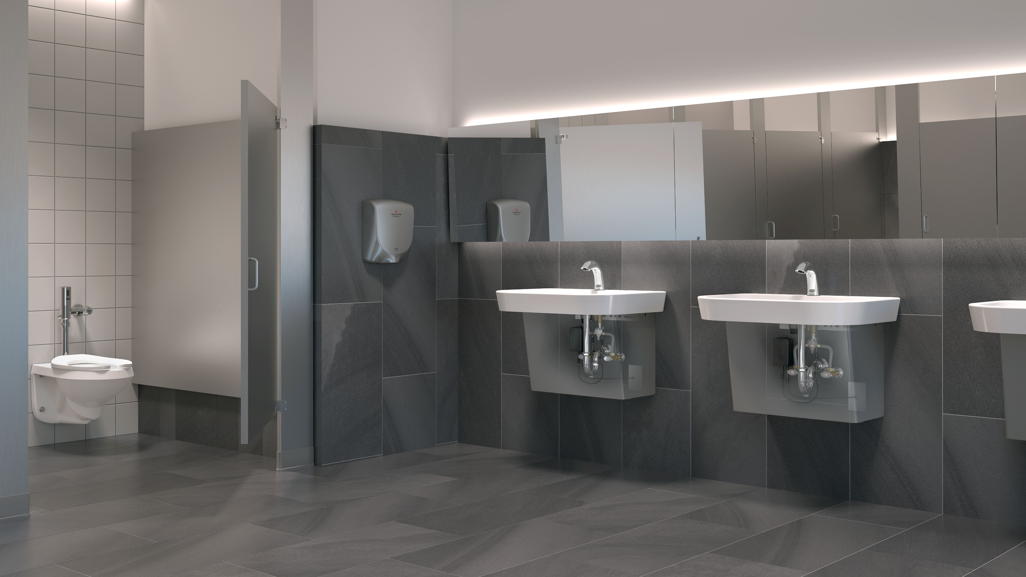
Test Your Knowledge
What are the top benefits of Zurn’s Connected Products?
Wireless monitoring of product operational status
Instant email and device event alerts based on customer-defined parameters
Secure web portal featuring dashboard-style views of product status and trends
All of the above

Slide 35
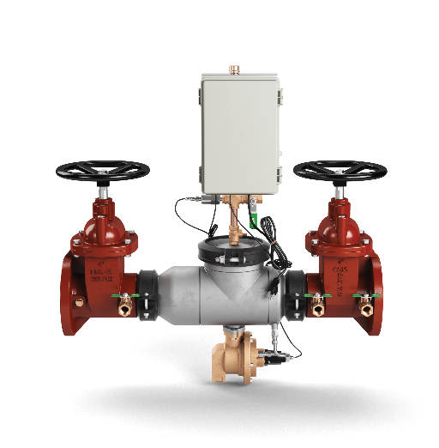
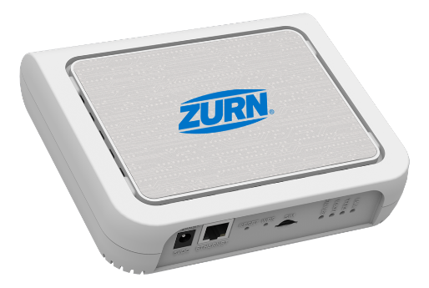
setting up your Zurn Connected Products
1
Setup your Zurn IoT Network
2
Install your Zurn Connected Products
3
Connect to the Zurn Cloud
4
Register products in plumbSMART
5
Add users in plumbSMART

Slide 36
setting up your Zurn Connected Products Network
Choose a location for your Zurn Gateway that is within 1000 feet of the Zurn Connected Products you're installing. Typically, your building’s walls should not be an issue. However, be sure to avoid major obstructions, such as thick concrete walls or metal reflective surfaces that will weaken the signal reception.
As with any electronic or networking device, install your Zurn Gateway in a cool, dry, dust-free location. In general, airconditioned offices or server rooms work best.
Make sure you have access to a standard 120V electrical outlet to plug your Zurn Gateway.
Connect to the Internet. You have two options to choose from, depending on your needs — Ethernet LAN or LTE Cellular. Both are as simple as setting up a modem in your home.

Slide 37
setting up your Zurn Connected Products Network
Ethernet LAN
STEP 1: Plug the power cord into the electrical outlet.
STEP 2: If the network is secured, ask your network administrator to authorize this gateway. You can provide the MAC address for the gateway, which is printed on the bottom of the label.
LTE Cellular
STEP 1: Check that the location isn't obstructed for sending and receiving cellular signals. You can use your own cellular device's connectivity as an indicator.
STEP 2: Once location is confirmed, plug the power cord into the electrical outlet.
STEP 3: Your gateway should power up automatically and, within a couple of minutes, all three indicators (Status, LoRa and Cell) should flash green.
Please contact your network administrator or Zurn Customer Care if you run into any issues with this installation.

Slide 38
install your Zurn Connected Products

Slide 39
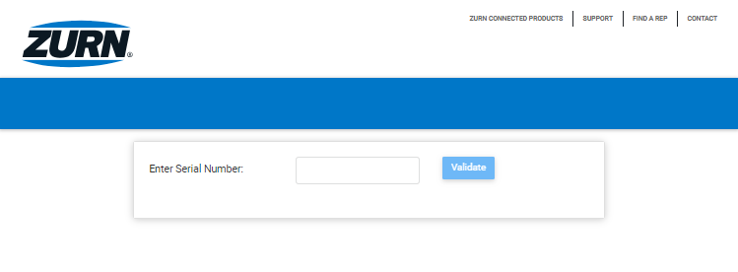
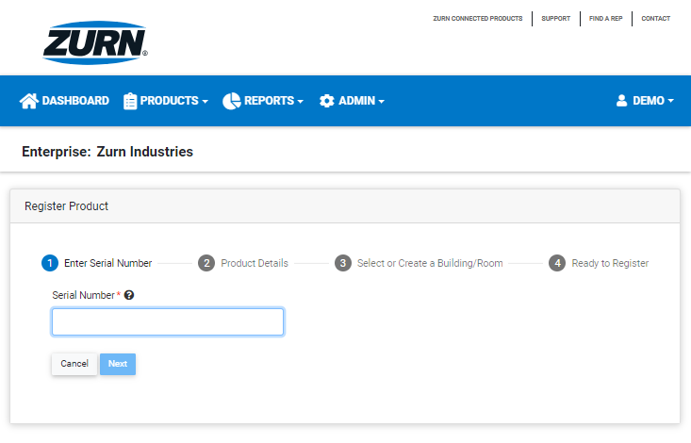
connect and register your Zurn Connected Products
TEST SYSTEM CONNECTION
REGISTER YOUR PRODUCTS
Make sure your gateway and products are talking now that everything is installed. You can conduct a system connection test.
Browse plumbsmart.zurn.com/install by typing in the products registration number.
Click on the ‘Validate’ button.
If the system recognizes the Zurn Connected Product, it will instantly connect to the Zurn Cloud.
The final step in the set-up process is to register your products in PlumbSMART in order to receive data.
Go to plumbsmart.zurn.com. Log in to your PlumbSmart account and select the 'Register Products' option from the 'Products’ menu within the main blue navigation bar.
Follow the prompts to complete the registration. At this point, you can give your Zurn Connected Product a unique name and assign it to a specific building location.
Finally, confirm or adjust your alert parameters based on your operation.

Slide 40
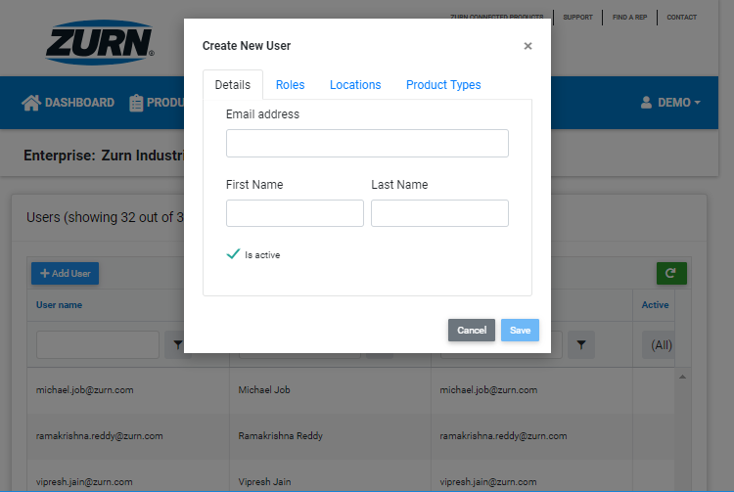
invite your team to plumbSMART – the Zurn Connected Products Portal
First, your enterprise system administrator (initially designated by Zurn) will need to log in to plumbSMART and click “Add Users” within the Admin menu options.
He/she will then enter the name and email address of each prospective user receiving access.
From there, the system administrator can select the level of permissions for the user, such as specific location(s) and product type(s), etc.
Once the new user has been added into the system, he/she will receive an invitation via email, including a link to activate the account.
After the user validates his/her email address, the system will send a verification code as part of a one-time, two-factor security measure into the plumbSMART portal.
The user will enter this emailed code to continue the account creation process and set his/her personal account preferences.
Once this is complete, the user is free to access the plumbSMART portal using the validated email address and created password.
Users may update their passwords and other personal settings at any time while they have an active account.
System administrators may add users, modify access privileges, or delete accounts at any time.

Slide 41
how it works plumbSMART™ portal
1
Register people and plumbing products on the portal
2
Get customized alerts for your products via email and/or text
3
Get a product building or campus-wide view of your connected plumbing system
4
24/7 access to device info, spec sheets, and data trends
In the office or on the go,
access your Zurn Connected Product data

Slide 42
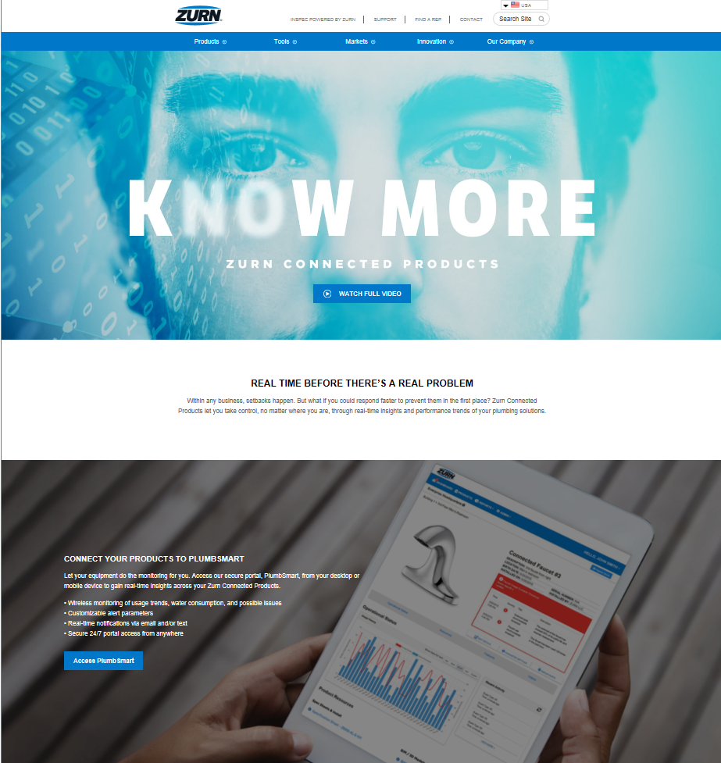
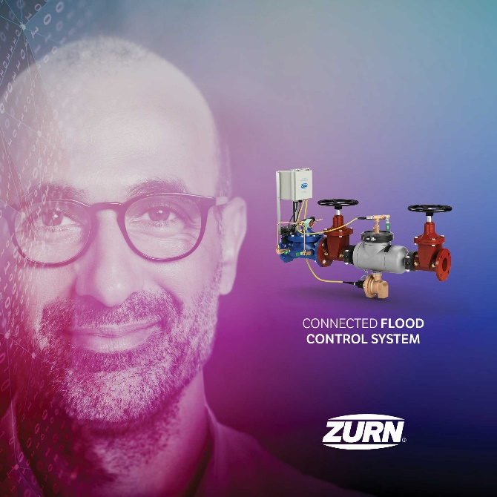
resources Zurn Connected Products
www.zurn.com/know-more
Print
Zurn YouTube videos
Zurn Connected Products
Zurn Wilkins Connected Flood Control System
Zurn Connected Flush Valves
Zurn Connected Faucets
Tri-fold brochures for each connected product
zurn.com>Innovation>Connected Products
Links to connected products and connected videos
Link to plumbSMART™
Lead capture capabilities on site
Zurn plumbSMART Portal Instructions
Spec sheets for each connected product
& more on ZIX
Learn how to perform all the functionalities of
Zurn’s plumbSMART™ Portal
in less than 15 minutes

Slide 43
Zurn connected plumbing products expanded portfolio coming soon
PORTAL | ANALYTICS | ALERTS

Slide 44
design & specify Zurn Connected Products
Create unlimited configurations
Solidify your basis of design
Generate your submittal package
Edit, share and copy projects
Zurn.com tools
inSpec | Create configurations, solidify your basis of design, generate your submittal package, edit/share/copy projects
Manufacturer Cross Reference | Select a manufacturer, then product, type, or competitor product number to find the corresponding Zurn Product
MasterSpec | Review spec files
BIM/Revit Files | Browse BIM objects
Product Warranties | Review One Zurn terms and conditions

Slide 45
TOP FAQ

Slide 46
What communications protocol do you use?
We use LoRa wireless communications technology.
LoRa (short for “long range”) is a wireless radio frequency technology that allows for secure data transmission across long ranges (up to a 5-mile radius) while consuming very little power.
One of the most popular technologies for Internet of Things (IoT) networks worldwide:
Over 600 known uses cases for smart cities, smart homes and buildings, smart agriculture, smart metering, smart supply chain and logistics, and more.
Over 50 million devices connected to networks in 95 countries and growing.

Slide 47
What is an Endpoint?
The endpoint is the set of IoT electronics that are part of, or attached to, your Zurn Connected Product. The end-points primary purpose is to collect and transmits data wirelessly from your Zurn Connected Products to the Zurn Gateway (which then transmits the data to the Zurn Cloud via Ethernet or LTE). Certain end-points can also act as controllers that can perform certain actions on your Zurn Connected Products.
Can you use one endpoint for multiple connected products?
NO, each connected product (e.g., backflow preventer, flush valve or faucet) must use its own unique endpoint. Zurn builds into each product its own unique endpoint to collect and communicate information about that product individually.

Slide 48
What is a Gateway?
A gateway is what allows Zurn Connected Products to send and receive data from the Zurn Cloud. Zurn Connected Products do not connect to the Internet directly. Instead, they connect securely to the Zurn gateway that is connected to the internet either via ethernet cable to your local area network or LTE cellular.
An easy way to think of this would be to compare it to your home or office, where your laptops and tablets and other internet devices connect to the internet through a modem/router or wireless cellular hotspot.
Can you use one Gateway for multiple connected products?
YES, one gateway will handle all Zurn connected products within its wireless range, which is typically a radius of roughly 1,000 feet from where the gateway is installed.

Slide 49
How secure is the Zurn Connected System?
All Zurn Connected Products data are contained in fully encrypted messages that are transmitted to the Zurn cloud, which is hosted and secured by IBM.
The Zurn Gateway does not have any Wi-Fi access points, which eliminates one of the more popular methods for unauthorized access to a network.
Our gateways also only accept LoRa message packets, that only contain data in message format and so, by design, cannot contain any executable scripts that could attack the network.
Zurn Connected Products generate messages with unique identifiers that allow them exclusive access to our Cloud servers. Any message that does not have these identifiers will be rejected.

Slide 50
Can you shut off the water remotely on a backflow preventer?
We do NOT currently offer the ability to shut-off the water through a remote signal sent by the Portal.
The Zurn Wilkins Connected Flood Control System (Model FCIS) in our suite of backflow preventers gives you the ability to set an automatic shut-off of the Automatic Control Valve (ACV) based on a customized relief valve discharge flow volume.
It will also send you a notification when the discharge rate reaches the severe alert threshold. A warning will be sent before reaching the severe alert threshold, and both settings can be adjusted to suit your specific needs at any point within the Portal by your system administrator.

Slide 51
resources support
address
phone
online
511 Freshwater Way
Milwaukee, WI 53204
toll-free 1-855-ONE-ZURN
zurn.com
Product Pages | Tools, Specifications, & Resources | Vertical Market Solutions
inSpec | Manufacturer Cross Reference | ARCAT | MasterSpec | SpecBuilder |
Specifiers | BIM/Revit Files
zurn.com/resources/product-training
Zurn Product - Overview
How to Install and Support
linkedin/Zurn Industries, LLC
facebook/Zurn Industries, LLC
youtube/Zurn
twitter/ZurnInd

