Slide 1
Zurn Flush Valves - Overview
July 16, 2019

Slide 2
agenda what you’ll learn
01
value proposition
02
how it works
03
features & benefits
04
design & specify
05
summary
06
resources

Slide 3
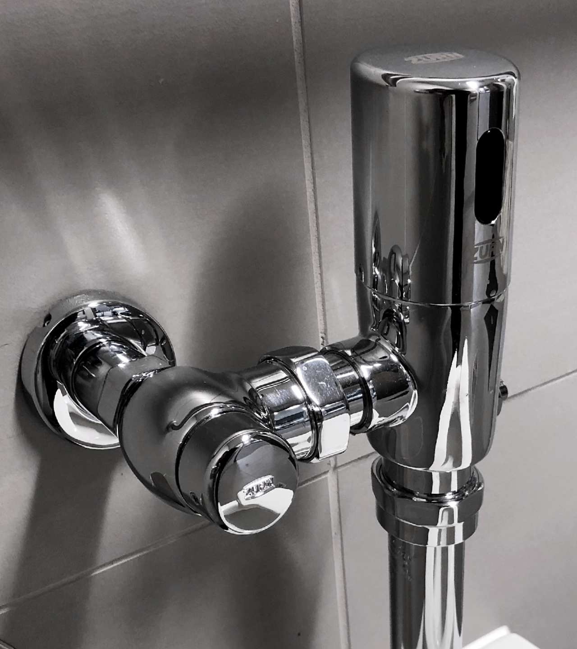
For building owners, engineers, and contractors,
Zurn Industries provides a wide array of manual, sensor, and specialty flush valves
that contain diaphragm or piston kits
unlike any competitor
allowing you to effectively remove waste, maintain a sanitary environment, and conserve water
for optimal toilet and urinal performance
2:43 Video:
Zurn Customer Story: AT&T Stadium

Slide 4
voice of customer industries
building owner
architect & engineer
contractor
“I need products that are durable and have a low total cost of ownership + require minimum downtime for maintenance.”
“I need products that are aesthetically pleasing, durable and cost-effective.”
“I need products that are easy and cost-effective to install and maintain, that are assembled and packaged in a manner that streamlines installation.”
Healthcare | Retail | Food Service | Hospitality | Restaurants | Institutional/Education | Government

Slide 5
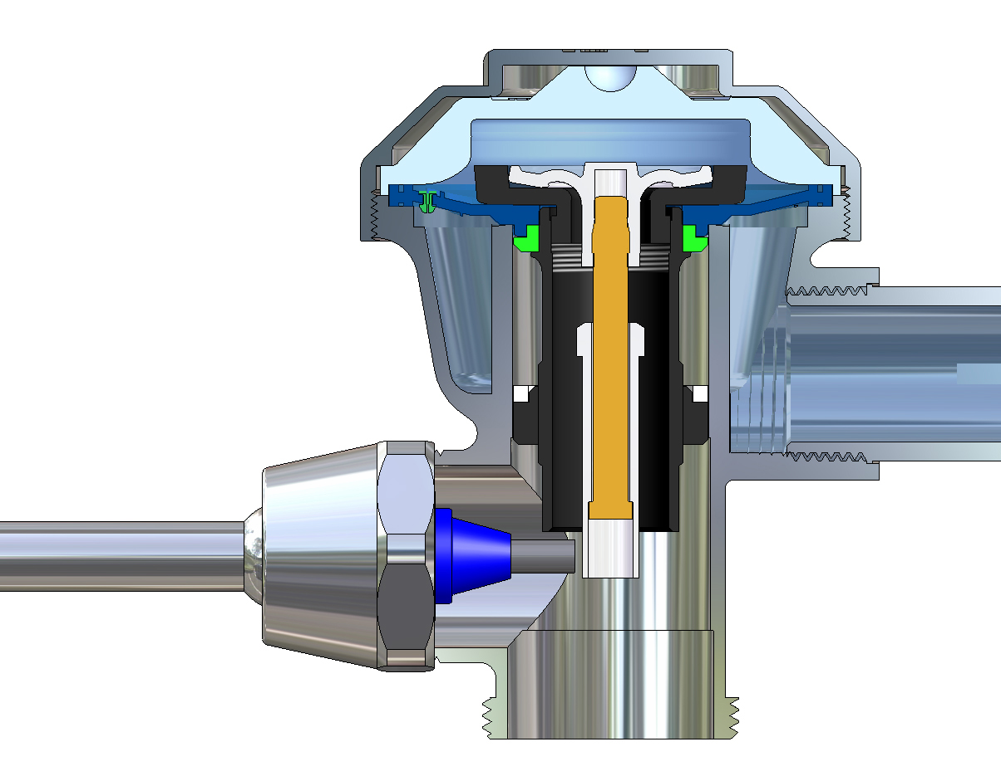
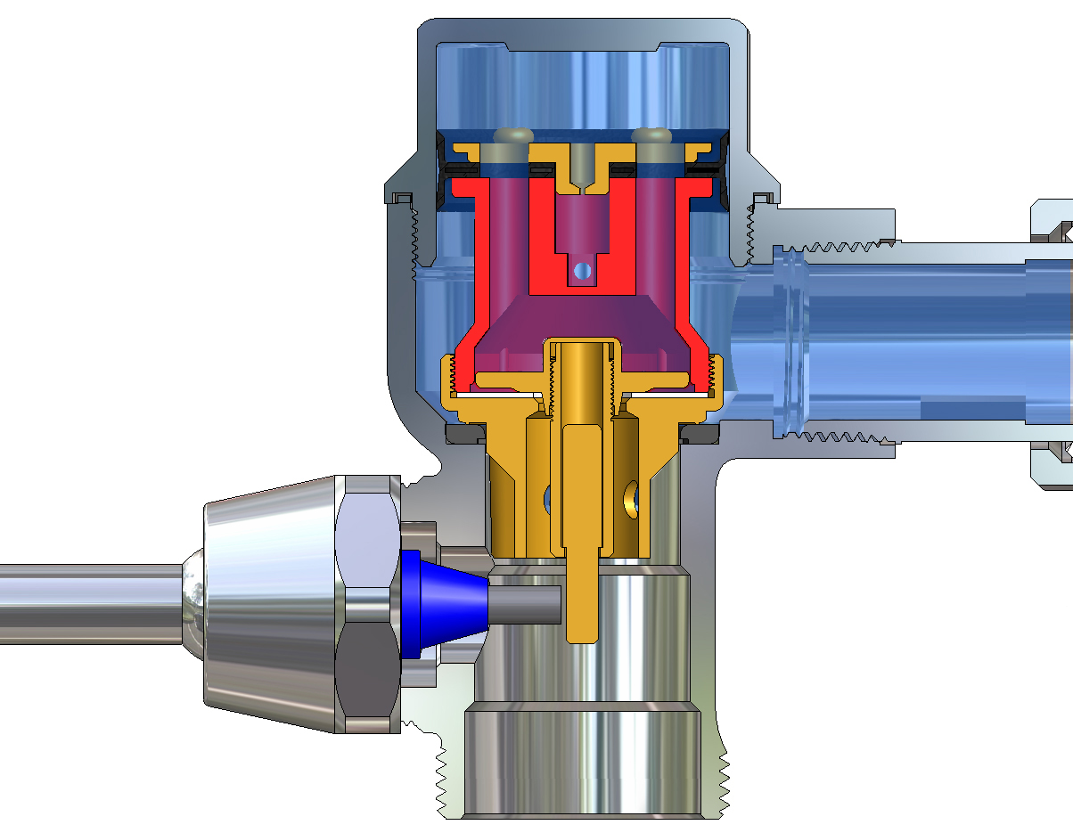
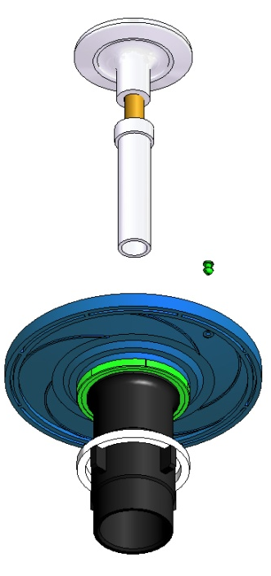
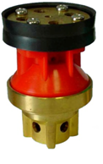
how it works diaphragm kits piston kits
Trip Length
(volume & timing)
Orifice
(timing)
Flow Ring
(volume)
Thermo Plastic Elastomer (TPE)
Superior chemical resistance
X
ORIFICE DIAMETER
TRIP LENGTH
AREA BETWEEN FLOW RING & CENTER BORE
ORIFICE DIAMETER
TRIP LENGTH
AREA BETWEEN FLOW RING & CENTER BORE
33% less clogs (AquaVantage triple filter) vs. traditional dual-filtered diaphragm technology
Good parts availability
Value-driven price; good in low pressure environments
Easy color-coded connections for fast, reliable installation
Easy repair and parts maintenance with no single point of failure

Slide 6
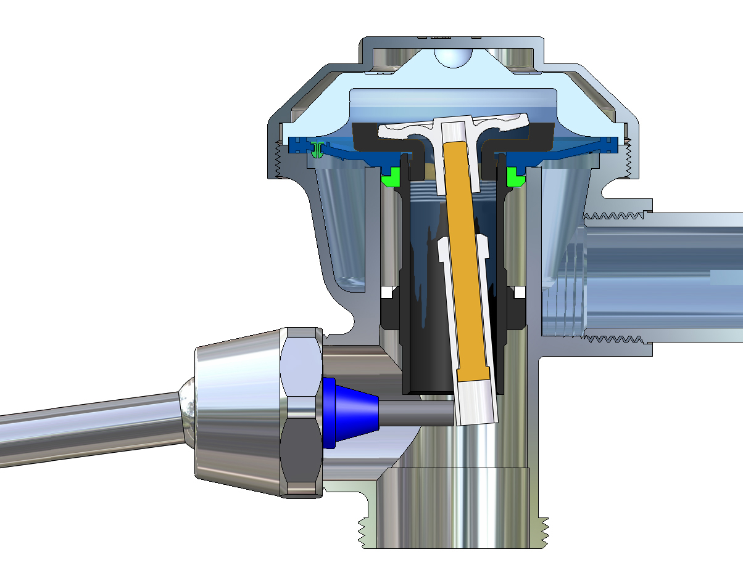
how it works step-by-step diaphragm valve
Plastic top cap
Trip Head
Orifice
Diaphragm
Allows water to flow for a specific length of time, at a specific rate (gpm/Lpf)
Flow Ring
1
from static to running
Static Position (closed)
Pressure diminishes from static to running. Inlet’s high pressure overcomes the diaphragm’s low pressure
2
running
Orifice is refilling the upper chamber which will equalize pressure & close the valve. Trip has reseated & sealed as the diaphragm kit is lifted
Handle
Trip
Actuator Rod
3
static
Orifice has refilled the upper chamber & shut the diaphragm down. Valve is closed and pressure is balanced
Static
65 psi
65 psi
Static Position (closed)
6

Slide 7
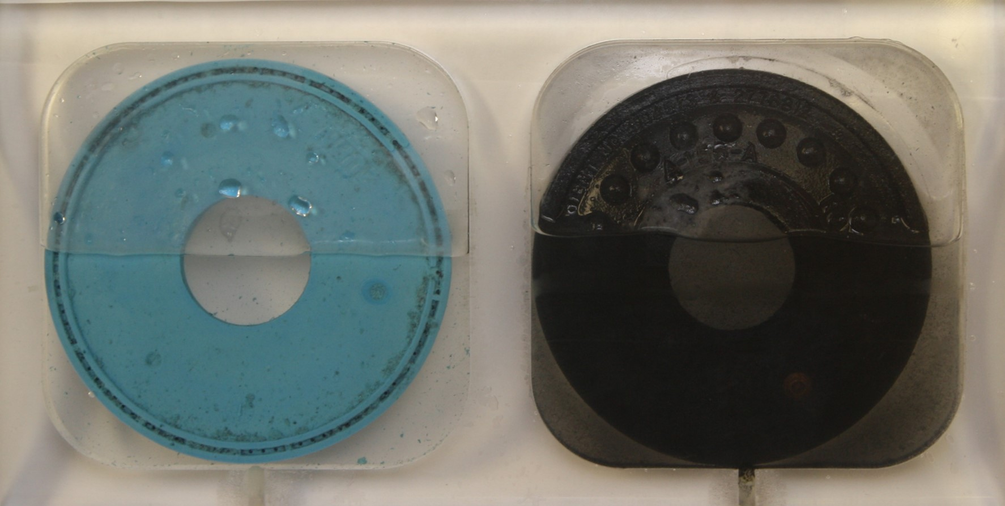
how it works GO BLUE® diaphragm - superior chemical resistance
Accelerated Chloramine Test
Exposure % Vol. Change
AquaVantage®
Zurn
TPE
Regal® Sloan® Synthetic Permex® Rubber
Sample was removed
Deterioration is visible in the water
Lasts 10x longer with its Thermal Plastic Elastomer (TPE)
Industry-leading filtering
Patented clog-resistant
Triple and linear filtered bypass
Consistent performance
Popular in North America
Contractors favor
Strong parts availability

Slide 8
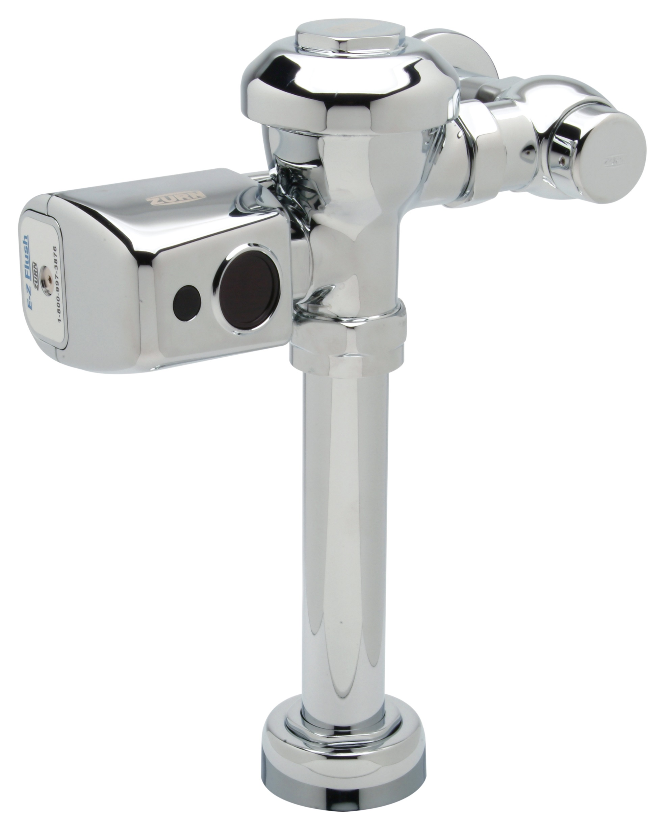
ZER 6000AV-CPM sensor flush valve, with diaphragm
Test Your Knowledge
How does a diaphragm valve function?
Place the following in the correct order:
Orifice has refilled the upper chamber & shut the diaphragm down. Valve is closed and pressure is balanced
Pressure diminishes from static to running
Orifice is refilling the upper chamber which will equalize pressure & close the valve

Slide 9
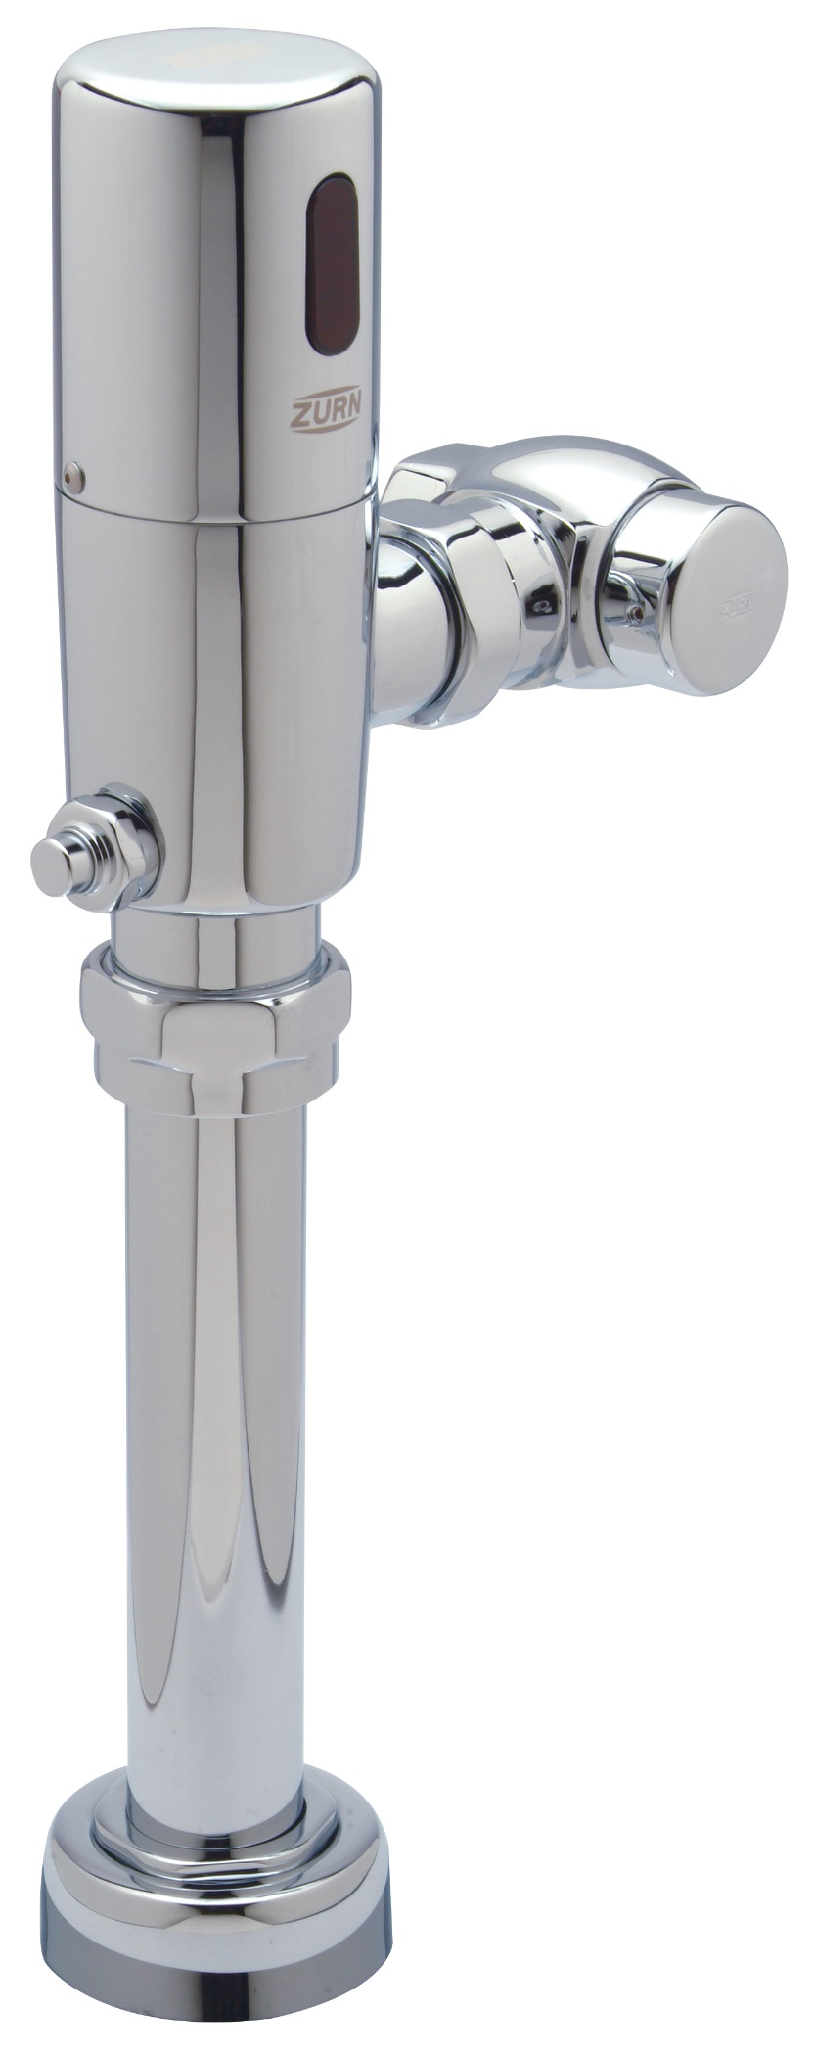
features & benefits flush valves
manual / sensor / specialty flush valves
Industry’s broadest offering of flow rates – from 0.125 gpf to 3.5 gpf – including the only 1.1 gpf closet valve available on the market
Better performing parts prevent run-ons, leaks, and inconsistent flushes, significant water conservation
Most U.S. water closets operate at 1.6 gpf and urinals operate at 1.0 gpf
Newer installations are utilizing 1.28 for closets and 0.5 gpf or less for urinals
Lean installation – especially when packaged with Zurn One systems
features
Advanced chemical resistance - lasts 8-10x longer than “black filters”
Industry-leading filtration - triple filter performance vs. dual filter performance
Interchangeability - works with competitors’ products
flow variables
Internal variables - diaphragm, trip length, orifice size, flow ring geometry
External variables - static water pressure, running water pressure, flow volume (gpm)
Body characteristics - bore diameter, handle location, actuator
operating pressure & conditions
Static pressure must be between 10 – 100 psi
Dynamic (running) pressure = a minimum of 25 psi for the bowl to evacuate 1.28 gpf
Operating pressure must not exceed 80 psi per ANSI A112.19.2 vitreous china fixtures

Slide 10
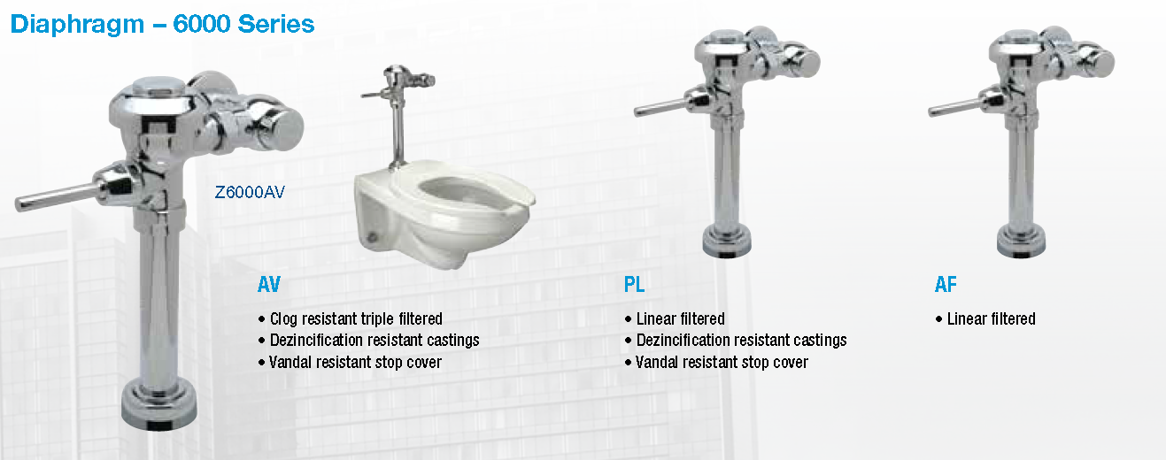
features & benefits manual flush valves
manual flush valves
Lowest price point
Proven technology, 3-year warranty
Extended service life with lower maintenance costs
Diaphragm and piston options
key features
Chemical resistant gaskets and seals
Dezincification resistant castings - Zurn proprietary alloy
High pressure vacuum breaker
Manual ADA compliant handle with no-leak seal technology

Slide 11
features & benefits sensor (automatic) flush valves
sensor flush valves
More convenient for users with automatic hands-free operation
More hygienic, lower bacterial transfer
Lower risk of excessive manual flushing, resulting in flooding
Easy maintenance with common wear parts
Diaphragm and piston options
3-year warranty
Electronic override button
Electronic override button
key features
Factory preset ranges and full customization from 2” - 60”
Replaceable lens with adjustable sensor and installation wrench
Optional 24, 48, 72-hour trap seal courtesy flush
Single electrical box and modular design for easy installation and maintenance
Mechanical override button option
(mechanical override button)

Slide 12
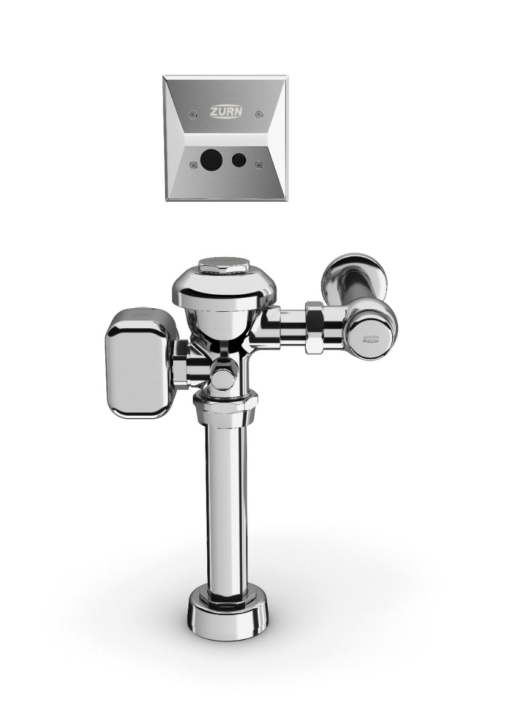
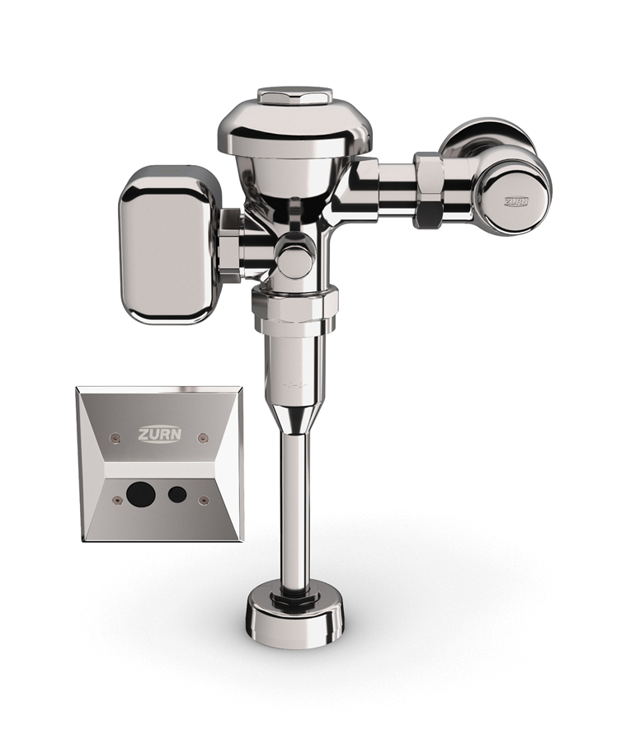
features & benefits connected products
connected flush valves
PRECISION
Sensor flush valve accurately delivers hands-free operation to reduce germ transfer and enhance the user experience
Connected
ZEMS Hardwired Sensor Flush Valve
for 3.5 gpf – 1.1 gpf Water Closets
ZEMS6000AV-MOB-W1
DEPENDABLE
Clog-resistant triple filter diaphragm, chemical-resistant gaskets, and seals extend service life and reduce maintenance costs
INSTANT ANALYTICS
Wireless monitoring technology tracks data around set parameters for usage, water consumption, and preventative maintenance
additional features
Connected
ZEMS Hardwired Sensor Flush Valve
for 0.125 gpf -1.5 gpf Urinals
ZEMS6003AV-MOB-W1
Water conserving options with LEED flow rates
Heavy-duty cast brass body with chrome finish
ADA compliant
Notes:
Thushan Hemachandra

Slide 13
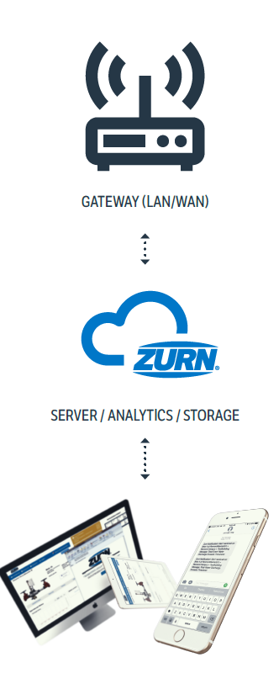
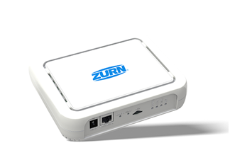
how it works connected flush valves
1
sensors capture and send data to cloud
flush valve transmits readings multiple times per second wirelessly to the Zurn cloud via Zurn gateway
ZURN GATEWAY
2
data analyzed for alerts and insights
flush valve data is then computed in real-time to determine:
flush count
water usage volume
diaphragm replacement alerts for preventative maintenance
ZURN CLOUD
3
alerts sent via web/email/text
if any of these computed results surpasses a threshold for warnings and then severe alerts, they are displayed immediately on plumbSMART™ and notifications are sent to the building owner/facility manager via email/text based on severity with link back to plumbSMART™
4
24/7 access to product info and trends
plumbSMART™ allows customers to view current product status, adjust their alert settings and view historic data trends from any location with an internet connection
IMPORTANT NOTE: Connected technology/electronics DOES NOT CHANGE OR AFFECT the regular functions of the flush valve in any way. Only senses for changes.

Slide 14
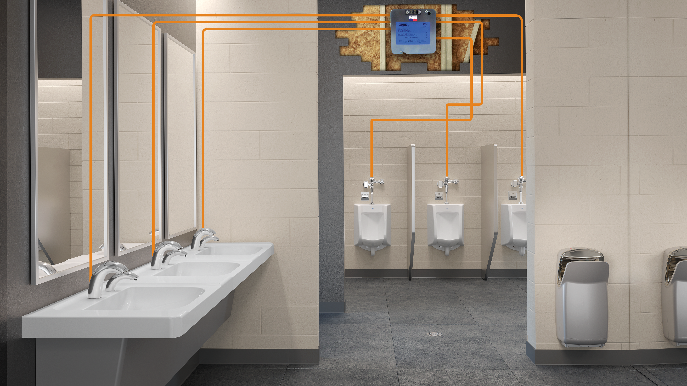
HW6
Power Supply
Powers 6 devices
Input = 120V
Output = 7.6V
Notes:
Each valve / faucet sends its own wireless signal to a single gateway
Do you have battery or power faucets today
Add benefits of hardwire vs. battery
Clarify the power vs. connectivity

Slide 15
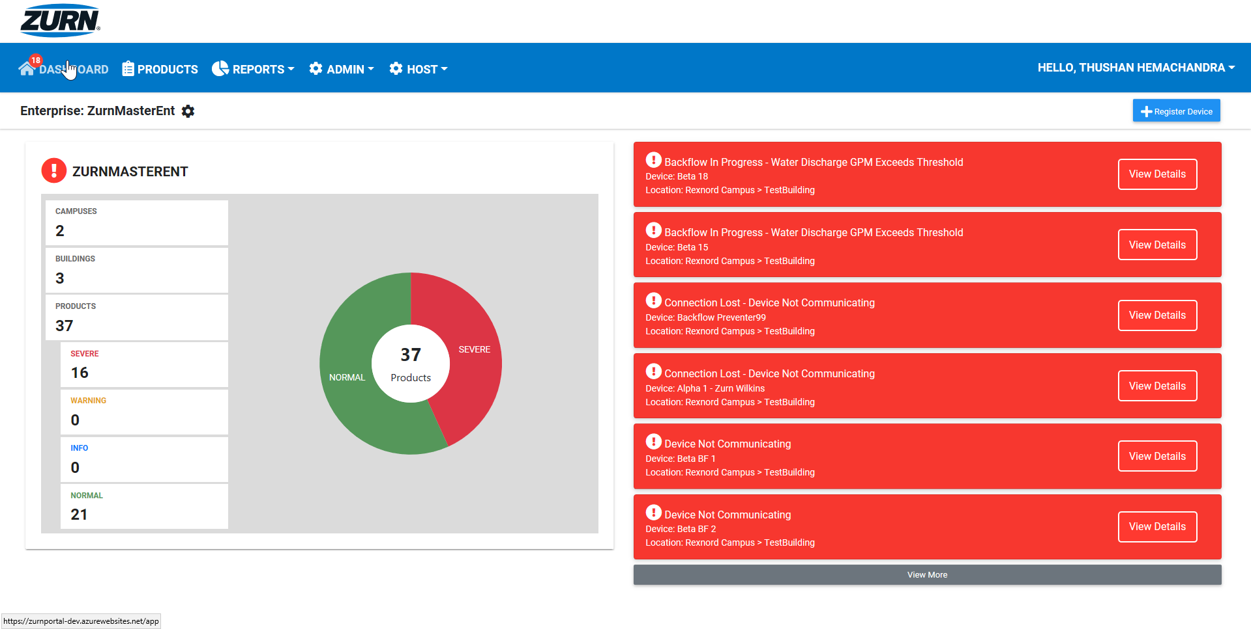
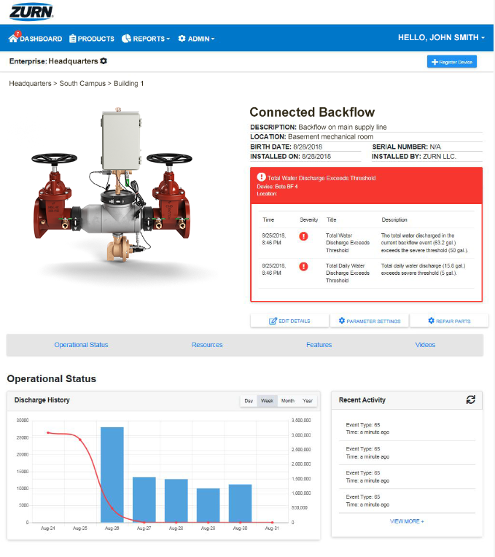
real-time alerts
preventative maintenance insights
historic data/trends
dashboard-style view of enterprise
organized by building and campus
customizable alert parameters
opt-in/out of email and mobile alerts
add/assign sub-users
Step-by-step PlumbSMART™ instructions in less than 15 minutes!
https://zurnportal.azurewebsites.net/app/
Zurn Connected Products – Headquarters – Backflow 3
PLUMBSMART™ ACCESS IS BY INVITATION ONLY; USERS MUST BE AUTHORIZED AND VALIDATED
AUTHENTICATION IS SECURED BY MICROSOFT AZURE ENCYPTION PROTOCOLS
USER PRIVILEGES CAN BE LIMITED TO SPECIFIC ROLES, LOCATIONS & PRODUCTS
Notes:
Complimentary access to the PlumbSMART™ and alerts for 1 year from the time of the first purchase of a Zurn Connected Product. Thereafter, subscription renewal rates are in a tiered format, based on the total number of Zurn Connected Products installed across your enterprise.

Slide 16
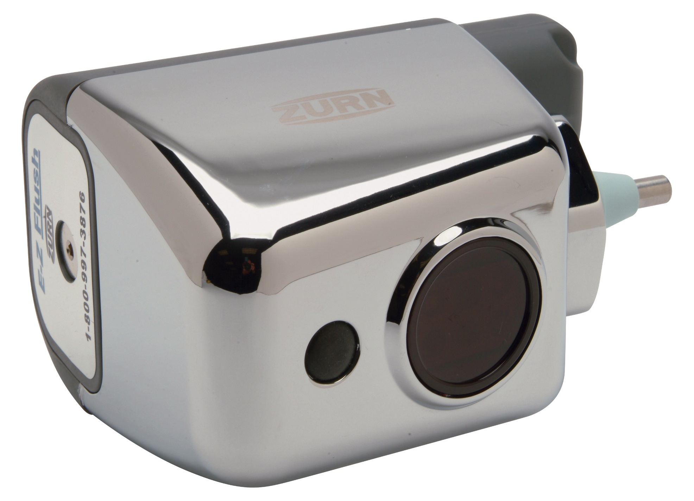
features & benefits sensor (automatic) flush valves
E-Z Flush features
E-Z flush retrofit kit (ZERK)
Gear based actuation ensures years of consistent performance (no solenoid)
Retrofit Zurn or Sloan manual valves to upgrade to sensor flushing for toilet and urinal flush valves
More hygienic, lower bacterial transfer
More convenient for users with automatic hands-free operation
Lower risk of excessive manual flushing, resulting in flooding
Installs in minutes and provide years of trouble free operation
key features
Replaceable lens with adjustable sensor and installation wrench
Optional 24, 48, 72-hour trap seal courtesy flush
Low battery light indicator (“c” battery) - 3-year battery life
Override button
Impact-resistant chrome-plated plastic E-Z Flush® sensor unit cover
Rubber or hard override button
1:40 Video:
Zurn Flush Valves AquaSense E-Z Flush

Slide 17
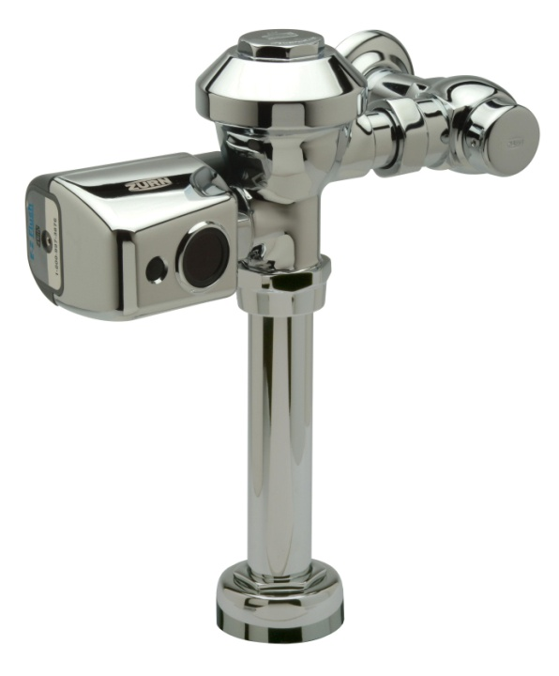
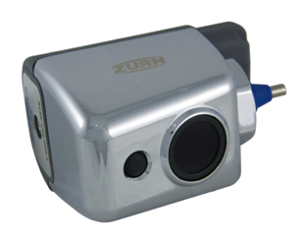
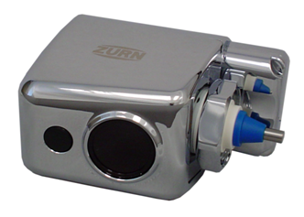
features & benefits ZERK sensor and actuators
ZERK-CP ZERK-CCP ZERK-CPM
Plastic non-chrome battery box
Plastic chrome cover
Rubber MOB
Plastic chrome battery box
High impact resistant chromed cover
Hard MOB
Plastic chrome battery box
Metal chromed cover
Hard MOB

Slide 18
features & benefits specialty flush valves
specialty flush valves
Diaphragm and piston options
Concealed valves, bedpan washers, penal valves…
key features
Chemical resistant gaskets and seals
Dezincification resistant castings - Zurn proprietary alloy
High pressure vacuum breaker
penal valve features
Solid brass construction with piston valve performance
Vandal-resistant stainless steel flush button
Reliable one-hour lockout feature for excessive flushing and flood prevention
Remote flushing capabilities with true mechanical override button
Up to 50% water savings on 3.5 gpf penal units
Hardwire or 10-year Lithium battery for easy design and retrofit applications
Override button
Override button

Slide 19
features & benefits accessories/variations

Slide 20
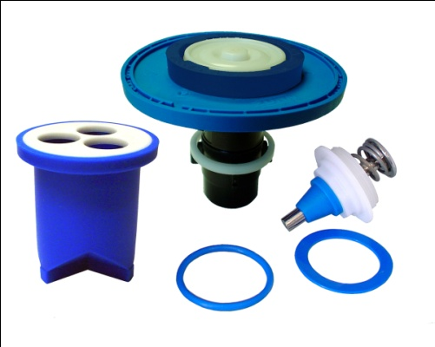
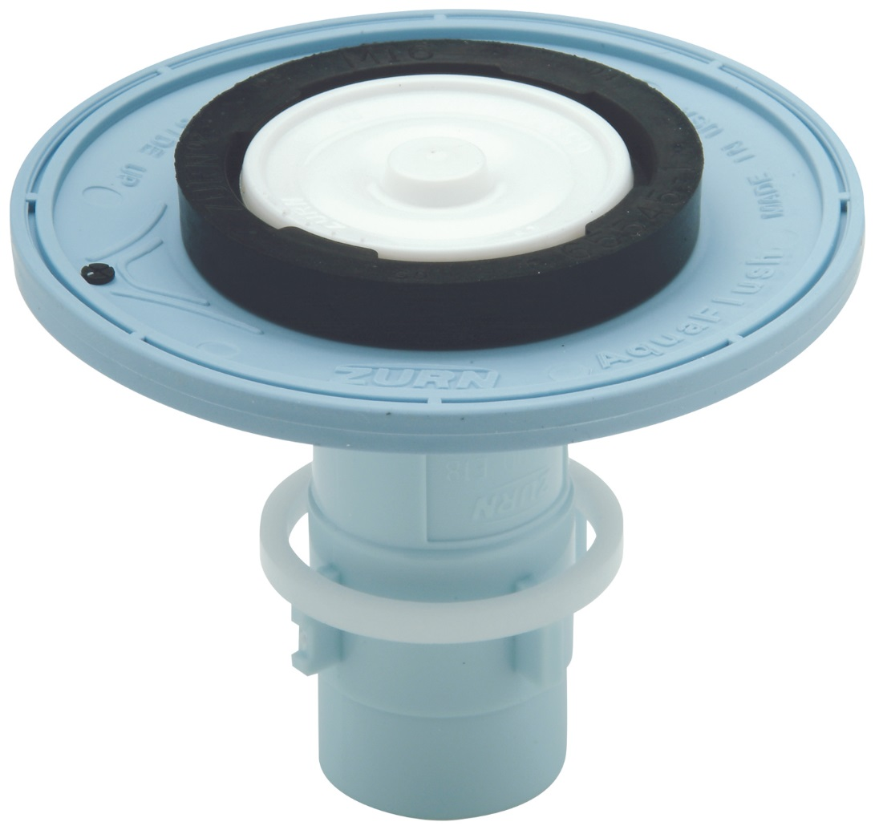
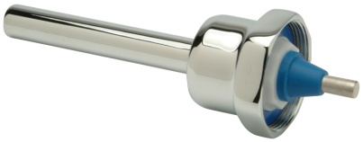
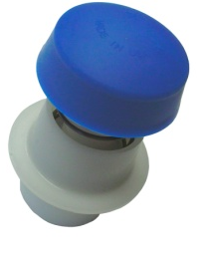
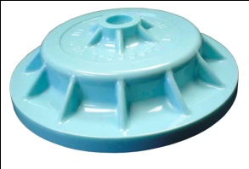
features & benefits Sloan to Zurn interchangeable flush valve parts
Retrofit or repair
Sloan Regal and Royal flush valves
Diaphragm kits
Vacuum breaker kits
Handles
Handle repair kits
O-rings
Spud gaskets
Inside plastic cover
Control stop kits
Vacuum breaker tubes
E-Z Flush side mount sensor units
Closet rebuild kit
Handle repair kit
Flush valve repair kit
Stop repair kit
Inside plastic cover

Slide 21
features & benefits questions
How important is water conservation? | Use Piston or diaphragm kits with optimal and reliable flush volumes Better performing parts prevent run-ons, leaks, and inconsistent flushes Industry-leading filterability Manual ADA compliant handle with no-leak seal technology Mechanical manual override button | Consistent Performance Conserves Water ADA Compliant
How important is ease of compatibility and interchangeability? | Design & Specify Largest breadth of flush valve options Zurn Online Specification Tools Manual / sensor / specialty flush valves Dezincification resistant castings – Zurn proprietary alloy Interchangeability – works with competitors’ products | Ease of Compatibility Zurn Proprietary Alloy Interchangeable with Competitor Products
How much do you value ease of installation? | Install Zurn One Systems/ease/speed/quick shipping availability/affordability Interchangeable flush valve parts | Ease of Installation Save Time & Money
How important is saving time and money on maintenance? | Support Advanced chemical resistance – TPE lasts 8-10x longer than “black filters” Proven technology, 3-year warranty Optional lithium battery, up to 10 years of life | Advanced Chemical Resistance Durable Parts Low Maintenance
How important is it that your components are vandal-resistant? | Vandalism/Theft Minimization Vandal-resistant stainless steel flush button on Penal valve | Vandal-Resistant
 |  |  |  |  |  |  | ADA

Slide 22
summary what you learned
building owner
architect & engineer
contractor
Consistent Performance and Durability, 3-Year Warranty Water Conservation Low Maintenance, Advanced Chemical Resistance
Ease of Compatibility, Interchangeable with Competitor Products
Highly Durable and Corrosion Resistant
Vandal-Resistant
Ease of Installation
Durable Parts, Low Maintenance
Interchangeable with Competitor Products

Slide 23
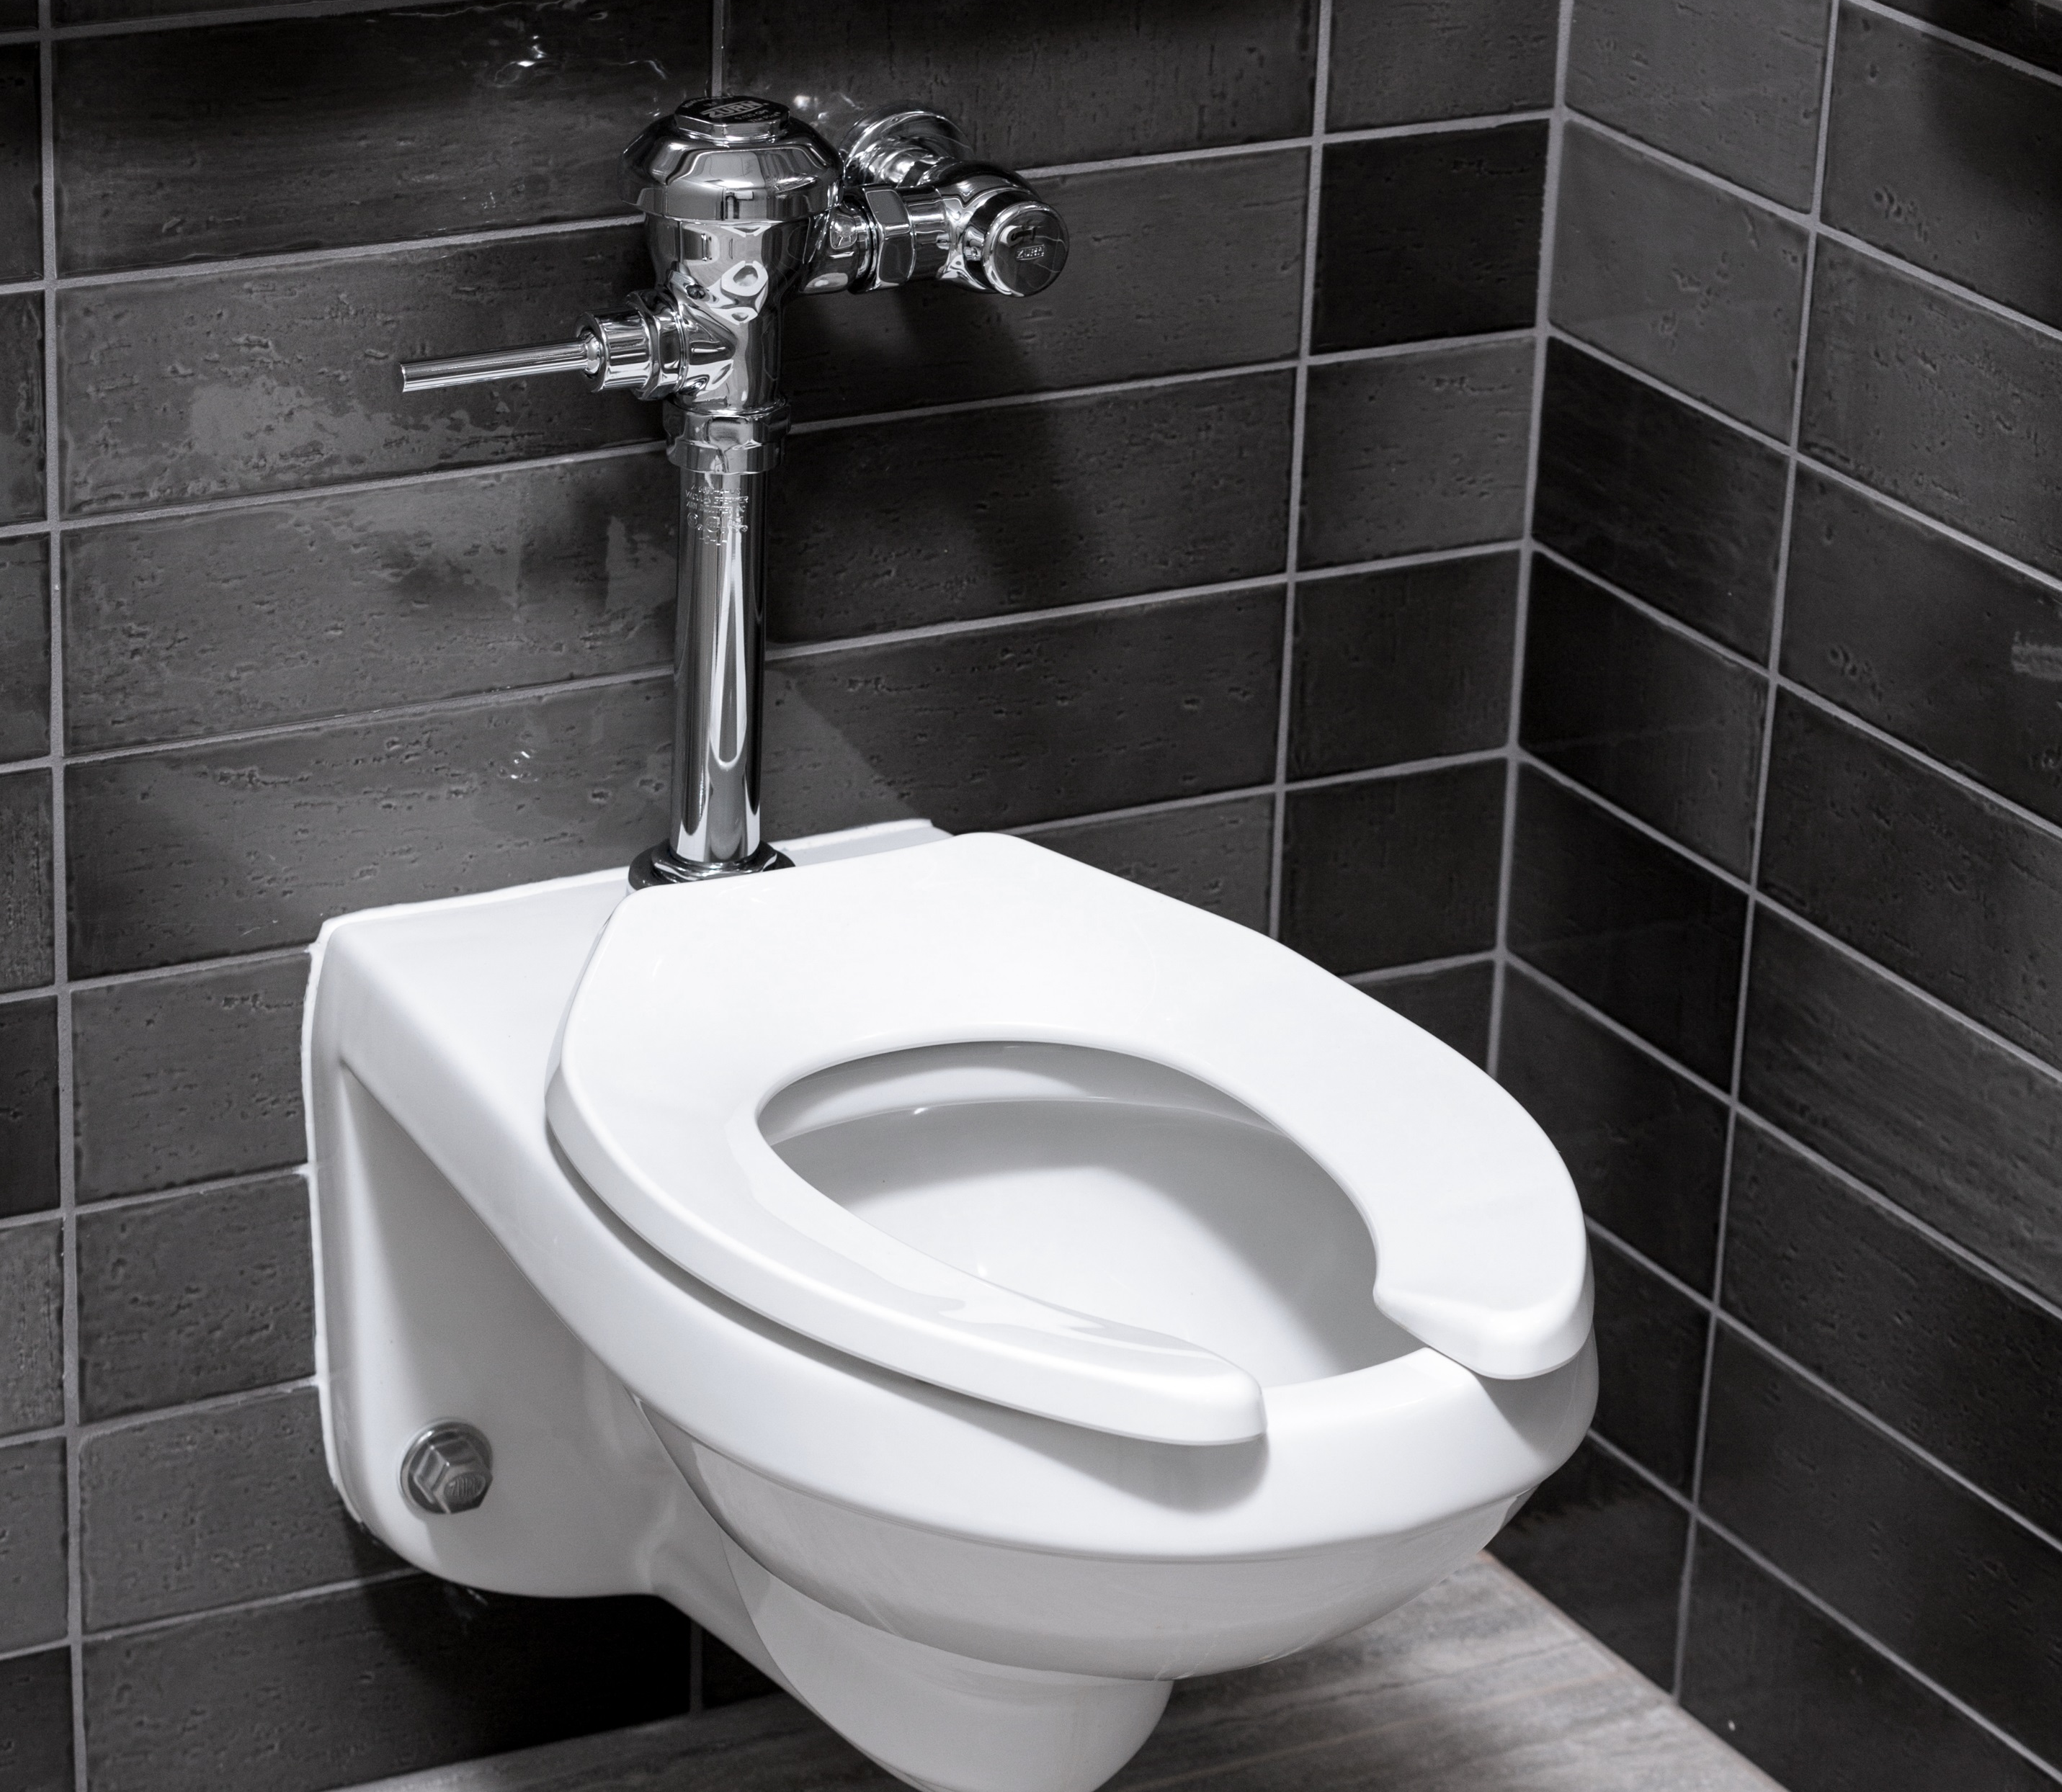
Test Your Knowledge
What are Zurn flush valves’ top 3 benefits?
A. Proprietary alloy
Chemically resistant TPE diaphragms
Water conservation
Ease of installation and maintenance

Slide 24
how to specify step-by-step
1
type
sensor or manual
2
application
diaphragm or piston
3
flow rate

Slide 25
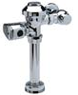
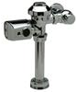
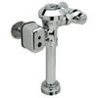
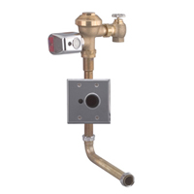
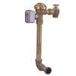
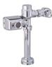
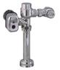
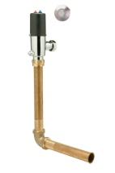
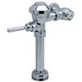
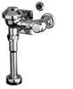
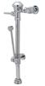
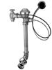
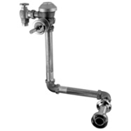
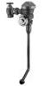
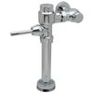
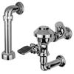
design & specify flush valves
FLUSH VALVES | DIAPHRAGM |  |  |  |  |  |  |  | PISTON
 | Preferred choice for high pressure systems; accommodates quick recovery to immediately flush again |  |  |  |  |  |  |  | Preferred choice in low pressure situations; value-driven price
 | Exposed |  |  | Exposed | Concealed |  | Exposed | Concealed | Exposed |  |  | Concealed
 | 6000 Series |  |  | 6100 Series |  |  | 6300 Series | 6600 Series | 6200 Series |  |  | 6800 Series
Sensor Hygienic, hands-free Less excessive flushing | ZR600_ Solenoid/Battery | ZER600_ Gear/Battery | ZEMS/IS600_ Hardwire integrated or wall plate | ZH61_ _ Hydraulic | ZER6100_ Gear/Battery | ZEMS6100_ Hardwire integrated or wall plate |  |  | ZER620_ Exposed battery | ZEM/IS620_ Hardware integrated or wall plate | ZTR620_ Battery or hardwire | ZP680_ Penal Battery or hardwire
 | Toilet 1.1, 1.6 Urinal 1.0 | Toilet 1.1, 1.28, 1.6 Urinal .125, .5, 1.0 | Toilet 1.28, 1.6 Urinal .5, 1.0 | Toilet 1.1, 1.6 Urinal .125, .5, 1 | Toilet 1.1, 1.28, 1.6 Urinal .125, .5, 1.0 | Toilet 1.1, 1.28, 1.6 Urinal .125, .5, 1.0 |  |  | Toilet 1.28, 1.6 Urinal .5, 1.0 | Toilet 1.1, 1.28, 1.6 Urinal .125, .5, 1.0, 1.28 | Toilet 1.1, 1.28, 1.6 Urinal .125, .5, 1.0 | Toilet 1.28, 1.6
Manual Lower price point | Z600_ AV/PL/AF | ZH600_ Hydraulic | Z600_BWN Bedpan | ZH61_ _ Hydraulic | Z61_ _ |  | Z630_ Foot Pedal | ZH660_ Hydraulic, Penal | Z600_ PL
 | Toilet 1.1, 1.28,1.6, 3.5 Urinal .125, .5, 1.0 | Toilet 1.6, 3.5, 4.5 | Toilet 1.28, 1.6 Sink 6.5 | Toilet 1.6 | Toilet 1.1, 1.28, 1.6 Urinal .125, .5, 1.0 |  | Toilet 1.6 Urinal 1.0 | Combination Toilet & Sink 1.6 Toilet 1.6 Urinal 1.0 | Toilet 1.28, 1.6 Urinal .5, 1.0

Slide 26
Test Your Knowledge
Place the following specify steps in the correct order:
A. Application
B. Type
C. Flow Rate

Slide 27
design & specify tools
Create unlimited configurations
Solidify your basis of design
Generate your submittal package
Edit, share and copy projects
Zurn.com tools
inSpec | Create configurations, solidify your basis of design, generate your submittal package, edit/share/copy projects
Manufacturer Cross Reference | Select a manufacturer, then product, type, or competitor product number to find the corresponding Zurn Product
ARCAT | Review CAD, BIM, and spec files
MasterSpec | Review spec files
BIM/Revit Files | Browse BIM objects
Cross Reference Guides | Review cross reference guides for individual products
Product Warranties | Review One Zurn terms and conditions

Slide 28
summary Zurn overview
For more than a century, Zurn Engineered Water Solutions® has established itself as an innovator and leading manufacturer of highly engineered water product solutions.
Markets We Serve
Zurn Engineered Water Solutions is a recognized leader in commercial, municipal, and industrial markets, delivering sustainable building solutions for new construction and retrofit applications.
Industry Leading Product Lines
The Zurn product offering includes items such as specification drainage products, manual and sensor operated flush valves, radiant heating systems, snow melt systems, trench drain systems, backflow and fire protection systems, and much, much more.
Solutions We Provide
At Zurn we are committed to providing smart solutions that save time and money. Our goal is serving the customer through innovation, continuous improvement, and assurance behind every installation.
One Choice. One Zurn.
Choose Zurn for a reliable, recognized manufacturer to supply your entire installation, from behind the wall rough-in, to finished trim product and fixture systems.

Slide 29
resources support
address
phone
online
511 Freshwater Way
Milwaukee, WI 53204
toll-free 1-855-ONE-ZURN
zurn.com
Product Pages | Tools, Specifications, & Resources | Vertical Market Solutions
inSpec | Manufacturer Cross Reference | ARCAT | MasterSpec | SpecBuilder |
Specifiers | BIM/Revit Files
zurn.com/resources/product-training
Zurn Product - Overview
How to Install and Support
facebook.com/ZurnIndustries
twitter.com/ZurnIndustries
linkedin.com/company/ZurnIndustries
youtube.com/ZurnIndustriesLLC

