Slide 1
Zurn Lavatories & Sinks - Overview
November 12, 2018

Slide 2
agenda what you’ll learn
01
value proposition
02
features & benefits
03
design & specify
04
summary
05
resources

Slide 3
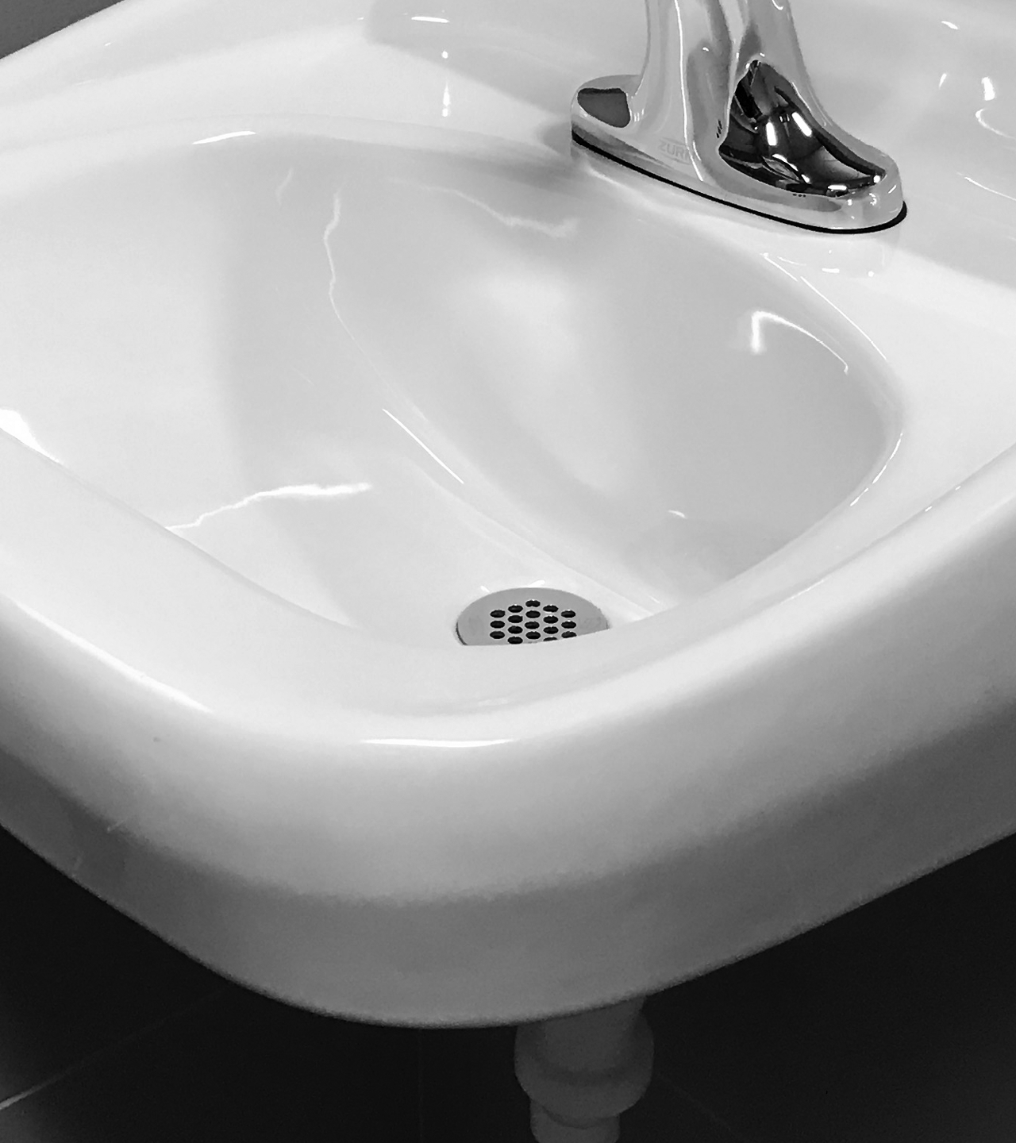
Z5340 series lavatory
For building owners, architects, and engineers,
Zurn Industries designs lavatories & sinks that deliver high functionality, durability, cleanliness, and water containment for a wide array of uses in commercial environments

Slide 4
voice of customer industries
building owner
architect & engineer
contractor
“I need products that are aesthetically pleasing, durable and have a low total cost of ownership + require minimum downtime for maintenance.”
“I need products that are aesthetically pleasing, durable and cost-effective.”
“I need products that are easy and cost-effective to install and maintain, that are assembled and packaged in a manner that streamlines labor.”
Healthcare | Retail | Food Service | Hospitality | Restaurants | Institutional/Education | Government

Slide 5
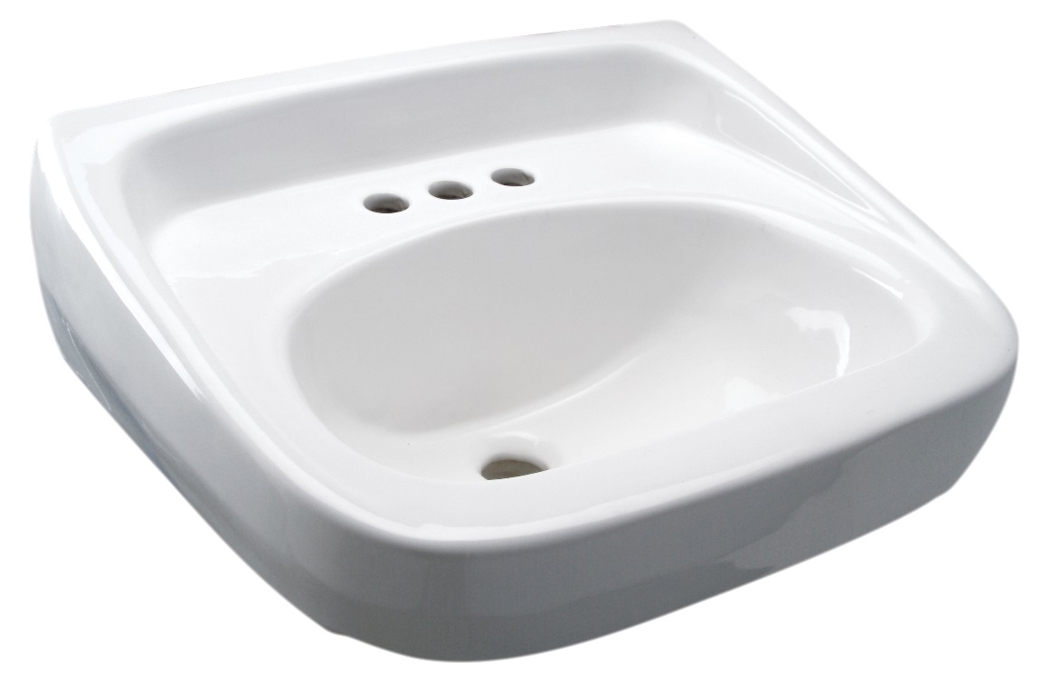
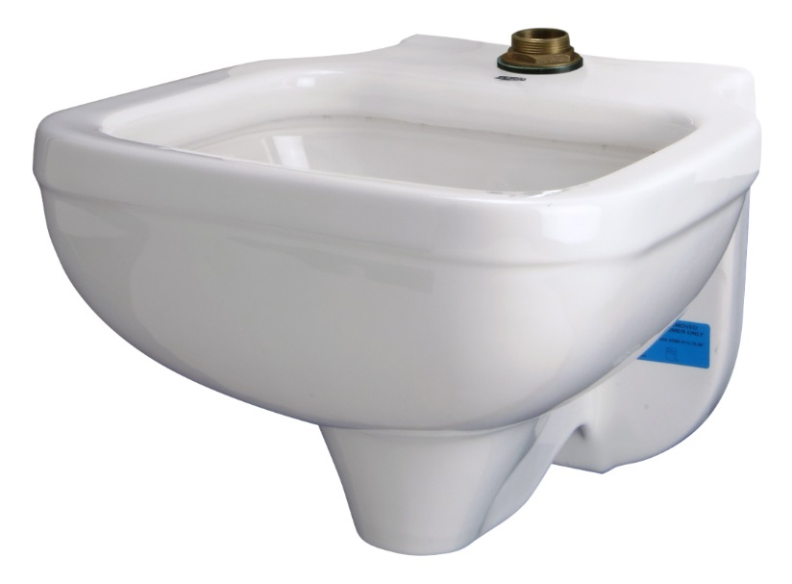
features & benefits lavatories & sinks
lavatories & sinks
Zurn’s lavatories and sinks, paired with Zurn’s faucets and carriers as a Zurn One system, deliver high functionality, cleanliness, and water containment.
Lavatory = for washing human hands/faces
Sink = for washing non-human items such as mops and other cleaning tools, bedpans, and bedsheets.

Slide 6
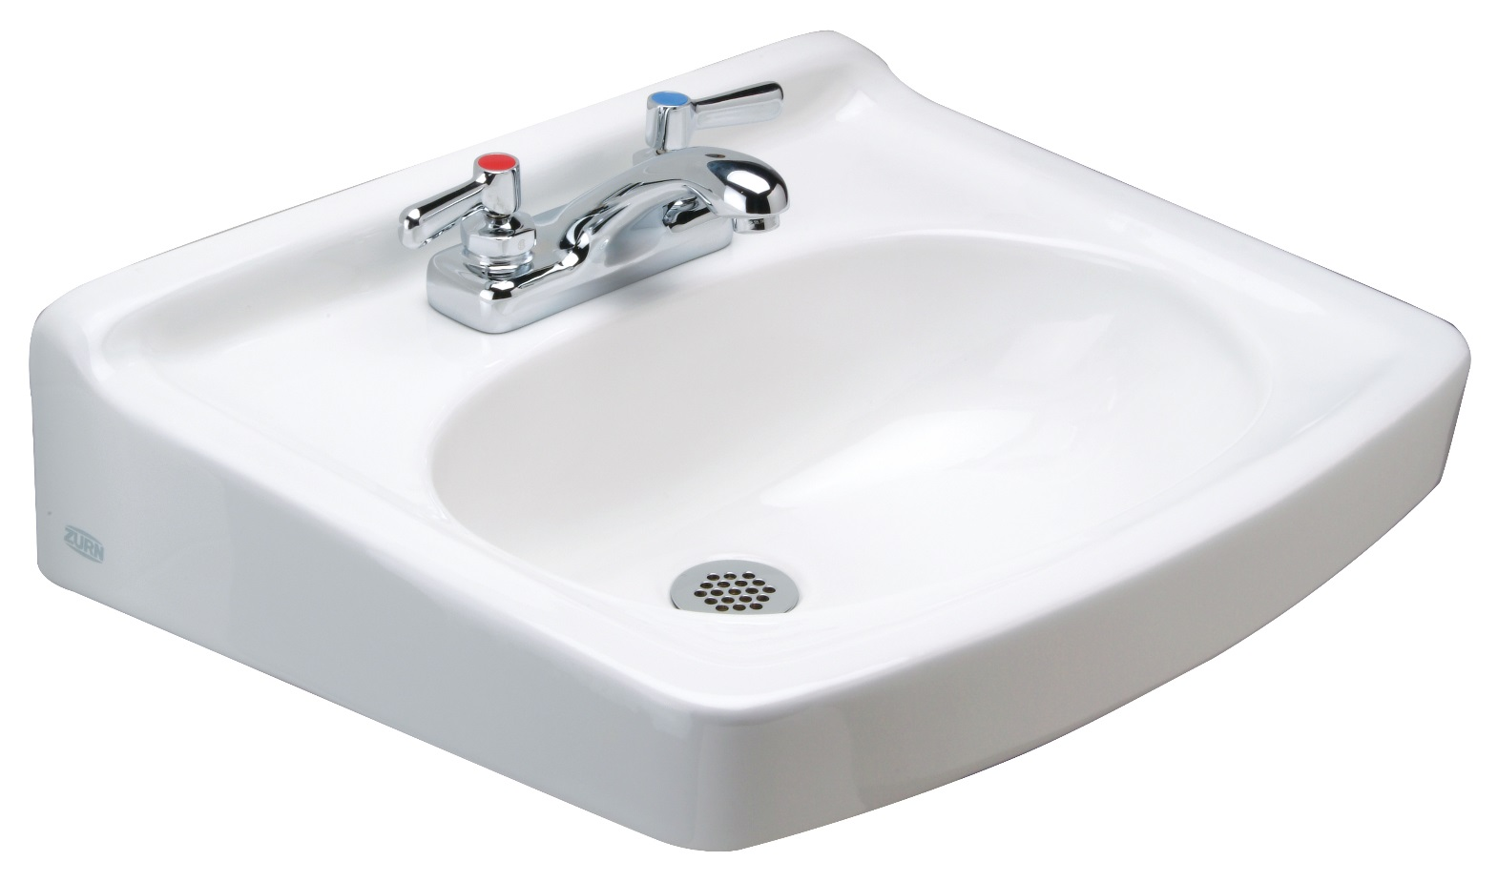
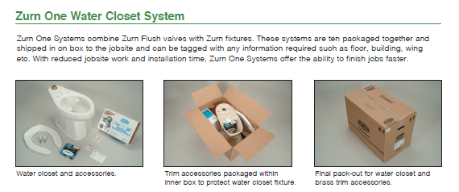
features & benefits lavatories & sinks
Zurn One complete sink systems
Zurn is the first manufacturer to engineer and pair sinks, faucets, tubular brass, and carrier systems to optimize water flow + achieve ease of procurement, installation, and servicing
Floor – Floor-Mount – Wall-Mount
key features
Z5354 wall mount lavatory, with manual faucet
Vitreous china products – nonporous, acid-resistant
Cast iron products – heavy duty, highly durable
Meets all ANSI/ASME and CAN/CSA industry standards
For new and retrofit applications
Abilene, Texas – main point for Zurn One processing, pack out, and shipment

Slide 7
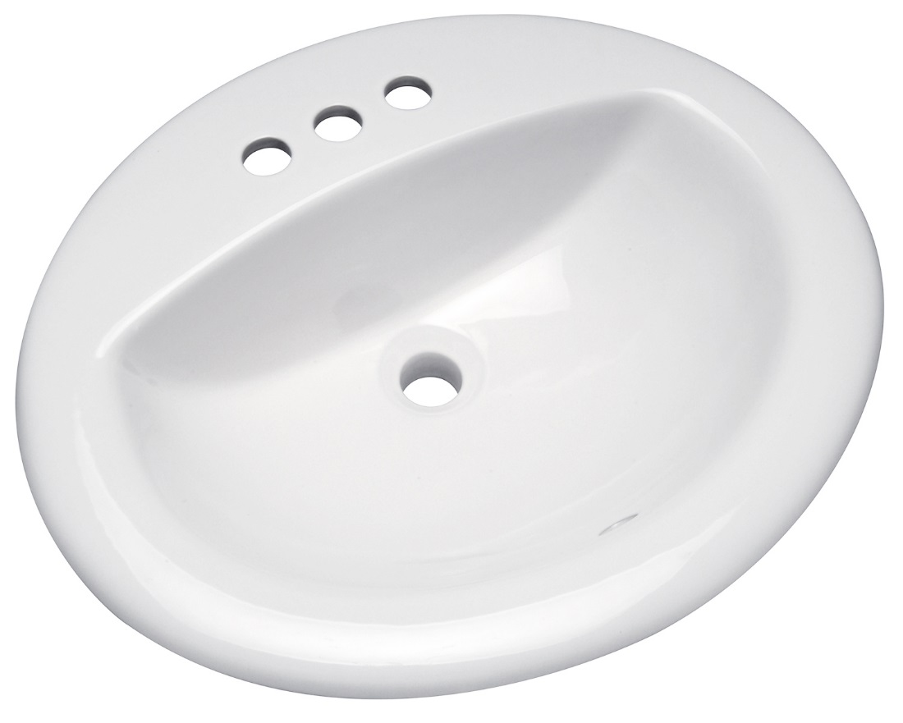
features & benefits lavatories, hands/face washing
Z5344 wall-mount lavatory
wall-mount lavatories
Vitreous china or cast iron
Faucet holes for single, 4” centers, 8” centers
High backsplash options
Concealed arm carrier system, exposed arm carrier system, or half pedestal
ADA designed, for wheelchair accessibility
3-year warranty
countertop lavatories
Faucet holes for single, 4” centers, 8” centers
Self-rimming with front overflow
ADA designed
Vitreous china
3-year warranty
undermount lavatory
Rimless design provides easier cleaning & maintenance
Concealed front overflow
Classic vitreous china oval design
3-year warranty
Z5114 countertop lavatory

Slide 8
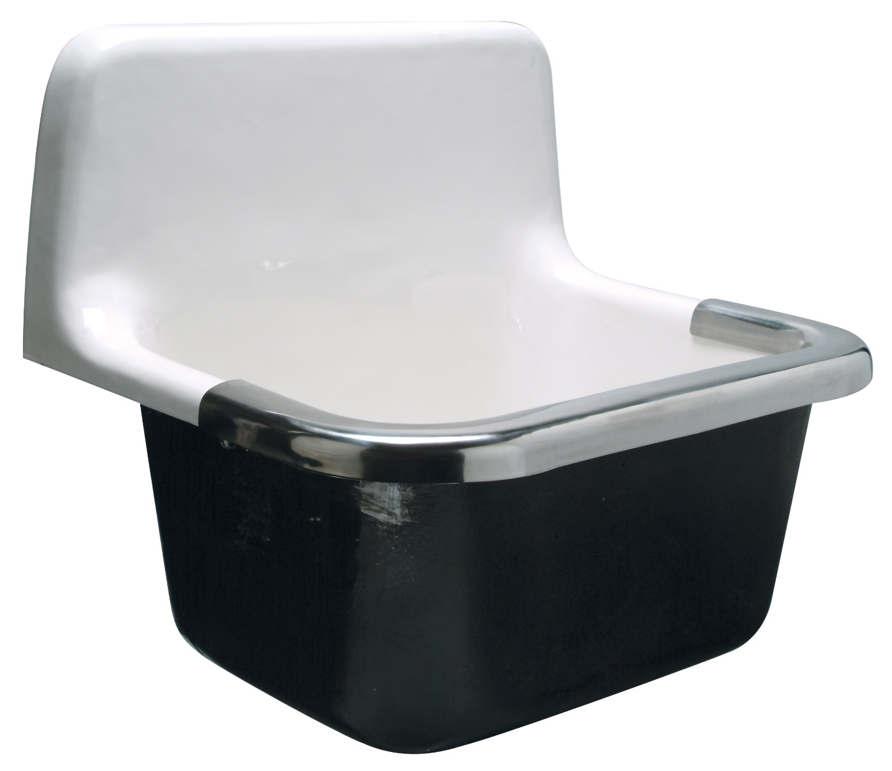
features & benefits service sinks, wall mount
Z5410
wall mount blowout service sink –
can be paired with a flush valve with a bedpan washer
blowout service sinks
For healthcare
Integral flushing rim for blowout action
Can be paired with a flush valve with a bedpan washer
Vitreous china with antimicrobial glaze
3-year warranty
general service sinks
For healthcare, schools, manufacturing…
Cast iron with stainless steel rim guard
Plain back with no faucet holes or 8” center faucet holes
Wall hanger
3-year warranty
surgeon sinks
For healthcare
Vitreous china with antimicrobial glaze
Low front rim and glazed underside
Single hole or 8” faucet centers
Concealed wall hangers and support brackets
3-year warranty
Z5880 series service sink

Slide 9
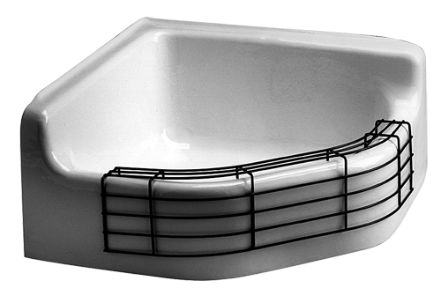
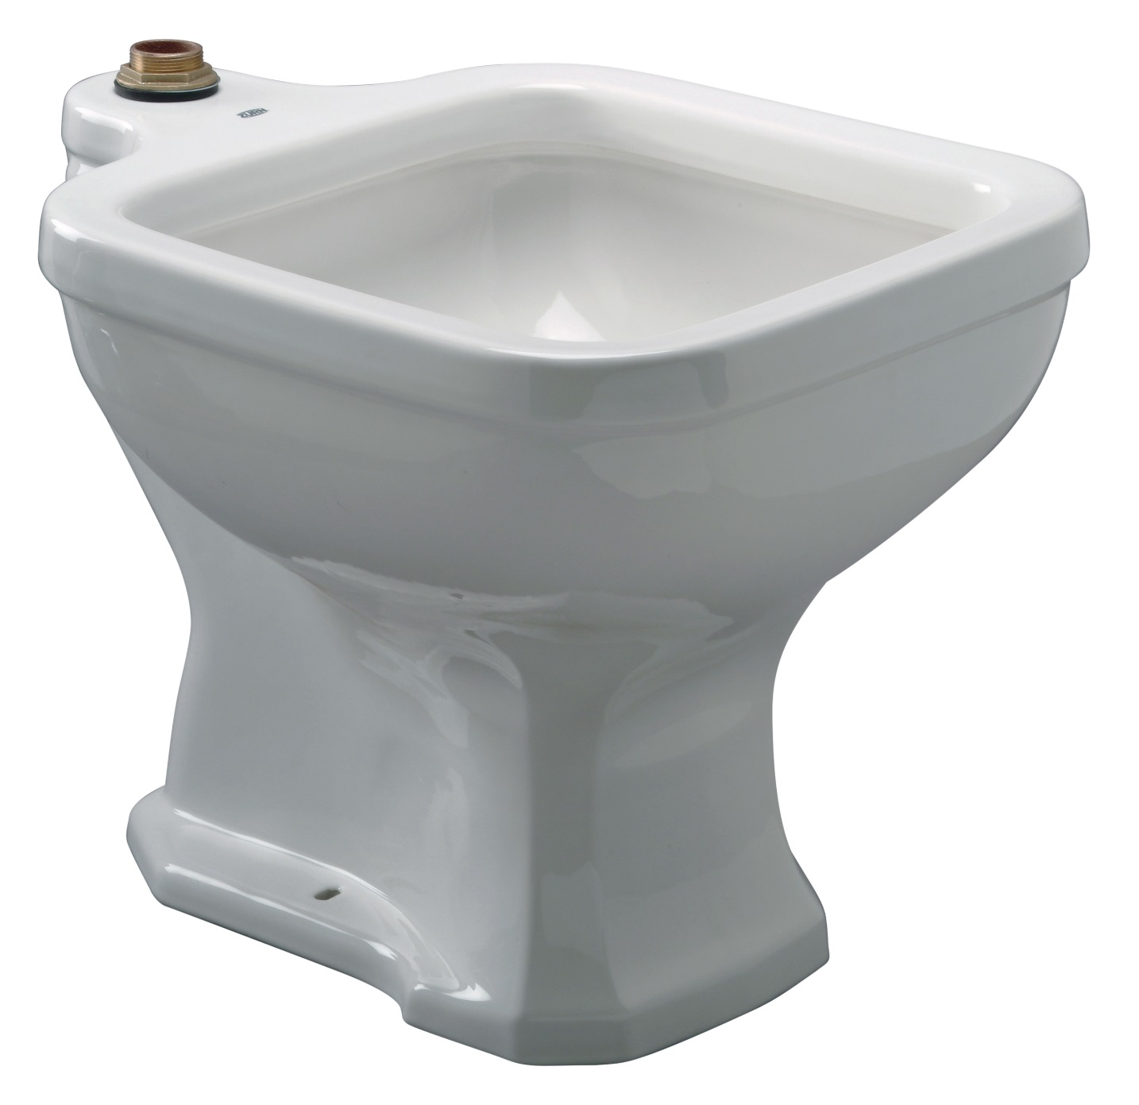
features & benefits service sinks, floor mount
Z5850
custodial floor sink
custodial floor sinks
For any company requiring mop cleanouts
Cast iron
8” high front curb
Optional rim guards
Integral tiling bead
3-year warranty
siphon jet service sinks
For healthcare
Integral flushing rim with siphon jet action
Can be paired with a flush valve with a bedpan washer
Antimicrobial glaze
3-year warranty
Z5420
siphon jet service sink - can be paired with a flush valve with a bedpan washer

Slide 10
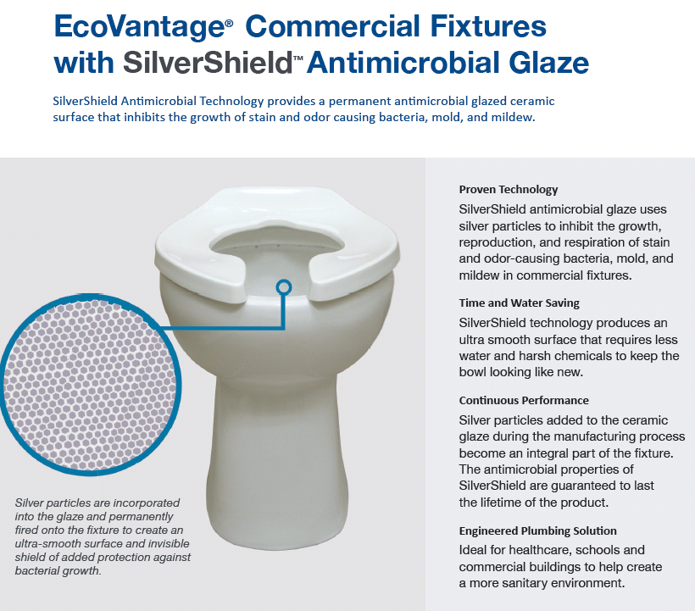
features & benefits SilverShield™ available on select Zurn fixtures

Slide 11
features & benefits questions
Do you wish for your lavatories and sinks to be highly durable? | Use Vitreous glaze china that’s nonporous and acid-resistant ADA designed | Highly Durable ADA Designed
Is ease of procurement and shipping important to you? | Design & Specify Zurn Online Specification Tools Zurn engineers and markets a complete line of lavatories, sinks, faucets, flush valves, and carriers Extensive wall-mount, floor mount, and undermount options | Zurn One Wide Product Breadth
Is ease of installation important to you? | Install New and retrofit applications | Easy Installation & Retrofit
Do you need long-term reliability with a low cost of ownership? | Support Consistent performance over the life of the product Lower cost of ownership with long-life durability 3-year warranty | Reliable Performance Lower Cost of Ownership Warranty
 |  |  |  |  |  |  | ADA

Slide 12
Test Your Knowledge
What are Zurn lavatories’ top 3 benefits?
Highly durable
Ease of installation for new and retrofit
Low lifelong cost of ownership
Shiny finish

Slide 13
how to specify step-by-step
1
lavatory or service sink
For washing hands/face or other
2
wall-mount or other
Wall-mount, countertop, undermount, or floor-mount
3
size
Various sizes and shapes
4
other options
Overflow, pediatric use, wheelchair sink, anti-microbial glaze

Slide 14
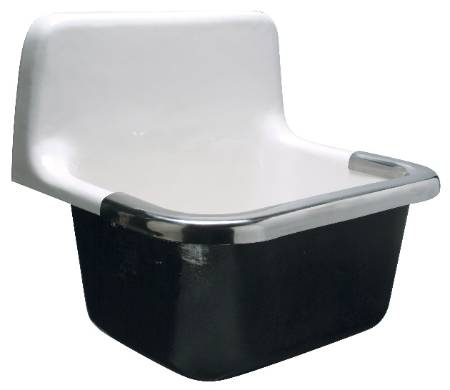
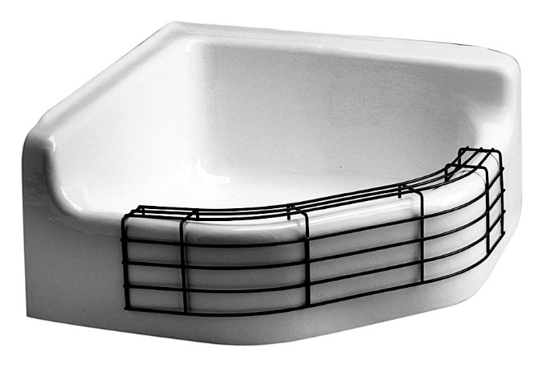
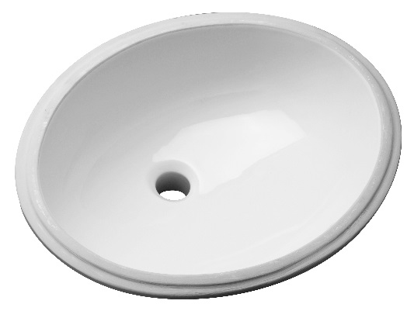
design & specify lavatories & sinks
LAVATORIES & SINKS | Lavatories – Wall-Mount | Lavatories – Countertop | Lavatories – Undermount | Service Sinks – Wall-Mount | Service Sinks – Floor-Mount
Vitreous China | Z5340 20”x18” (Ped Option) Front Overflow Z5350 19”x17” Front Overflow Z5310 20”x18” Rear Overflow Z5360 20”x18” (Ped Option) Front Overflow Z5320 20”x23”Wheel Chair Series (Ped Option) Z5830 19”x17” Front Overflow | Z5110 20”x17” Front Overflow Z5120 19” Round Front Overflow | Z5220 19”x16” Front Overflow | Z5460 28”x22” Surgeon Sink w/Antimicrobial Glaze Z5410 Blowout Service Sink w/Antimicrobial Glaze *Primarily for healthcare | Z5420 Siphon Jet Service Sink w/ Antimicrobial Glaze *Primarily for washing bedpans in healthcare
Enameled Cast Iron | Z5840 20”x18” Front Overflow Z5830 19”x17” Front Overflow | Z5810 20”x17” Self-Rimming Z5820 19” Round Self-Rimming |  | Z5880 22”x18” Z5890 24”x20” | Z5850 28”x28” Corner Custodial Sink *Primarily for washing mops

Slide 15
design & specify tools
Create unlimited configurations
Solidify your basis of design
Generate your submittal package
Edit, share and copy projects
Zurn.com tools
inSpec | Create configurations, solidify your basis of design, generate your submittal package, edit/share/copy projects
Manufacturer Cross Reference | Select a manufacturer, then product, type, or competitor product number to find the corresponding Zurn Product
MasterSpec | Review spec files
BIM/Revit Files | Browse BIM objects
Product Warranties | Review One Zurn terms and conditions

Slide 16
Test Your Knowledge
Place the following specify steps in the correct order:
A. Size
B. Lavatory or service sink
C. Other options
D. Wall-mount or other installation

Slide 17
summary what you learned
building owner
architect & engineer
contractor
Highly Durable Lower Cost of Ownership Product Warranty
Wide Breadth of Products
Consistent Performance
Single Manufacturer for Commercial Plumbing Products
Ease of Installation and Maintenance
Highly Durable
Product Warranty

Slide 18
summary Zurn overview
For more than a century, Zurn Engineered Water Solutions® has established itself as an innovator and leading manufacturer of highly engineered water product solutions.
Markets We Serve
Zurn Engineered Water Solutions is a recognized leader in commercial, municipal, and industrial markets, delivering sustainable building solutions for new construction and retrofit applications.
Industry Leading Product Lines
The Zurn product offering includes items such as specification drainage products, manual and sensor operated flush valves, radiant heating systems, snow melt systems, trench drain systems, backflow and fire protection systems, and much, much more.
Solutions We Provide
At Zurn we are committed to providing smart solutions that save time and money. Our goal is serving the customer through innovation, continuous improvement, and assurance behind every installation.
One Choice. One Zurn.
Choose Zurn for a reliable, recognized manufacturer to supply your entire installation, from behind the wall rough-in, to finished trim product and fixture systems.

Slide 19
resources support
address
phone
online
511 Freshwater Way
Milwaukee, WI 53204
toll-free 1-855-ONE-ZURN
zurn.com
Product Pages | Tools, Specifications, & Resources | Vertical Market Solutions
inSpec | Manufacturer Cross Reference | ARCAT | MasterSpec | SpecBuilder |
Specifiers | BIM/Revit Files
zurn.com/resources/product-training
Zurn Product - Overview
How to Install and Support
facebook.com/ZurnIndustries
twitter.com/ZurnIndustries
linkedin.com/company/ZurnIndustries
youtube.com/ZurnIndustriesLLC

