Slide 1
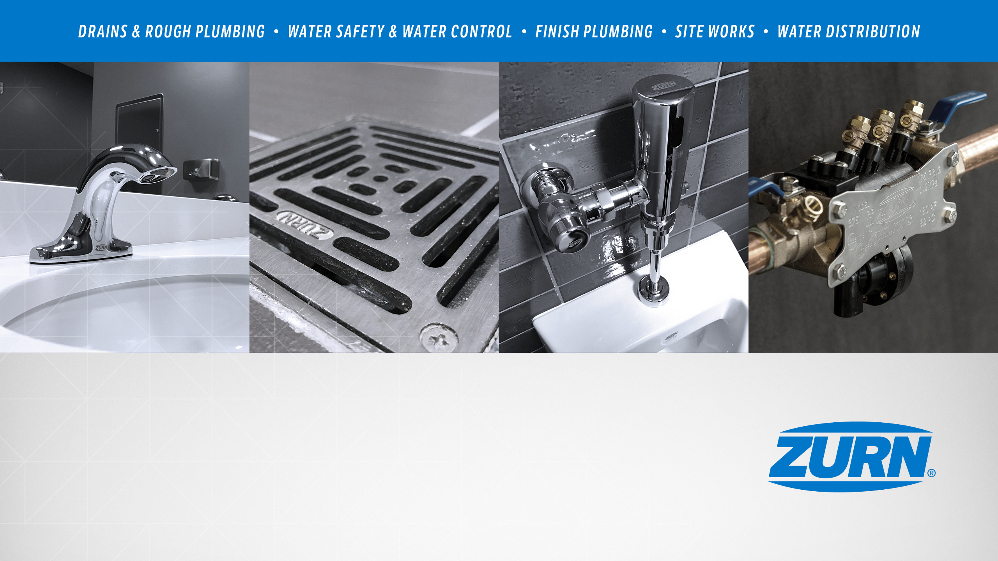
Zurn New Product Launches
April 2019
Notes:
Cassandra Wurster

Slide 2
agenda what you’ll learn
01
past launches
02
present launches
Backflow prevention - 400ST n-Pattern series, USC update
Marketing update
Zurn Wilkins Parts Simplification - individual parts to repair kits
Faucets - EZ Gear-Driven Sensor Faucets
Connected - flood control systems, flush valves, faucets
World Dryer - Vmax V2 hand dryers
inSpec
Erie Test Lab
Jon Everett Training Center
03
future launches
04
resources
Fire valves - ZW5000 Pressure-Tru field adjustable fire valves
Floor Sinks - polymer
inSpec
Product training
Notes:
Cassandra Wurster

Slide 3

past launches
April 2019
Notes:
Cassandra Wurster

Slide 4
past launches backflow prevention
Notes:
Nicole Raftery

Slide 5
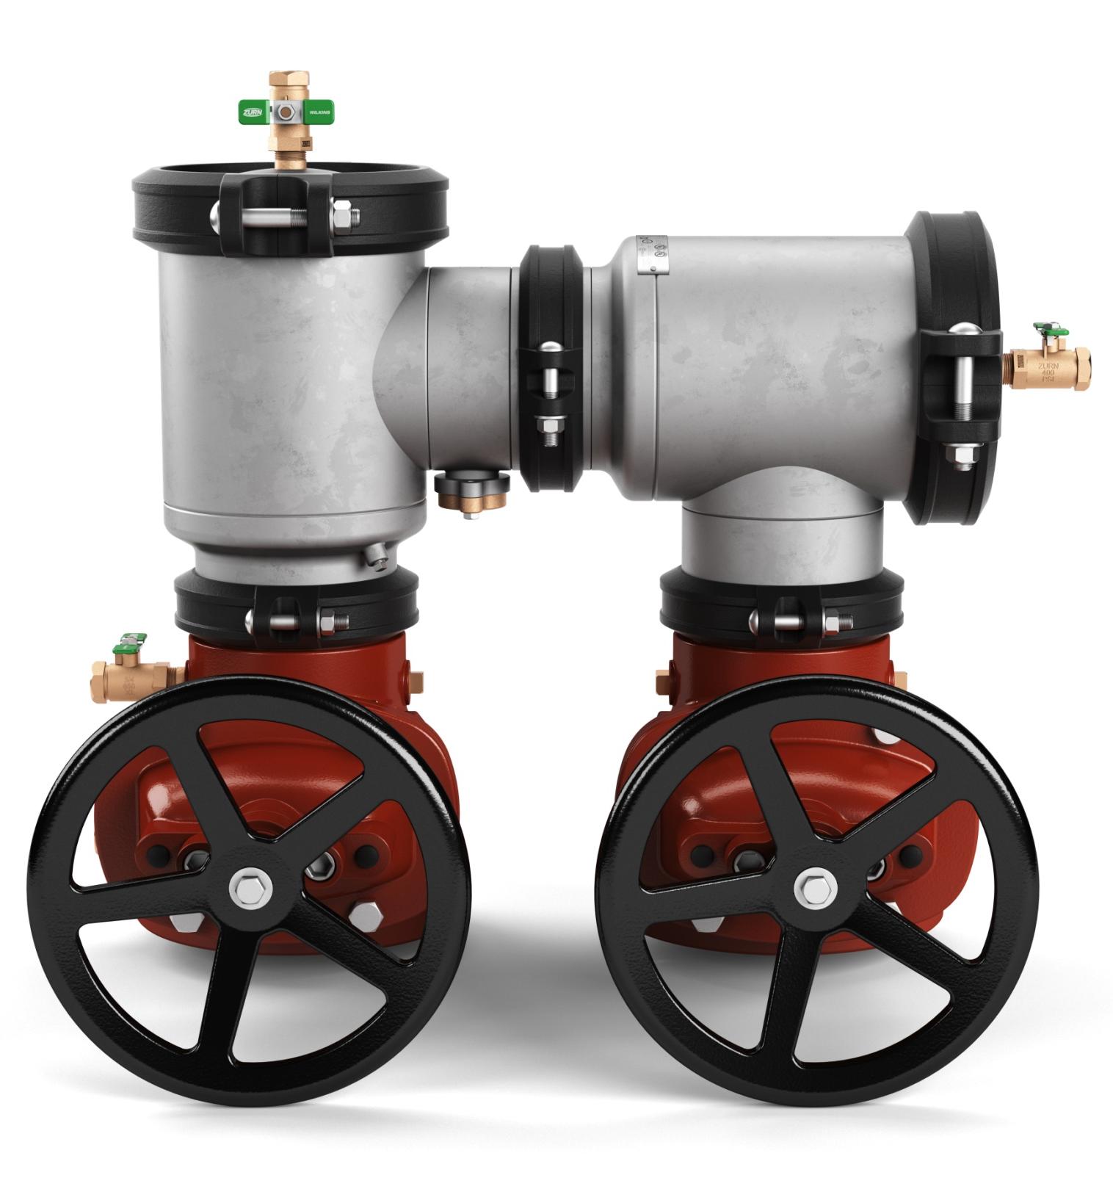
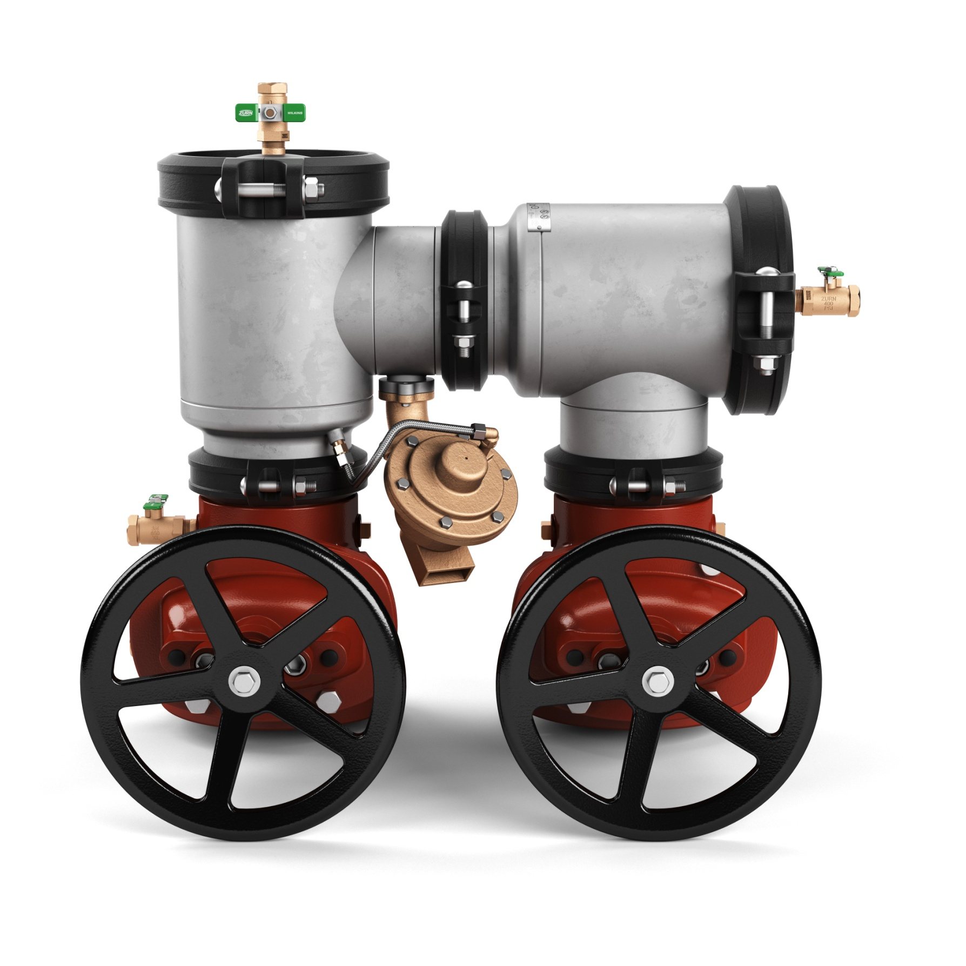
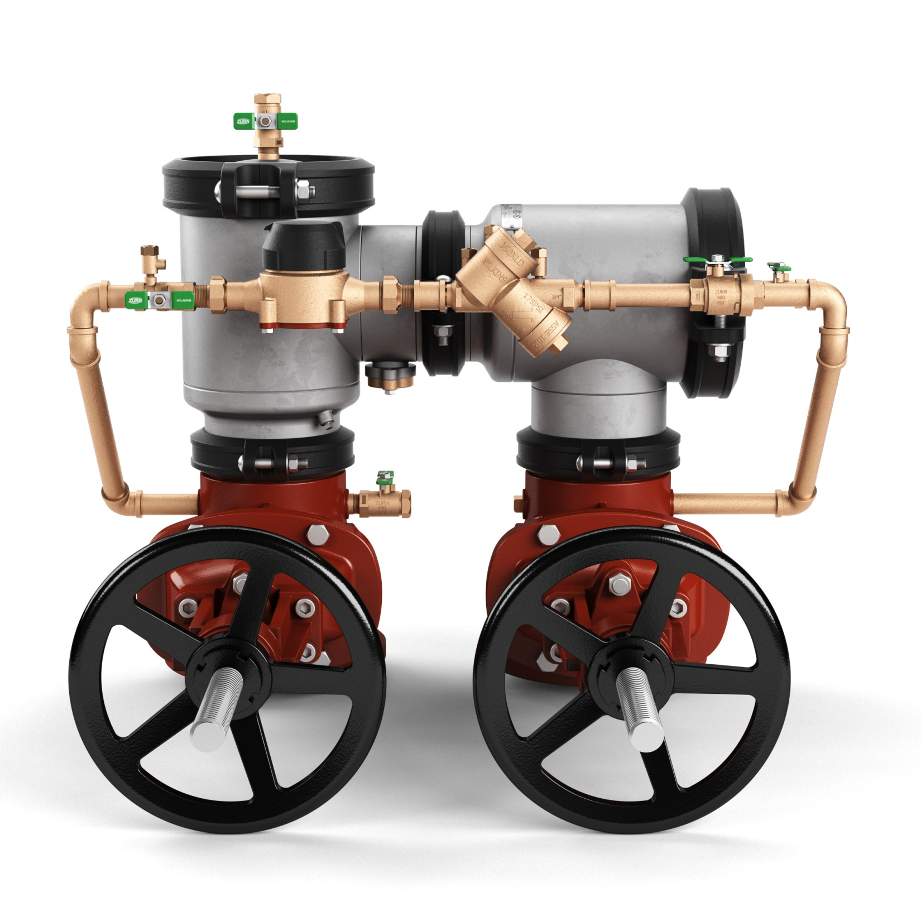
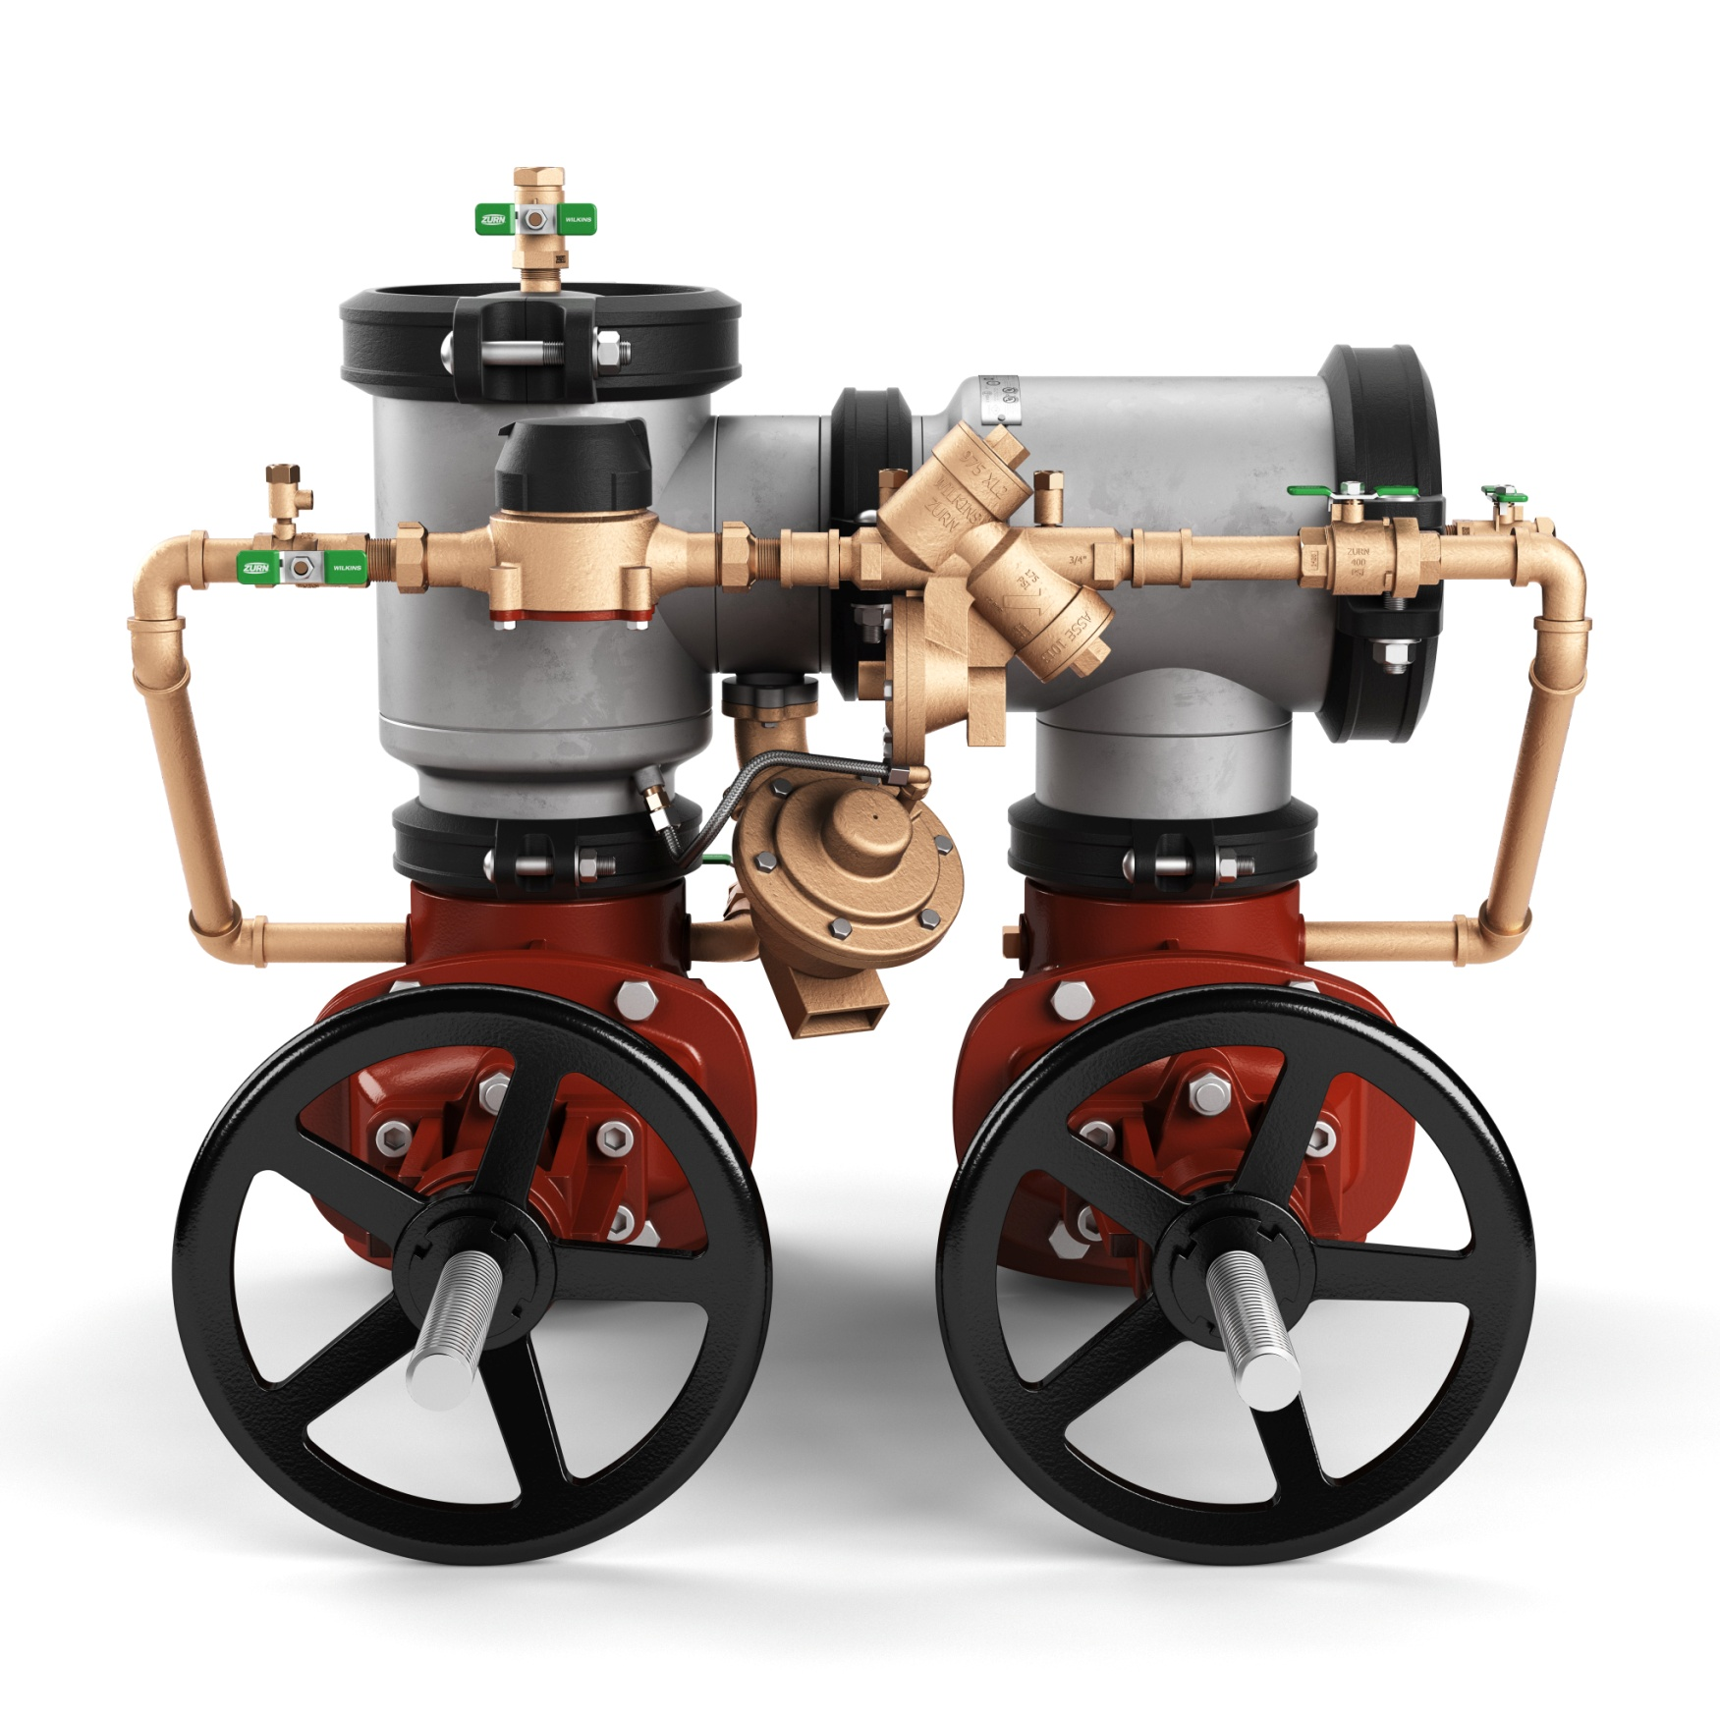
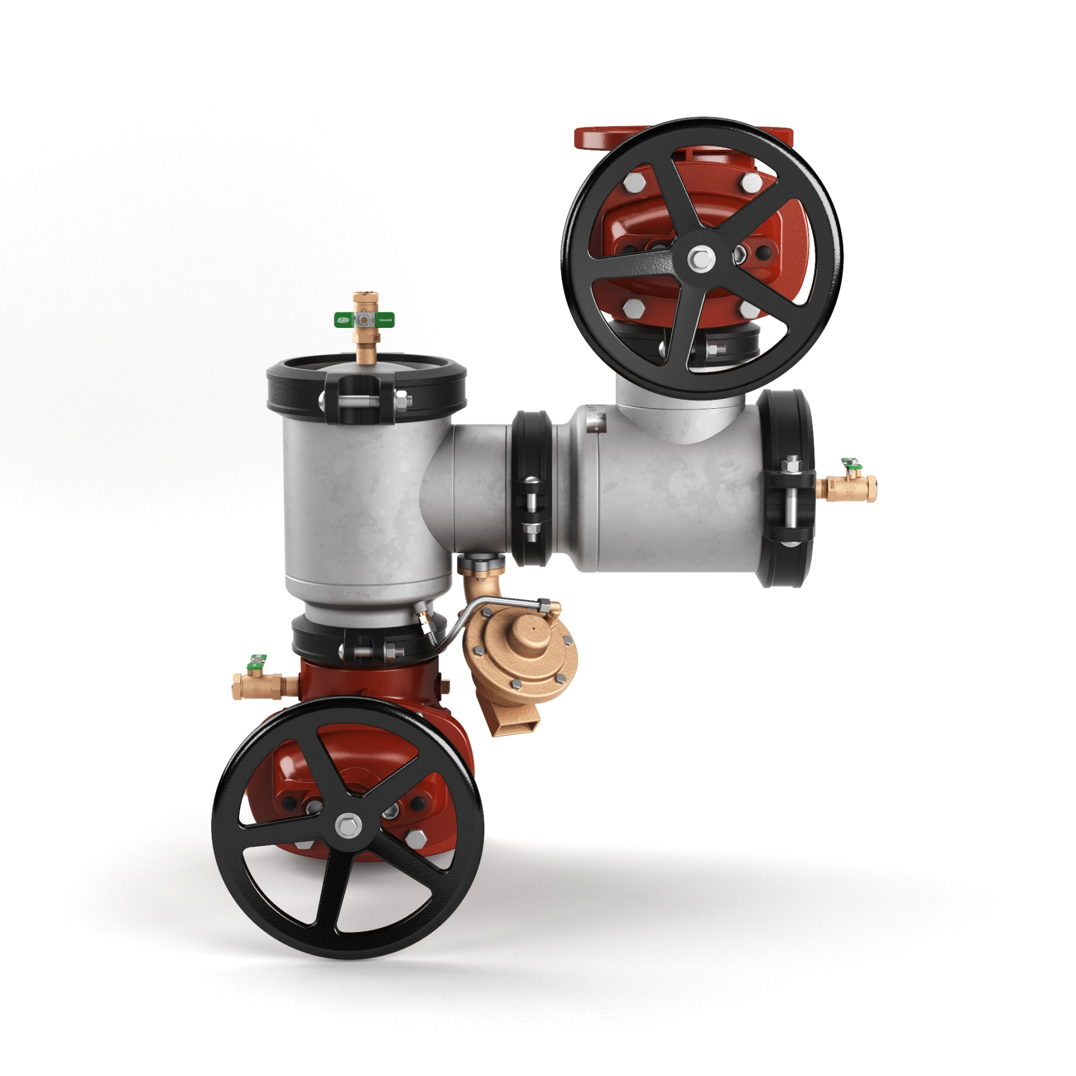
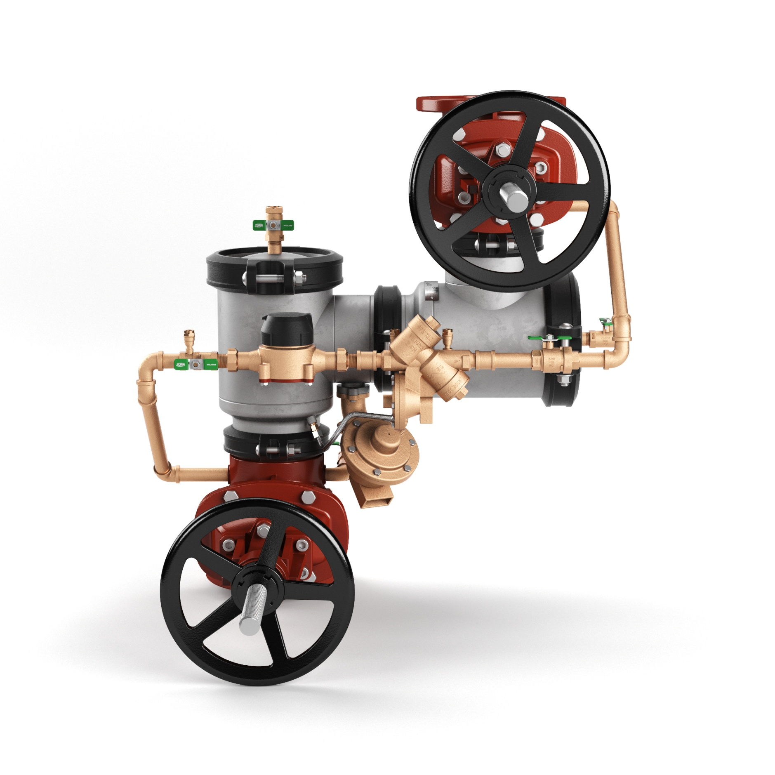
past launches backflow prevention
400ST n-Pattern Series (USC launch)
USC approved on all size and types!
Same internal components as the Zurn Wilkins 300 and 400 series ductile iron n-Pattern – field tested and proven for 18+ years
Drop-in-replacement for the Febco n-Pattern
Smaller footprint – new ductile iron setters to fit tighter center line dimensions
Includes R replacements of Zurn Wilkins 400 series ductile iron n-Pattern
description
Stainless steel body (corrosion resistant body and cover)
Sizes: 4” – 10”
Types: DC (double check), RP (reduced pressure), DCDA (double check detector assembly), RPDA (reduced pressure detector assembly)
2:52 Video:
Zurn Backflow Prevention 400ST n-Pattern
Notes:
Nicole Raftery
Drop-in replacement for the Febco n-Pattern
Launched October 2017 in ASSE territories,
Sales are growing, including in USC only territories
Fantastic product video available on zurn.com and OneZurn Youtube channel – use it as a sales and specification tool (reinforce that all attendees should subscribe to the channel)

Slide 6
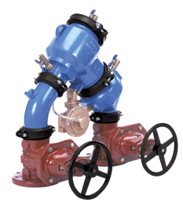
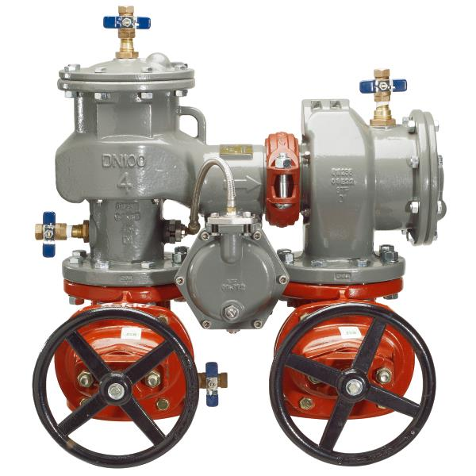
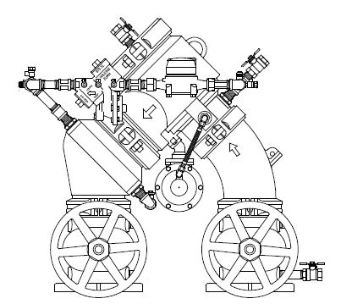
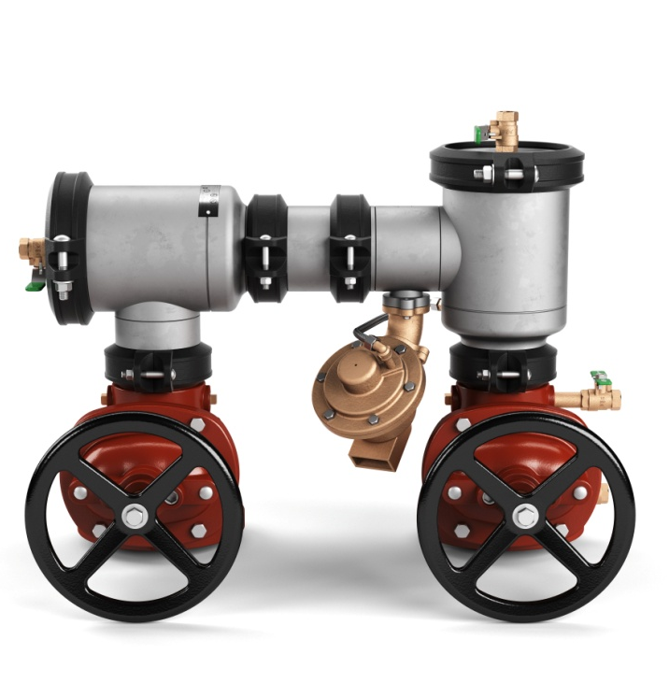
past launches replacement field conversion
Febco 880
Zurn Wilkins 400 Series
compliance and approvals
It is ideal to stock 475ST for new construction and Febco replacements and to stock the 475STR for Zurn Wilkins ductile replacements
Field conversion invalidate our approvals and should be avoided
Field conversions must be approved by the authority having jurisdiction over backflow installation
conversion kits
Conversions may require flipping the gate valve, an elbow to rotate the relief valve, and a new sensing line
ST to STR | STR to ST
RK4-475STR-RVELBOW | RK4-475ST-RVELBOW
RK6-475STR-RVELBOW | RK6-475ST-RVELBOW
RK8-475STR-RVELBOW | RK8-475ST-RVELBOW
RK10-475STR-RVELBOW | RK10-475ST-RVELBOW
Model 475ST
Replaces Febco
Model 475STR
Replaces Zurn Wilkins 400 ductile iron series
Notes:
Nicole Raftery

Slide 7
past launches marketing
Notes:
Jill Nagg

Slide 8
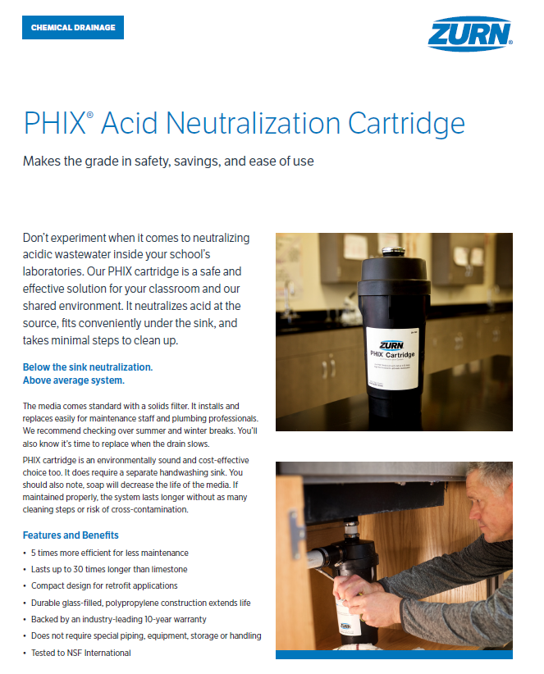
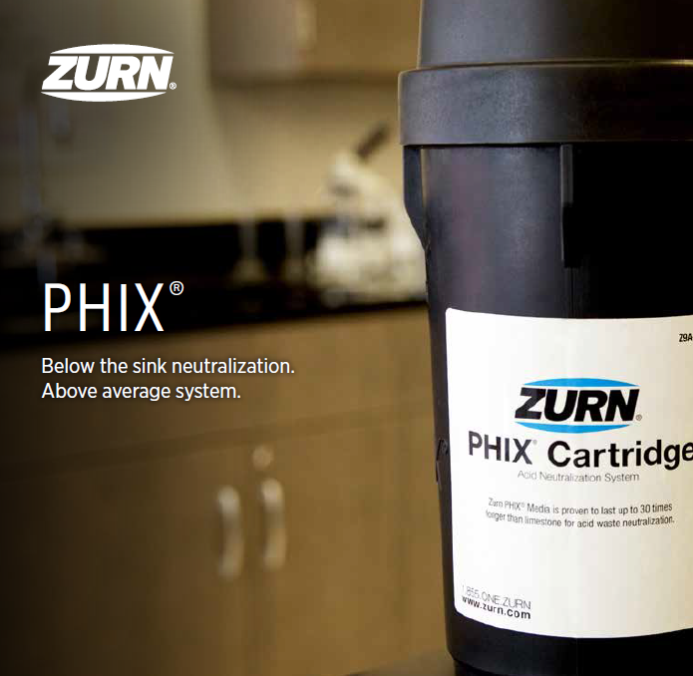
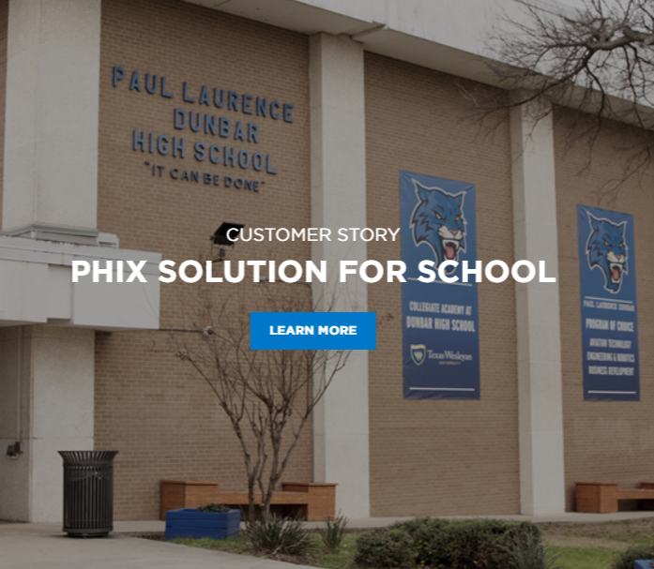
past launches marketing
PHIX
case study, brochure, sell sheet
Notes:
Jill Nagg

Slide 9

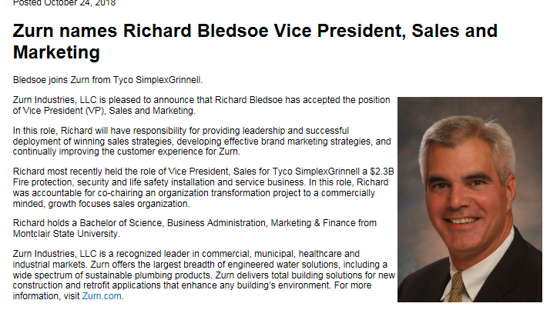
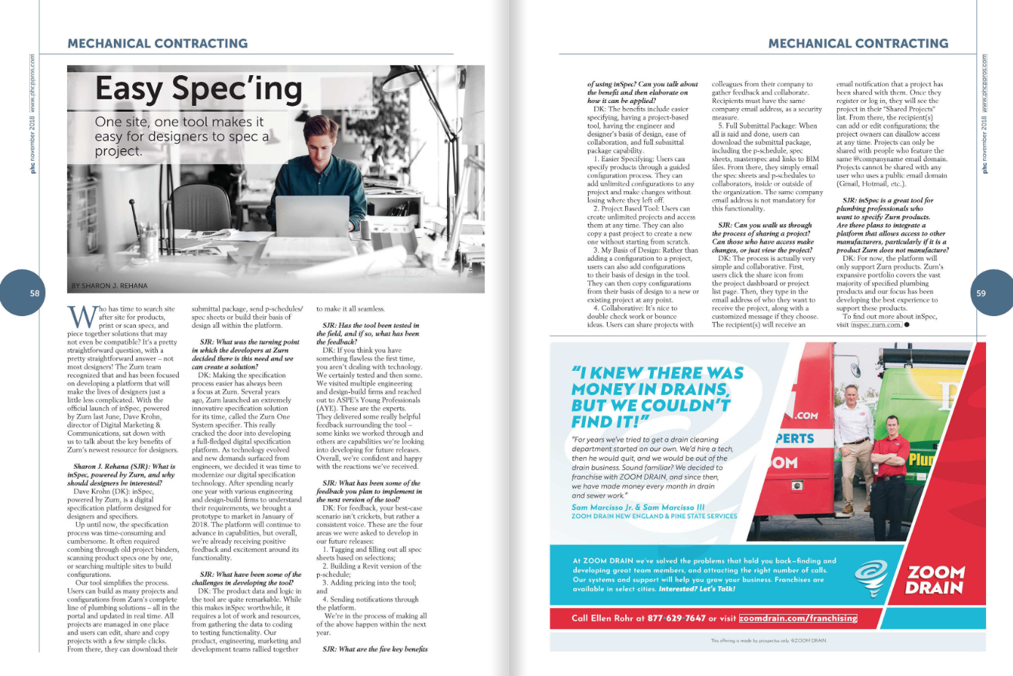
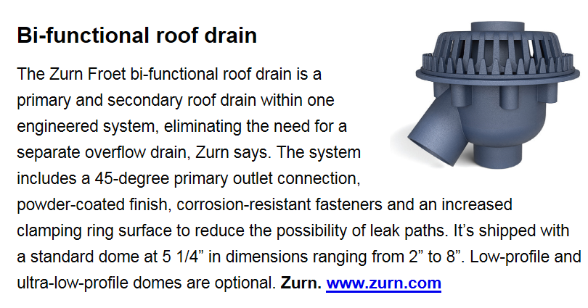
past launches public relations
Core Publication Reach 1,703,502 | Overall Mentions 472 | Overall Reach 35,943,744**
Plumbing and Mechanical
PHc News
FY18 Core Publication Press Mentions 74
FY19 Core Publication Press Mentions 116
*42 more mentions than FY18
**Adjusted
Construction Specifier
Notes:
Leslie McGowan

Slide 10
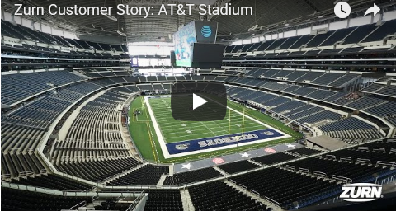
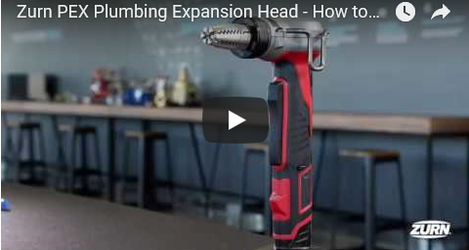
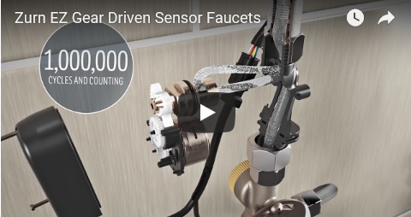
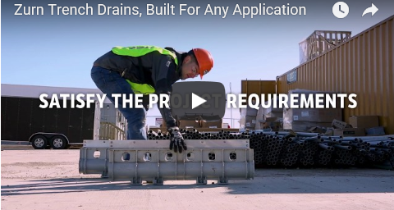
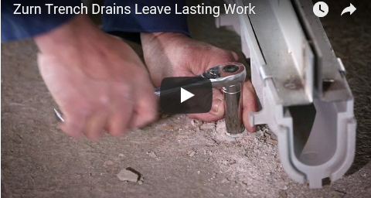
past launches videos
Notes:
Cassandra Wurster

Slide 11

present launches
April 2018
Notes:
Cassandra Wurster

Slide 12
present launches
Zurn Wilkins parts simplification
Notes:
Nicole Raftery

Slide 13
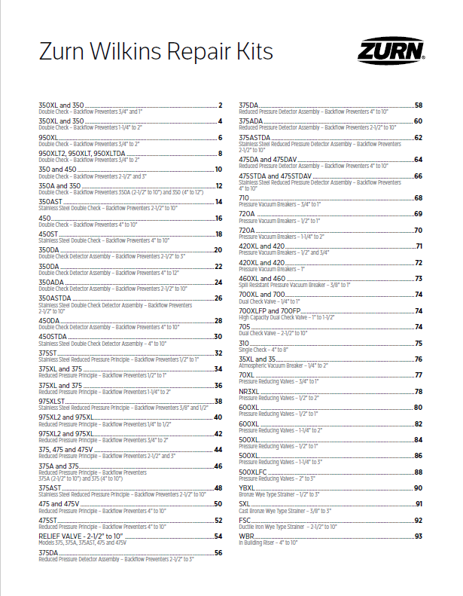
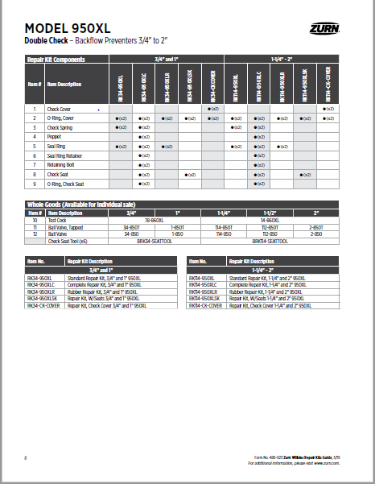
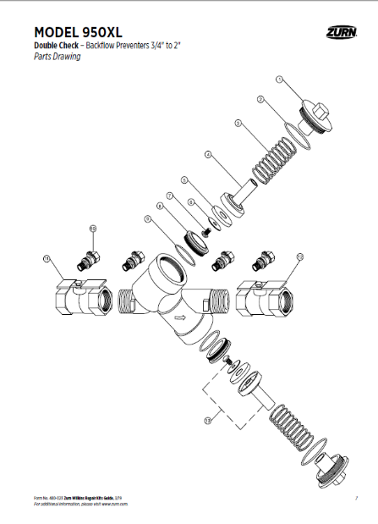
present launches
Zurn Wilkins parts simplification
from individual parts to repair kits
Overhauled 100+ pages of repair parts guide to be a repair kit guide
Continues to include parts drawings and identify parts
Consolidation of parts into specially designated repair kits
Provides an outline of all the kits that the part can be located in
Eases the stress of finding all the parts necessary to make a repair
Simplification of business transactions
available now
Zurn.com (https://www.zurn.com/media-library/web_documents/pdfs/catalogs/zmktg480-023-pdf.aspx)
Individual product pages
ZIX (Zurn Info>Literature Fulfillment>Wilkins Literature>Flyers)
Please begin to promote and move your customers to purchasing repair kits containing the parts they may need for their Zurn Wilkins products
Notes:
Nicole Raftery

Slide 14
present launches faucets
Notes:
Dan Danowski

Slide 15
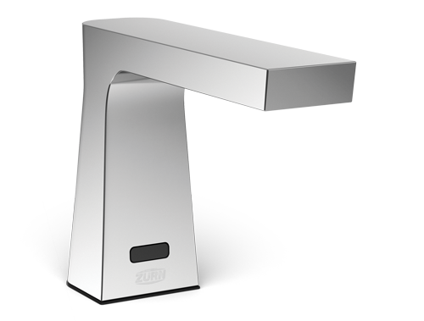
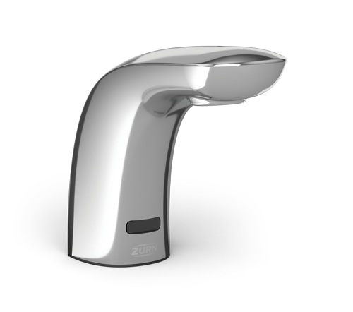
present launches faucets
EZ Gear-Driven Sensor Faucets
Reliability
    Extends the life of sensor faucets by eliminating old compression sealing technology
    Minimizes the amount of moving parts in direct contact with the water path
    Eliminates water hammer for less wear on the faucet and your entire water line system
    Withstands over 1,000,000 cycle tests thanks to AquaSpec® ceramic disc technology – backed with a limited lifetime warranty.
Precision
    Ergonomically designed for precise sensor detection for an intuitive user experience
Efficiency
    Available in low flow rates achieving EPA WaterSense compliance
Camaya Series Z6953-XL-CV
Key Features
hardwire power only -ACA or -HW6
polished chrome & brush nickel finishes
black/ brown out protection - 30 sec timeout
lead- free compliant
Cumberland Series Z6956-XL-CV
Notes:
Dan Danowski

Slide 16
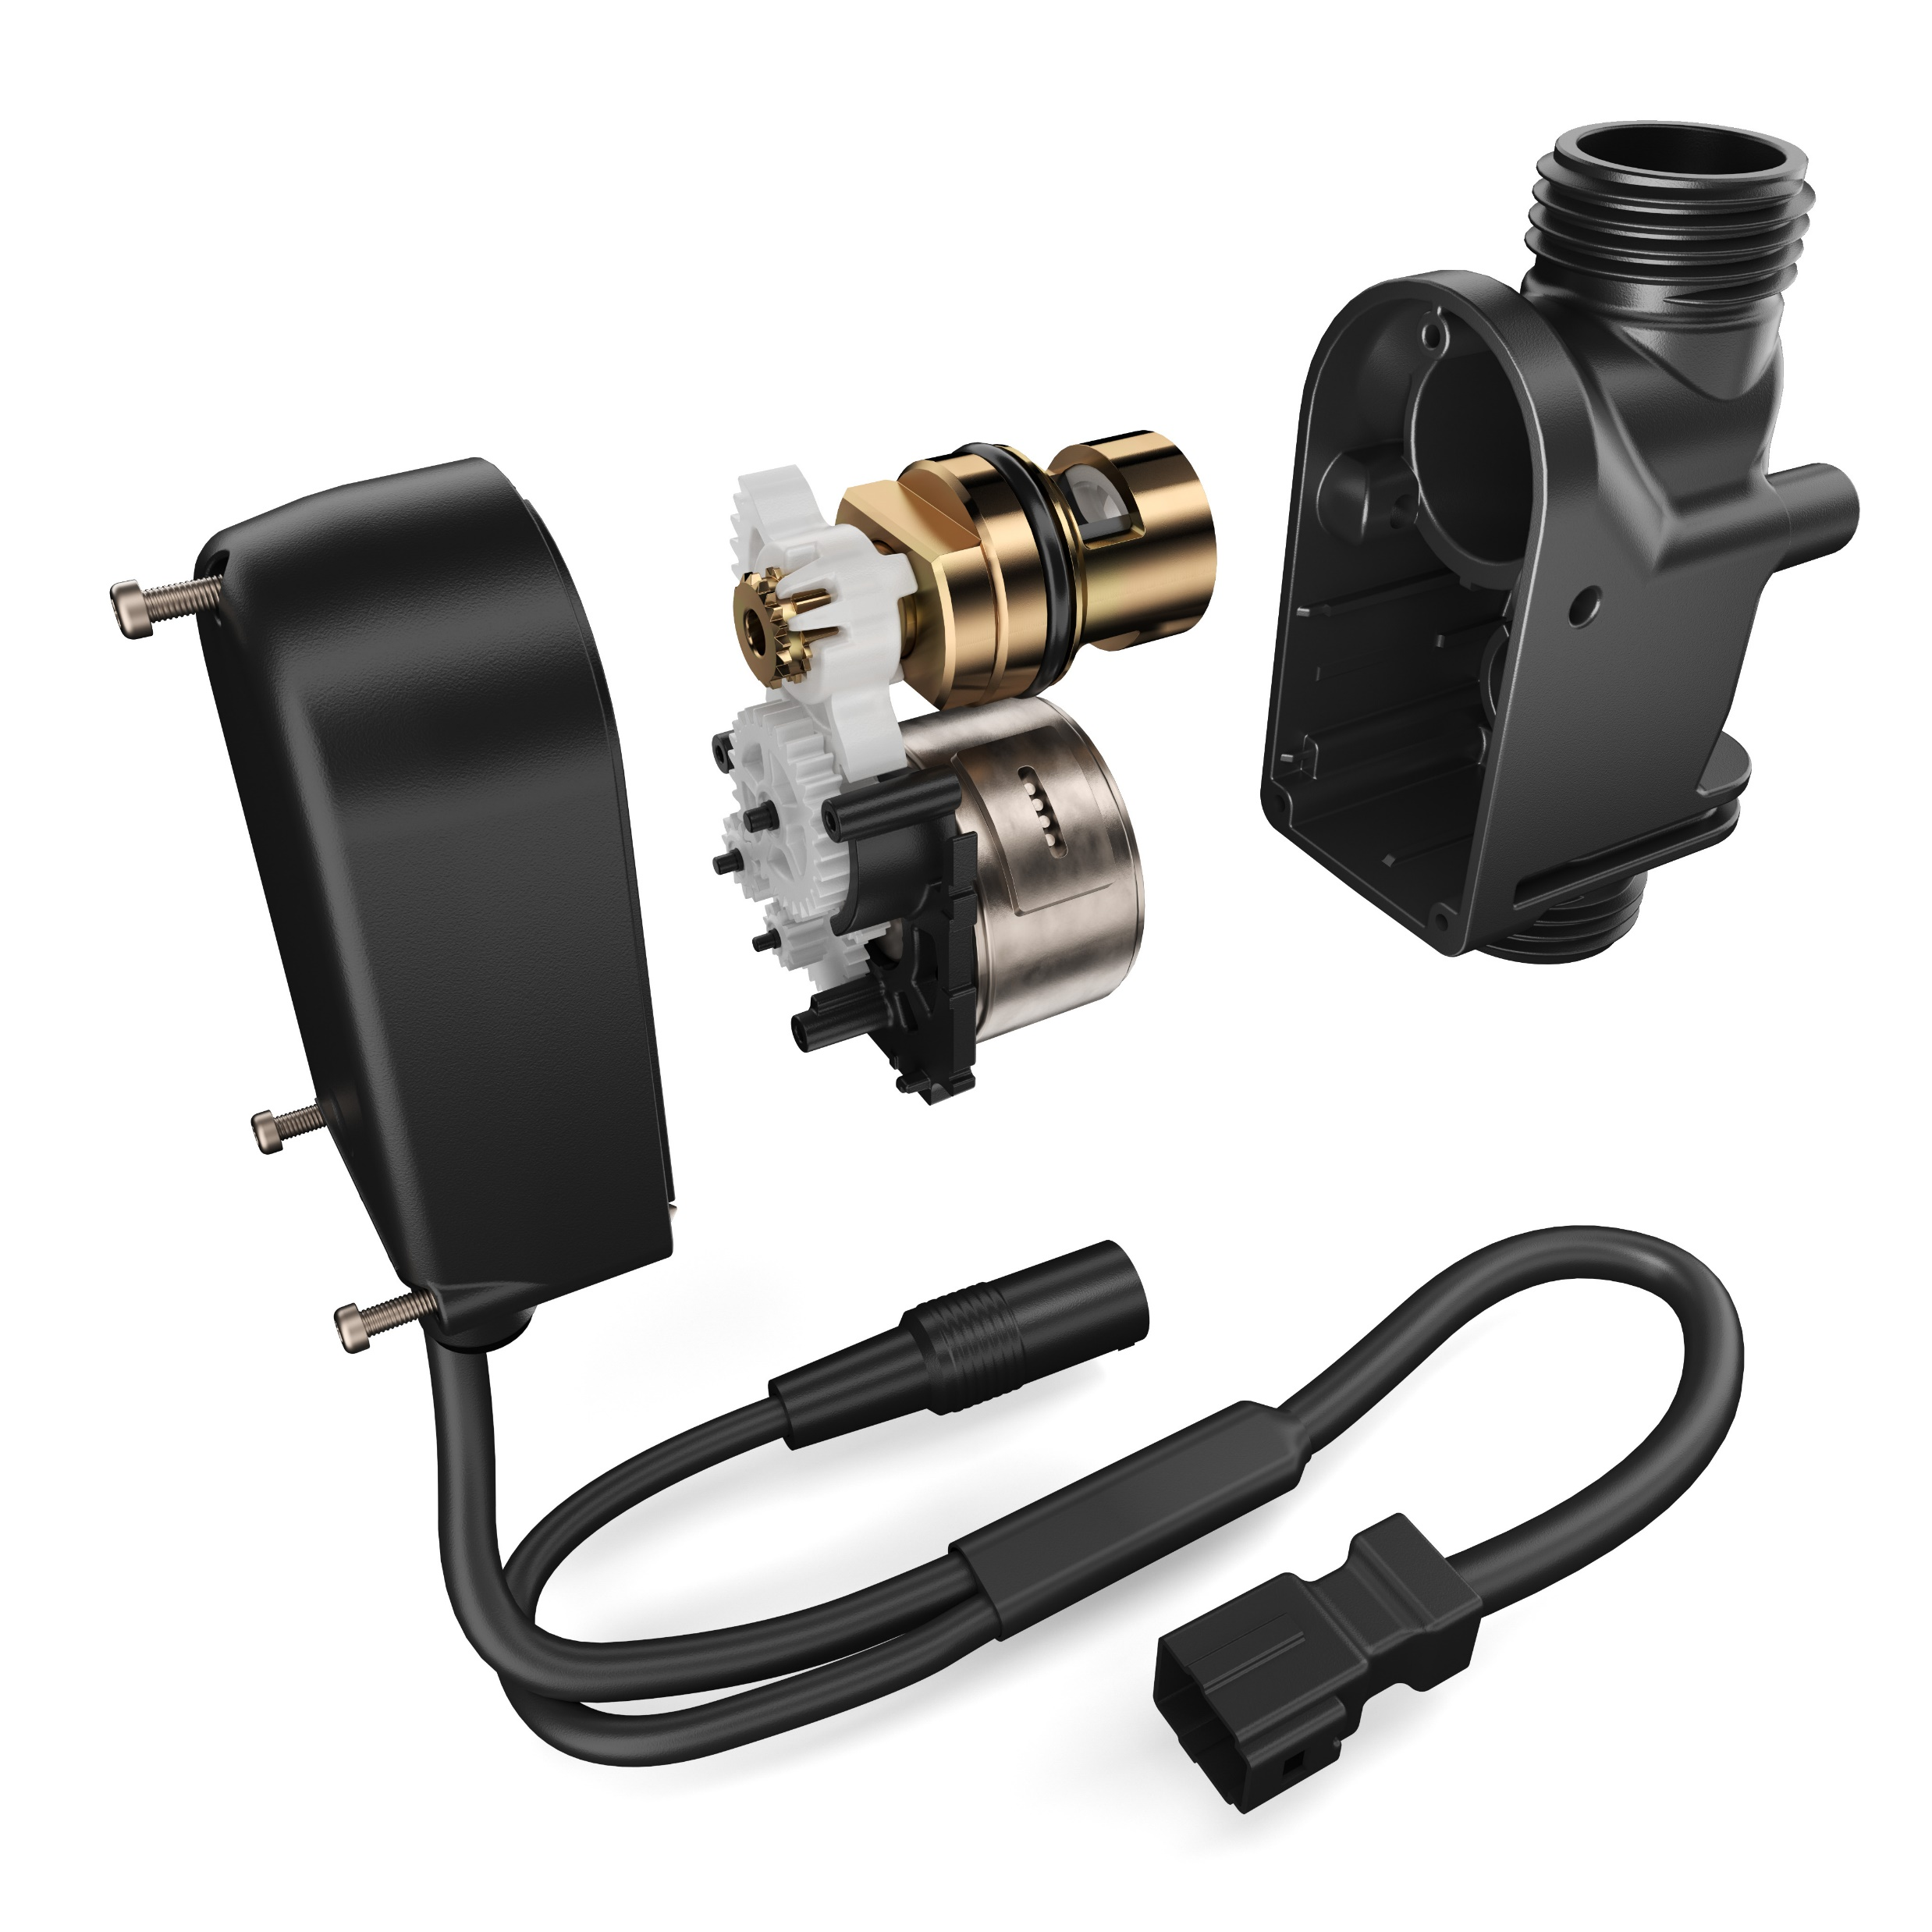


present launches faucets
EZ Gear-Driven Sensor Faucets
LASTING PERFORMANCE
Automatic micro-swipe of ceramic disc every 12 hours removing potential debris build- up extends the life of the ceramic disc for up to 20+ years of trouble-free operation.
PRECISE TECHNOLOGY
Tested and proven, the motor-gear operation provides a soft close, ultimately delivering an effortless, quiet water flow.
Notes:
Dan Danowski

Slide 17
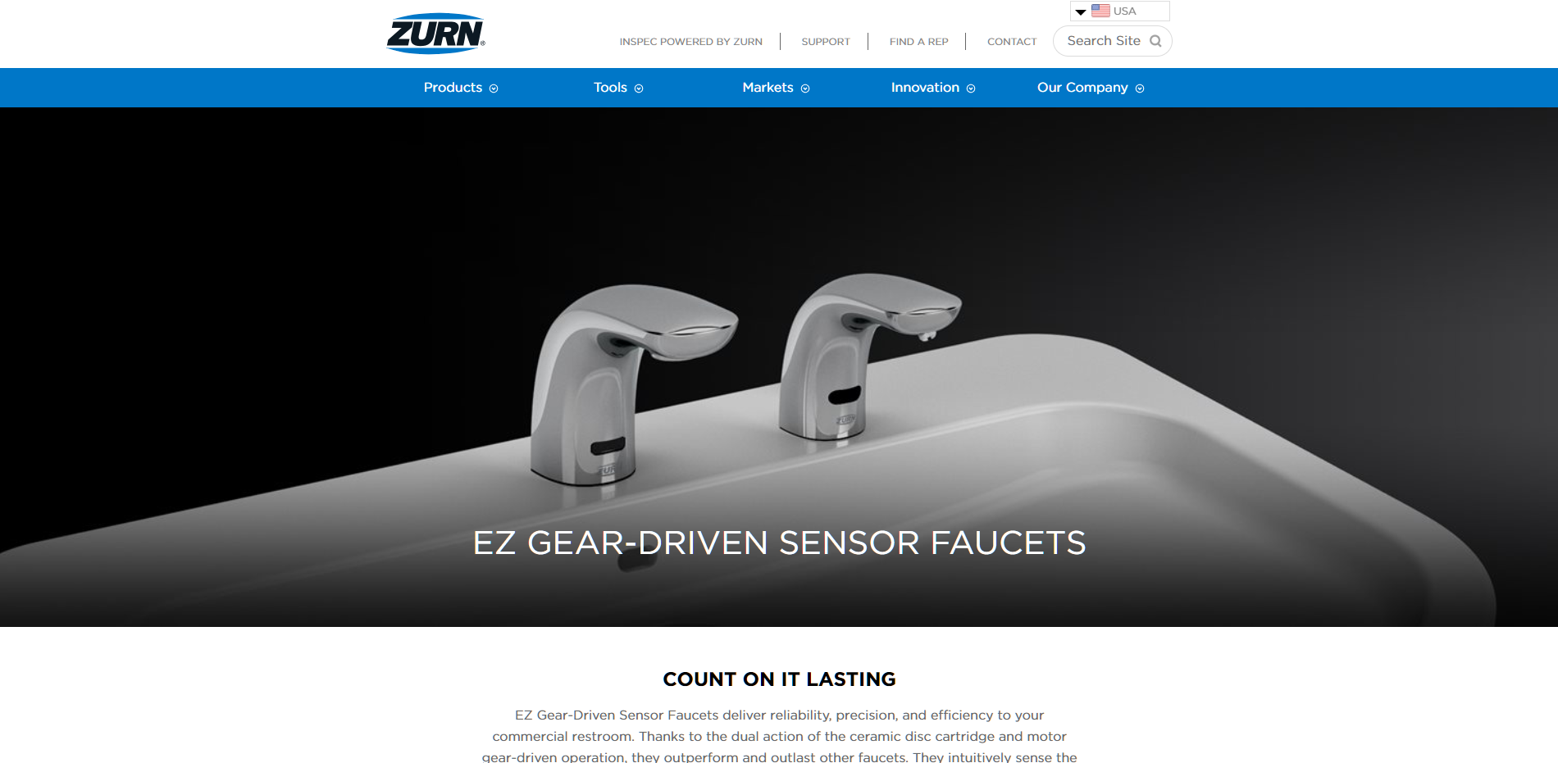
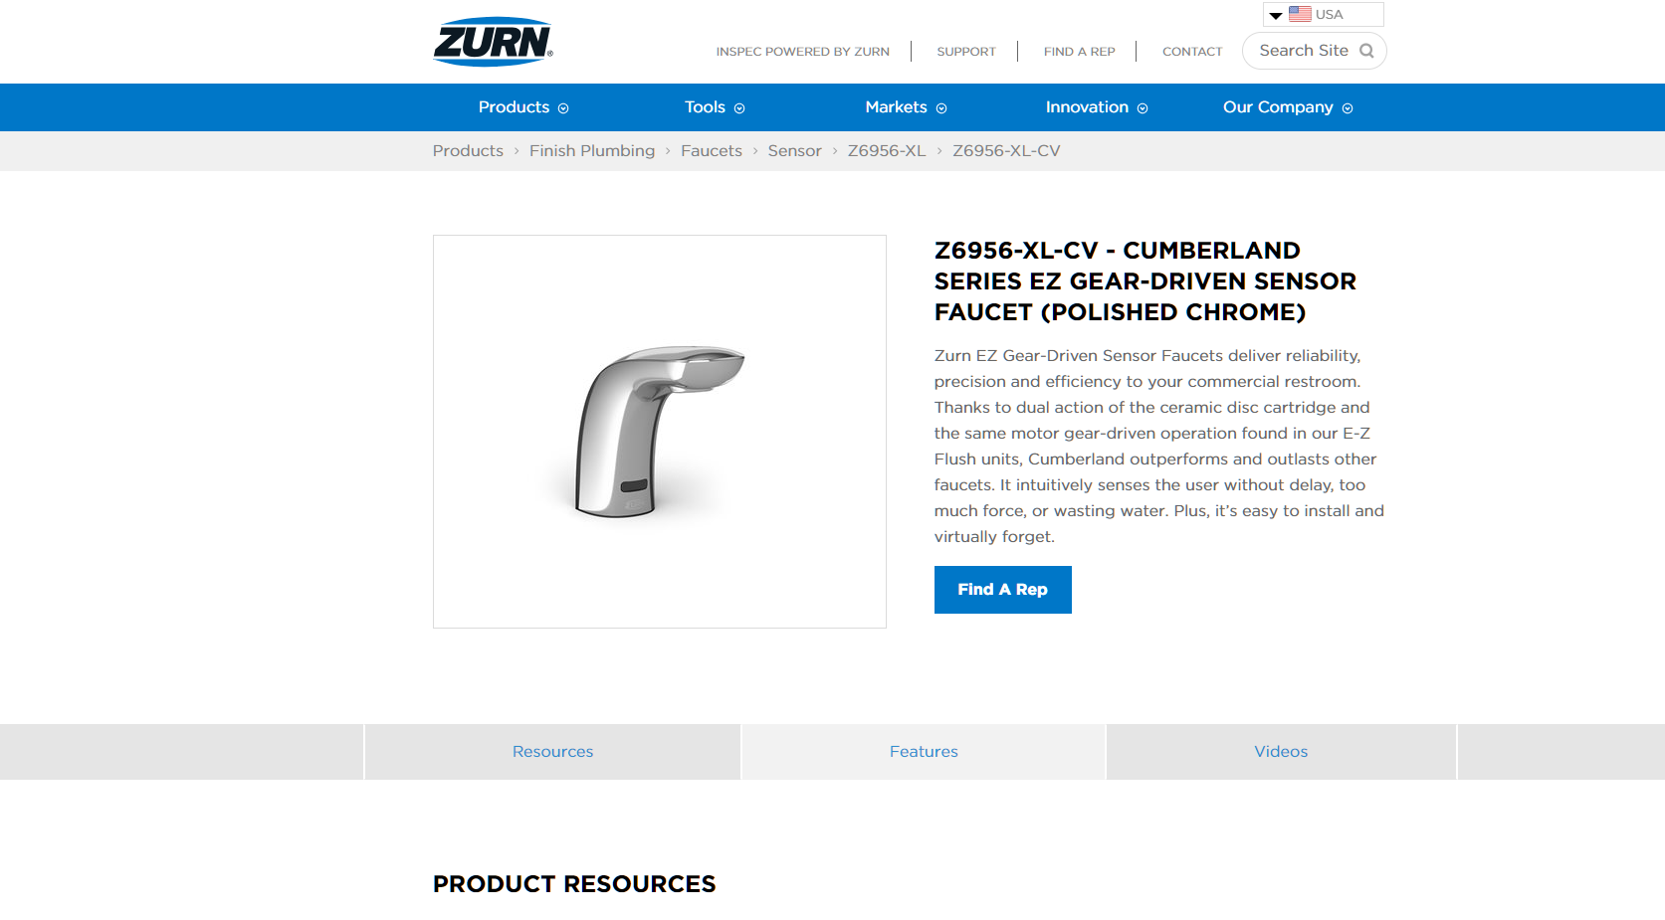
present launches faucets
EZ Gear-Driven Sensor Faucets
Zurn.com landing page
Zurn.com product pages
Notes:
Landing page
Flush Product Pages

Slide 18
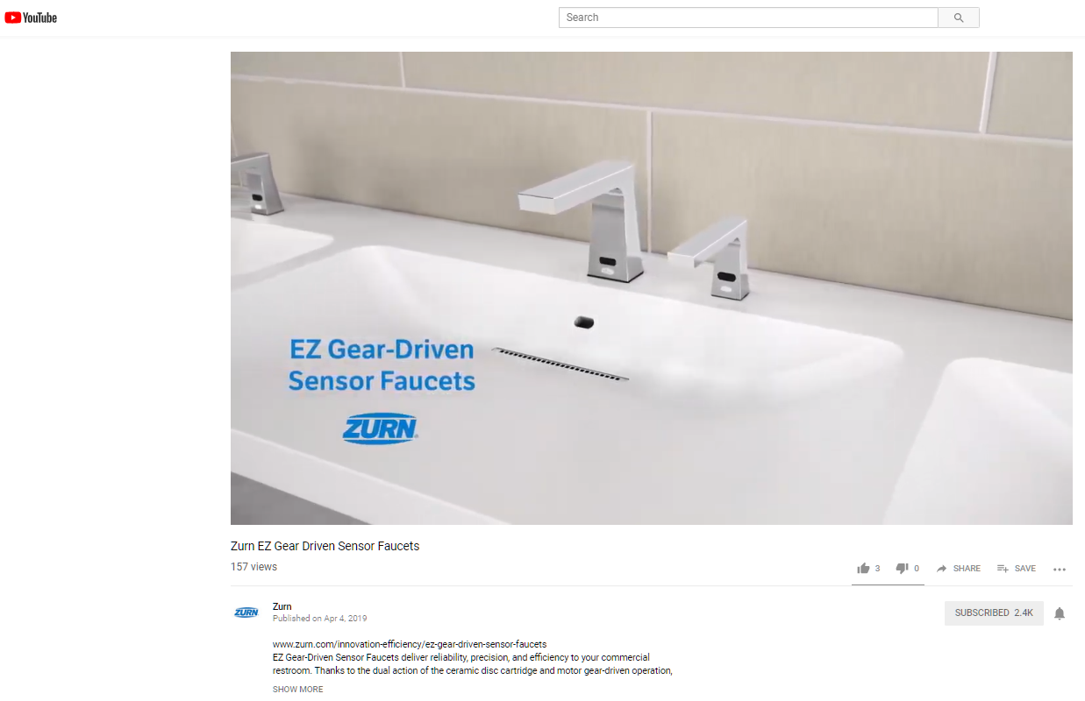
present launches faucets
EZ Gear-Driven Sensor Faucets
2:01 Video:
Zurn EZ Gear Driven Sensor Faucets
Notes:
Dan Danowski

Slide 19
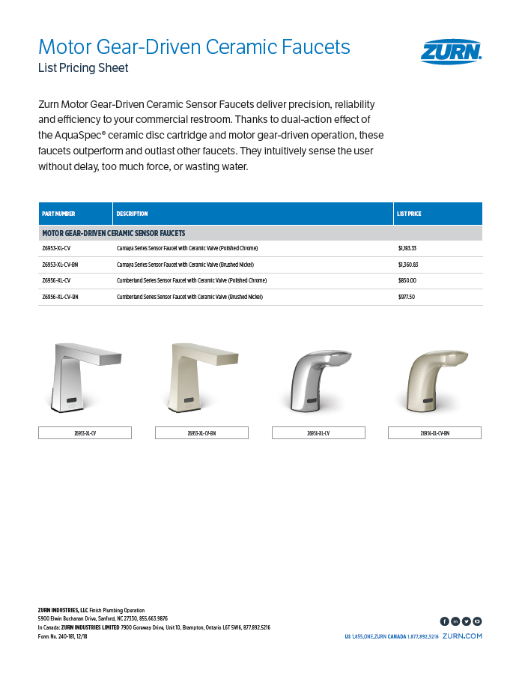
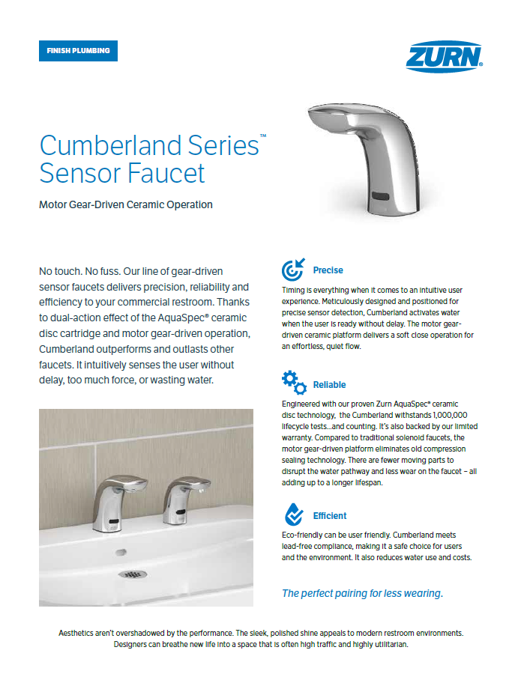
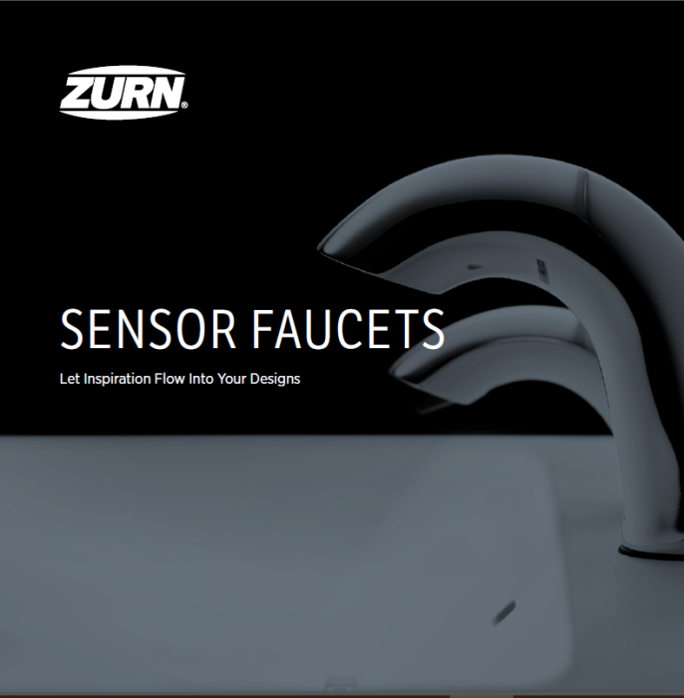
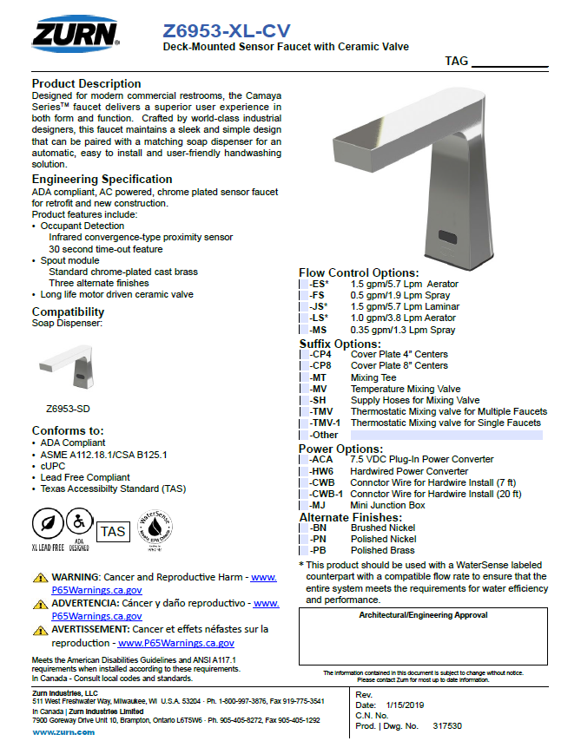
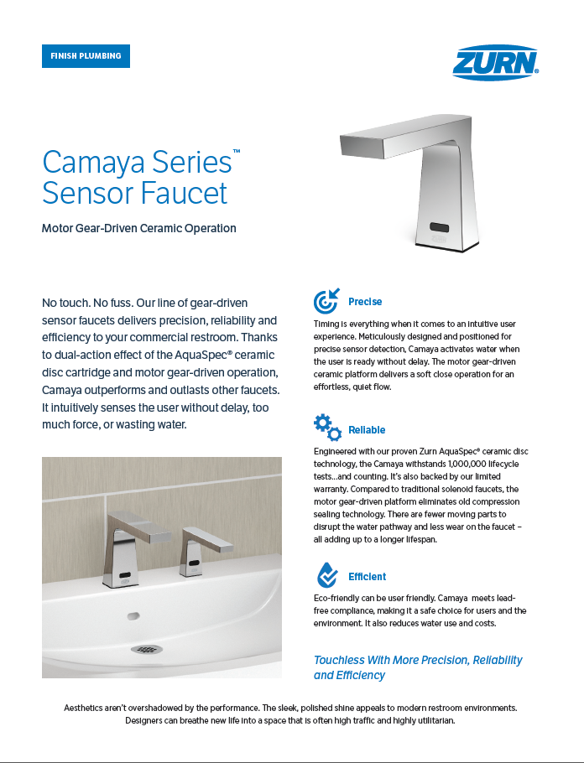
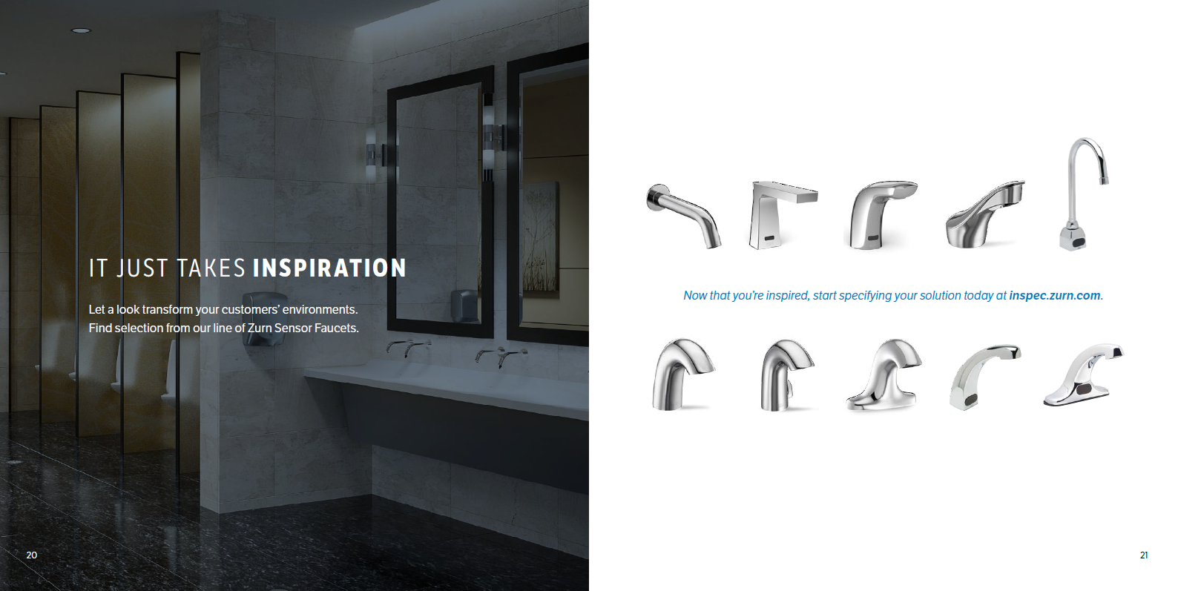
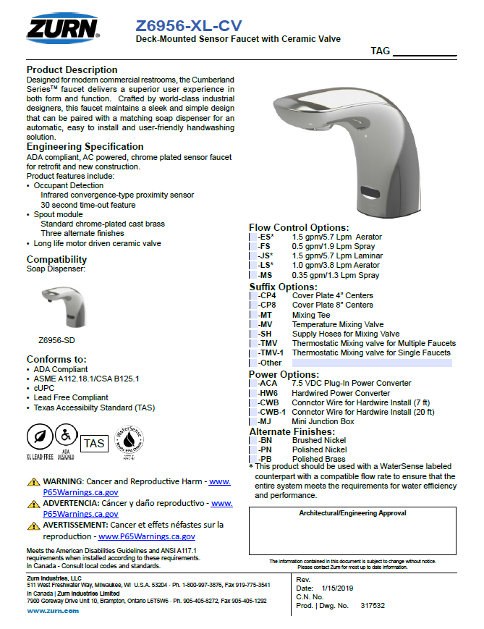
present launches faucets
List Price Sheet
also available on ZIX with fulfillment through Delzer
Net Price Strategy: 5% /Under Sloan
Commission 10%
Brochure
Coming Soon!
Sell Sheets
also available on ZIX with fulfillment through Delzer
Spec Sheets
Notes:
Features and Benefits:
Aesthetics:
Sleek design; all chrome body with modern ZEONEX® lens cover
Serviceability
Easy access to internals with the use of only a single Allen wrench provide labors savings with the reduced time associated with battery replacement, sensor range adjustment, courtesy flush settings.
Reliability
Internal ceramic cartridge withstands over 500,00 lifecycle tests for reliable performance
Gear driven motor actuated ceramic disc architecture provides an enhanced and quite flush
Sensor lens constructed of high performance Cylco – olefin polymer material which provides superior chemical and abrasion resistance, high transparency and clarity which results into more precise signal sensor detection for a reliable flush. Also, the strength of the material provides a protection against vandalism.
True manual override button provides flush for complete bowl evacuation and peace of mind.
Savings
Lasting 8-10 times longer than traditional black rubber components, Zurn GO BLUE® patented diaphragms, gaskets, and seals achieve savings from reduced maintenance costs, consistent flush volume, and reduced water usage
Flush valve internals are enclosed in water resistant housing with hidden and corrosion resistant set screws which impede the ingress of water and extend product life
Lowest Total Cost of Ownership

Slide 20
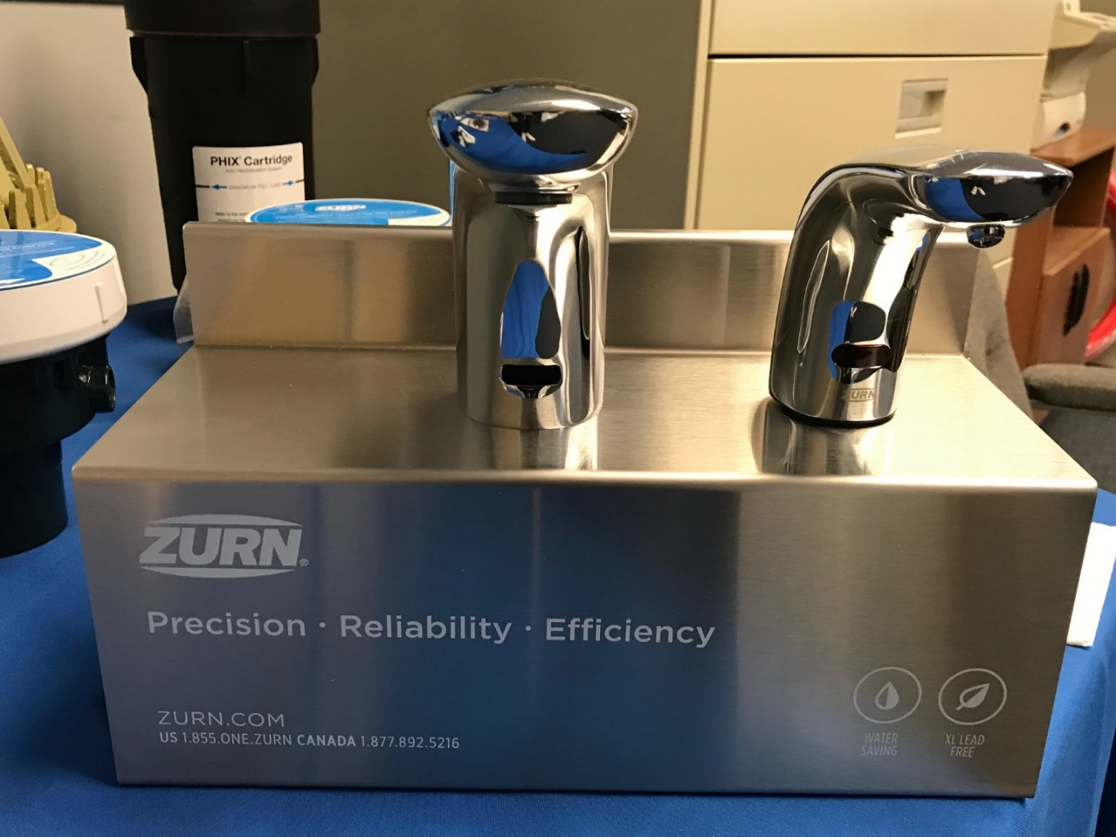
present launches faucets
EZ Gear-Driven Sensor Faucets
Faucet display stand with matching soap
Available upon request
Notes:
New graphics for flush valve stand
Additional Promotional item

Slide 21
present launches connected products
Notes:
Thushan Hemachandra

Slide 22
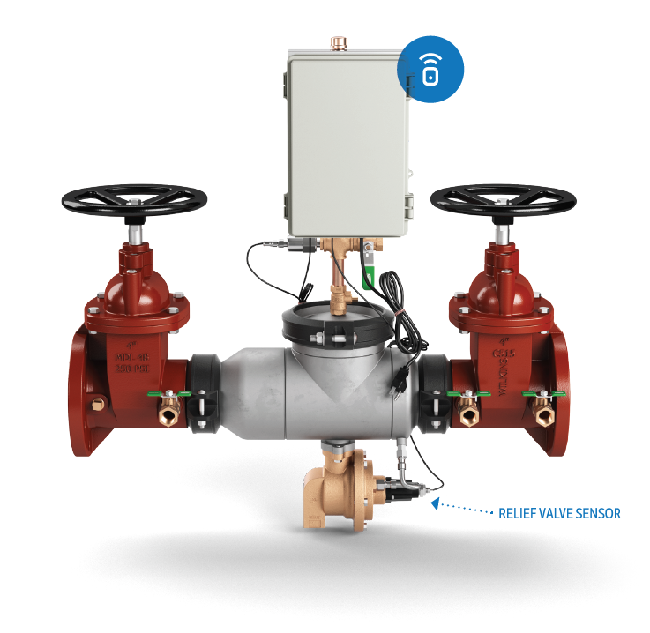


present launches connected products
Connected Backflow Preventer
REAL-TIME DETECTION
Sensor detects minute openings of relief valve and instantly calculates discharge flow rate and volume
PRESSURE MONITOR
Zone pressure sensor monitors system and provides alerts you when the pressure deviates from desired range
Launched Oct. 1, 2018
Connected Backflow Preventer
Model 375ASTW1 shown
Notes:
Thushan Hemachandra

Slide 23



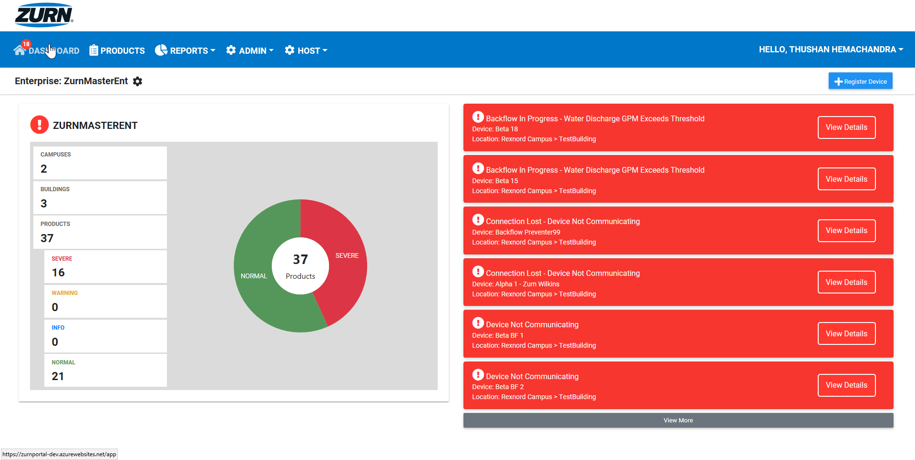


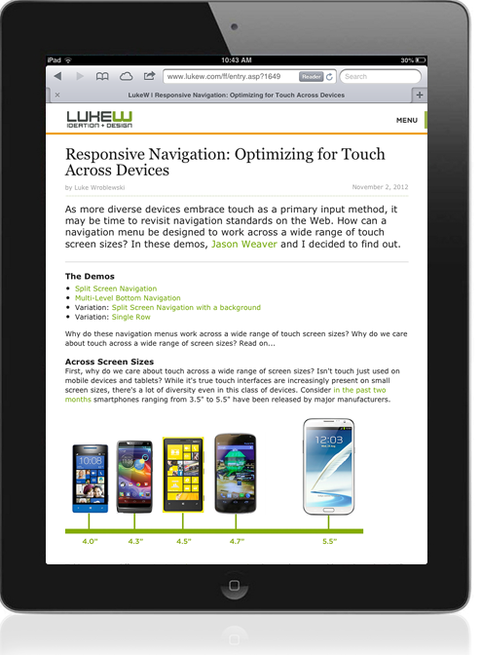
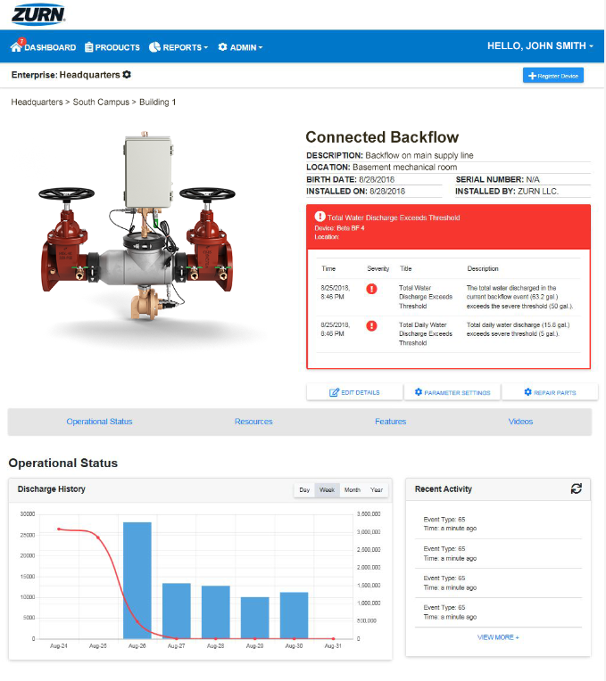

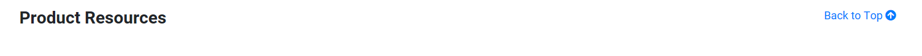
real-time alerts
preventative maintenance insights
historic data/trends
dashboard-style view of enterprise
organized by building and campus
customizable alert parameters
opt-in/out of email and mobile alerts
add/assign sub-users
Step-by-step PlumbSMART™ instructions in less than 15 minutes!
https://zurnportal.azurewebsites.net/app/
Zurn Connected Products – Headquarters – Backflow 3
PLUMBSMART™ ACCESS IS BY INVITATION ONLY;
USERS MUST BE AUTHORIZED AND VALIDATED
AUTHENTICATION IS SECURED
BY MICROSOFT AZURE ENCYPTION PROTOCOLS
USER PRIVILEGES CAN BE LIMITED
TO SPECIFIC ROLES, LOCATIONS & PRODUCTS
Notes:
Complimentary access to the PlumbSMART™ and alerts for 1 year from the time of the first purchase of a Zurn Connected Product. Thereafter, subscription renewal rates are in a tiered format, based on the total number of Zurn Connected Products installed across your enterprise.

Slide 24
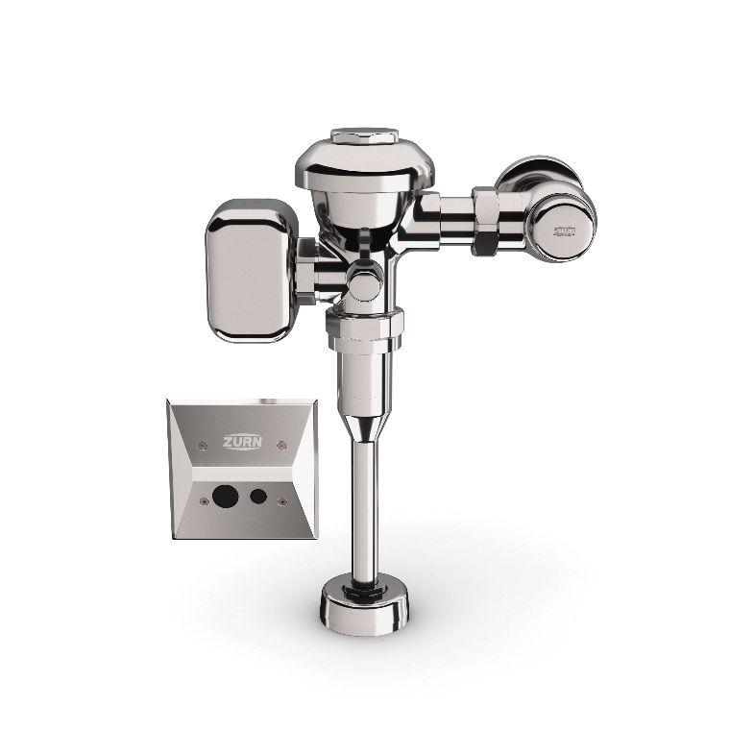
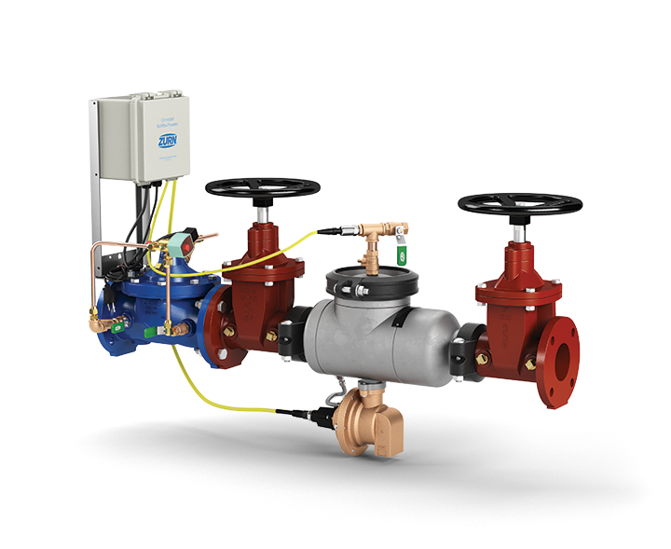

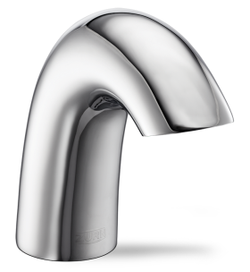
present launches connected products
Connected
Flood Control System (FCIS)
Connected Faucets
Connected Flush Valves
All features of backflow preventer (relief valve discharge detection and alerts)
Automatic shutoff of water supply based on preset/customizable parameters
Faucet usage metrics
Water consumption metrics
Preventative maintenance alerts
Fixture usage metrics
Water consumption metrics
Preventative maintenance alerts
For more information visit https://www.zurn.com/know-more
Ryan Langan - Director of Sales, Connected Products
Thushan Hemachandra - Product Manager, Connected Products
Notes:
Thushan Hemachandra

Slide 25
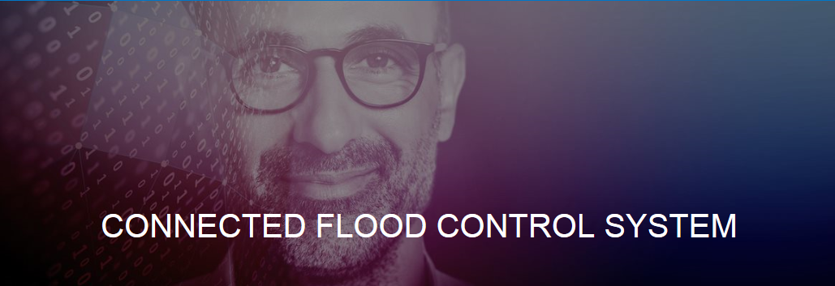

present launches connected products
Connected Flood Control System (FCIS)
REAL-TIME DETECTION
Sensor detects minute openings of relief valve and instantly calculates discharge flow rate and volume
WATER SHUTOFF
System automatically shuts off water if relief discharge is beyond set tolerances to prevent catastrophic flooding
PRESSURE MONITOR
Zone pressure sensor monitors system and provides alerts you when the pressure deviates from desired range
FCIS standard with connectability – June 1, 2019
2-1/2” – 10”
Connected Flood Control System (FCIS)
Model FCISAST shown
Notes:
Thushan Hemachandra

Slide 26
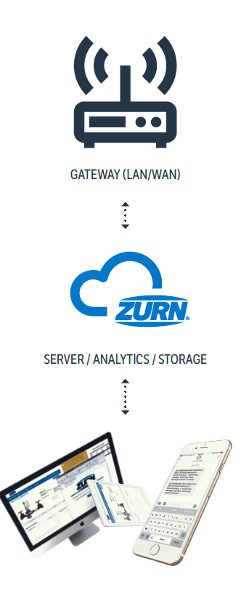
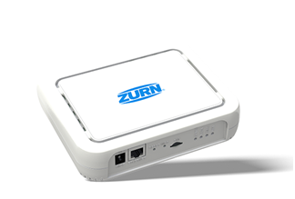

how it works
Connected Flood Control System
1
sensors capture and send data to cloud
relief valve position sensor detects for opening of the relief valve and size of that opening, and then transmit these readings multiple times per second wirelessly to the Zurn cloud via Zurn gateway
ZURN GATEWAY
ZURN GATEWAY
2
data analyzed for alerts and insights
relief valve opening size data is then computed in real-time to determine:
current flow rate (gallons per minute)
total volume of water discharged during an event (gallons)
total volume discharged by product in a 24-hr period (gallons)
ZURN CLOUD
ZURN CLOUD
3
alerts sent via web/email/text
if any of these computed results surpasses a threshold for warnings and then severe alerts, they are displayed immediately on plumbSMART™ and notifications are sent to the building owner/facility manager via email/text based on severity with link back to plumbSMART™
4
24/7 access to product info and trends
plumbSMART™ allows customers to view current product status, adjust their alert settings and view historic data trends from any location with an internet connection
IMPORTANT NOTE:
Connected technology/electronics DOES NOT CHANGE OR AFFECT the regular functions of the backflow preventer in any way. Only senses for changes.
Notes:
Thushan Hemachandra

Slide 27





present launches
Connected Flood Control System
1:49 Video:
Zurn Connected Flood Control System
Leave-behind brochure
also available on ZIX with fulfillment through Delzer
Connected Flood Control System Landing Page
Spec Sheets
Notes:
Features and Benefits:
Aesthetics:
Sleek design; all chrome body with modern ZEONEX® lens cover
Serviceability
Easy access to internals with the use of only a single Allen wrench provide labors savings with the reduced time associated with battery replacement, sensor range adjustment, courtesy flush settings.
Reliability
Internal ceramic cartridge withstands over 500,00 lifecycle tests for reliable performance
Gear driven motor actuated ceramic disc architecture provides an enhanced and quite flush
Sensor lens constructed of high performance Cylco – olefin polymer material which provides superior chemical and abrasion resistance, high transparency and clarity which results into more precise signal sensor detection for a reliable flush. Also, the strength of the material provides a protection against vandalism.
True manual override button provides flush for complete bowl evacuation and peace of mind.
Savings
Lasting 8-10 times longer than traditional black rubber components, Zurn GO BLUE® patented diaphragms, gaskets, and seals achieve savings from reduced maintenance costs, consistent flush volume, and reduced water usage
Flush valve internals are enclosed in water resistant housing with hidden and corrosion resistant set screws which impede the ingress of water and extend product life
Lowest Total Cost of Ownership

Slide 28





present launches connected products
Connected Flush Valves
PRECISION
Sensor flush valve accurately delivers hands-free operation to reduce germ transfer and enhance the user experience
Connected
ZEMS Hardwired Sensor Flush Valve
for 3.5 gpf – 1.1 gpf Water Closets
ZEMS6000AV-MOB-W1
DEPENDABLE
Clog-resistant triple filter diaphragm, chemical-resistant gaskets, and seals extend service life and reduce maintenance costs
INSTANT ANALYTICS
Wireless monitoring technology tracks data around set parameters for usage, water consumption, and preventative maintenance
additional features
Connected
ZEMS Hardwired Sensor Flush Valve
for 0.125 gpf -1.5 gpf Urinals
ZEMS6003AV-MOB-W1
Water conserving options with LEED flow rates
Heavy-duty cast brass body with chrome finish
ADA compliant
Notes:
Thushan Hemachandra

Slide 29

present launches connected flush valves
1
sensors capture and send data to cloud
flush valve transmits actuation data wirelessly to the Zurn cloud via Zurn gateway
ZURN GATEWAY
data analyzed for alerts and insights
2
flush valve data is then computed in real-time to determine:
flush count
water usage volume
diaphragm replacement alerts for preventative
ZURN CLOUD
3
alerts sent via web/email/text
if any of these computed results surpasses a threshold for warnings and then severe alerts, they are displayed immediately on plumbSMART™ and notifications are sent to the building owner/facility manager via email/text based on severity with link back to plumbSMART™
4
24/7 access to product info and trends
plumbSMART™ allows customers to view current product status, adjust their alert settings and view historic data trends from any location with an internet connection
IMPORTANT NOTE:
Connected technology/electronics DOES NOT CHANGE OR AFFECT the regular functions of the flush valve in any way. Only senses for changes.
Notes:
Thushan Hemachandra

Slide 30






present launches connected flush valves
1:36 Video:
Zurn Connected Flush Valves
Leave-behind brochure
also available on ZIX with fulfillment through Delzer
Connected Flush Valve Landing Page
Spec Sheets
Notes:
Features and Benefits:
Aesthetics:
Sleek design; all chrome body with modern ZEONEX® lens cover
Serviceability
Easy access to internals with the use of only a single Allen wrench provide labors savings with the reduced time associated with battery replacement, sensor range adjustment, courtesy flush settings.
Reliability
Internal ceramic cartridge withstands over 500,00 lifecycle tests for reliable performance
Gear driven motor actuated ceramic disc architecture provides an enhanced and quite flush
Sensor lens constructed of high performance Cylco – olefin polymer material which provides superior chemical and abrasion resistance, high transparency and clarity which results into more precise signal sensor detection for a reliable flush. Also, the strength of the material provides a protection against vandalism.
True manual override button provides flush for complete bowl evacuation and peace of mind.
Savings
Lasting 8-10 times longer than traditional black rubber components, Zurn GO BLUE® patented diaphragms, gaskets, and seals achieve savings from reduced maintenance costs, consistent flush volume, and reduced water usage
Flush valve internals are enclosed in water resistant housing with hidden and corrosion resistant set screws which impede the ingress of water and extend product life
Lowest Total Cost of Ownership

Slide 31




features & benefits connected faucets
Connected Faucets
PRECISION
Concealed sensor lens accurately delivers hands-free operation to reduce germ transfer and enhance the user experience
Connected
Aqua-FIT® Serio Series™
Hardwired Sensor Faucet
Z6950-XL-S-W1
FEATURE FLEXIBILITY
Timeouts, line purge, sensor range and metering mode offer custom control to meet the varying demands of restroom environments
INSTANT ANALYTICS
Wireless monitoring technology tracks data around set parameters for usage, water consumption, and preventative maintenance
Connected
Aqua-FIT® Serio Series™
Hardwired Sensor Faucet
Z6955-XL-S-W1
additional features
Water conserving options with LEED flow rates of 0.5/0.35 gpm
Heavy-duty cast brass body with chrome finish
ADA compliant
Notes:
Thushan Hemachandra

Slide 32

how it works connected faucets
1
sensors capture and send data to cloud
faucet transmits actuation data wirelessly to the Zurn cloud via Zurn gateway
ZURN GATEWAY
2
data analyzed for alerts and insights
faucet data is then computed in real-time to determine:
usage count and duration
total volume (gallons) of water discharged in a 24-hr period
preventative maintenance alerts
ZURN CLOUD
3
alerts sent via web/email/text
if any of these computed results surpasses a threshold for warnings and then severe alerts, they are displayed immediately on plumbSMART™ and notifications are sent to the building owner/facility manager via email/text based on severity with link back to plumbSMART™
4
24/7 access to product info and trends
plumbSMART™ allows customers to view current product status, adjust their alert settings and view historic data trends from any location with an internet connection
IMPORTANT NOTE:
Connected technology/electronics DOES NOT CHANGE OR AFFECT the regular functions of the faucet in any way. Only senses for changes.
Notes:
Thushan Hemachandra

Slide 33






present launches connected faucets
1:50 Video:
Zurn Connected Faucets
Leave-behind brochure
also available on ZIX with fulfillment through Delzer
Connected Faucets Landing Page
Spec Sheets
Notes:
Features and Benefits:
Aesthetics:
Sleek design; all chrome body with modern ZEONEX® lens cover
Serviceability
Easy access to internals with the use of only a single Allen wrench provide labors savings with the reduced time associated with battery replacement, sensor range adjustment, courtesy flush settings.
Reliability
Internal ceramic cartridge withstands over 500,00 lifecycle tests for reliable performance
Gear driven motor actuated ceramic disc architecture provides an enhanced and quite flush
Sensor lens constructed of high performance Cylco – olefin polymer material which provides superior chemical and abrasion resistance, high transparency and clarity which results into more precise signal sensor detection for a reliable flush. Also, the strength of the material provides a protection against vandalism.
True manual override button provides flush for complete bowl evacuation and peace of mind.
Savings
Lasting 8-10 times longer than traditional black rubber components, Zurn GO BLUE® patented diaphragms, gaskets, and seals achieve savings from reduced maintenance costs, consistent flush volume, and reduced water usage
Flush valve internals are enclosed in water resistant housing with hidden and corrosion resistant set screws which impede the ingress of water and extend product life
Lowest Total Cost of Ownership

Slide 34
real-time alerts
preventative maintenance insights
historic data/trends
dashboard-style view of enterprise
organized by building and campus
customizable alert parameters
opt-in/out of email and mobile alerts
add/assign sub-users
Step-by-step PlumbSMART™ instructions in less than 15 minutes!
https://zurnportal.azurewebsites.net/app/
Zurn Connected Products – Headquarters – Backflow 3
PLUMBSMART™ ACCESS IS BY INVITATION ONLY;
USERS MUST BE AUTHORIZED AND VALIDATED
AUTHENTICATION IS SECURED
BY MICROSOFT AZURE ENCYPTION PROTOCOLS
USER PRIVILEGES CAN BE LIMITED
TO SPECIFIC ROLES, LOCATIONS & PRODUCTS
Notes:
Complimentary access to the PlumbSMART™ and alerts for 1 year from the time of the first purchase of a Zurn Connected Product. Thereafter, subscription renewal rates are in a tiered format, based on the total number of Zurn Connected Products installed across your enterprise.

Slide 35
present launches hand dryers
Notes:
Alejandra Edwards-Garcia

Slide 36












present launches
World Dryer VMax V2
 | VMax | VMax V2 (brushless motor)
Model | V-639A | V-649A
LED Information Display & Cavity Accent Lighting
Operating Display
Water Collection Empty
HEPA Filter Replacement
HEPA Filter
3X longer filter life (1-3 yrs expected depending on washroom traffic)
Notes:
Alejandra Edwards-Garcia

Slide 37
present launches inSpec
Notes:
Katy Rice

Slide 38



present launches inSpec
new to inSpec
Discontinued product notification
  A ‘Discontinued Product Alert’ informs the user of the discontinued product and what projects it is in.
  You will also see the red highlighting on your ‘My Projects’ tab and in the project.
Expanding drain category options
inSpec certification is now available
  Visit inspec.zurn.com/certification
NEW TRENCH GRATE IMAGES
Notes:
Katy Rice

Slide 39
present launches
Erie Test Lab
Notes:
Jill Nagg

Slide 40


present launches
Erie Test Lab
Grand Opening April 25
Roof Drain Test Stand
Notes:
Jill Nagg

Slide 41
present launches
Jon Everett Training Center
Notes:
Cassandra Wurster

Slide 42

present ribbon cutting
Zurn
Paso Robles’
Jon Everett
Training Center
Remodeled & renamed
Ribbon cutting
May 8 3PM
Notes:
Cassandra Wurster

Slide 43

future launches post-April 2019
Notes:
Cassandra Wurster

Slide 44
future launches fire valves
Notes:
Nicole Raftery

Slide 45


future launches fire valves
Pressure-Tru® ZW5000 Series
Pressure Reducing Valve
field adjustable fire valves (hose and floor control)
Widest range of flow performance allows for replacement of any competitor valve
Low torque – only 9ft lb of torque to field adjust
Compact - designed to fit in tighter spaces
Tamper proof shield (standard)
  New Construction – drops out of way for ease of in field adjustments
  Fire Fighting – breakaway for quick in field adjustments
Larger handwheel for ease of operation
Lightweight aluminum adjusting rod included
Angle or inline globe body with grooved or threaded connections
Regulates pressure under both FLOW and NO-FLOW conditions
Tamper resistant integral supervisory switch (standard) on all floor control valves
ZW5000 Pressure-Tru®
Field Adjustable Hose Valve
Start Spec Conversion NOW!
ZW5004 Pressure-Tru®
Field Adjustable Floor Control Valve
Notes:
Nicole Raftery
Pre-launch awareness at NFSA (May), NFPA (June)
Start spec conversion process now

Slide 46
future launches floor sinks
Notes:
Jill Nagg

Slide 47
future launches floor sinks
polymer floor sinks
Notes:
Jill Nagg

Slide 48
future launches inSpec
Notes:
Katy Rice

Slide 49


future launches inSpec
coming to inSpec
World Dryer
PEX
Do you have an idea to make inSpec even better?
  Reach out to our team to let us know the updates you would like to see.
Notes:
Katy Rice

Slide 50
future launches product training
Notes:
Cassandra Wurster

Slide 51


future launches product training
live product training
Zurn Headquarters, Milwaukee, WI
July 16-18, 2019
Learn from our Zurn product experts:
Product Value Proposition
How it Works
Top Features & Benefits
Design & Specify
Additional Resources
36 student capacity
For Zurn sales and rep sales
Zurn customer care and rep customer care
Other Zurn employees and rep employees
Live product training
October 2018
Zurn Headquarters
Milwaukee, WI
Notes:
Cassandra Wurster

Slide 52
resources support
address
phone
online
511 Freshwater Way
Milwaukee, WI 53204
toll-free 1-855-ONE-ZURN
zurn.com
Product Pages | Tools, Specifications, & Resources | Vertical Market Solutions
inSpec | Manufacturer Cross Reference | ARCAT | MasterSpec | SpecBuilder |
Specifiers | BIM/Revit Files
zurn.com/resources/product-training
Zurn Product - Overview
How to Install and Support
linkedin/Zurn Industries, LLC
facebook/Zurn Industries, LLC
youtube/Zurn
twitter/ZurnInd
Notes:
Cassandra Wurster

