Slide 1
Zurn PEX Plumbing - Overview
March 2019

Slide 2
agenda what you’ll learn
01
value proposition
02
how it works
03
features & benefits
04
design & specify
05
summary
06
resources

Slide 3
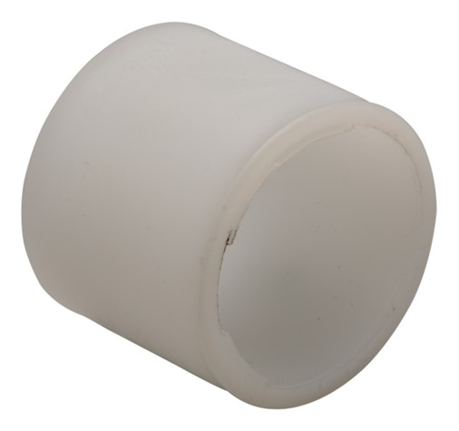
For contractors and building owners,
Zurn Industries provides PEX (cross linked polyethylene) for residential, commercial, and industrial plumbing
that offers pipe and system superiority
unlike any other manufacturer
allowing you to use one pipe for both crimp and expansion fittings
for a variety of plumbing applications

Slide 4
voice of customer industries
builder
wholesaler
contractor
“I need products that are durable and have a low total cost of ownership + require minimum downtime for maintenance.”
“I need products that are durable and cost-effective.”
“I need products that are easy and cost-effective to install and maintain, that are assembled and packaged in a manner that streamlines installation.”
Healthcare | Retail | Food Service | Hospitality | Restaurants | Institutional/Education | Government
Residential | Multi-Family | Commercial

Slide 5
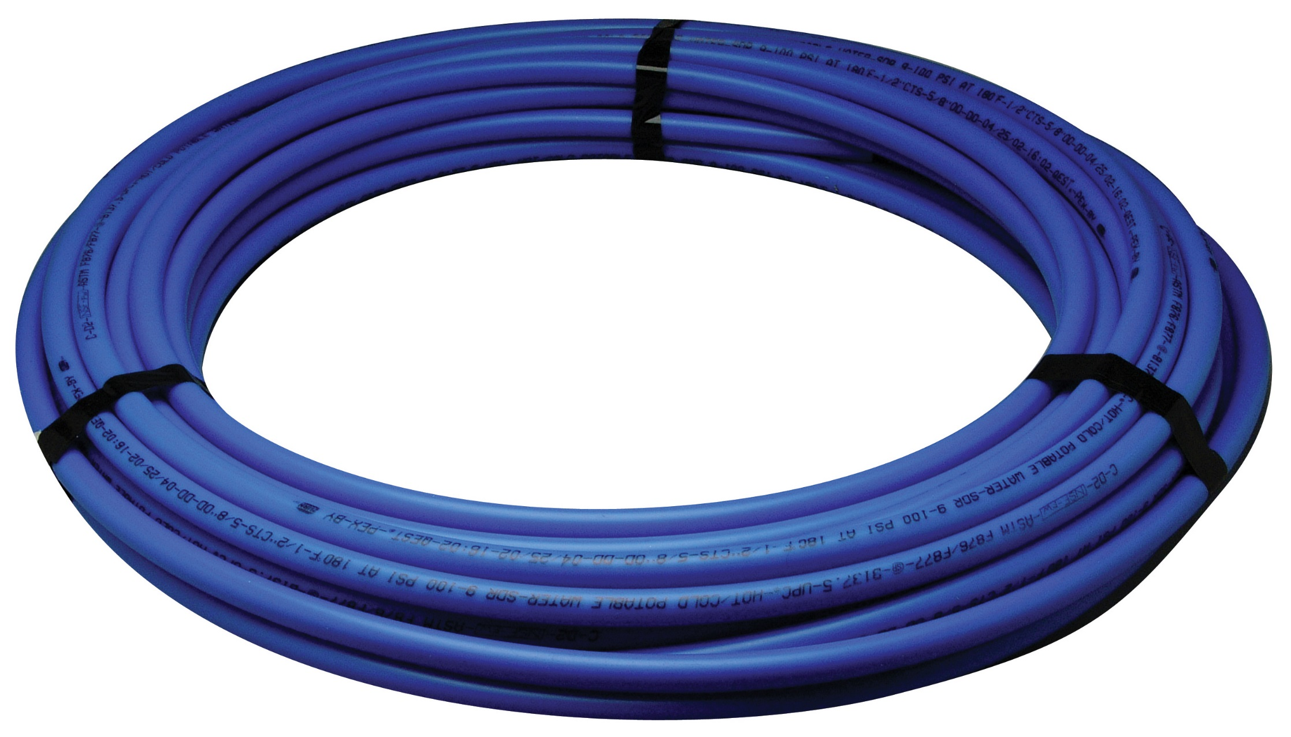
how it works step-by-step
Blue (for cold water)
PEX (cross-linked polyethylene) pipe
1
water travels thru pipes
As an alternative or in additional to copper, PVC…
2
and fittings
Leak-free XL (lead-free) brass or polymer, crimp, push type, or expansion connections
3
to fixtures, a manifold…
Securely delivering hot and cold water

Slide 6
Test Your Knowledge
How do Zurn PEX pipes function?
Place the following in the correct order:
Water reaches the consumer, lead-free
Water travels to fixtures or a manifold
Water travels through pipes and fittings

Slide 7
features & benefits PEX manufacturing methods
*PEX-a, b, and c designations are not recognized by ASTM standards because they are often misinterpreted as a grading system for PEX. In truth, the terms only identify production methods in Europe.
*Silane (Zurn)*
PEX-b
Pipe and system superiority
Highest burst pressure rating/tensile strength
Highest density of the base resin
Significantly higher levels of antioxidants for improved thermal, chlorine, and UV resistance
Links up to 4 molecules at any given cross-link for superior mechanical strength and dimensional stability
Peroxide (Engel)
PEX-a
Dimensional stability is affected by pulsating nature of equipment during production.
No room for colors, stabilizer packages, and UV resistance
Limited resistance to oxidation
Limited 1-month UV warranty
No colors without more expansive secondary extrusion
Radiation (E-Beam)
PEX-c
Pin holes in the pipe may result if radiation using during production is too strong
Large diameter, thick walled pipe is difficult to produce because the outside can be “overcooked” before the inner surface properly cross-links

Slide 8
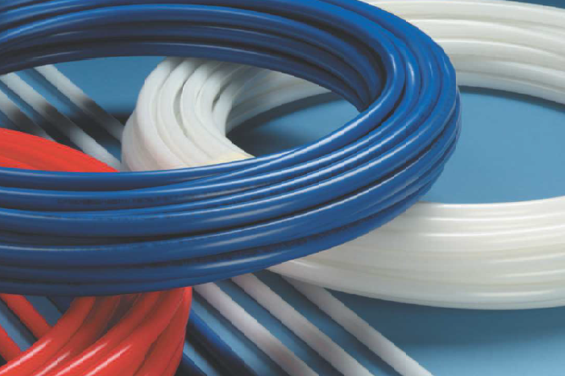
features & benefits Zurn PEX potable pipes
.
PEX pipes
Residential and commercial applications for cold water service, hot and cold potable water, fire protection, underground fluid distribution, and water distribution to manifolds, hydronic coils, etc.
key features
1:22 Video:
Zurn PEX Piping Superior Strength Tests
3/8”-2” flexible coils (in customizable lengths) and 20’ sticks
Highest burst pressure ratings and tensile strength in the industry
Corrosion, mineral, and freeze resistant; UV and chlorine resistant
Easy to install; requires fewer fittings
Less susceptible to damage/noise due to pressure surges, reducing water hammer
Great for reverse osmosis or deionized water apps (when paired with Qick Sert CR® insert fittings) because it’s not susceptible to the corrosive effects of pure water

Slide 9
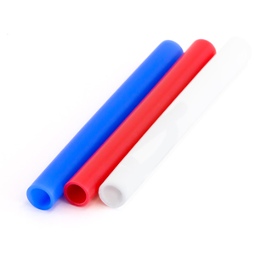
features & benefits PEX pipes
Non-barrier potable pipe
PEX pipes
Provides a reliable, corrosion and mineral resistant, freeze resistant, and safe potable distribution system, with a 25-year warranty (when all Zurn PEX components are used)
pipe types
blue (cold water) / red (hot water)
white (fire sprinkler, commercial, and larger diameter)
3/8” – 2”

Slide 10
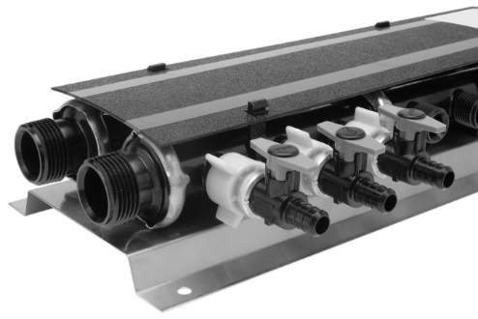
features & benefits PEX manifolds
QuickPort manifold system
Optimizes plumbing applications with port configurations
Available in pre-assembled valve and unvalved options
Corrosion resistant polymer and stainless steel construction
For hot and cold water use
Reduced installation; delivers hot water faster
10-year warranty
Lead-free
copper manifolds
QuickPort whole house preassembled manifold
Tried and true water distribution method
Available in crimp and expansion connections
For hot and cold water use
Reduced installation; delivers hot water faster
25-year warranty
Lead-free

Slide 11
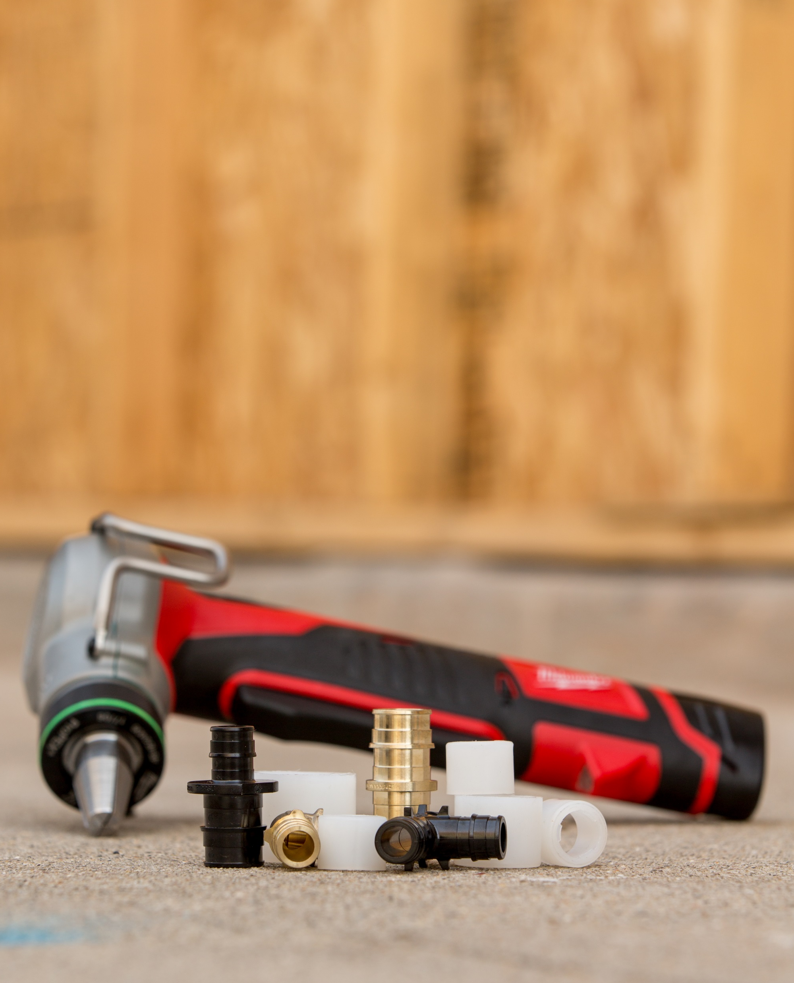
features & benefits Expansion PEX System
certified Zurn Expansion PEX
Certified for use with Zurn PEX pipes
Industry leading 25-year warranty
Third party tested system: F1960, NSF…
Works with brass and CR polymer expansion fittings
Visual validation of watertight seal – no dry fit
Zurn Expansion PEX types
Blue / red / white Zurn potable PEX
3/8”- 2” pipes
easy, quick installation
1. Place ring on pipe
0:00 Video:
Zurn Expansion PEX
2. Use expansion tool to expand ring and pipe, rotating the tool between expansions to ensure even expansion of the pipe and ring and create a leak-free path
3. Immediately insert brass or CR polymer expansion fitting into the ring/pipe and then allow a few seconds for the PEX to re-tighten around it for a water-tight seal
3:35 Video:
Zurn PEX Plumbing, Expansion Head – How to Install
2:54 Video:
Zurn PEX Plumbing, Expansion PEX
Expansion PEX

Slide 12
how it works step-by-step installation
1
place
Place ring on tubing
2
expand
Use expansion tool to expand ring and tubing
3
contract
Immediately insert brass or CR polymer expansion fitting into the ring/tubing and then allow a few seconds for the PEX to re-tighten around it for a water-tight seal

Slide 13
Test Your Knowledge
How does Zurn PEX tubing function?
Place the following in the correct order:
Immediately insert brass or CR polymer expansion fitting into the ring/tubing and then allow a few seconds for the PEX to re-tighten around it for a water-tight seal
Place ring on tubing
Use expansion tool to expand ring and tubing

Slide 14
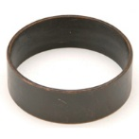
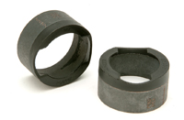
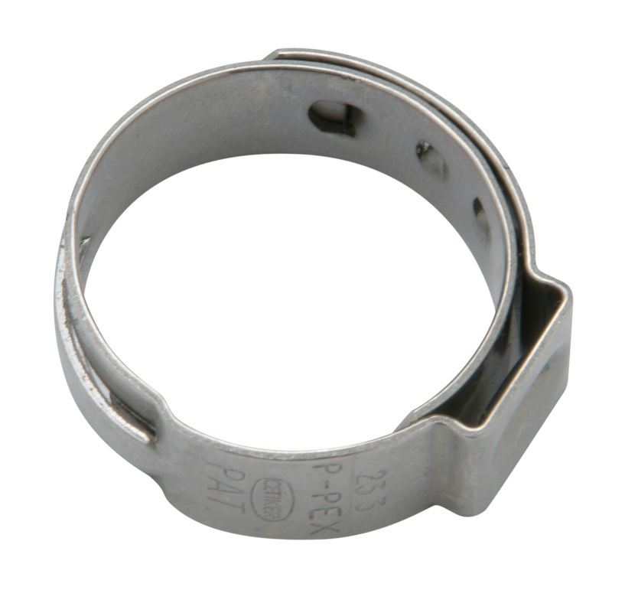
features & benefits PEX crimp rings
copper ring
6:24 Video:
Zurn PEX Plumbing Copper Crimp Ring –
How it Works
highly secure
QickCap™ ring
Secures Zurn PEX pipes to XL Brass and Qick Sert CR® fittings
Hot/cold water plumbing apps
4:29 Video:
Zurn PEX Plumbing QickCap Ring
standard copper crimp ring (QCR_X)
Tried and true crimp ring
3/8” – 2”
QickCap copper crimp ring (QCR_XPC)
Accurately positions crimp ring on pipe
1/2” – 2”
stainless steel crimp ring (QSOET_X)
Only one tool needed
1/2” – 1”
QSOET stainless steel crimp ring

Slide 15
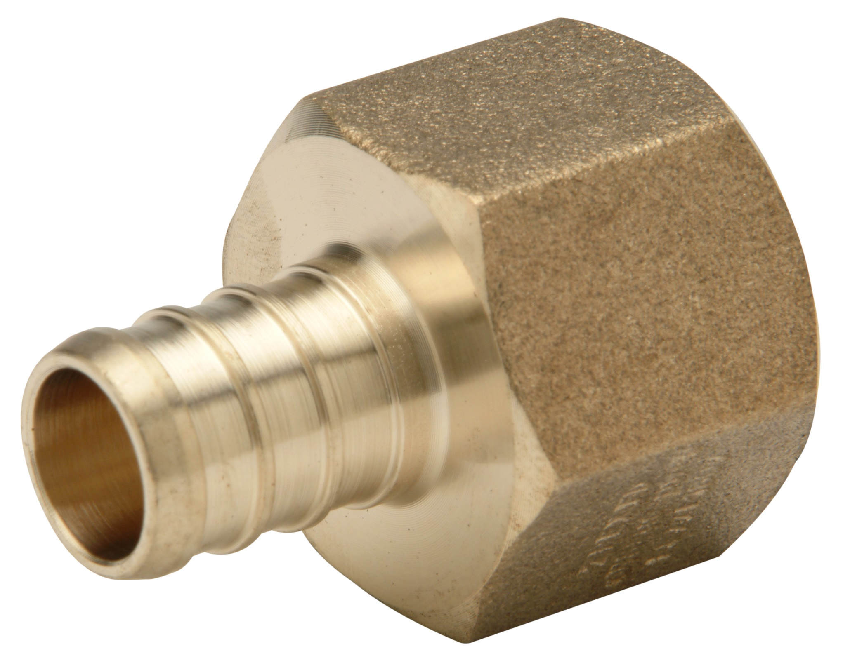
features & benefits PEX brass fittings
Brass female pipe thread non swivel adapter
fast and easy to install
Crimp and expansion fittings that are fast and easy to install
Tried and true fittings
Available in select fittings from 3/8” to 2”. Manufactured from a dezincification resistant low lead alloy called ECO BRASS®. It is compliant with low lead legislation in California and Vermont
fitting types
Adapters-transition fittings
Elbows
Tees
Test plugs
Lead-free Ecobrass
Couplings

Slide 16
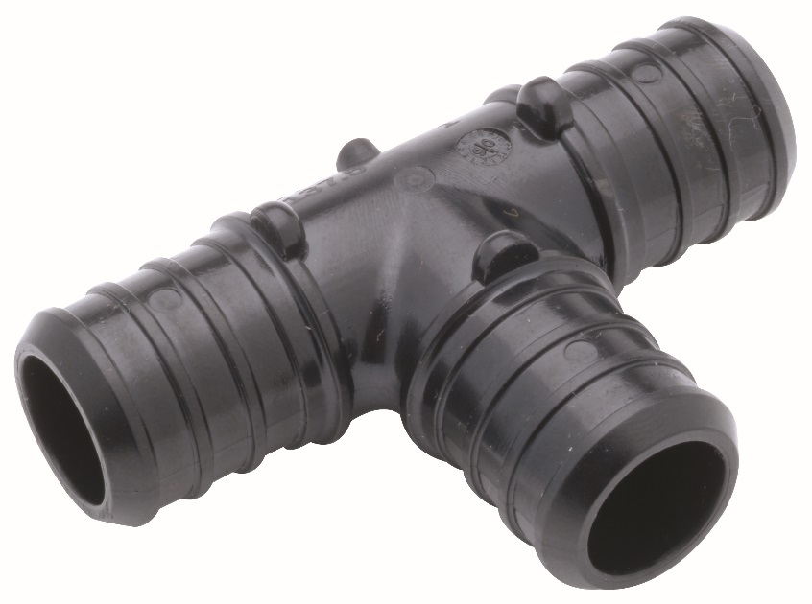
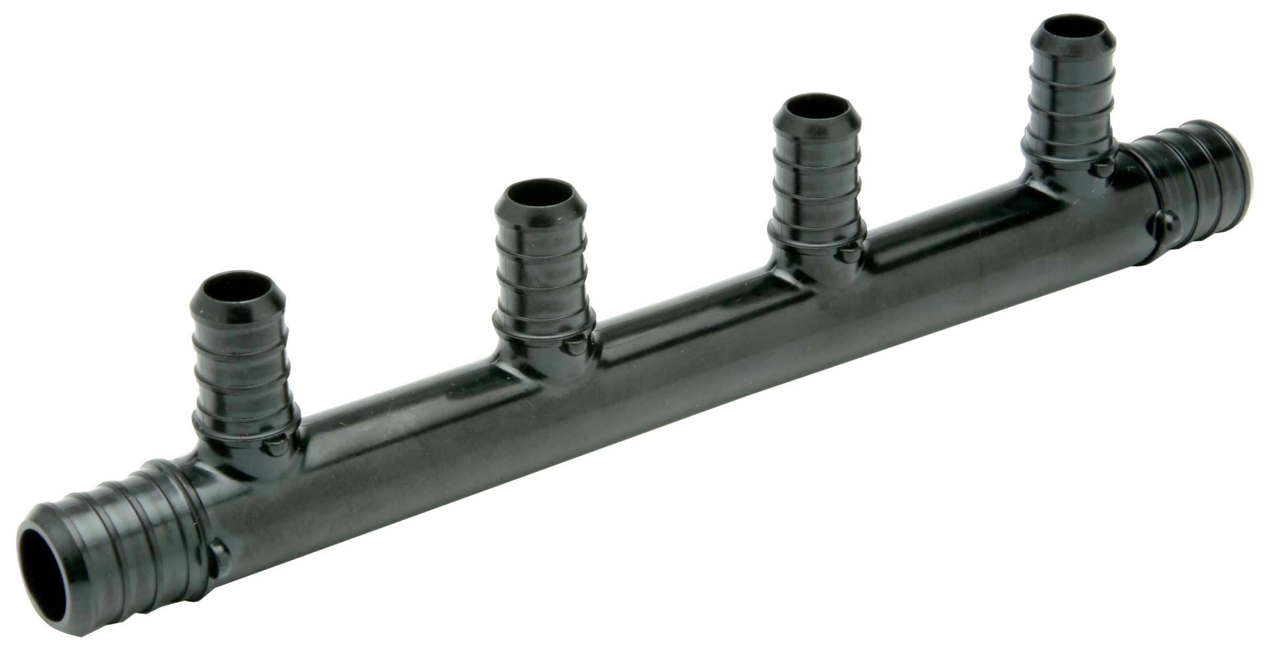
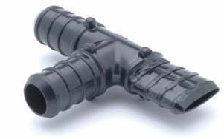
features & benefits PEX polymer fittings
Qick Sert CR® (chemical-resistant) tee
highly durable and easy to install
Crimp and expansion fittings that are fast and easy to install
crimp and expansion fitting types
Adapters-transition fittings
Elbows
Tees – standards and multi-port
Test plugs
Lead free
Couplings
Qick Sert CR® (chemical-resistant) multi-port tees
Zurn Qick Sert CR® fittings are molded using engineered polymers, making fittings highly resistant to chlorine and other chemicals present in potable water.
A superior alternative to brass fittings in areas with localized aggressive water chemistries.
When hit with a hammer, Zurn CR polymer fittings deform but do not break
2:50 Video:
Zurn PEX Plumbing Qick Sert CR Multi-Port Tees
4:54 Video:
Zurn PEX Plumbing Large Diameter Qick Sert CR Polymer Fittings

Slide 17
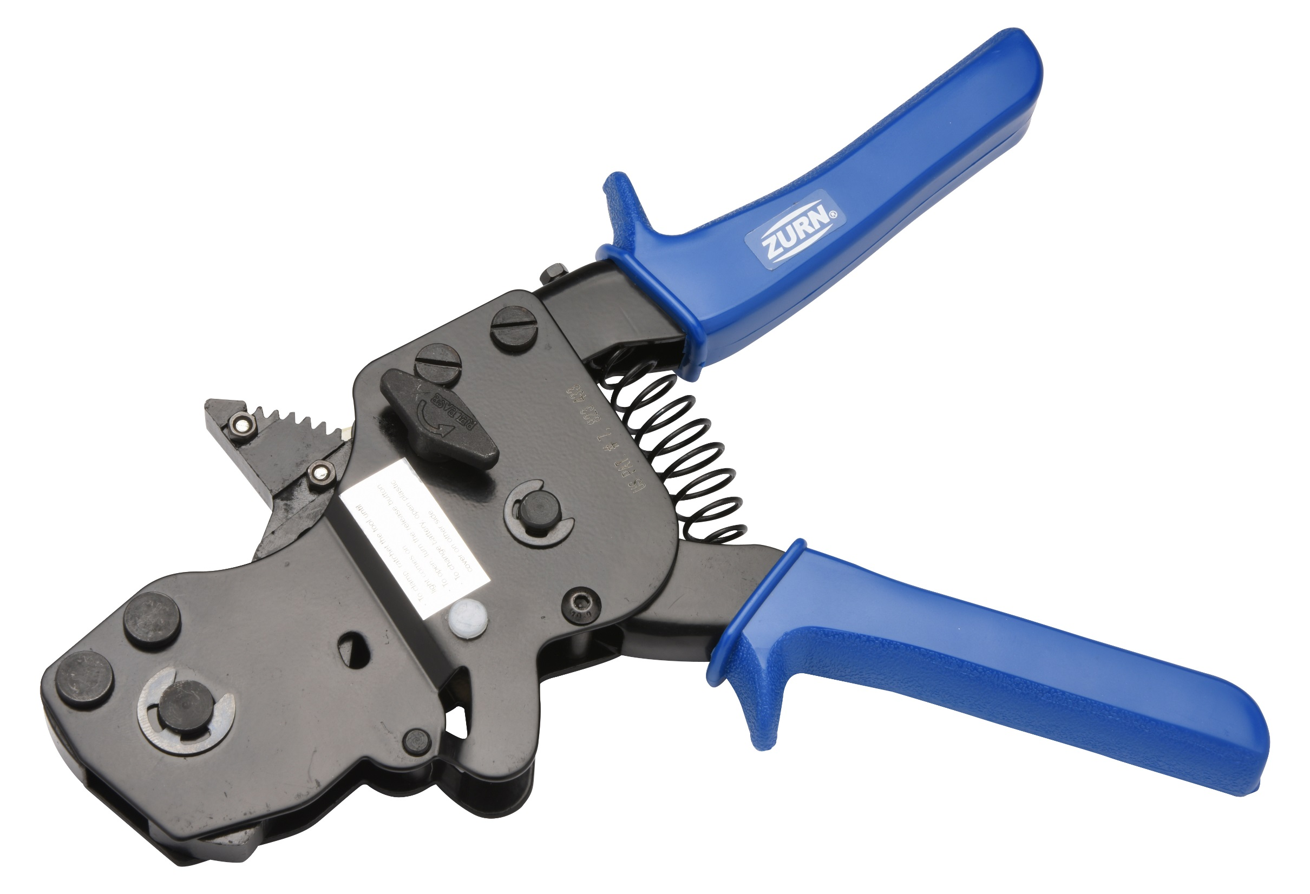
features & benefits PEX tools
easy installation and repairs
Tools for PEX installation and repairs
tool types
Pipe cutters
Crimping tools
QickClamp® tool
Deburring tool
Go/no-go gauge
Go/go gauge for
large diameter
polymer fittings
Expansion tools
stainless steel crimp ring tool,
one tool to crimp 3/8” – 1” pipes

Slide 18
features & benefits questions
How helpful would it be to have color differentiation? | Red, blue, and white pipes to visually differentiate hot and cold water lines and commercial applications 3/8”-2” flexible coils | Visual Color Representation Breadth of Size and Applications
How important is a 25-year warranty and overall durability? | Zurn PEX CR fittings are molded from engineered polymers, making fittings highly resistant to chlorine and other chemicals present in potable water Great for reverse osmosis or deionized water apps (when paired with PEX CR insert fittings) because it’s not susceptible to the corrosive effects of pure water Less susceptible to damage/noise due to pressure surges, greatly reducing the need for water hammer arrestors | Industry-Leading 25-Year Warranty Third Party Tested Corrosion, Mineral, and Freeze Resistant UV and Chlorine Resistant
Is pipe superiority important to you? | Zurn PEX pipes link up to four molecules at any given cross-link for superior mechanical strength and dimensional stability Highest density of the base resin Highest burst pressure rating and tensile strength in the industry Significantly higher levels of antioxidants for improved thermal, chlorine, and UV resistance Lead-free compliant | Pipe and System Superiority in the Industry Highest Burst Pressure Rating and Tensile Strength
How important is ease of installation? | Easy to install; requires fewer fittings One type of pipe for expansion or crimp fitting options Insert and crimp fittings that are fast and easy to install All tools necessary for PEX installation are available | Lean Installation
 |  |  |  |  |  |  | ADA

Slide 19
Test Your Knowledge
What are Zurn PEX plumbing’s top 3 benefits?
Pipe and system superiority
Lean installation
25-year warranty
3/8”-2” flexible coils

Slide 20
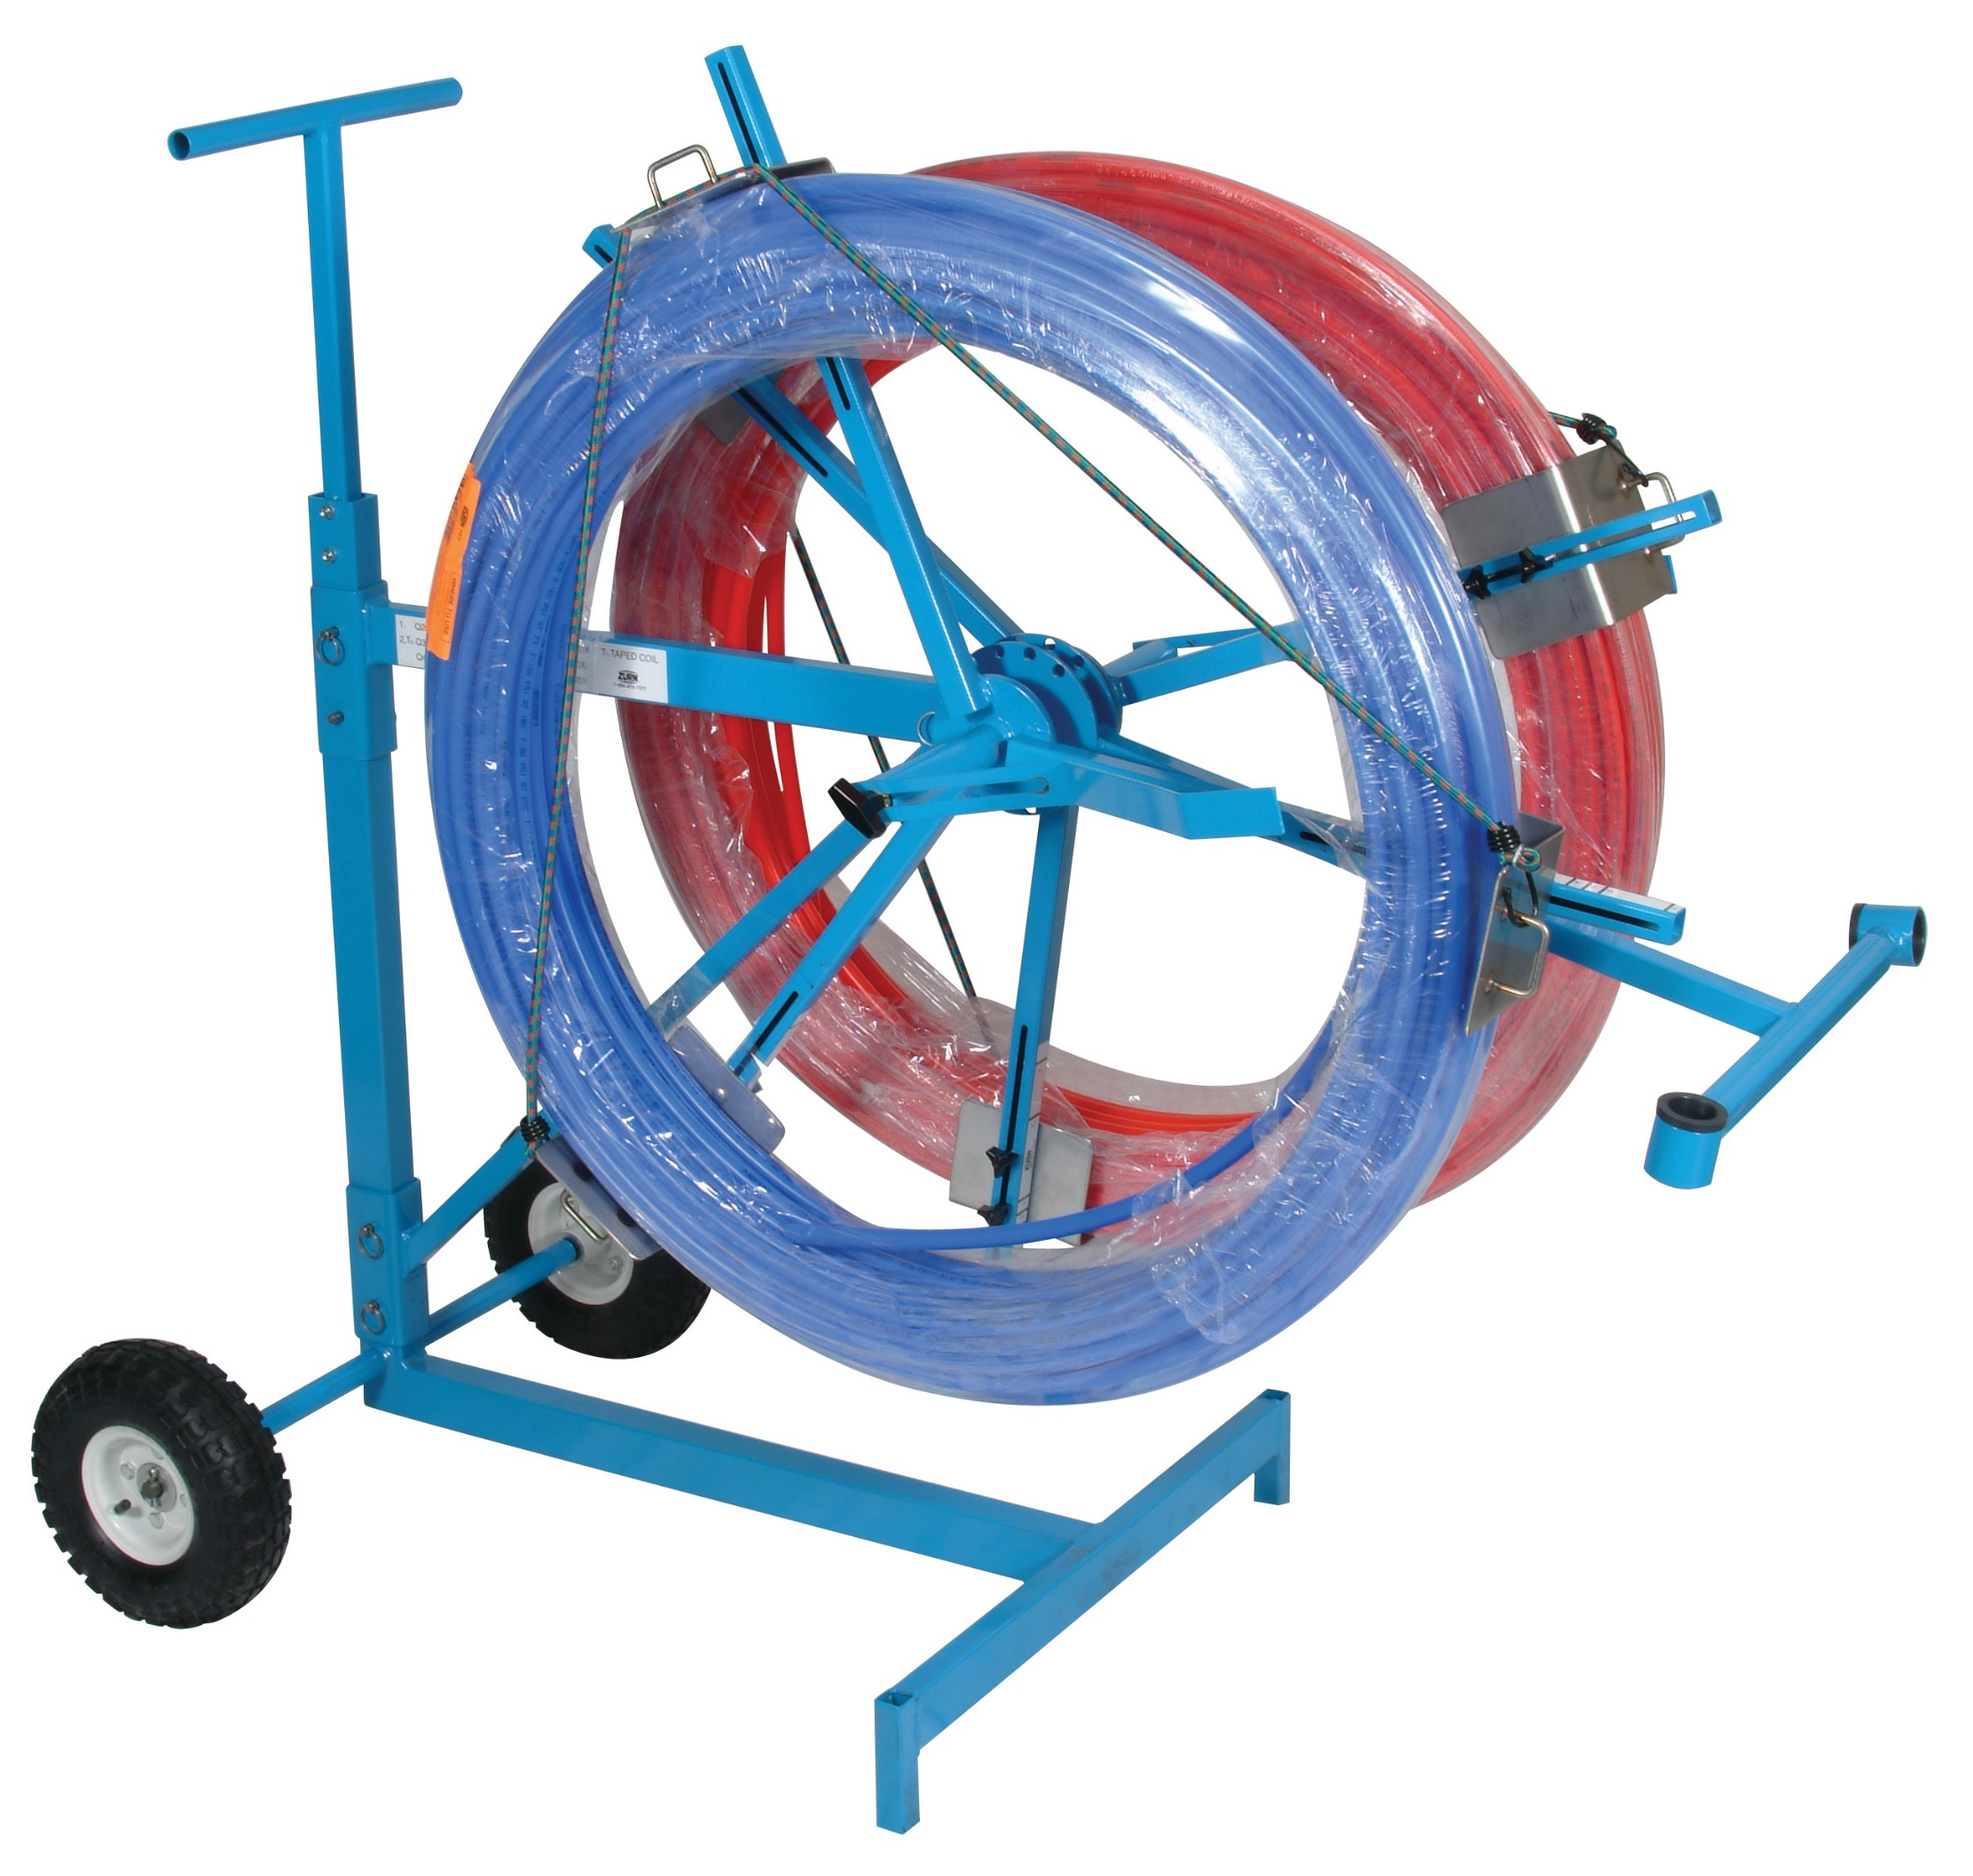
how to specify step-by-step
1
application
Residential plumbing, fire protection…
2
piping size
¼” – 2”
3
joining systems
Crimp or expansion
4
other
Certifications, warranties

Slide 21
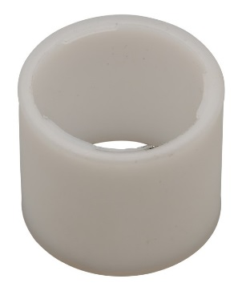
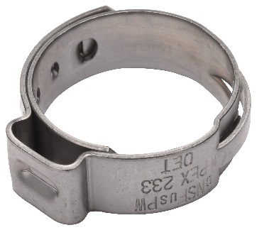
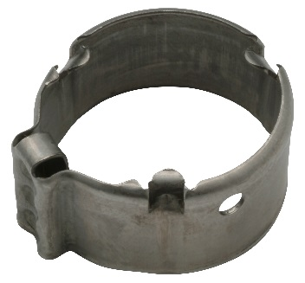
design & specify PEX plumbing
PEX PLUMBING | 1/4” | 3/8” | 1/2” | 3/4” | 1” | 1-1/4” | 1-1/2” | 2”
NSF to UL1821 for Use in Multipurpose Residential Fire Sprinkler (RFS) applications |  |  |  |  | RFS applications (white only) | RFS applications | RFS applications | RFS applications
Average Fluid Capacity in Gallons/Feet | 0.0024 | 0.005 | 0.0092 | 0.01843 | 0.0303 | 0.0454 | 0.0636 | 0.108
Medium and Color | 100’ coils - white | 100’ coil – white, blue, red 500’ coil – blue, red | 20’ straight – white, blue, red 100’ coil – white, blue, red 300’ coil – white, blue, red 500’ coil – white, blue, red 1000’ coil – white, blue, red | 20’ straight – white, blue, red 100’ coil – white, blue, red 300’ coil – white, blue, red 500’ coil – white, blue, red 1000’ coil – white, blue, red | 20’ straight – white, blue, red 100’ coil – white, blue, red 300’ coil – white, blue, red 500’ coil – white, blue, red | 20’ straight - white 100’ coil – white 300’ coil - white | 20’ straight - white 100’ coil – white 300’ coil - white | 20’ straight – white 100’ coil – white 300’ coil - white
Joining System |  | Expansion PEX Copper Crimp Ring Stainless Steel Crimp Ring QickClamp System | Expansion PEX Copper Crimp Ring QickCap Copper Crimp Ring Stainless Steel Crimp Ring QickClamp System | Expansion PEX Copper Crimp Ring System QickCap Copper Crimp Ring Stainless Steel Crimp Ring QickClamp System | Expansion PEX Copper Crimp Ring QickCap Copper Crimp Ring Stainless Steel Crimp Ring | Expansion PEX Copper Crimp Ring System QickCap Copper Crimp Ring | Expansion PEX Copper Crimp Ring System QickCap Copper Crimp Ring | Expansion PEX Copper Crimp Ring System QickCap Copper Crimp Ring
F1960 Expansion PEX System | Copper Crimp Ring System | QickCap Copper Crimp Ring System | Stainless Steel Crimp Ring System | QickClamp System
For plumbing applications Easy to Install Certified with NSF/ANSI Standard 14, NSF/ANSI Standard 61, NSF/ANSI Standard 372 (low lead), ASTM F1960, CSA B137.5 25 year warranty when used with ZurnPEX™ tubing | For plumbing or fire protection applications Zurn crimping tools provide approximately 2,000 lbs. of compression assuring a water-tight seal “360 degree” crimp Annealed copper crimp ring For use with SDR9 tubing 25 year warranty when used with ZurnPEX™ tubing | For plumbing or fire protection applications Accurately positions crimp ring on tubing to ensure proper installation Quick and easy installation reduces labor Simplified installation of crimp ring on the tube, even in tight spaces 25 year warranty when used with ZurnPEX™ tubing | For plumbing applications Crimping ear allows one tool for multiple sizes Stainless steel resists corrosion 15 year warranty when used with ZurnPEX™ tubing | For plumbing applications Crimping ear allows one tool for multiple sizes Stainless steel resists corrosion Gripping ribs minimize installation time Bridge feature provides uniform crimping forces Locating shoulder properly positions critical components Position indicator visually confirms assembly 25 year warranty when used with ZurnPEX™ tubing
Use with either Zurn F1960 CR Polymer Expansion Fittings or Zurn F1960 XL Low Lead Expansion Brass Fittings | Use with either Zurn PEX CR Polymer Crimp Fittings or Zurn PEX XL Low Lead Brass Crimp Fittings | Use with either Zurn PEX CR Polymer Crimp Fittings or Zurn PEX XL Low Lead Brass Crimp Fittings | Use with either Zurn PEX CR Polymer Crimp Fittings or Zurn PEX XL Low Lead Brass Crimp Fittings | Use with either Zurn PEX CR Polymer Crimp Fittings or Zurn PEX XL Low Lead Brass Crimp Fittings

Slide 22
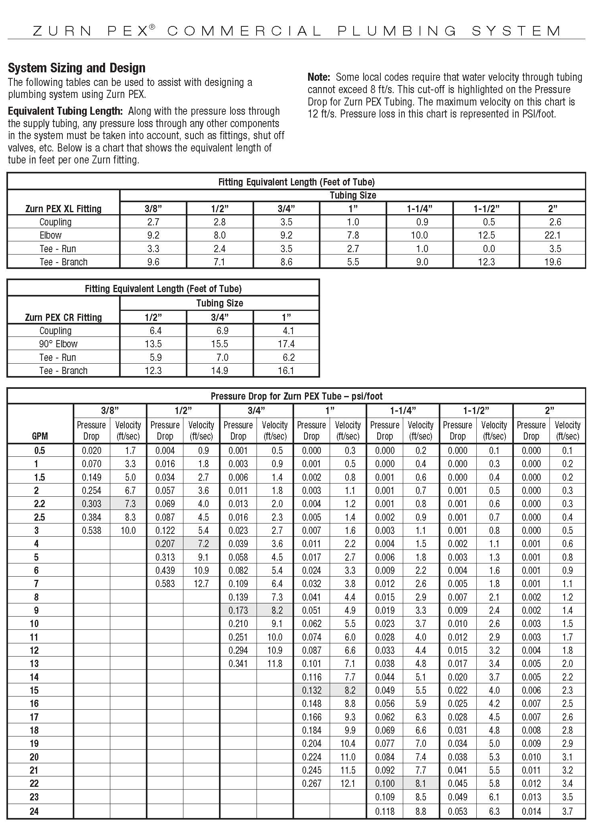
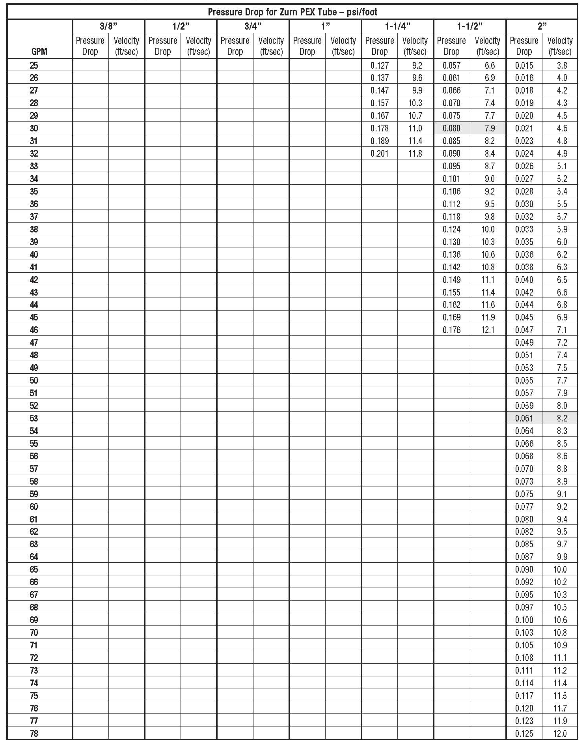
design & specify PEX plumbing

Slide 23
Test Your Knowledge
Place the following specify steps in the correct order:
A. Application
B. Joining systems
C. Piping size
D. Other

Slide 24
specify tools
Zurn.com tools | description
Manufacturer Cross Reference | Select a manufacturer, then product, type, or competitor product number to find the corresponding Zurn Product
ARCAT | Review CAD, BIM, and spec files
MasterSpec | Review spec files
Cross Reference Guides | Review cross reference guides for individual products
Product Warranties | Review One Zurn terms and conditions

Slide 25
summary what you learned
building owner
wholesaler
contractor
Industry-Leading 25-Year Warranty Highest Burst Pressure Rating and Tensile Strength Corrosion, Mineral, and Freeze Resistant
Third Party Tested, Pipe and System Superiority, 25-Yr Warranty
UV and Chlorine Resistant
Low Lead Compliant
Lean Installation & Maintenance
Superior Silane PEX Pipes for Various Installation Options
Pipe Color Options for Hot & Cold

Slide 26
summary Zurn overview
For more than a century, Zurn Engineered Water Solutions® has established itself as an innovator and leading manufacturer of highly engineered water product solutions.
Markets We Serve
Zurn Engineered Water Solutions is a recognized leader in commercial, municipal, and industrial markets, delivering sustainable building solutions for new construction and retrofit applications.
Industry Leading Product Lines
The Zurn product offering includes items such as specification drainage products, manual and sensor operated flush valves, radiant heating systems, snow melt systems, trench drain systems, backflow and fire protection systems, and much, much more.
Solutions We Provide
At Zurn we are committed to providing smart solutions that save time and money. Our goal is serving the customer through innovation, continuous improvement, and assurance behind every installation.
One Choice. One Zurn.
Choose Zurn for a reliable, recognized manufacturer to supply your entire installation, from behind the wall rough-in, to finished trim product and fixture systems.

Slide 27
resources support
address
phone
online
511 Freshwater Way
Milwaukee, WI 53204
toll-free 1-855-ONE-ZURN
zurn.com
Product Pages | Tools, Specifications, & Resources | Vertical Market Solutions
inSpec | Manufacturer Cross Reference | ARCAT | MasterSpec | SpecBuilder |
Specifiers | BIM/Revit Files
zurn.com/resources/product-training
Zurn Product - Overview
How to Install and Support
facebook.com/ZurnIndustries
twitter.com/ZurnIndustries
linkedin.com/company/ZurnIndustries
youtube.com/ZurnIndustriesLLC

