Slide 1
Zurn Roof Drains - Overview
July 25, 2019

Slide 2
agenda what you’ll learn
01
value proposition
02
features & benefits
03
how it works
04
design & specify
05
summary
06
resources

Slide 3
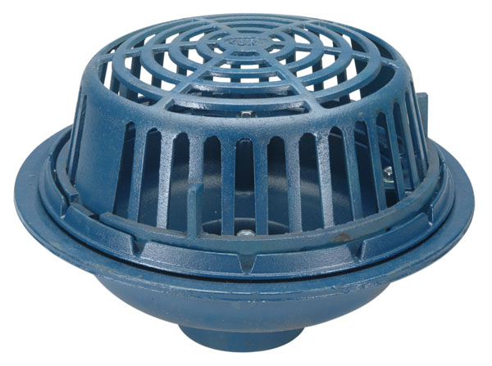
Z100
15” diameter
primary roof drain
For building owners, engineers, and contractors,
Zurn Industries provides a wide array of roof drains that systematically control the removal of rainwater from commercial/industrial roofs allowing for the efficient and effective egress into the storm sewer

Slide 4
voice of customer industries
building owner
architect & engineer
contractor
“I need products that are aesthetically pleasing, durable and have a low total cost of ownership + require minimum downtime for maintenance.”
“I need products that are aesthetically pleasing, durable and cost-effective.”
“I need products that are easy and cost-effective to install and maintain, that are assembled and packaged in a manner that streamlines installation.”
Healthcare | Retail | Food Service | Hospitality | Restaurants | Institutional/Education | Government

Slide 5
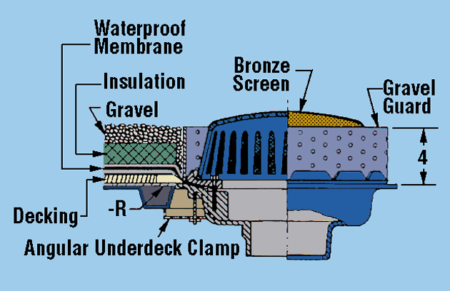
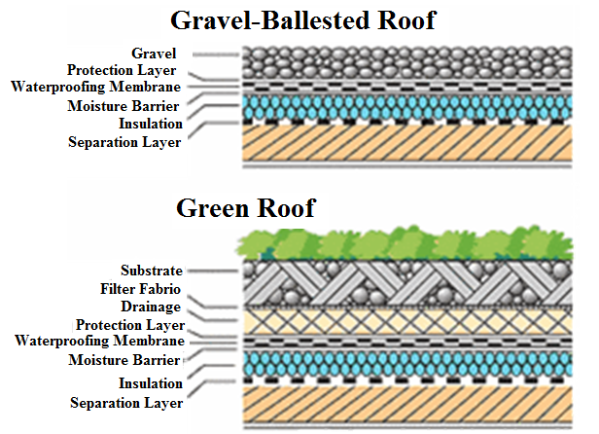
features & benefits roof drainage basics
Waterproofing seals any moisture from entering the building, commonly a EPDM sheet or mopped on tar
Insulation is a layer of foam that isolates the building from external temperatures and prevents melting on the roof

Slide 6
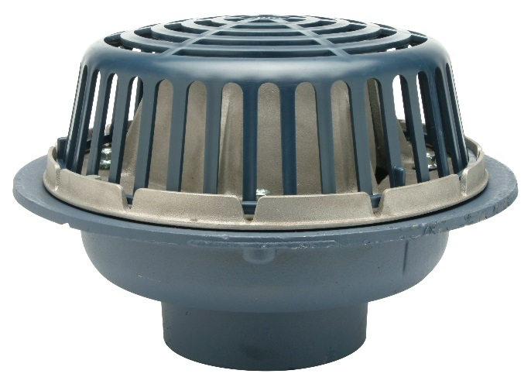
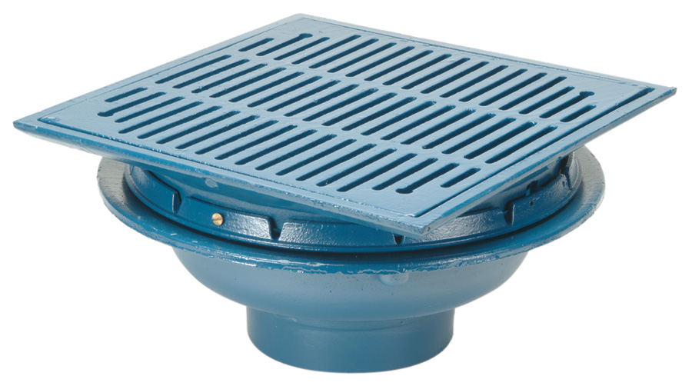
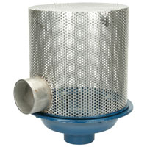
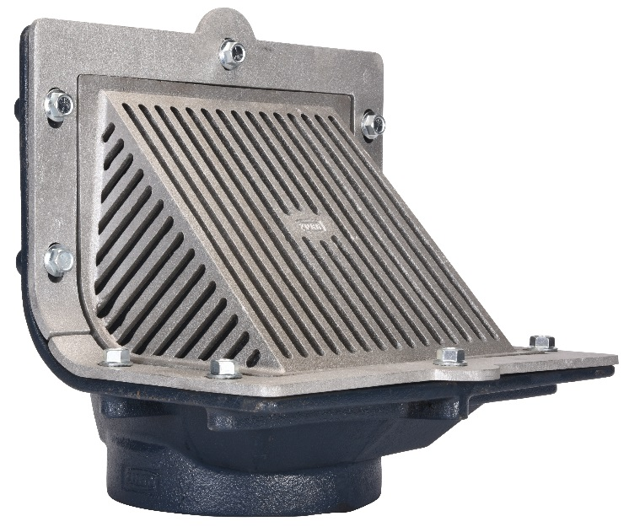
features & benefits roof drains
systematic rainwater drainage
Systematically collects and drains rainwater off a roof
Drain body materials = cast iron (for fire codes), stainless steel, polymer
Various flange diameters to accommodate a range in roof sizes
New construction and retrofit drains
Many interchangeable drain components
common roof drains
Primary roof drains
Control-Flo™ roof drains
Siphonic roof drains
Promenade/deck roof drains
Green roof drains
Scupper (overflow) roof drains
ASME standard
One-year warranty, to match most new building warranties

Slide 7
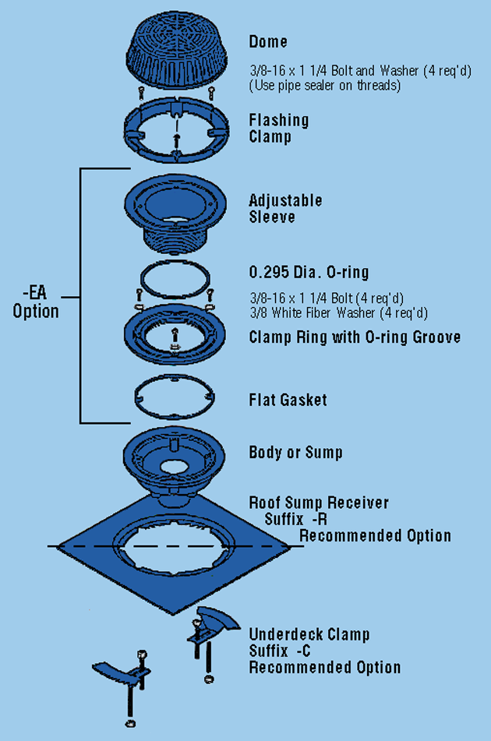
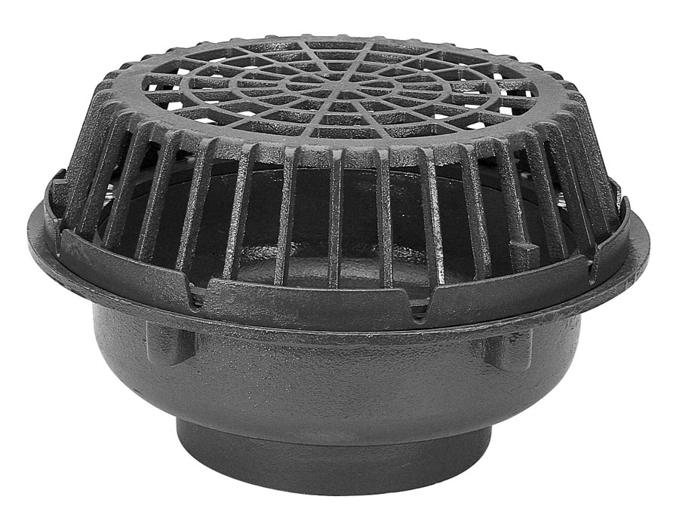
features & benefits primary roof drains
main roof drainage
Collects rainwater from the roof and drains it into the storm sewer
Provides drainage for large, medium, and small roof areas
Accessories = deck plates, extensions, and underdeck clamps
Z100
15” diameter
primary roof drain
Z100
Highly customizable
Standard with clamping collar and low silhouette Poly-Dome
Aluminum, bronze, and cast iron domes also available
2”-8” outlet sizes
Z101
Dome open area of 216 square inches for high capacity
8”, 10”, and 12” no-hub connection only
Standard with clamping collar and low silhouette iron dome
Z101
20” diameter high capacity
primary roof drain

Slide 8
features & benefits Control-Flo™ roof drains
storm water retention
Z105 Control-Flo™ roof drain, with internal parabolic weir managing 10 GPM flow per inch of head depth
Reduces peak storm water discharge and strain on the storm water infrastructure by retaining rainwater on roofs
key features
Internal parabolic weir, clamping collar, gravel guard, and Poly-Dome
Dura-Coated cast iron body – will form rust which actually protects the cast iron and makes it stronger, forming “patina”
Purposely restricts flow to 10 GPM per inch of water above drain body

Slide 9
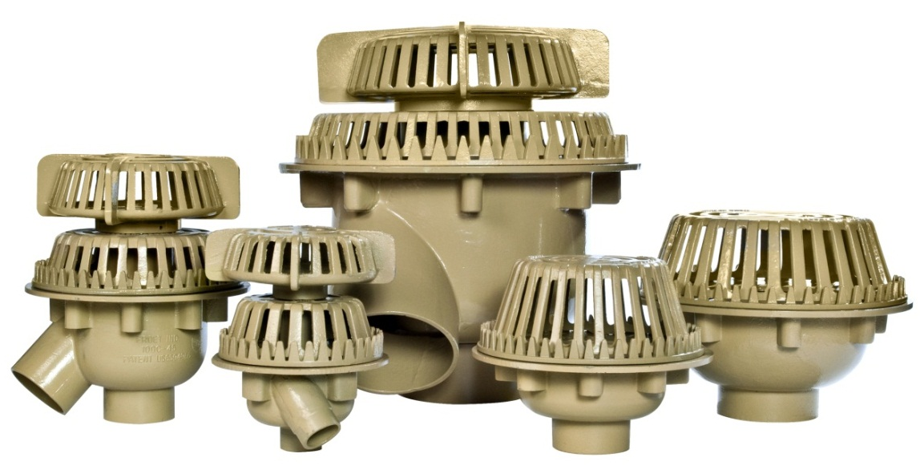
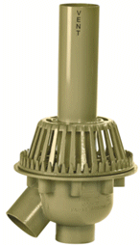
features & benefits bi-functional roof drains
Froet roof drains
Designed like no other roof drain
The industry’s original patented bi-functional roof drain and drain with vent
Notes:
Jill Nagg

Slide 10
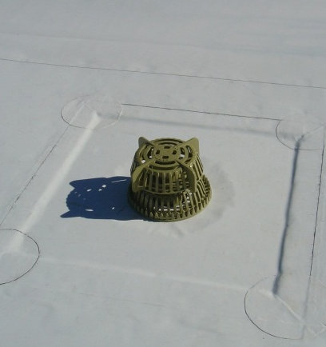
features & benefits bi-functional roof drains
Froet roof drains
Cast iron
Fully cast one piece sump
Powder coated finish
Labor savings
Roof penetration reduction
Roof drainage simplified
Most stoutly built roof drain on the market
UPC and IPC Listed
Notes:
Jill Nagg

Slide 11
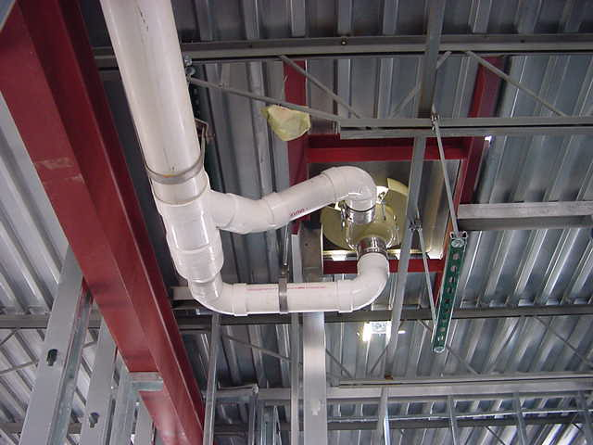
features & benefits bi-functional roof drains
superior quality
Cast iron construction for all parts (no plastic)
Powder coat finish exceeds the industry standard
Superior quality will provide decades of service
Notes:
Jill Nagg

Slide 12
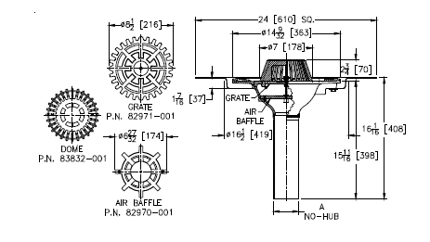
features & benefits siphonic roof drains
higher flow velocities
More efficient than conventional drainage
key features
Hold water in high volume situations, to avoid flooding the sewer system
Engineered air baffle induces siphonic action and eliminates air from piping system - no pitch requirement in piping to induce flow
High flow velocities help to clean pipes; no cleanouts necessary
Low baffle location; requires only 2” of water on roof to go siphonic
Small pipe diameters achieve equal flow rates
Vertical stack placement is flexible
Flow rates:
2” 147 GPM
3” 380 GPM
4” 703 GPM
Engineered to reduce installation and rework time
LEED points potentially awarded for siphonic construction

Slide 13
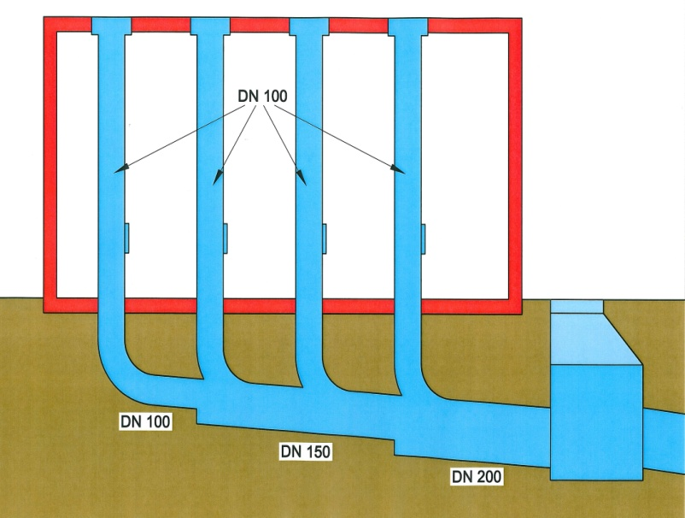
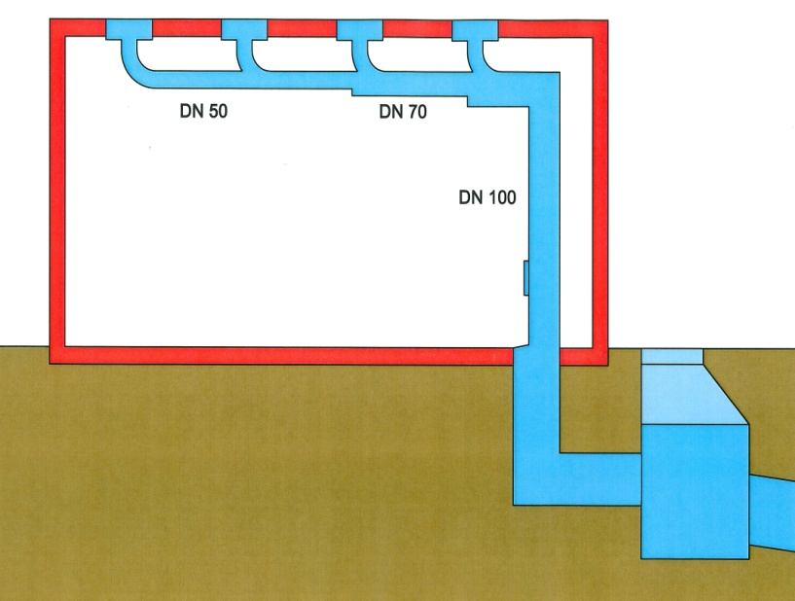
how it works step-by-step
4” diameter
conventional roof drain system
1
negative pressure is created
After 2” of water collects on the roof, above an air baffle; water forces air out; and negative pressure is created in the pipe
4” diameter
6” diameter
2
air baffle prevents vortex flow
8” diameter
The air baffle prevents vortex flow and restricts air from entering the pipes
3
gravity drainage reoccurs
2” diameter
3” diameter
Multiple vertical pipes flow into a common horizontal pipe and eventually turn downward into a vertical downspout where conventional gravity drainage returns
8” diameter
siphonic roof drain system
1:51 Video:
Zurn Roof Drains Siphonic Drainage Systems

Slide 14
Test Your Knowledge
How do Zurn siphonic roof drains function?
What is required to make a siphonic drain go to full bore flow:
Dome
Baffle
Gravel guard
None of these

Slide 15
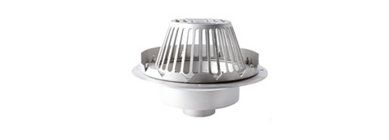
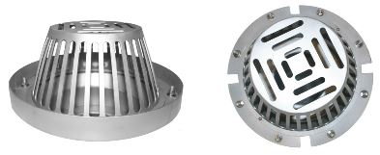
features & benefits stainless steel roof drains
SDcRF-R4X150 Roof Drain Standard Configuration
15” Diameter
304 Stainless Steel Construction
Stainless Steel Combination Membrane and Flashing Collar
Stainless Steel Dome
2” 3” 4” or 6” Outlet
Schedule 10 or Schedule 40 Outlet
SDcRF- R4X150 Roof Drain Options
17” Diameter
316 Stainless Steel Construction
Stainless Steel Gravel Guard
Under Deck Clamp
2” High Stainless Steel External Water Dam
Stainless Steel Adjustable Outlet (4” Sch. 40 Only)
collects rainwater on a roof & discharges it into a leader or downspout
corrosion-resistant properties
customizable to meet any customer need

Slide 16
features & benefits promenade/deck roof drain
for pedestrian/vehicular traffic
Rotatable frame ideal for use with paver systems
Z150 series promenade/deck roof drain
key features
Cast iron heel-proof grating
Decorative top (-DT) or nickel bronze veneer options
Available in:
Z150 16” square frame
Z154 12” square frame
Z158 10” square frame

Slide 17
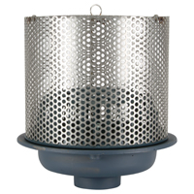
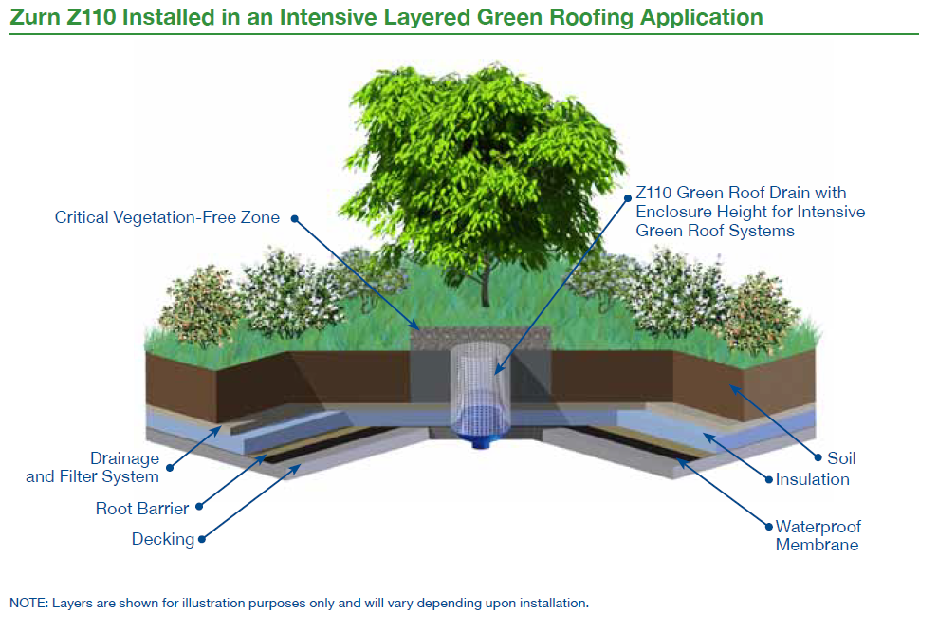
features & benefits green roof drains
prevents gravel/soil from entering
Typically installed in a rooftop planting areas
Z110
Z110-AI,
with auxiliary inlet
for additional drainage capabilities
key features
Custom height enclosures, designed for both extensive and intensive green roof applications, guarantee the roof drain aligns with the green roof surface
Stainless steel perforated extension allows for optimal flow
Removable lid allows for easy routine maintenance
May be fully or partially recessed in dirt/substrate

Slide 18
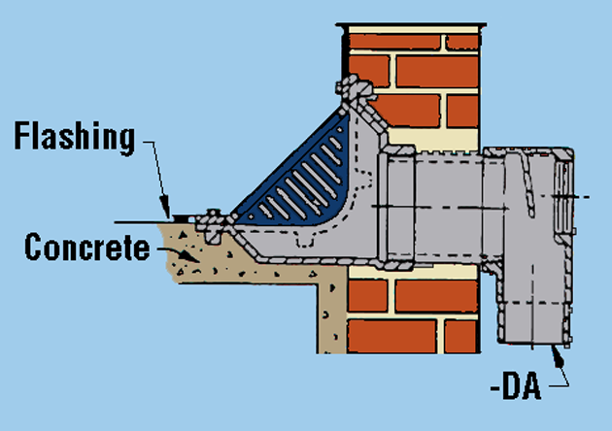
features & benefits scupper (overflow) drain
Optional –DA downspout adapter connect directly to downspout
scupper drains
Placed within the *parapet wall
*The wall that runs around the outside of the roof and prevents water from running down the sides of the building
key features
Z187-6NH scupper drain
Cast iron or stainless steel body material
–BS bronze mesh screen option, to keep debris out
Reversible back or bottom outlets
Typically used for secondary drainage on pitched roofs
Clamping ring to secure waterproofing to drain
Vandal-proof option

Slide 19
features & benefits accessory
Z199-6IP downspout nozzle
downspout nozzles (cows tongue or lambs tongue)
Directs water away from building, preventing stains on exterior walls
key features
Decorative bronze or nickel bronze finish
Flange secures downspout to building, preventing theft
PVC connection requires machining for 3 set screws
No-hub or threaded options

Slide 20
features & benefits questions
Do you need a highly durable AND aesthetically pleasing drain? | Product Aesthetic Aesthetically pleasing/heel proof promenade roof drains | Aesthetically Pleasing Options
Do you need drainage speed/volume control? | Use Systematically removes rainwater efficiently and effectively Siphonic drains provide high flow velocities which help clean pipes; no cleanouts necessary Green roof drains available | Systematically Controls Water Removal
Do you have a unique roof drain requirement? | Design & Specify Zurn Online Specification Tools Wide array of roof drains for a variety of applications Customizable drains Body materials = cast iron, stainless steel, and polymer Various flange sizes to support a range in open roof area sizes Some drains are designed to retain storm water on roofs, to reduce strain on the storm water infrastructure | Options for Various Roofing Sizes/Types Customizable Options Available Ease of Compatibility Highly Durable
Do you need to be efficient with installation? | Install New construction and retrofit drains Engineered to reduce installation and rework time LEED points potentially awarded for siphonic construction | Ease of Installation and Rework
Do you need vandal-proof drains and components? | Vandalism/Theft Minimization Vandal-proof drain options | Vandal-Proof Options
 |  |  |  |  |  |  | ADA

Slide 21
Test Your Knowledge
What are Zurn roof drains’ top 3 benefits?
Systematic water drainage and control
LEED points potentially available
Wide array of drain options for a variety of applications
Ease of installation

Slide 22
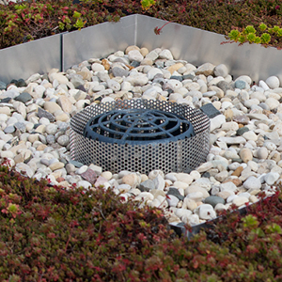
how to specify step-by-step
1
application
Primary, overflow, siphonic, control flow, scupper
2
# drains required
3
construction type
Deck plates, extensions, vandal proofing, water dams…

Slide 23
ROOF DRAINS Application Model-Pipe Sizes- Description | 8” | 12” | 15” | 20” | OTHER
Primary | Z125 2” 3” 4”; Small Areas Z127 2” 3” 4”; 8-1/2” Small Areas | Z111 3” 4” 6”; Flat For Metal Decks Z121 2” 3” 4” 6”; Low Silhouette Dome Z122 2” 3” 4” 6”; Deck Receptor Z1715 3” 4” 6”; Low Silhouette Dome RD2120 2” 3” 4”; Replacement | Z100 2” 3” 4” 6” 8”; Water Insulated Roof Z104 3” 4” 6” 8”; Deep Sump, Low Silhouette Dome Z105 2” 3” 4”; For Dead Level Roofs Z108 2” 3” 4” 6” 8”; Deck Receptor | Z107 3” 4” 6” 8”; Deck Flange | (4-1/2”) RD08PLP3S 2” 3” 4”; 4” Replacement
Combination-Primary-Overflow (Easy Installation) | Z165 2” 3” 4”; Low Silhouette Dome | Z164 2” 3” 4” 6”; Low Silhouette Dome | Z163 2” 3” 4” 6” 8”; Low Silhouette Dome
High Capacity |  |  |  | Z101 8” 10” 12”; Low Silhouette Dome
Siphonic (Easy Installation) |  |  | Z130 2” 3” 4”; 14-9/32” Main Z131 2” 3” 4”; 14-9/32” Overflow
Control Flow |  |  | Z105 2” 3’ 4”; Parabolic Weir
Green Roof |  |  | Z110 2” 3” 4” 6” 7” 8”; Perforated Screen Assembly
Promenade (Heel-Proof, Square) | Z158 2” 3” 4”; 10” Square | Z154 2” 3” 4” 6”; 12” Square | Z150 2” 3” 4” 6” 8”; 14” Square
Retrofit |  | RD2150 3” 4” 5” 6”; 12-1/2” Light Commercial Replacement
Bi-Functional Froet (Easy Installation) |  |  |  |  | Z103 4”, 6”, 8”
Cornice (For Canopies/Terraces) |  |  |  |  | (4-1/2”) Z180 2” 3”; Bottom Outlet (4-1/2”) Z182 2”; 90° Outlet (6”) Z181 3” 4”; Bottom Outlet (6”) Z185 3” 4”; 90° Outlet
Scupper |  |  |  |  | Z160 4” 6”; 135° 12” Wide Z161 2” 3”; 3”x10” Oblique Grate Z187 2” 3” 4” 6” 8”; 6”x7”, 8”x12” Oblique Grate Z189 2” 3” 4”; 5”x6”x11” 45° Outlet Z1717 3” 4”; 7-1/2” Wide

Slide 24
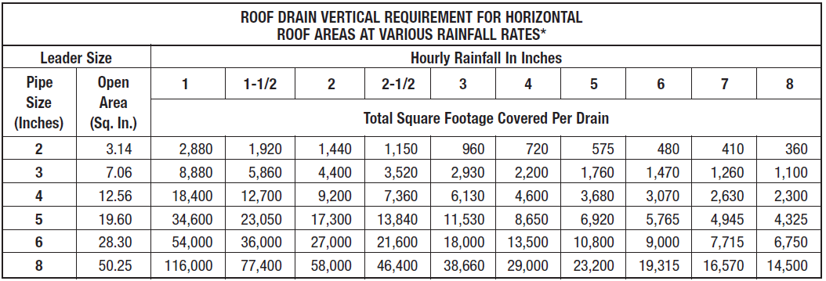
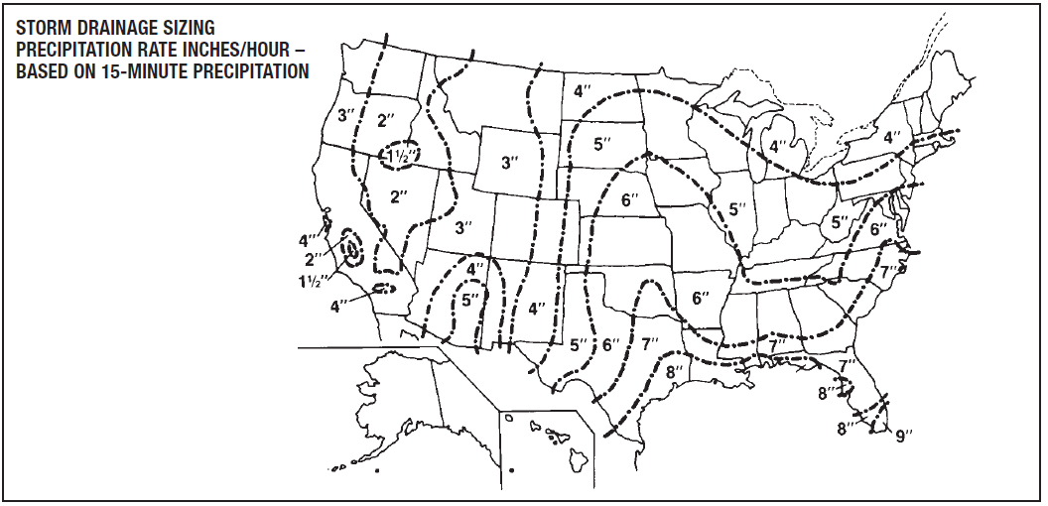
design & specify roof drain sizing
example
Erie, PA
4”/hr. rainfall
20,000 sq. ft. roof
4” pipe preferred
1. area drain will cover
4600 sq. ft.
2. number of drains needed
20,000/sq. ft. / 4600 sq. ft. per drain = 4.3 drains needed
Round up to 5 drains needed

Slide 25
design & specify options
Static Extension (-E)
Used when a fixed insulation thickness is known
Raises the clamp collar to the finished roof surface
Membrane is installed under the top clamp collar
Adjustable Extension (-EA)
Provides accurate adjustability to the finished roof surface
Provides extension height from 2-1/8”-3-1/2”
Used when exact extension height is not known
Top-Set Adjustable Extension Assembly (-EB)
Engineered to reduce installation and rework time
Perforated Extension (-85)
Used to extend the drain assembly to finished roof surface
Allows for seepage of rainwater within the roofing insulation

Slide 26
Test Your Knowledge
Place the following specify steps in the correct order:
A. Application
B. # drains required
C. Construction type

Slide 27
design & specify tools
Create unlimited configurations
Solidify your basis of design
Generate your submittal package
Edit, share and copy projects
Zurn.com tools
inSpec | Create configurations, solidify your basis of design, generate your submittal package, edit/share/copy projects
Manufacturer Cross Reference | Select a manufacturer, then product, type, or competitor product number to find the corresponding Zurn Product
ARCAT | Review CAD, BIM, and spec files
Light Commercial Drainage System | Configure unique drainage systems complete with specifications and submittal data
BIM/Revit Files | Browse BIM objects
Cross Reference Guides | Review cross reference guides for individual products
Technical Resources | Review specs, calculation sheets, engineering guides, sizing and selections, materials and finishes, installation +
Product Warranties | Review One Zurn terms and conditions

Slide 28
summary what you learned
building owner
architect & engineer
contractor
Systematic Control of Rainwater Removal Highly Durable; Aesthetically Pleasing Options Customizable Options Available
Wide Array of Drain Options for a Variety of Applications
All Highly Durable; Aesthetically Pleasing Options
Systematic Control of Rainwater Removal
Ease of Installation and Rework
New Construction & Retrofit
Drains Designed for Specific Roof Types

Slide 29
summary Zurn overview
For more than a century, Zurn Engineered Water Solutions® has established itself as an innovator and leading manufacturer of highly engineered water product solutions.
Markets We Serve
Zurn Engineered Water Solutions is a recognized leader in commercial, municipal, and industrial markets, delivering sustainable building solutions for new construction and retrofit applications.
Industry Leading Product Lines
The Zurn product offering includes items such as specification drainage products, manual and sensor operated flush valves, radiant heating systems, snow melt systems, trench drain systems, backflow and fire protection systems, and much, much more.
Solutions We Provide
At Zurn we are committed to providing smart solutions that save time and money. Our goal is serving the customer through innovation, continuous improvement, and assurance behind every installation.
One Choice. One Zurn.
Choose Zurn for a reliable, recognized manufacturer to supply your entire installation, from behind the wall rough-in, to finished trim product and fixture systems.

Slide 30
resources support
address
phone
online
zurn.com
Product Pages | Tools, Specifications, & Resources | Vertical Market Solutions
inSpec | Manufacturer Cross Reference | ARCAT | MasterSpec | SpecBuilder |
Specifiers | BIM/Revit Files
zurn.com/resources/product-training
Zurn Product - Overview
How to Install and Support
facebook.com/ZurnIndustries
twitter.com/ZurnIndustries
linkedin.com/company/ZurnIndustries
youtube.com/ZurnIndustriesLLC
511 Freshwater Way
Milwaukee, WI 53204
toll-free 1-855-ONE-ZURN

