Slide 1
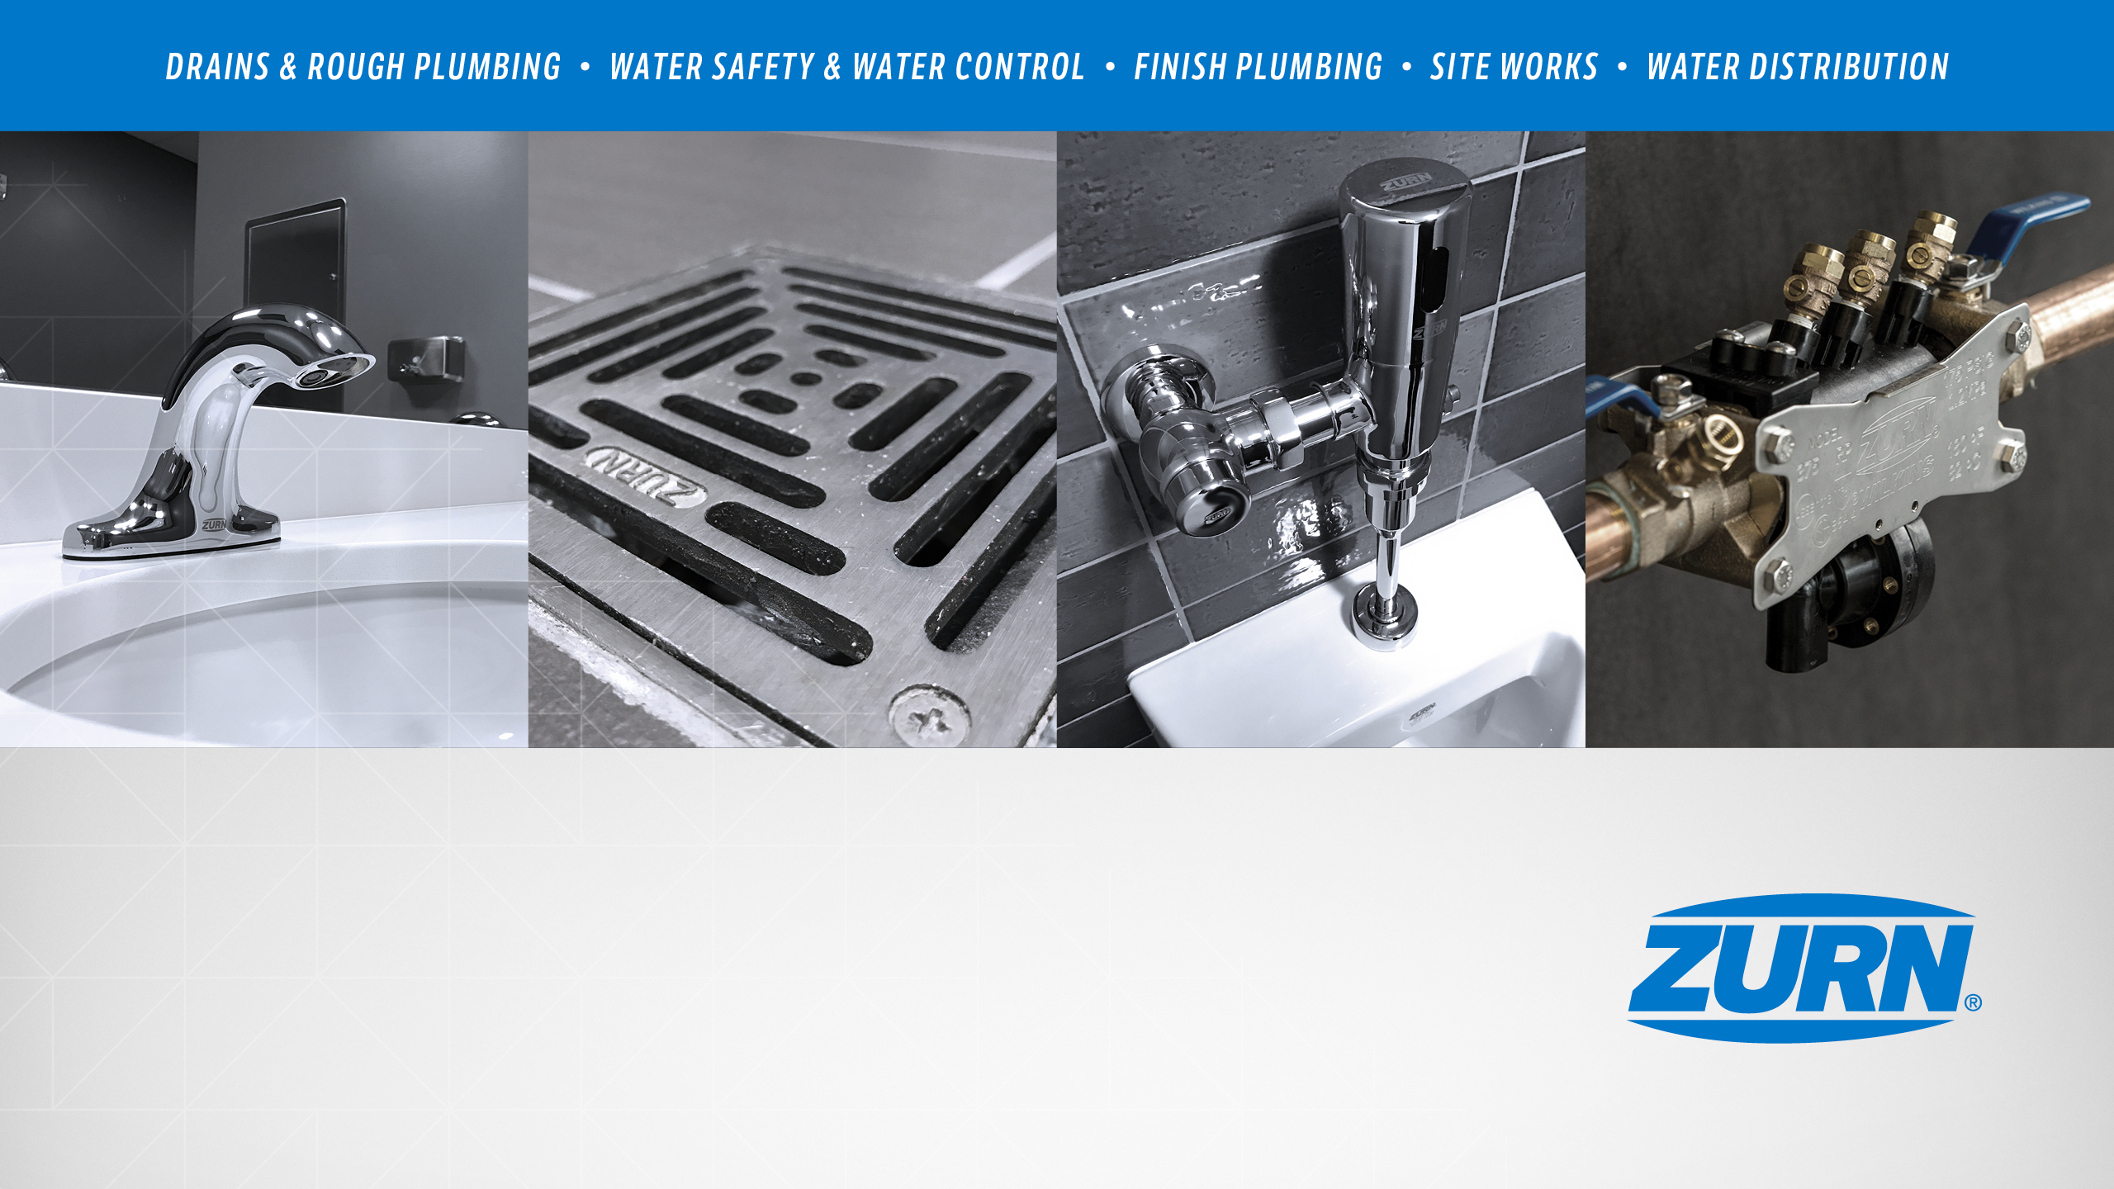
Zurn Thermostatic Mixing Valves –
Overview
March 2019

Slide 2
agenda what you’ll learn
01
value proposition
02
how it works
03
features & benefits
04
design & specify
05
summary
06
resources

Slide 3
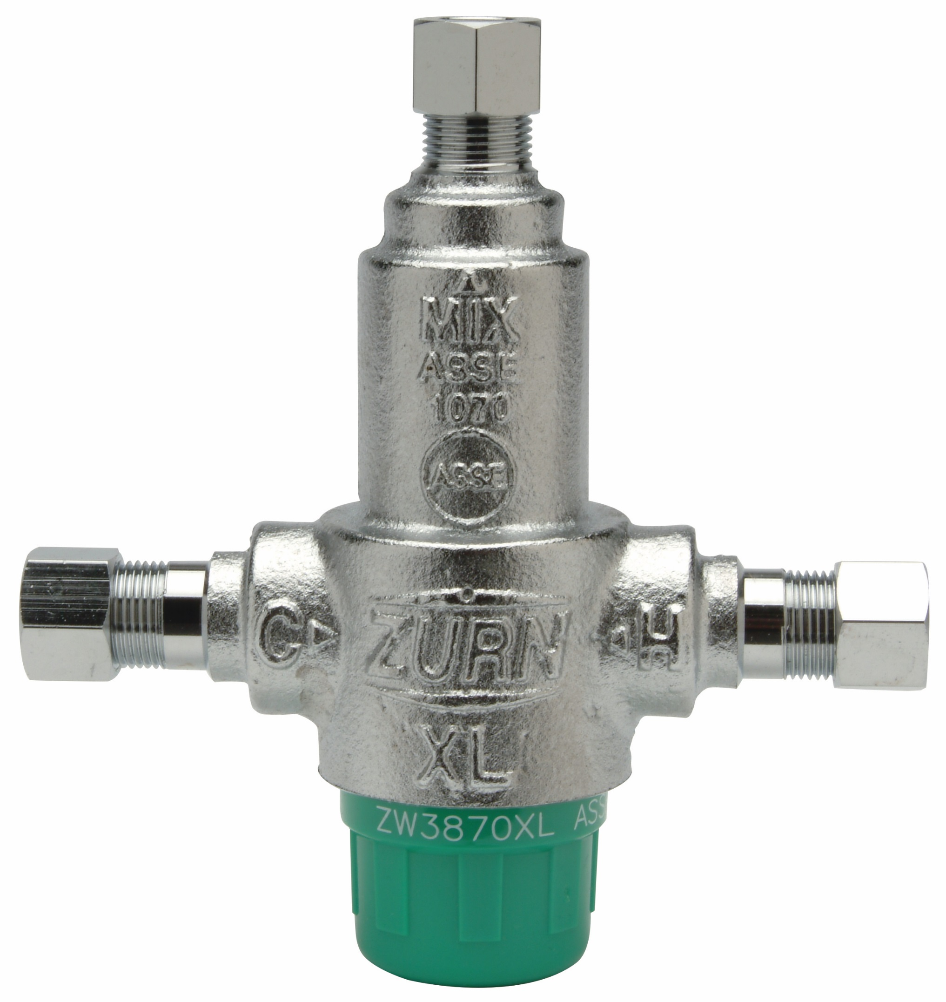
Aqua-Gard® ZW3870XLT thermostatic mixing valve
For building owners, engineers, and contractors,
Zurn Industries provides thermostatic mixing valves
that mix hot and cold water from the distribution system to final end connection at a desired temperature,
providing safe protection from scalding and bacterial infection, while delivering lower energy costs

Slide 4
features & benefits why thermostatic control? – conflicting needs
Scalding Injury
Maintain the temperature of the delivered hot water to below 120°F, to minimize Scalding
Bacterial Infection
Maintain the temperature of the hot water heater to 140°F to minimize the potential of Legionella
Energy Costs
The American Society of Plumbing Engineers has noted that maintaining hot water at 140°F vs. 110°F resulted in LESS energy use and lower costs – 1989 study
*The supply of stored heated water is extended, as less hot water is required to maintain comfortable temps for showering, bathing, and washing
Temperature | Result
68º F | Dormant
69 – 122º | Growth Range
95 - 115º | Ideal Growth Range
122º | Can Survive, Won’t Multiply
131º | 5-6 Hours to Kill (Risk of Scalding)
140º | Dies within 32 Minutes (High Risk of Scalding)
150º | Dies within 2 Minutes (Scald Injury Likely)
Temperature | Adult | Child
120º F | 4 – 5 Minutes | 4 – 5 Minutes
130º | 30 Seconds | 30 Seconds
140º | 5 Seconds | 1 Second
150º – 160º | 1 Second | .5 Second
2nd degree = blisters
3rd degree = destruction of skin, tissues
Integration of a thermostatic mixing valve into a plumbing system allows for the use of >140°F water to fight bacterial infection as well as maximize energy efficiency, while providing safely tempered water to a fixture (such as a sensor faucet) without the risk of scalding

Slide 5



voice of customer industries
building owner
architect & engineer
contractor
“I need products that are durable and have a low total cost of ownership + require minimum downtime for maintenance.”
“I need products that are durable and cost-effective.”
“I need products that are easy and cost-effective to install and maintain, that are assembled and packaged in manner that streamlines labor.”
Healthcare | Retail | Food Service | Hospitality | Restaurants | Institutional/Education | Government

Slide 6
how it works step-by-step
1
1
adjusting spindle
Allows user to preset desired outlet temp
4
2
2
2
water enters mixing valve
5
Hot and cold water enters mixing chamber
3
thermal motor
Senses change in outlet temperature
3
4
actuator
Extends or retracts in response to temperature
5
flow cartridge
Moves in opposite direction of actuator to adjust the incoming amount of hot and cold water
6
6
preset temperature
Temperature is maintained

Slide 7
how it works rapid temperature adjustments
1
thermal motor
Thermal motor expands
3
2
2
actuator
Actuator extends into spindle
4
5
1
3
flow cartridge
Flow cartridge is pushed down
4
cold supply
Cold supply increases
5
hot supply
Hot supply decreases

Slide 8
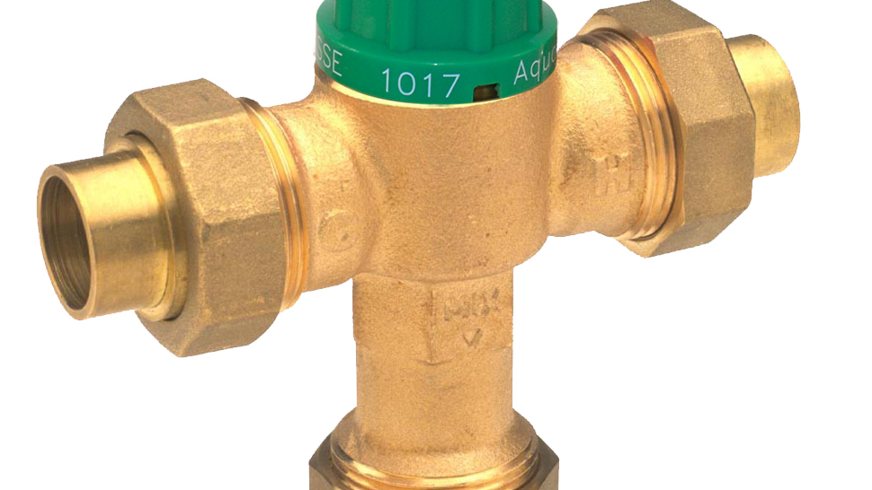
Test Your Knowledge
How do thermostatic mixing valves react to sudden increases in temperature?
Place the following in the correct order:
Flow cartridge is pushed down
Thermal motor senses outlet temperature and reacts by expanding or contracting
Actuator is pushed by the thermal motor and rams spindle
Both cold and hot water supplies are adjusted quickly to deliver a safe temperature mixture

Slide 9
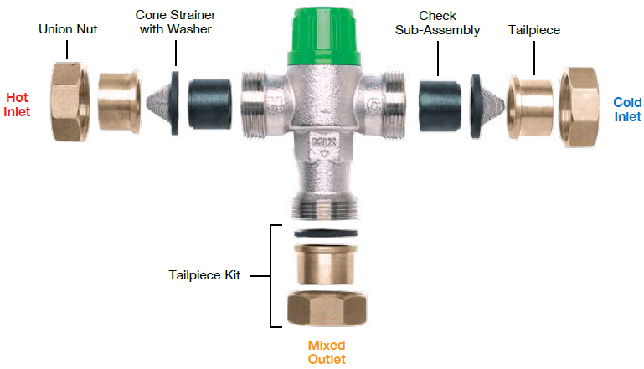
features & benefits checks and screens
Checks protect the water system from crossing hot and cold lines
Screens protect the valve from debris and fouling
Multiple tailpiece option increase installation versatility
Copyright © 2017 by American Society of Plumbing Engineers

Slide 10

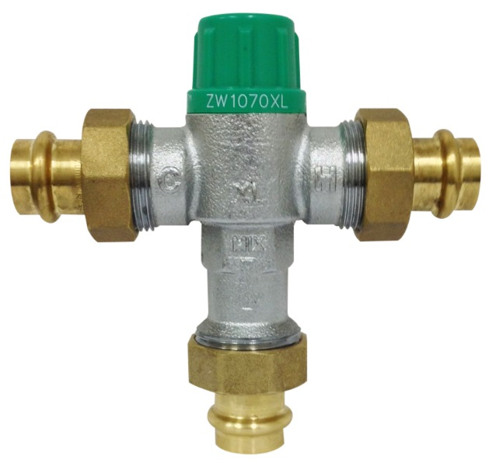

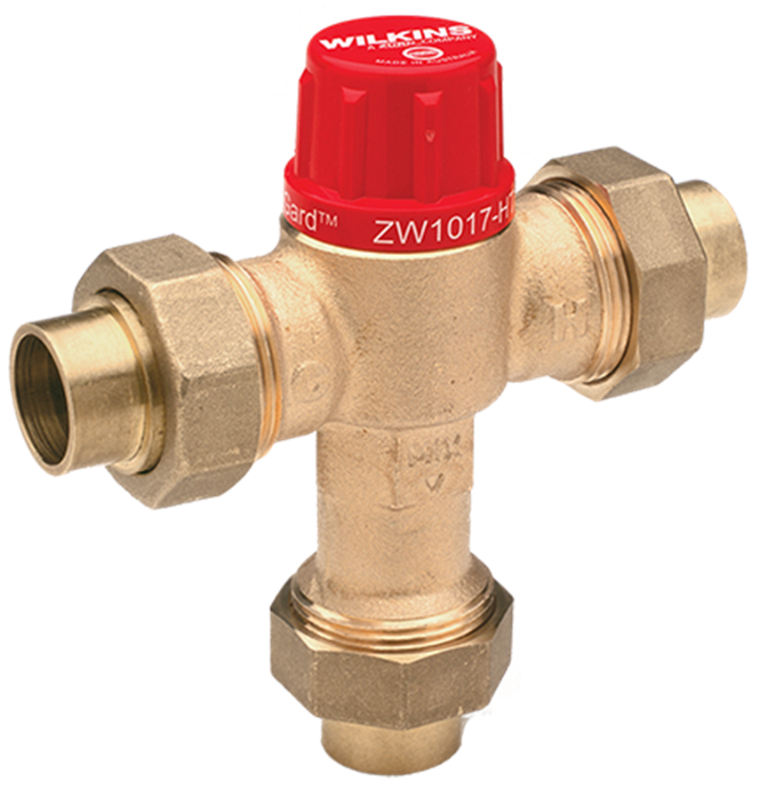
features & benefits designed and manufactured Wilkins thermostatic mixing valves
key features
ASSE® 1070 or 1017 standards compliant
CSA® certified
Rapid shut-off if either hot or cold supply failure
Precise temperature control +/- 3°F
Simplified design with wax thermal motor
Greatest choice of union configurations in the industry
Tamper resistant temperature adjustment cap
Integral strainers and check valves
Low-lead law compliant
Simple to install

Slide 11
features & benefits wax element
Desired Features | Element Design
 | Wax | Liquid Filled/Bellows | Bi-metal
Simple design with fewer moving parts | X |  | X
Corrosion resistant | X | X
High reliability | X
Precise temperature control | X | X | X
No small orifices, which are susceptible to blockage | X

Slide 12

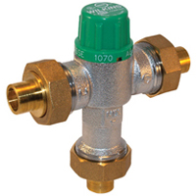

features & benefits
ASSE Standard 1070
ZW1070XL
thermostatic mixing valve
key features
Point of use application
For devices designed to limit the water temperature to a single fixture, the temperature setting is set and adjusted by the end user
The device must reduce flow to .5 gpm, within 5 seconds, when cold water supply failure occurs
Under cold water failure, the device must maintain temperature below 120ºF (48.9ºC) prior to the reduction of flow
ZW3870XLT
thermostatic mixing valve

Slide 13

features & benefits
Aqua-Gard® ZW3870XLT thermostatic mixing valve
Aqua-Gard® ZW3870XLT
thermostatic mixing valve,
for 3/8” point-of-use applications
for a single fixture
For devices designed to limit the water temperature to a single fixture, the temperature setting is set and adjusted by the end user
key features
Most suitable for use with faucets
Inlet checks and strainers included
Nickel plated
ASSE 1070 compliant
Outlet temperature range 95-115°F

Slide 14
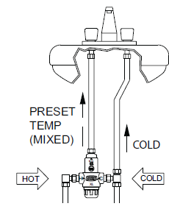
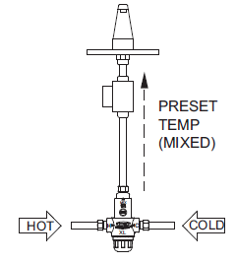
features & benefits
Aqua-Gard® ZW3870XLT (-4P)
Single Use
ZW3870XLT
Individual Use
ZW3870XLT-4P

Slide 15

features & benefits
Aqua-Gard® ZW1070XL thermostatic mixing valve
Aqua-Gard® ZW1070XL
thermostatic mixing valve, for point-of-use applications
point-of-use
For devices designed to limit the water temperature to a single fixture, the temperature setting is set and adjusted by the installer
key features
Nickel plated
ASSE 1070 Compliant
Inlet strainers and checks included
Various inlets and outlet connection options available
Outlet temperature range 95-115°F

Slide 16

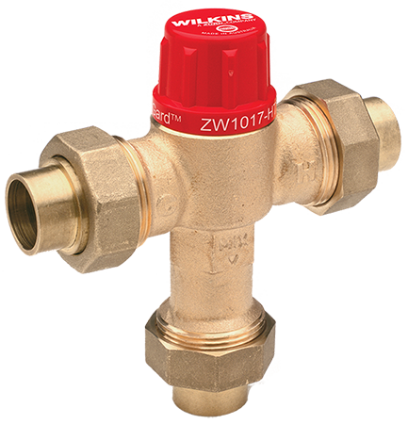
features & benefits
ASSE Standard 1017
Aqua-Gard® ZW1017XL
tempering mixing valve for use at the potable hot water source (residential and light commercial installations)
key features
A system application used with other ASSE 1070 valves
For devices designed to limit the water temperature at the source of hot water for distribution to a supply system
Permissible temperature tolerance varies from 3ºF to 7ºF (1.7ºC to 3.9ºC), depending on the size of the valve, when flowing at the required flow rate
Aqua-Gard® ZW1017XLHT
high temperature tempering mixing valve for use at the hot water source, for higher temperature apps (hydronic/radiant heating)

Slide 17
features & benefits
Aqua-Gard® ZW1017XL (HT) thermostatic mixing valves
Aqua-Gard® ZW1017XL
tempering mixing valve for use at the potable hot water source (residential and light commercial installations)
point-of-distribution
Designed to limit the water temperature at the source of hot water for distribution to a supply system
key features
Various inlets and outlet connection options available
High temperature option available
Inlet strainers and checks included
***1017 devices should NEVER be installed at the point-of-use
Aqua-Gard® ZW1017XLHT
high temperature tempering mixing valve for use at the hot water source, for higher temperature apps (hydronic/radiant heating)

Slide 18



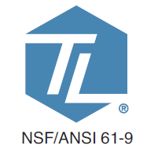
features & benefits questions
How important is water temperature safety to you? | Use Delivers a final, safe temperature Protection against scalding, bacterial infection, higher energy costs, and financial liability | Precise Temperature Regulation Protection from Bacterial Infection Protection from Scalding Injury
What fixtures and systems need water temperature safety? | Design & Specify Simplified design with highly-reliable, corrosion resistant wax thermal motor Greatest choice of union configurations in the industry Tamper resistant temperature adjustment cap Integral strainers and check valves Low-lead law compliant Designed and manufactured by Zurn Wilkins Zurn Online Specification Tools | Highly Reliable and Durable Corrosion-Resistant for Long Life
How important is ease of installation? | Install Simple installation | Simple Installation
 |  |  |  |  |  |  | ADA

Slide 19

Test Your Knowledge
What makes TMVs safety products?
They allow us to use hot water to minimize bacteria growth such as legionella
They protect people from potential burns caused by hot water
Required by code
All the above

Slide 20

how to specify step-by-step
A
point of system vs.
point of use
B
potable vs.
radiant heating delivery
C
flow rate
D
time-saving connections

Slide 21
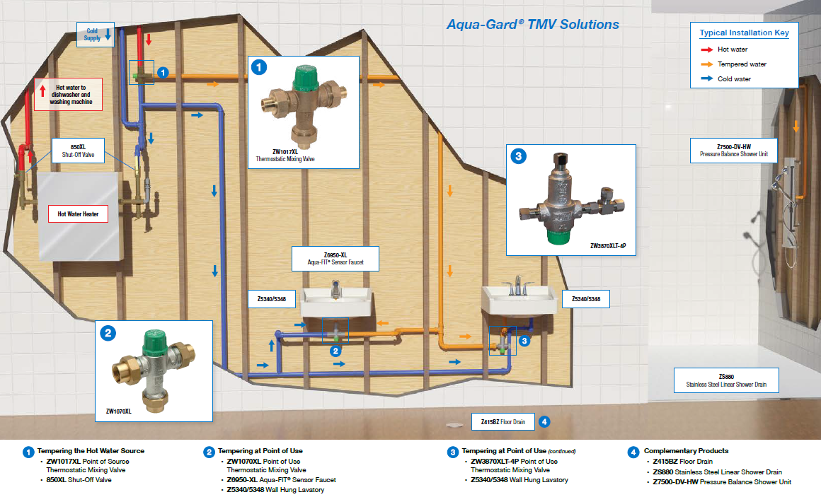

Slide 22
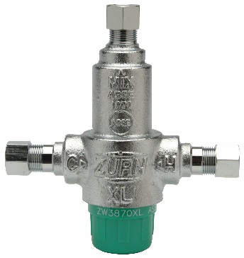

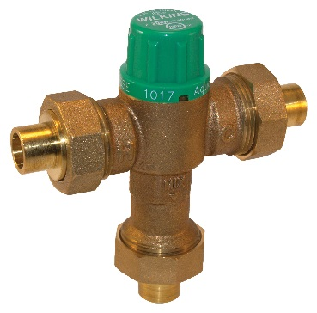

design & specify thermostatic mixing valves
THERMOSTATIC MIXING VALVES (inlet checks and strainers) (NSF/ANSI 61) | ZW3870XLT (-4P for manual faucets) 3/8” | ZW1070XL 3/8” ½” , ¾”, 1” | ZW1017XL ½” , ¾”, 1” | ZW1017XLHT ½” , ¾”, 1”
Point of System (installed at the hot water source) (ASSE 1017 certified) |  |  | ZW1017XL | ZW1017XLHT
Point of Use (installed to fittings for fixtures) (ASSE 1070 certified) | ZW3870XLT | ZW1070XL
Potable Delivery | ZW3870XLT (95°-115° F outlet) | ZW1070XL (95°-115° F outlet) | ZW1017XL (95°-115° F outlet)
Radiant Heating Delivery (for high temperatures) |  |  |  | ZW1017XLHT (95°-131° F outlet)
Flow Rate @45 psi Pressure Loss | 3.1 gpm (min flow .35 gpm for low flow faucets) | 12 gpm | 25 gpm | 25 gpm
Application Type | Single Application (-4P = two-handle faucet) | Multiple Applications | N/A | N/A
Time-Savings Connections (Threaded, copper sweat, PEX, CPVC, Z-Bite push connections, Z-Press press connections) |  | ZW1070XL | ZW1017XL | ZW1017XLHT

Slide 23
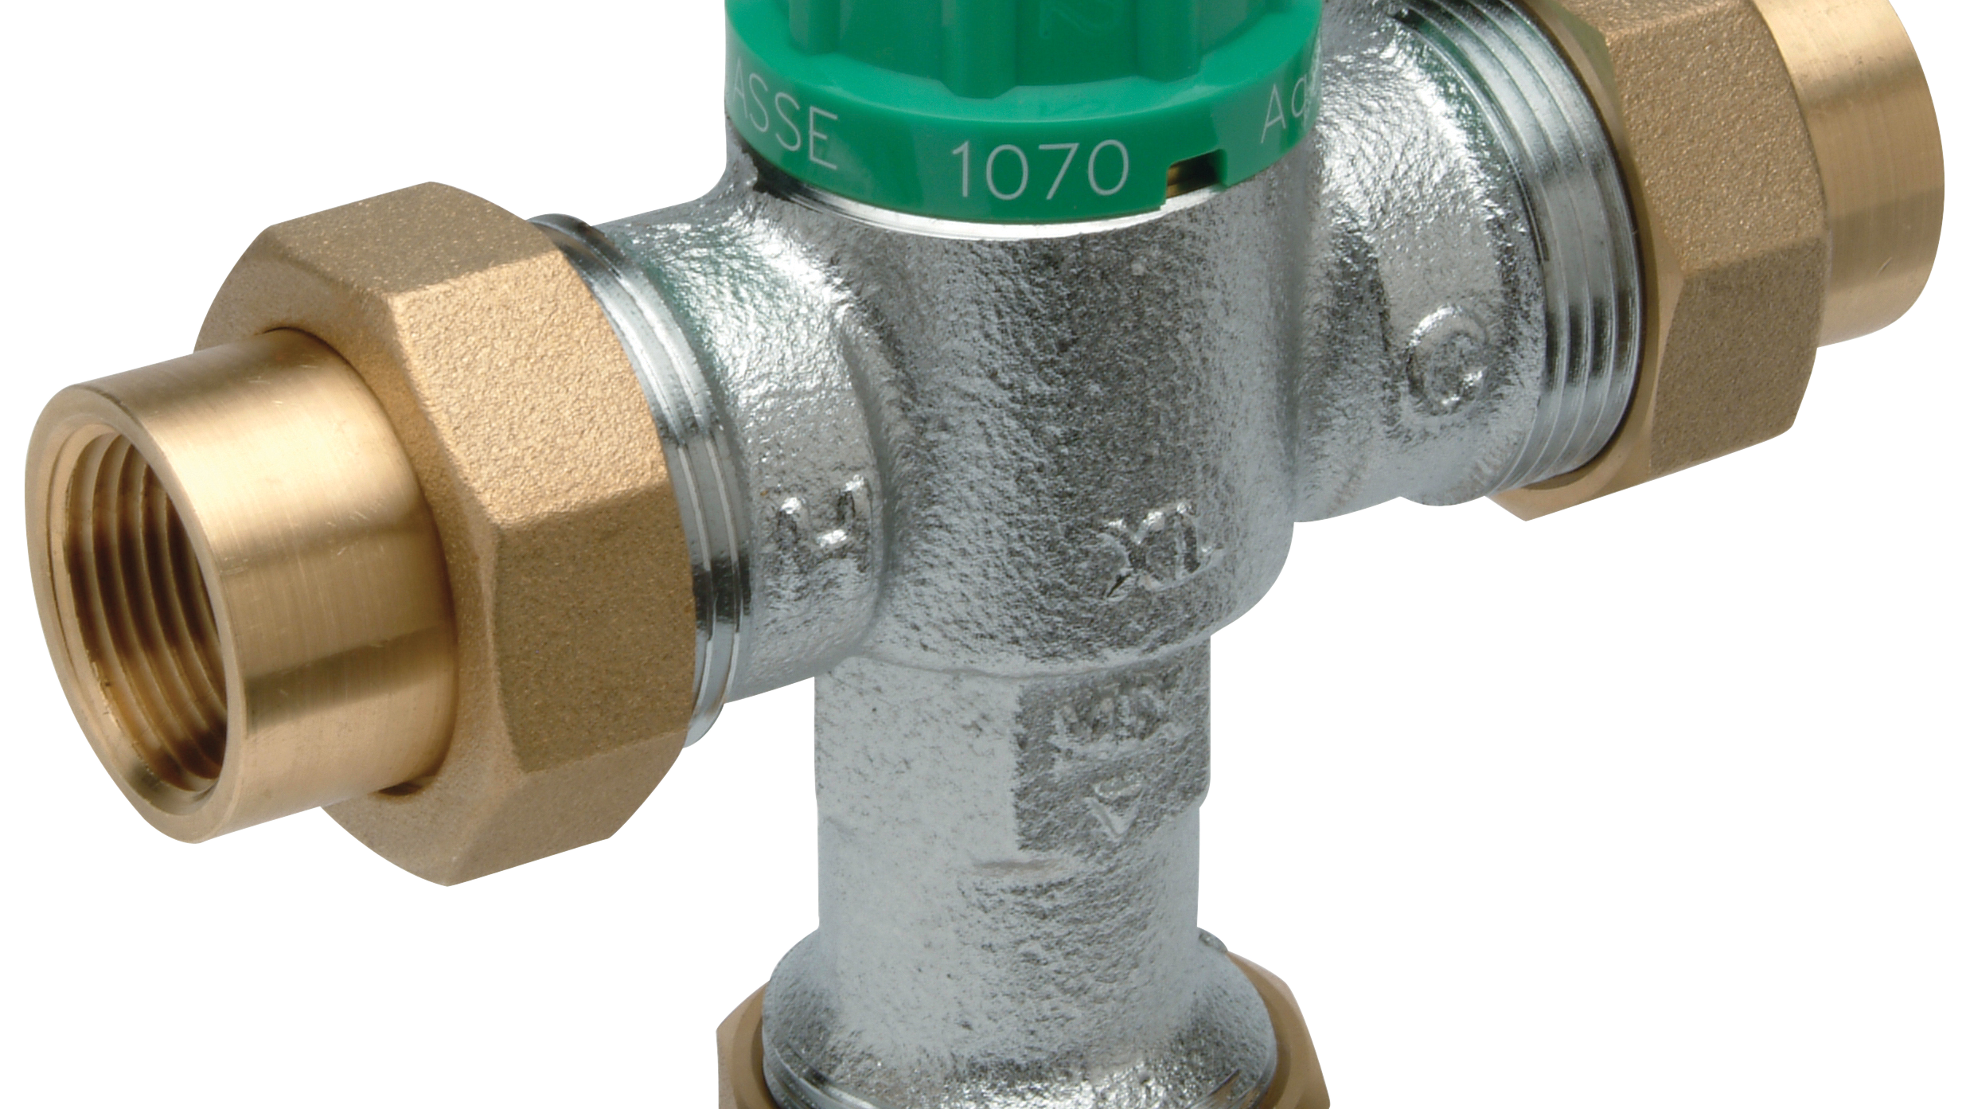
Test Your Knowledge
Place the following specify steps in the correct order:
A. Potable vs. radiant heating (high temperature) delivery
B. Time savings connections
C. Point of system vs. point of use
D. Flow rate

Slide 24







design & specify tools
Create unlimited configurations
Solidify your
basis of design
Generate your
submittal package
Edit, share
and copy projects
Zurn.com tools
inSpec | Create configurations, solidify your basis of design, generate your submittal package, edit/share/copy projects
Manufacturer Cross Reference | Select a manufacturer, then product, type, or competitor product number to find the corresponding Zurn Product
ARCAT | Review CAD, BIM, and spec files
Cross Reference Guides | Review cross reference guides for individual products
Technical Resources | Review specs, calculation sheets, engineering guides, sizing and selections, materials and finishes, installation +
Product Warranties | Review One Zurn terms and conditions

Slide 25
summary what you learned
building owner
architect & engineer
contractor
Precise, Safe Temperature Regulation Single Fixtures or Combined Systems Easiest Maintenance
Highly Reliable and Durable
Effective Water Temperature Safety
Compliant
Corrosion Resistant
Simple Installation
Easiest Maintenance

Slide 26
summary
Zurn overview
For more than a century, Zurn Engineered Water Solutions® has established itself as an innovator and leading manufacturer of highly engineered water product solutions.
Markets We Serve
Zurn Engineered Water Solutions is a recognized leader in commercial, municipal, and industrial markets, delivering sustainable building solutions for new construction and retrofit applications.
Industry Leading Product Lines
The Zurn product offering includes items such as specification drainage products, manual and sensor operated flush valves, radiant heating systems, snow melt systems, trench drain systems, backflow and fire protection systems, and much, much more.
Solutions We Provide
At Zurn we are committed to providing smart solutions that save time and money. Our goal is serving the customer through innovation, continuous improvement, and assurance behind every installation.
One Choice. One Zurn.
Choose Zurn for a reliable, recognized manufacturer to supply your entire installation, from behind the wall rough-in, to finished trim product and fixture systems.

Slide 27
resources support
address
phone
online
toll-free 1-855-ONE-ZURN
zurn.com
Product Pages | Tools, Specifications, & Resources | Vertical Market Solutions
inSpec | Manufacturer Cross Reference | ARCAT | MasterSpec | SpecBuilder |
Specifiers | BIM/Revit Files
zurn.com/resources/product-training
Zurn Product - Overview
How to Install and Support
facebook.com/ZurnIndustries
twitter.com/ZurnIndustries
linkedin.com/company/ZurnIndustries
youtube.com/ZurnIndustriesLLC
511 Freshwater Way
Milwaukee, WI 53204

